Slide 1
Skeletal & Reduced Models for Cat A2, C1, C5 Yang Gao & Tianfeng Lu University of Connecticut Email: tianfeng.lu@uconn.edu

Slide 2
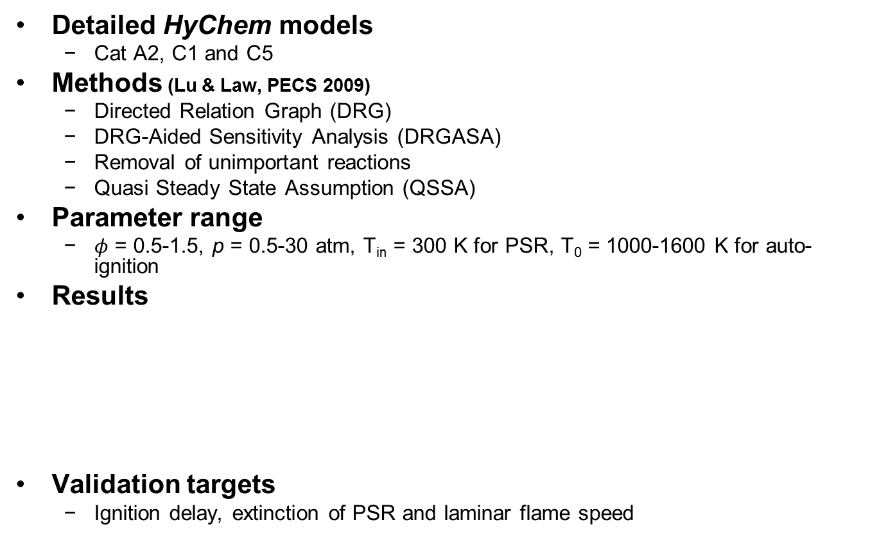
Development of Fuel Specific Reduced Models
Detailed HyChem models
Cat A2, C1 and C5
Methods (Lu & Law, PECS 2009)
Directed Relation Graph (DRG)
DRG-Aided Sensitivity Analysis (DRGASA)
Removal of unimportant reactions
Quasi Steady State Assumption (QSSA)
Parameter range
$φ$ = 0.5-1.5, p = 0.5-30 atm, T_{in} = 300 K for PSR, T₀ = 1000-1600 K for auto-ignition
Results
Validation targets
Ignition delay, extinction of PSR and laminar flame speed
Models | Cat A2 | Cat C1 | Cat C5
Detailed HyChem | 119 | 119 | 119
Skeletal | 41 | 34 | 41
Reduced | 31 | 26 | 31

Slide 3

Selected Validations in Auto-Ignition & Laminar Flame Speed
Cat A2
Cat C1
Cat C5
Solid lines : detailed HyChem model
Dashed lines : skeletal model
Symbols : reduced model
Blue : p = 0.5 atm
Red : p = 1 atm
Black : p = 5 atm
Magenta : p = 30 atm
Similar agreements for $φ$ = 0.5 and $φ$ = 1.5

Slide 4
Changes in Year 1 & 2 Models
Detailed models:
Fuel cracking reactions:
Fuel + O reaction added as a cracking reaction (H, CH₃, OH, O₂, HO₂, O)
Cat A2: C₄H₈-1 added in cracked products
Cat C1: C₂H₄ added in cracked products, removed aromatics (C₆H₆ C₆H₅CH₃)
Cat C5: C₄H₆ replaced by C₄H₈-1 in cracked products
Oxidation core:
Modified reactions for iC₄H₇ and iC₄H₈
7 more species (CH*, OH*, HE, iC₄H₇-1, C₂C*CC, C*C₂CC, C₈H₁₄)
Skeletal/Reduced models:
Three more aromatics related species added to the skeletal models of A2 (C₅H₄O, C₅H₅, C₃H₃) and C1 (C₅H₄O, C₅H₅, c-C₄H₅) for better prediction of fuel rich conditions
Year 1 Cat A2 reduced vs. detailed
Year 2 Cat A2 reduced vs. detailed

Slide 5
Next Steps
Validate the fuel specific reduced kinetic models in PSR at LBO conditions
Validate the fuel specific reduced kinetic models in counterflow extinction
Update the universal reduced kinetic model and universal reduced molecular diffusion model
Update/development of reduced sub-models for NO and PAH/soot

Slide 6
Development of Reduced A2 Kinetic Model
Detailed HyChem model
Cat A2 (POSF10325) with 119 species and 843 reactions
Methods
Skeletal reduction with DRG, sensitivity analysis and further removal of unimportant reactions
Error tolerance in DRG and sensitivity analysis: 30%, 20%
Error tolerance in removing unimportant reactions: 20%
Targets in sensitivity analysis: auto-ignition delay, PSR extinction time
Parameter space (auto-ignition and PSR)
𝜙 = 0.5-1.5, p = 0.5-30 atm, T_{in} = 300 K for PSR, T₀ = 1000-1600 K for auto-ignition
Results
Skeletal model: 41 species and 202 reactions
Reduced model: 31 species

Slide 7
Validations of Reduced Cat A2 Model
Blue : p = 0.5 atm
Red : p = 1 atm
Black : p = 5 atm
Magenta : p = 30 atm
Solid lines : detailed HyChem A2 model (119 species)
Dashed lines: skeletal A2 model (41 species)
Symbols : reduced A2 model (31 species)

Slide 8
Development of Reduced C1 Kinetic Model
Detailed HyChem model
Cat C1 (POSF11498) with 119 species and 843 reactions
Methods
Skeletal reduction with DRG, sensitivity analysis and further removal of unimportant reactions
Error tolerance in DRG and sensitivity analysis: 30%
Error tolerance in removing unimportant reactions: 20%
Targets in sensitivity analysis: auto-ignition delay, PSR extinction time
Parameter space (auto-ignition and PSR)
𝜙 = 0.5-1.5, p = 0.5-30 atm, T_{in} = 300 K for PSR, T₀ = 1000-1600 K for auto-ignition
Results
Skeletal model: 34 species and 182 reactions
Reduced model: 26 species

Slide 9
Validations of Reduced Cat C1 Model
Solid lines : detailed HyChem C1 model (119 species)
Dashed lines: skeletal C1 model (34 species)
Symbols : reduced C1 model (26 species)
Blue : p = 0.5 atm
Red : p = 1 atm
Black : p = 5 atm
Magenta : p = 30 atm

Slide 10
Development of Reduced C5 Kinetic Model
Detailed HyChem model
Cat C5 (POSF12345) with 119 species and 843 reactions
Methods
Skeletal reduction with DRG, sensitivity analysis and further removal of unimportant reactions
Error tolerance in DRG and sensitivity analysis: 30%, 20%
Error tolerance in removing unimportant reactions: 20%
Targets in sensitivity analysis: auto-ignition delay, PSR extinction time
Parameter space (auto-ignition and PSR)
𝜙 = 0.5-1.5, p = 0.5-30 atm, T_{in} = 300 K for PSR, T₀ = 1000-1600 K for auto-ignition
Results
Skeletal model: 41 species and 200 reactions
Reduced model: 31 species

Slide 11
Validations of Reduced Cat C5 Model
Blue : p = 0.5 atm
Red : p = 1 atm
Black : p = 5 atm
Magenta : p = 30 atm
Solid lines : detailed HyChem C5 model (119 species)
Dashed lines: skeletal C5 model (41 species)
Symbols : reduced C5 model (31 species)

Slide 12
Laminar Flame Speed
Cat A2
Cat C1
Cat C5
Solid lines : detailed HyChem models
Dashed lines: skeletal models
Symbols : reduced models

Slide 13
Non-Stiff Versions
Dynamic stiffness removal (Lu et al., CNF 2009) enables explicit time integration with time step ~< 20ns, suitable for compressible flow simulations
Solid lines: SENKIN with implicit DASAC
Symbols: SENKIN with explicit RKF45, h = 10 ns

