Slide 1
html/css
lab4

Slide 2
task1
create html page containing 3 text paragraphs. Use tag selector to change text color to green and align them to center. Then use class selector to make first and third paragraphs red. Use id selector to make second paragraph pink. Create multilevel menu. Change link color to pink and menu heading color to green

Slide 3
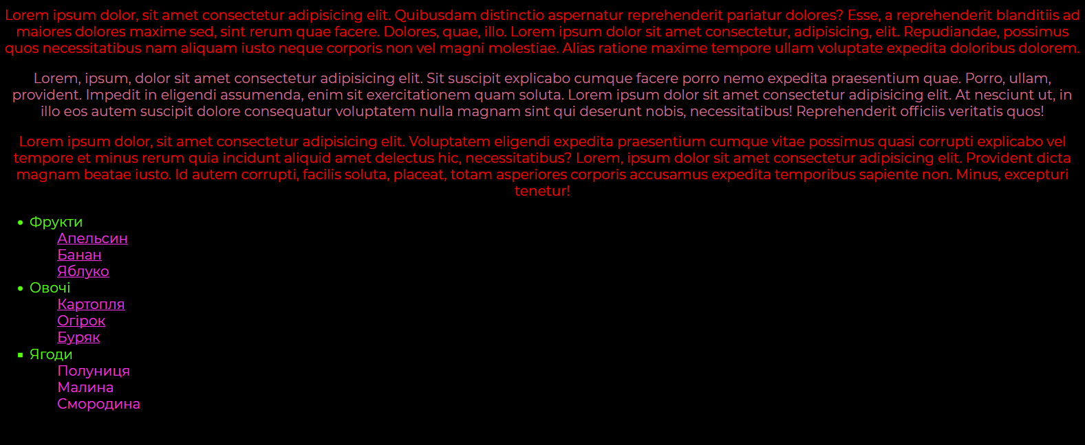
task1

Slide 4
task2
Create html page. Link separate stylesheet to it. Change font size and some colors

Slide 5
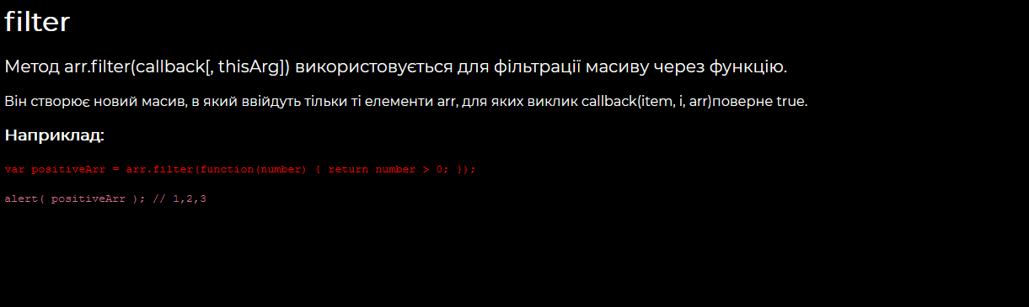
task2

Slide 6
task3
Create horizontal menu with some hover effects

Slide 7
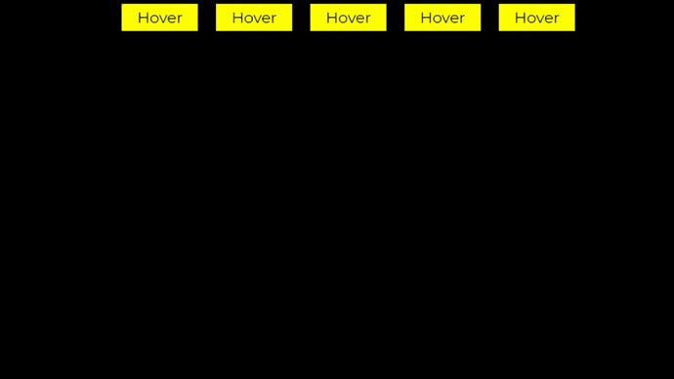
task3

Slide 8
task4
Create dropdown menu

Slide 9

task4

Slide 10
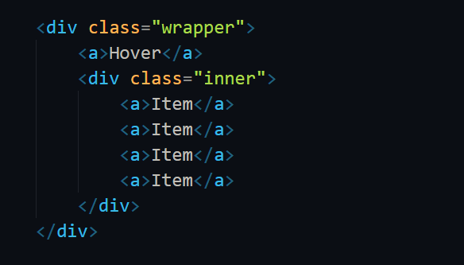
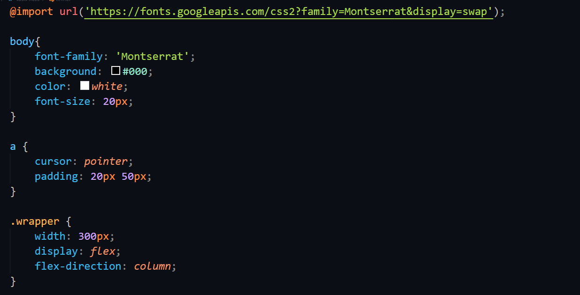
task4

Slide 11
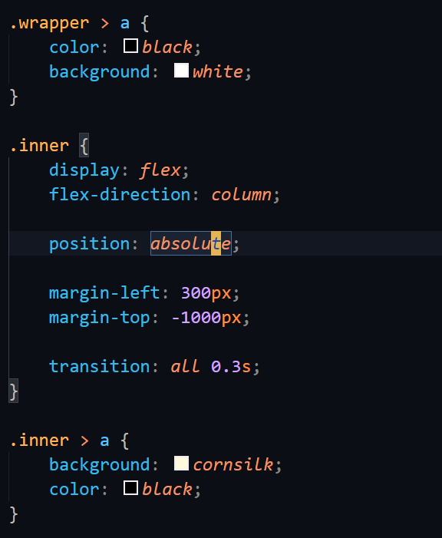
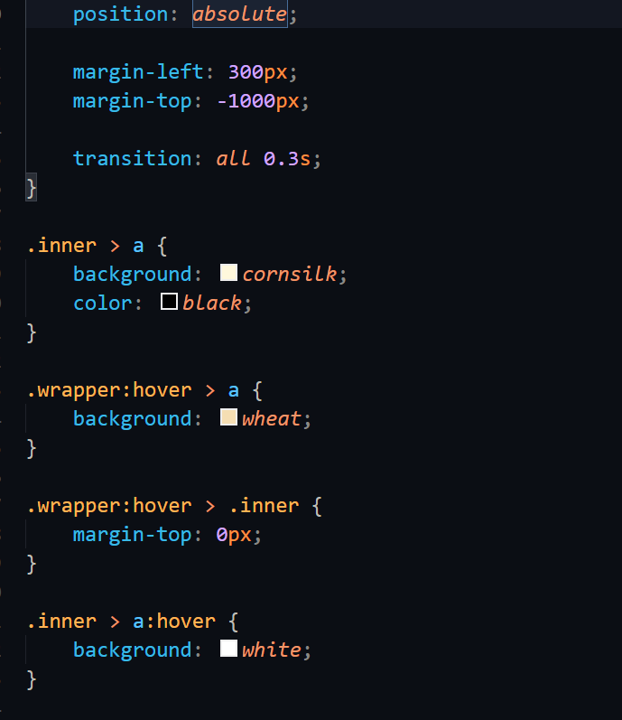
task4

Slide 12
task5
Change checkbox style

Slide 13

task5

Slide 14
task6
Create hamburger menu

Slide 15

task6

Slide 16
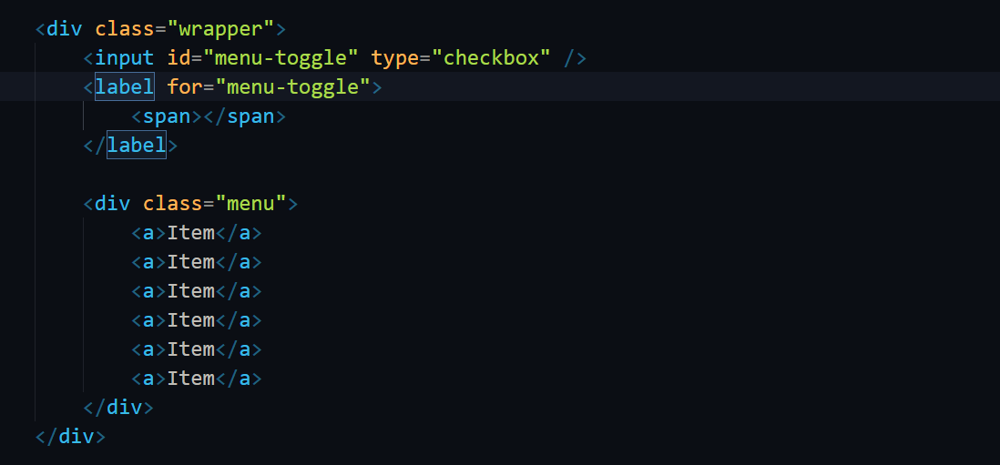
task6

Slide 17
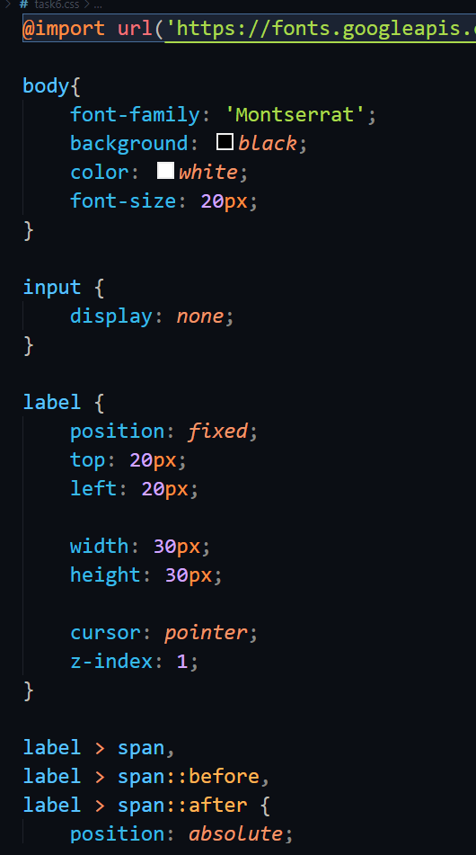
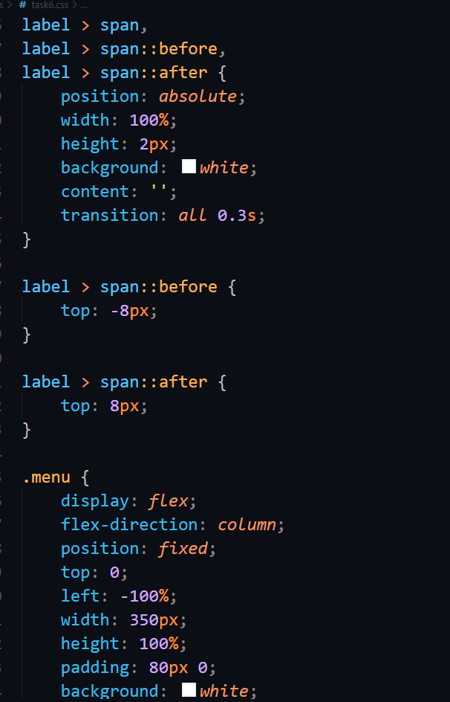
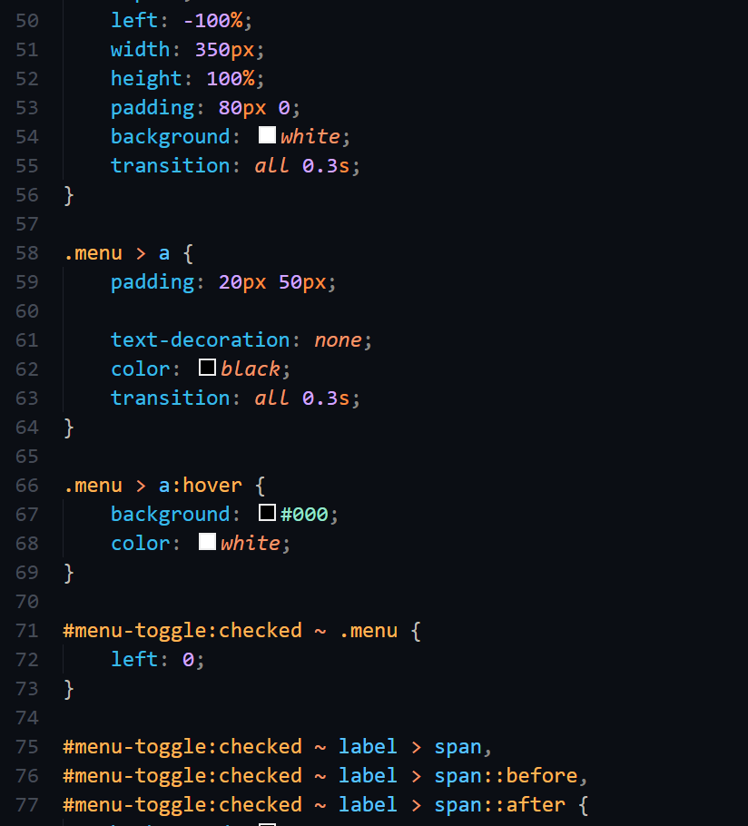
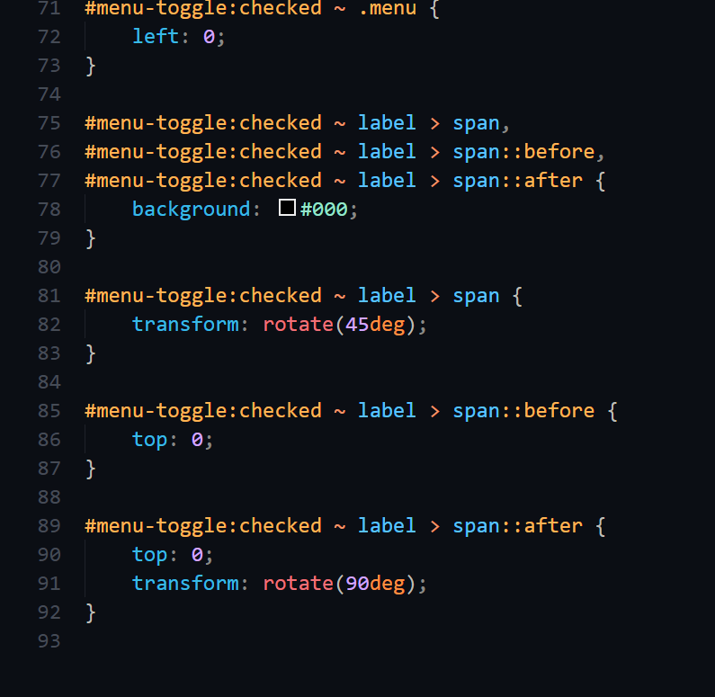
task6

Slide 18
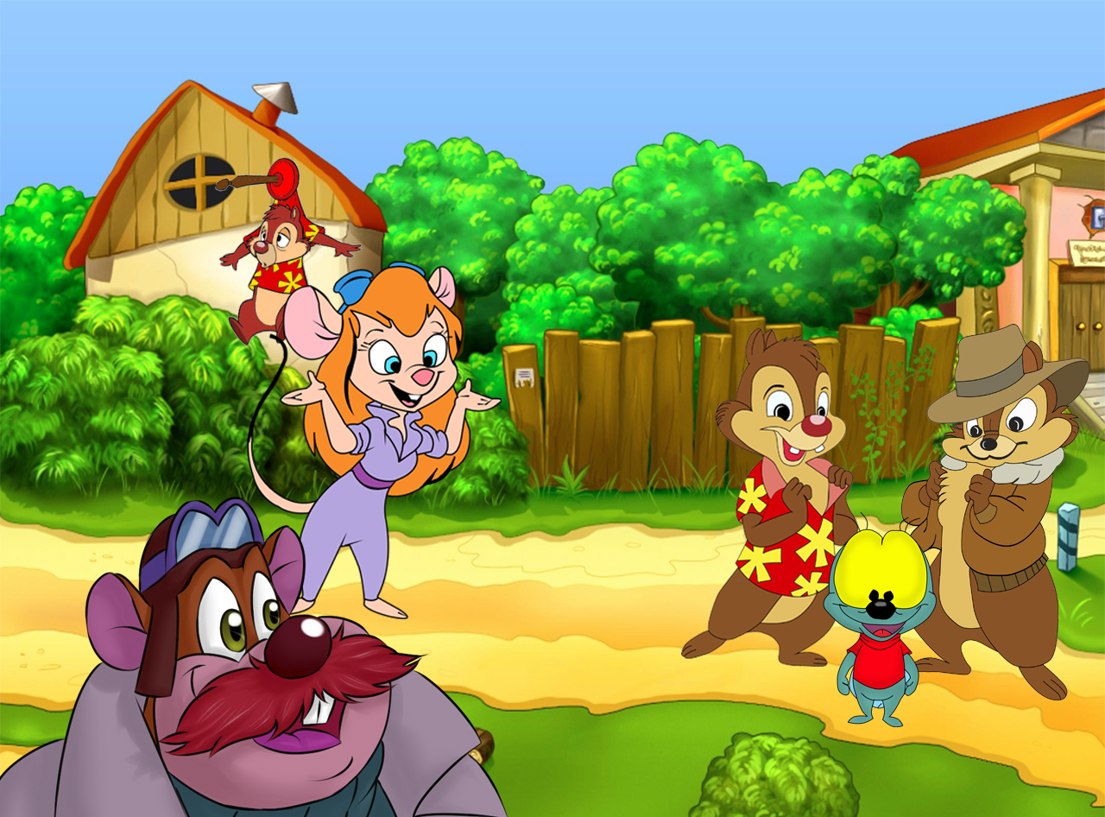
task7
Create html page. Use css bg properties to place images in there
Example:

Slide 19
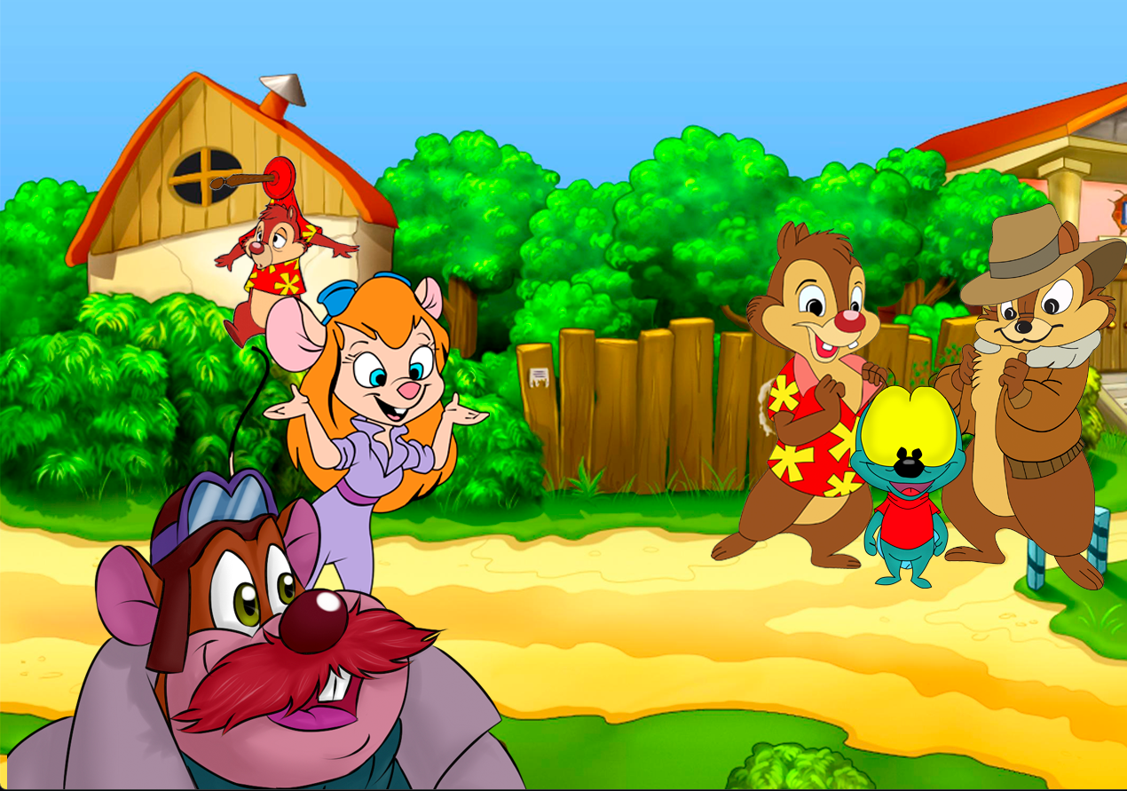
task7

Slide 20
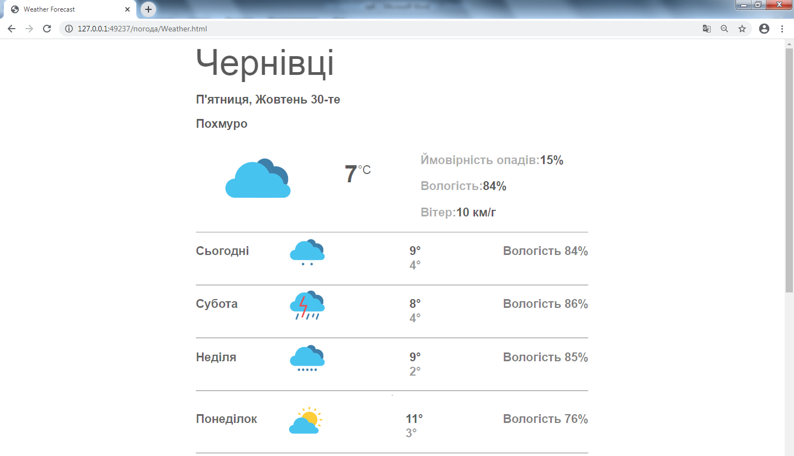
task8
Create html page according to this mockup design

Slide 21
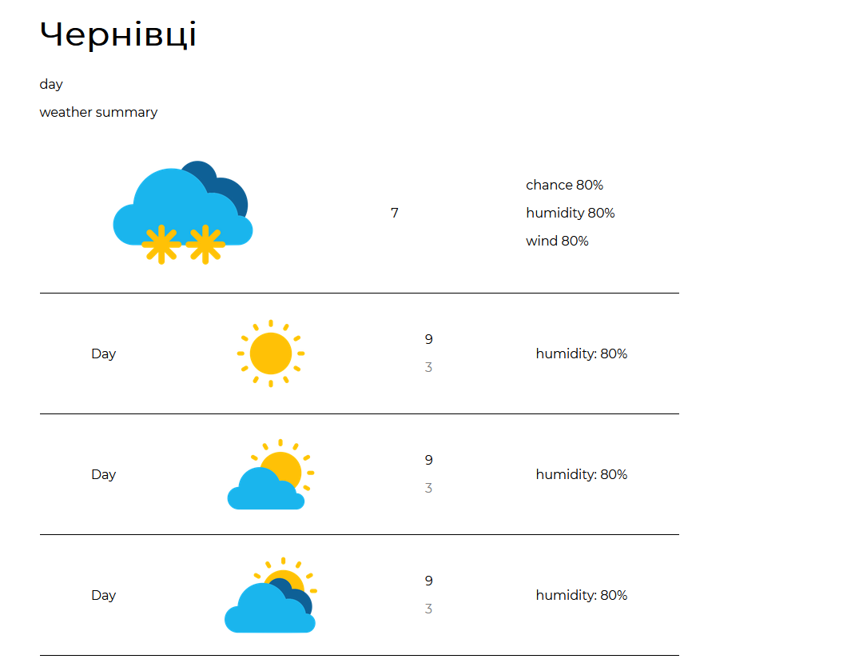
ефлы8

