Slide 1
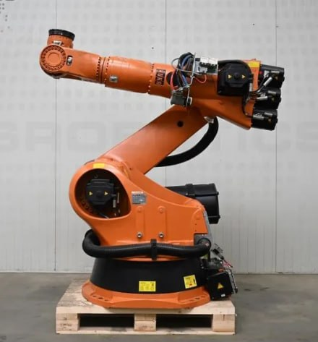
Interactive IK
Algorithms
Visualizer
An Educational, Interactive Sandbox for
Robotic Arm Inverse Kinematics
Phase 1: Introduction & Problem Definition
Notes:
Welcome everyone. Today we present our project: an Interactive Inverse Kinematics Algorithms Visualizer. This is an educational sandbox that lets users see, feel, and understand how robotic arms find their way to a target — a problem that sounds simple on the surface but hides deep mathematics. We'll walk you through why we built it, who needs it, and how it works. Let's begin.

Slide 2
Presentation Roadmap
WHAT WE'LL COVER TODAY
01
Introduction & Problem Research
04
Algorithms: Jacobian, FABRIK, CCD
02
Stakeholders & User Problems
05
Proposed Architecture & Solution
03
Theoretical Background & Math
06
Interactive Features & Conclusion
Notes:
Here's our roadmap for today. We'll spend significant time in the first two phases covering the grading rubric points: research, stakeholders, user problems, and the final problem determination. Then we'll move into the math and algorithms before presenting our solution.

Slide 3
Research: What is Inverse Kinematics?
PHASE 1 — PROBLEM TOPIC RESEARCH
Forward Kinematics
FK vs IK
Given joint angles → compute end-effector position
Deterministic: one input → one output
Simple matrix multiplication along the chain
FORWARD KINEMATICS
INVERSE KINEMATICS
θ₁, θ₂, θ₃
⬇
Position (x, y)
Position (x, y)
⬇
θ₁, θ₂, θ₃ = ?
Inverse Kinematics (IK)
Given target position → compute the required joint angles
Non-trivial: multiple solutions or none may exist
Core challenge in robotics, animation, and biomechanics
Research Context
IK is foundational to: industrial robotics, game character animation, surgical robots, VR hand tracking
Notes:
Our research began with the fundamental question: what exactly is Inverse Kinematics, and why is it hard? Forward Kinematics is the 'easy' direction — given the joint angles, you simply multiply transformation matrices along the chain to find where the tip ends up. Inverse Kinematics flips this question: given where we WANT the tip to be, what angles do we need? This is computationally expensive because the solution space is non-linear, solutions may not exist, and multiple solutions often exist. IK powers everything from KUKA robots in car factories to character animation in video games.

Slide 4
Research: Why Is IK Difficult?
PHASE 1 — PROBLEM TOPIC RESEARCH
Non-Linear Math
Multiple Solutions
Singularities
Joint rotations compose via matrix multiplication — small angle changes near singularities cause wildly disproportionate end-effector movement.
A 3-joint arm can reach a single target with infinitely many angle configurations. Choosing the 'best' one requires optimization criteria.
Configurations where the robot loses a degree of freedom. The Jacobian determinant → 0, causing algorithm instability or infinite velocities.
Closed-Form Limits
Joint Constraints
Real-Time Demand
Analytical solutions exist only for simple chains (≤3 joints). Real robots require iterative numerical methods that may diverge.
Real joints have angle limits. Every algorithm must clamp solutions within physical limits while still converging to the target.
Animation and robotics require re-solving IK at 30–120 fps. Algorithms must be fast enough to run within a single frame budget.
Notes:
Our research revealed six core reasons IK is genuinely difficult. First, the math is non-linear — joint angles interact multiplicatively, not additively. Second, multiple solutions exist for any reachable target. Third, singularities are dangerous edge cases where algorithms break down. Fourth, closed-form solutions don't scale beyond simple 3-joint systems. Fifth, real joints have physical limits that must be respected. And sixth, performance is critical — games and robots need this solved every frame. These challenges justify the need for educational tooling.

Slide 5
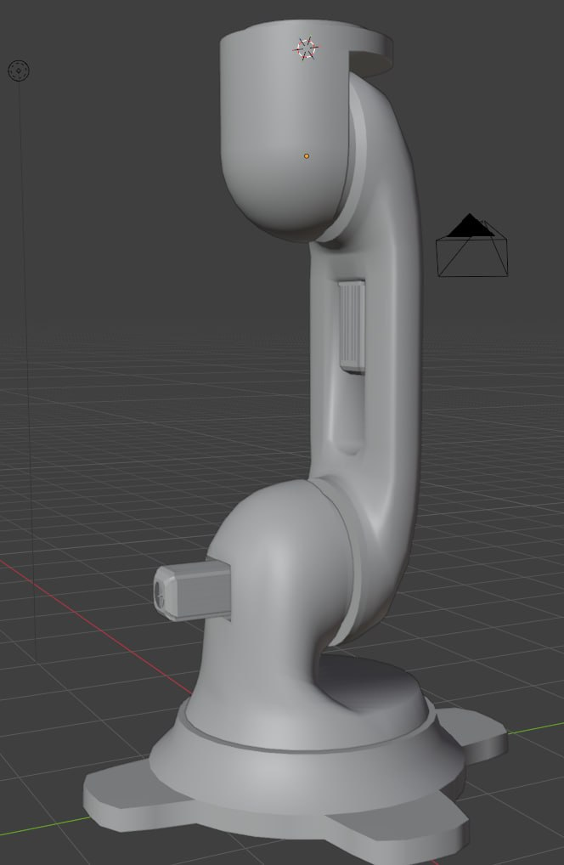
Identifying Users & Stakeholders
PHASE 1 — WHO NEEDS THIS TOOL?
1. CS & Engineering Students
Learning robotics, computer graphics, or mechatronics — need intuition before equations
2. Robotics Educators
Professors and instructors who need a live demo tool during lectures on kinematics
3. Game & Animation Developers
Developers implementing IK for character rigs who need to compare algorithm trade-offs
4. Robotics Researchers
Early-stage researchers prototyping new IK methods who need a quick visual sandbox
Notes:
We identified four main stakeholder groups. First and most important: students in robotics, CS, and engineering courses who are learning IK for the first time. Second: educators who need a live, interactive demo rather than static diagrams in slides. Third: game and animation developers who need to choose between algorithms like FABRIK and CCD based on their specific use case. Fourth: early-stage researchers who need a fast visual sandbox to test new ideas. Each group has different needs — but all share the core problem that IK is hard to understand without visualization.

Slide 6
Identifying User-Specific Problems
PHASE 1 — WHAT PAIN POINTS DO USERS HAVE?
Students
Educators
Developers
Math appears as a 'black box' — equations without intuition
No way to see what singularities look like in practice
Can't compare algorithms side-by-side to understand trade-offs
Static diagrams in textbooks fail to convey convergence dynamics
No off-the-shelf interactive tool for live classroom demonstrations
No tool that shows iteration count and convergence in real time
Hard to predict algorithm behavior at joint limits or near singularities
No quick sandbox to prototype chain configurations without coding
Debugging IK requires a visual — log output is insufficient
Notes:
Let's get specific about the pain points each stakeholder experiences. Students encounter IK as pure equations with no intuition — they can't see WHY the arm moves the way it does, and singularities are completely invisible. Educators lack an interactive demo tool — every existing resource requires coding setup before you can see anything. Developers struggle to predict algorithm behavior at the edges — joint limits, singularities, and non-planar chains all create invisible bugs that are nearly impossible to debug from log files alone. These are the specific problems our visualizer solves.

Slide 7
Final Determination of the Problem to Be Solved
PHASE 1 — THE CORE PROBLEM STATEMENT
"There is no accessible, interactive tool that allows students, educators, and developers to visually observe, compare, and manipulate multiple IK algorithms in real time — making the mathematics of inverse kinematics unnecessarily opaque."
Therefore, the problem to solve is threefold:
1
Visibility: Make IK algorithms visually transparent: show joint movement, convergence path, and iteration count in real time.
2
Comparability: Let users switch between algorithms (FABRIK, CCD, Jacobian methods) on the same arm instantly, revealing trade-offs.
3
Interactivity: Give users direct manipulation — drag joints, pin/lock segments, set targets — to build physical intuition through experimentation.
Notes:
This is the core problem statement we arrived at after research. There is no tool that combines visual transparency, algorithm comparability, and direct manipulation in one accessible package. The threefold solution required is: making algorithms visible — showing the arm's path to convergence; making algorithms comparable — instant switching between methods; and making the tool interactive — direct joint dragging and pinning so users build intuition by doing, not just watching. This is our north star for the entire project.

Slide 8
Theoretical Background: Forward Kinematics
PHASE 2 — THE MATHEMATICAL FOUNDATION
Building Blocks of FK
2D Rotation Matrix
Kinematic Chain:
R(θ) = [ cos θ −sin θ ]
[ sin θ cos θ ]
A series of rigid links connected by joints. Each joint has one degree of freedom (rotation in 2D).
Transformation Matrices:
Homogeneous Transform (per joint i)
Each joint applies a rotation matrix T(θ) and a translation by link length L. Composed left-to-right along the chain.
Tᵢ(θᵢ) = [ R(θᵢ) Lᵢ · x̂ ]
[ 0 1 ]
Degrees of Freedom (DOF):
Number of independent parameters controlling the chain. A 2D n-joint arm has n DOF.
Full FK Computation
P_end = T₁(θ₁) · T₂(θ₂) · … · Tₙ(θₙ) · p₀
End-Effector Position:
FK is cheap, deterministic, always used as
the final verification step after IK converges.
The final accumulated transform gives the tip position: P_end = T₁ · T₂ · … · Tₙ · origin.
Notes:
Forward Kinematics is the tool every IK algorithm calls to verify its answer. Given the joint angles, we compose rotation and translation matrices from the base outward to compute the end-effector position. In 2D, each joint applies a 2x2 rotation matrix and translates by the link length. The full FK is a chain of matrix products. FK is always the 'forward pass' — cheap, deterministic, and used by every IK solver to check convergence.

Slide 9
Theoretical Background: The Jacobian Matrix
PHASE 2 — RELATING JOINT VELOCITIES TO END-EFFECTOR VELOCITIES
What is the Jacobian?
⚠ SINGULARITIES
The Jacobian J is a matrix of partial derivatives that maps joint angle velocities (θ̇) to end-effector velocities (ẋ).
When det(J) = 0, the arm loses a degree of freedom
Jacobian becomes rank-deficient — not invertible
End-effector can no longer move in certain directions
Naive algorithms produce infinite velocities (blow up!)
Occur when arm is fully extended or fully folded back on itself
Damped Least Squares (DLS) is the standard fix: adds λI to avoid division by near-zero
ẋ = J(θ) · θ̇
Each column of J is the partial derivative of the end-effector position with respect to one joint angle. In 2D with n joints:
J[:, i] = ∂P_end / ∂θᵢ = zᵢ × (P_end − Pᵢ)
where zᵢ is the joint axis (in 2D: [0, 0, 1]) and Pᵢ is joint i's position.
Notes:
The Jacobian is the mathematical engine behind all gradient-based IK methods. It's a matrix that maps how fast each joint rotates to how fast the end-effector moves. To invert IK, we invert this relationship — but that only works when the Jacobian is full rank. At singularities, the determinant of J goes to zero, meaning the robot loses the ability to move in certain directions. This is one of the most visually striking phenomena our tool demonstrates — you can see the arm 'freeze up' or jerk violently at singularities, and then observe how DLS prevents the blow-up.

Slide 10
Algorithms: Jacobian-Based Methods
PHASE 3 — THE ALGORITHM ENGINE
Jacobian Transpose
Moore-Penrose Pseudoinverse
Damped Least Squares (DLS)
Simple & Robust
Least Squares Solution
Industry Standard
Uses Jᵀ instead of J⁻¹. No matrix inversion required. Slow convergence — oscillates near target. Good first baseline. Update: Δθ = α · Jᵀ · Δx
Computes J⁺ = Jᵀ(JJᵀ)⁻¹ — the least squares solution that minimizes joint velocity. Accurate but unstable near singularities where JJᵀ → singular.
J⁺_DLS = Jᵀ(JJᵀ + λ²I)⁻¹. The damping factor λ prevents instability near singularities by adding a small bias. Best real-world convergence.
✔ Never diverges
✔ Optimal joint velocities
✔ Stable near singularities
✘ Slow convergence, oscillates
✘ Blows up at singularities
✘ Trades accuracy for stability
All three are implemented in the Algorithm Engine. Users can switch between them with a single click and observe the behavioral differences live.
Notes:
We implement three Jacobian-based methods. The Jacobian Transpose is the simplest — no matrix inversion, just multiply by the transpose. It always converges but oscillates. The Moore-Penrose Pseudoinverse gives the minimum-norm velocity solution via least squares but breaks down at singularities. Damped Least Squares is the industry standard — it adds a small damping term lambda-squared-I to the denominator, trading a tiny bit of accuracy for rock-solid stability even at singular configurations. Our visualizer shows all three simultaneously or lets users switch on the fly.

Slide 11
Algorithms: FABRIK & CCD (Heuristic Methods)
PHASE 3 — THE ALGORITHM ENGINE
FABRIK
CCD
Forward And Backward Reaching IK
Cyclic Coordinate Descent
Operates purely on vectors — no matrices or trig
Backward pass: snap tip to target, pull each joint back
Forward pass: re-root base, push joints outward
Repeat until end-effector within tolerance ε of target
Fast convergence — typically 5–10 iterations
Handles joint constraints, multiple end-effectors, and sub-chains
Processes joints one-at-a-time from end to base
For each joint: rotate to point directly at target
Apply angle clamping to enforce joint limits per step
Repeat full cycle until convergence
Slower convergence than FABRIK, more iterations needed
Naturally handles per-joint angle limits with clamping
Our fabrik.py implementation is already written and uses this exact backward/forward cycle.
CCD is especially intuitive to visualize: you can watch each joint 'decide' its angle one by one.
Notes:
Our two heuristic algorithms are FABRIK and CCD. FABRIK is exceptional — it operates on vectors, not trig, and converges in very few iterations. Our fabrik.py is already written and implements the exact backward-forward cycle described here. CCD is more intuitive to animate because you can watch each joint independently rotating toward the target, one at a time. While CCD needs more iterations, it's perfect for educational demonstrations because the step-through animation is crystal clear. Both algorithms are already better understood with visualization than with any textbook description.

Slide 12
Proposed Solution: System Architecture
PHASE 4 — THE FOUR-MODULE DESIGN
Data Flow
Kinematic
Chain Model
Algorithm
Engine
UI → Algorithm Engine
(target position + settings)
Stores joint angles, link lengths. Performs Forward Kinematics.
Takes target + chain. Runs CCD, FABRIK, or Jacobian method. Returns updated angles.
Algorithm Engine → Model
(read + update joint angles)
Model → Renderer
(joint positions to draw)
Renderer
User
Interface
Algorithm Engine → UI
(iteration count, error, status)
Reads positions from Model. Draws arm, joints, target, and convergence path.
Handles clicks, dragging, algorithm selection, sliders, animation controls.
UI → Renderer
(animation speed, step mode)
Notes:
Our architecture has four clean modules. The Kinematic Chain Model owns all data — joint angles, link lengths — and provides the forward kinematics computation. The Algorithm Engine is the pure math solver — it takes the arm's current state and a target and iterates until convergence. The Renderer reads from the model and draws everything. The UI handles all human input. Critically, these modules communicate in one direction: UI drives the engine, engine drives the model, renderer reads the model. This separation means you can swap any algorithm without touching the renderer or UI.

Slide 13
Implementation: Python, 2D First
PHASE 4 — TECHNOLOGY & SCOPE DECISIONS
Why Python?
Scope: 2D First, 3D Later
Accessible ecosystem
Phase 1 — 2D Implementation:
NumPy for matrix math, Pygame or Tkinter for rendering — no boilerplate.
All joints rotate in a single plane
2×2 rotation matrices — no gimbal lock, no quaternions
Easy to visualize on a flat screen, instant feedback
Full algorithm suite implemented and debugged here
Rapid prototyping
IK algorithms can be written and tested in minutes, not hours.
Readable math
Phase 2 — 3D Extension (if time permits):
NumPy expressions mirror mathematical notation closely.
Extend to 4×4 homogeneous transforms
Add camera orbit controls and 3D rendering
Quaternions for rotation interpolation
Cross-platform
Runs on any OS with no additional install burden for users.
Notes:
We chose Python for its unmatched combination of readability, mathematical expressiveness with NumPy, and rapid prototyping speed. For scope, we're starting with 2D for several important reasons: 2D eliminates 3D-specific complexity like gimbal lock and quaternions, it's easier to visualize on a flat screen with no camera controls needed, and it lets us perfect all algorithm implementations before adding the 3D rendering layer. The full algorithm suite — Jacobian methods, FABRIK, CCD — all work identically in 3D once the math is solid in 2D. 3D is a stretch goal.

Slide 14
Core Interactive Features
PHASE 5 — WHAT MAKES THIS A SANDBOX, NOT JUST A DEMO
Real-Time Joint Dragging
Joint Pinning / Locking
Drag any joint — not just the end-effector
Rest of the chain adjusts in real time using IK
Reveals how the chain adapts to mid-chain constraints
Demonstrates degrees of freedom intuitively
Right-click any joint to pin it in place
Locked joints become fixed constraints
Algorithm must route around pinned joints
Simulates real robot joint locks and limits
Algorithm Switching & Comparison
Animation & Playback Controls
Single click to switch between all algorithms
Observe same arm, same target, different paths
Live display of iteration count and error
Step-through mode: advance one iteration at a time
Play / Pause / Step buttons for convergence animation
Adjustable animation speed slider
Joint count and link length sliders
Click-to-set target anywhere in the workspace
Notes:
These four features are what make this a genuine interactive sandbox rather than just a passive animation. Joint dragging is the most powerful — it lets users physically grab any part of the arm and watch the whole chain respond. Joint pinning simulates real-world robot constraints and teaches students that IK must sometimes work around fixed degrees of freedom. Algorithm switching on a live arm is uniquely educational — you can see FABRIK reach the target in 5 iterations while CCD takes 20. The step-through mode is especially valuable for educators: advance one iteration at a time and narrate exactly what the algorithm is doing.

Slide 15
Conclusion &
Next Steps
Problem
IK is a black box for students and developers — no interactive tool exists.
Research
Identified 3 Jacobian methods + 2 heuristic algorithms covering the full solution space.
Architecture
4-module Python system: Model, Engine, Renderer, UI — clean data flow.
Innovation
Mid-chain dragging + joint pinning go beyond any existing IK demo tool.
Next Steps
Build kinematic chain model → Integrate FABRIK (done) → Add CCD & Jacobian → Build renderer → Add UI → Polish & test
Notes:
To close: we've established through research that IK is genuinely hard to learn without visualization. We've identified four stakeholder groups and their specific pain points. We've determined the three-part problem to solve — visibility, comparability, and interactivity. Our architecture is clean, modular, and already partially implemented with fabrik.py. The features that differentiate us — mid-chain dragging and joint pinning — go well beyond any existing tool. Our next step is integrating all four modules and building the renderer and UI layer. Thank you — we're happy to take questions.

