Slide 1
REACT Intro
by Ihor Kalyta

Slide 2
AGENDA
What is React?
Virtual DOM in ReactJS
First react app
Introducing JSX
Components
Props & State
Handling Events
Lifecycle Methods
Composing Components
Routing

Slide 3

What is React?
React is a JavaScript library - one of the most popular ones.
React is not a framework (unlike Angular, which is more opinionated).
React is an open-source project created by Facebook.
React is used to build user interfaces (UI) on the front end.
React is the view layer of an MVC application (Model View Controller)

Slide 4
Virtual DOM in ReactJS
ReactJS does not update the Real DOM directly but it updates the Virtual DOM.
When we do,
document.getElementById('elementId').innerHTML = "New Value“
Following thing happens:
Browser have to parses the HTML
It removes the child element of elementId
Updates the DOM with the “New Value”
Re-calculate the CSS for the parent and child
Update the layout i.e. each elements exact co-ordinates on the screen
Traverse the render tree and paint it on the browser display

Slide 5
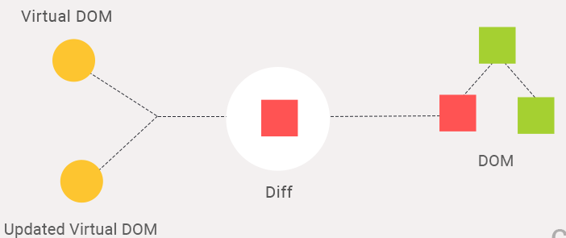
How Does Virtual DOM Work?
Whenever anything may have changed, the entire UI will be re-rendered in a Virtual DOM representation.
The difference between the previous Virtual DOM representation and the new one will be calculated.
The real DOM will be updated with what has actually changed. This is very much like applying a patch.

Slide 6
First react app
<body>
<div id="app"> </div>
<script crossorigin src="https://unpkg.com/react@16/umd/react.production.min.js"></script>
<script crossorigin src="https://unpkg.com/react-dom@16/umd/react-dom.production.min.js"></script>
<script src="https://cdnjs.cloudflare.com/ajax/libs/babel-standalone/6.25.0/babel.min.js"></script>
<script type="text/babel">
// element rendering
ReactDOM.render(
<h1>Hello React</h1>, // element that we want to create
document.getElementById("app") // where to put it
)
</script>
</body>

Slide 7
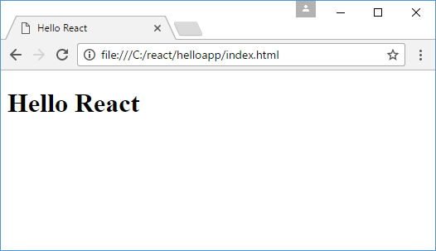

Slide 8
Introducing JSX
const element = <h1>Hello, world!</h1>;
This tag syntax is neither a string nor HTML.
It is called JSX, and it is a syntax extension to JavaScript. Use it with React to describe what the UI should look like.
React doesn’t require using JSX, but most people find it helpful as a visual aid when working with UI inside the JavaScript code. It also allows React to show more useful error and warning messages.

Slide 9
const name = 'Josh Perez';
const element = <h1> Hello, {name} </h1>;
ReactDOM.render(
element,
document.getElementById('root')
);
You can put any valid JavaScript expression inside the curly braces in JSX. For example, 2+2
user.firstName are all valid JavaScript expressions.

Slide 10
Components
Components let you split the UI into independent, reusable pieces, and think about each piece in isolation. Conceptually, components are like JavaScript functions. They accept arbitrary inputs (called "props") and return React elements describing what should appear on the screen.
One of the main advantages of components is taking potentially large pieces of code that make up views and break them down in the smaller more manageable pieces that are easier to work with.

Slide 11
Functional Component
The simplest way to define a component is to write a JavaScript function:
function Welcome(props) {
return <h1>Hello, {props.name}</h1>;
}
This function is a valid React component because it accepts a single “props” (which stands for properties) object argument with data and returns a React element. We call such components “function components” because they are literally JavaScript functions.

Slide 12
Class Component
You can use an ES6 class to define a component:
class Welcome extends React.Component {
render() {
return <h1> Hello, {this.props.name} </h1>
}
}
A class component always needs a render() method and always needs to return() something.

Slide 13
Props
Props presents a collection of values that are associated with a component. These values allow you to create dynamic components that do not depend on hard-coded static data.
Whether you declare a component as a function or a class, it must never modify its own props.
All React components must act like pure functions with respect to their props.

Slide 14
Functional Component
function Hello(props) {
return <div>
<p>Name: {props.name}</p>
<p>Age: {props.age}</p>
</div>;
}
Class Component
class Hello extends React.Component {
render() {
return <div>
<p>Name: {this.props.name}</p>
<p>Age: {this.props.age}</p>
</div>;
}
}

Slide 15
class Hello extends React.Component {
render() {
return <div>
<p>Name: {this.props.name}</p>
<p>Age: {this.props.age}</p>
</div>;
}
}
ReactDOM.render(
<Hello name="Tom" age=“23" />,
document.getElementById("app")
)

Slide 16
State
The state object describes the internal state of the component; it is similar to props, with the exception that the state is defined within the component and is only available from the component.
If the props represents inputs that are passed to the component from the outside, then the state stores such objects that are created in the component and entirely dependent on the component.
Also, unlike props, state can be changed.

Slide 17
The only place where you can install a state object is the class constructor:
class Hello extends React.Component {
constructor(props) {
super(props);
this.state = {welcome: “Welcome!"};
}
render() {
return <h1>{this.state.welcome}</h1>;
}
}
ReactDOM.render(
<Hello />,
document.getElementById("app")
)
When defining a component constructor, a constructor of the base class to which the props object is passed must be called in it.

Slide 18
To update the state, the setState () function is called:
this.setState({welcome: “Hello React"}); // Correct
But this will not re-render a component:
this.state.welcome = 'Hello React’; // Wrong
Changing the state will cause the component to be rendered, according to which the web page will be updated.

Slide 19
Handling Events
Handling events with React elements is very similar to handling events on DOM elements. There are some syntactic differences:
React events are named using camelCase, rather than lowercase.
With JSX you pass a function as the event handler, rather than a string.

Slide 20
class ClickButton extends React.Component {
constructor(props) {
super(props);
this.state = {class: "off", label: “Press me"};
this.press = this.press.bind(this);
}
press(){
let className = (this.state.class==="off")?"on":"off";
this.setState({class: className});
}
render() {
return <button onClick={this.press} className={this.state.class}>{this.state.label}</button>;
}
}
ReactDOM.render(
<ClickButton />,
document.getElementById("app")
)

Slide 21
You cannot return false to prevent default behavior in React. You should use SyntheticEvent :
function ActionLink() {
function handleClick(e) {
e.preventDefault();
console.log('The link was clicked.');
}
return (
<a href="#" onClick={handleClick}>
Click me
</a>
);
}

Slide 22
Lifecycle Methods
During the process, the component passes through a series of stages of the life cycle. At each of the stages a certain function is called in which we can determine any actions:
constructor (props): constructor in which the initial component initialization occurs
componentWillMount (): called directly before component rendering
render (): component rendering
componentDidMount (): called after component rendering. Here you can perform queries to remote resources
componentWillUnmount (): called before deleting a component from the DOM

Slide 23
Composing Components
Components may consist of other components.
A standard example is any list, such as a menu. Each menu item can be represented by a separate component, and the menu itself can also represent the component

Slide 24
class Item extends React.Component {
render() {
return <li>{this.props.name}</li>;
}
}
class ItemsList extends React.Component {
render() {
return(
<div>
<h2>{this.props.title}</h2>
<ul>
<Item name="iPhone 7" />
<Item name="HTC U Ultra" />
<Item name="Google Pixel" />
</ul>
</div>);
}
}
ReactDOM.render(
<ItemsList title=“Smartphones" />,
document.getElementById("app")
)

Slide 25
Routing
React has its own routing system, which allows you to match queries to an application with specific components. The key to the routing operation is the react-router module, which contains the main routing functionality.
However, if we are going to work in a browser, we need to use the module react-router-dom.
In the Route component, we need to pass the two props
path: it means we need to specify the path.
component: which component user needs to see when they will navigate to that path.

Slide 26
const Router = ReactRouterDOM.BrowserRouter;
const Route = ReactRouterDOM.Route;
const Switch = ReactRouterDOM.Switch;
class About extends React.Component{
render(){
return <h2>About</h2>;
}
}
class NotFound extends React.Component{
render(){
return <h2>Not Found</h2>;
}
}
class Main extends React.Component{
render(){
return <h2>Main</h2>;
}
}
ReactDOM.render(
<Router>
<Switch>
<Route exact path="/" component={Main} />
<Route path="/about" component={About} />
<Route component={NotFound} />
</Switch>
</Router>,
document.getElementById("app")
)

Slide 27
Children Attribute
Using the children attribute of the Route object, you can define the contents of the component that will handle the route:
<Router>
<Switch>
<Route exact path="/" component={Main} />
<Route path="/about" children={()=><h2>About</h2>} />
<Route path="/contact" children={()=><h2>Contact</h2>} />
<Route component={NotFound} />
</Switch>
</Router>

Slide 28
Let’s take one previously defined route and slightly change it by adding a final slash:
<Route path="/about/" children={()=><h2>About</h2>} />
http://localhost:3000/about
http://localhost:3000/about/
http://localhost:3000/about/25

Slide 29
exact & strict
qualifier exact:
<Route exact path="/about/" children={()=><h2>About</h2>} />
http://localhost:3000/about
http://localhost:3000/about/
qualifier strict:
<Route strict path="/about/" children={()=><h2>About</h2>} />
http://localhost:3000/about/

Slide 30
Resources
https://reactjs.org/docs
https://metanit.com/web/react
https://hackernoon.com/virtual-dom-in-reactjs-43a3fdb1d130

Slide 31
THANK YOU

