Slide 1
CSS Basics
by Ihor Kalyta

Slide 2
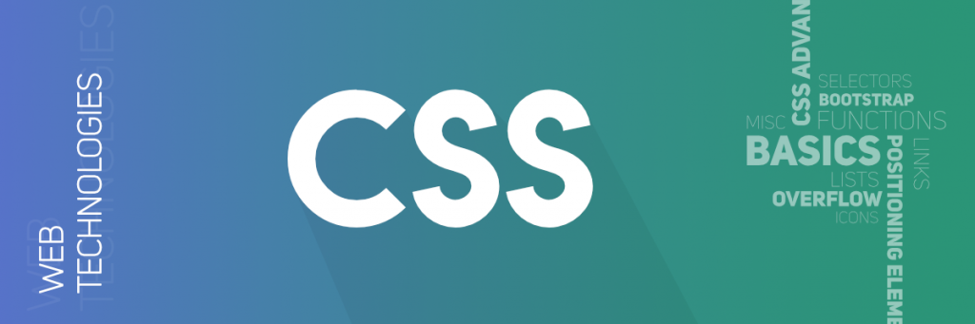
AGENDA
What is CSS?
CSS Syntax
CSS Selectors
How to use…
CSS Box Model
CSS Display
CSS Position
CSS Float

Slide 3
CSS INTRODUCTION
What is CSS?
CSS stands for Cascading Style Sheets
CSS describes how HTML elements are to be displayed on screen, paper, or in other media
CSS saves a lot of work. It can control the layout of multiple web pages all at once
External stylesheets are stored in CSS files

Slide 4
WHY USE CSS?
CSS is used to define styles for your web pages, including the design, layout and variations in display for different devices and screen sizes.
HTML was created to describe the content of a web page, like:
<h1>This is a heading</h1>
<p>This is a paragraph</p>
When attributes were added to the HTML 3.2 specification, it started a nightmare for web developers.
To solve this problem, CSS was created.

Slide 5
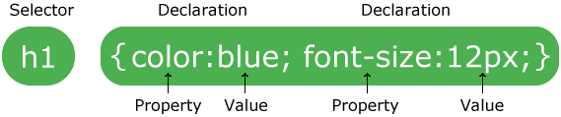
CSS Syntax
The selector points to the HTML element you want to style.
The declaration block contains one or more declarations separated by semicolons.
Each declaration includes a CSS property name and a value, separated by a colon.

Slide 6
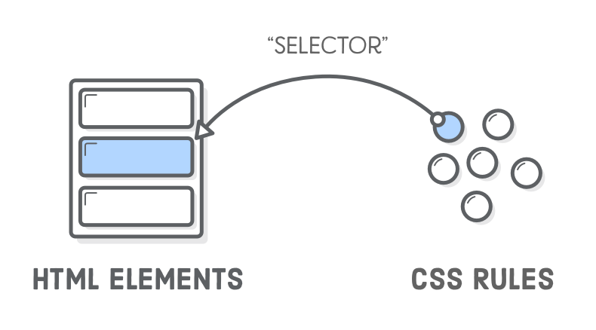
CSS SELECTORS
CSS selectors are used to "find" (or select) HTML elements based on their element name, id, class, attribute, and more.

Slide 7
In CSS, selectors are patterns used to select the element(s) you want to style.
Selector | Example | Example description
.class | .intro | Selects all elements with class="intro"
#id | #firstname | Selects the element with id="firstname"
* | * | Selects all elements
element | p | Selects all <p> elements
element,element | div, p | Selects all <div> elements and all <p> elements
element element | div p | Selects all <p> elements inside <div> elements
element>element | div > p | Selects all <p> elements where the parent is a <div> element
element+element | div + p | Selects all <p> elements that are placed immediately after <div> elements
element1~element2 | p ~ ul | Selects every <ul> element that are preceded by a <p> element
[attribute] | [target] | Selects all elements with a target attribute
[attribute=value] | [target=_blank] | Selects all elements with target="_blank"

Slide 8
The element Selector
The element selector selects elements based on the element name.
Select and style all <div> elements:
div { background-color: yellow; }

Slide 9
The id Selector
The id selector uses the id attribute of an HTML element to select a specific element.
The id of an element should be unique within a page, so the id selector is used to select one unique element.
#menu { text-align: center; color: red; }

Slide 10
The class Selector
The class selector selects elements with a specific class attribute.
To select elements with a specific class, write a period (.) character, followed by the name of the class.
.center { text-align: center; color: red; }

Slide 11
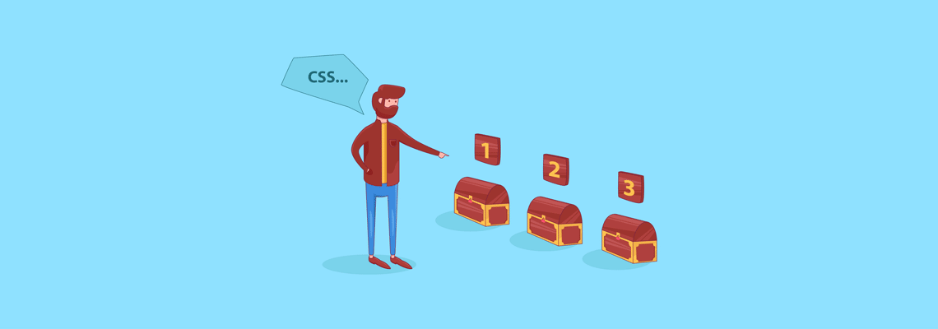
Three Ways to Insert CSS
External style sheet
Internal style sheet
Inline style

Slide 12
External Style Sheet
External styles are defined within the <link> element, inside the <head> section of an HTML page.
<head> <link rel="stylesheet" type="text/css" href="style.css"> </head>

Slide 13
Internal Style Sheet
Internal styles are defined within the <style> element, inside the <head> section of an HTML page:
<head> <style> body { background-color: green; }
</style> </head>

Slide 14
Inline Styles
An inline style may be used to apply a unique style for a single element.
To use inline styles, add the style attribute to the relevant element. The style attribute can contain any CSS property.
<h2 style="color:blue;margin-left:30px;">Heading</h2>

Slide 15
Cascading Order
What style will be used when there is more than one style specified for an HTML element?
All the styles in a page will "cascade" into a new "virtual" style sheet by the following rules, where number one has the highest priority:
Inline style (inside an HTML element)
External and internal style sheets (in the head section)
Browser default
So, an inline style has the highest priority, and will override external and internal styles and browser defaults.

Slide 16

CSS Box Model

Slide 17
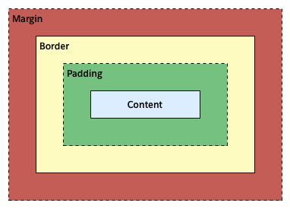
The CSS Box Model
All HTML elements can be considered as boxes.
Content - The content of the box, where text and images appear
Padding - Clears an area around the content. The padding is transparent
Border - A border that goes around the padding and content
Margin - Clears an area outside the border. The margin is transparent

Slide 18
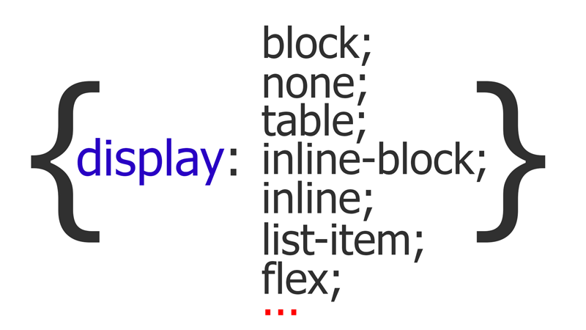
CSS Layout

Slide 19
The display Property
The display property specifies if/how an element is displayed.
Every HTML element has a default display value depending on what type of element it is. The default display value for most elements is block or inline.

Slide 20
Block-level Elements
A block-level element always starts on a new line and takes up the full width available (stretches out to the left and right as far as it can).
Examples of block-level elements:
<div> <ol>
<form> <li>
<ul> <table>
The <div> element is a block-level element.

Slide 21
Inline Elements
An inline element does not start on a new line and only takes up as much width as necessary.
This is a paragraph.
Examples of inline elements:
<span> <button>
<a> <input>
<img> <code>
an inline <span> element inside

Slide 22
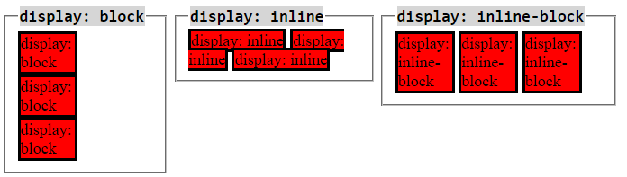
Display: inline-block
Compared to display: inline, the major difference is that display: inline-block allows to set a width and height on the element.
Also the top and bottom margins/paddings are respected.

Slide 23
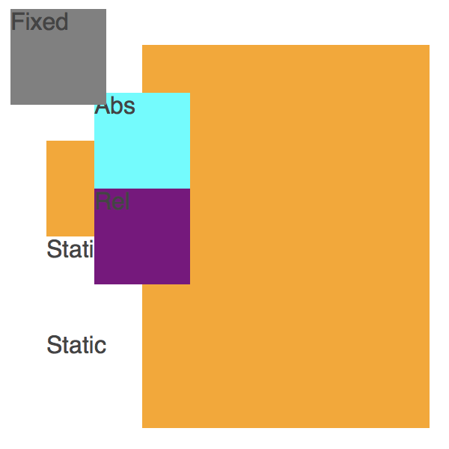
CSS POSITION

Slide 24
The position Property
The position property specifies the type of positioning method used for an element.
There are five different position values:
static
relative
fixed
absolute
sticky

Slide 25
position: static;
HTML elements are positioned static by default.
Static positioned elements are not affected by the top, bottom, left, and right properties.
An element with position: static; is not positioned in any special way; it is always positioned according to the normal flow of the page:
This <div> element has position: static;

Slide 26
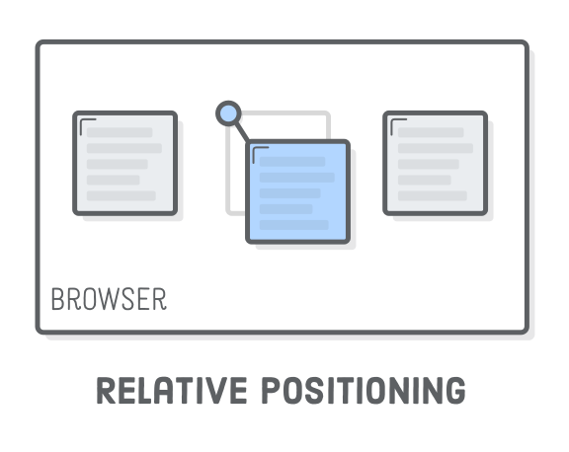
position: relative;
An element with position: relative; is positioned relative to its normal position.
Setting the top, right, bottom, and left properties of a relatively-positioned element will cause it to be adjusted away from its normal position.
div.relative { position: relative; left: 30px; }

Slide 27
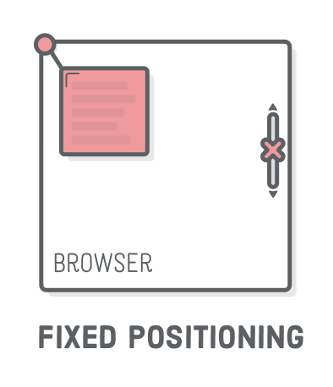
position: fixed;
An element with position: fixed; is positioned relative to the viewport, which means it always stays in the same place even if the page is scrolled. The top, right, bottom, and left properties are used to position the element.
div.fixed { position: fixed; bottom: 0; right: 0; }

Slide 28
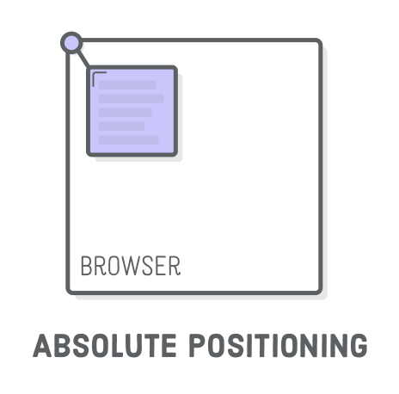
position: absolute;
An element with position: absolute; is positioned relative to the nearest positioned ancestor (instead of positioned relative to the viewport, like fixed).
div.absolute { position: absolute; top: 80px; right: 100px; width: 80px; height: 80px; }

Slide 29
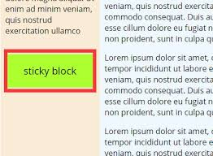
position: sticky;
An element with position: sticky; is positioned based on the user's scroll position.
A sticky element toggles between relative and fixed, depending on the scroll position. It is positioned relative until a given offset position is met in the viewport - then it "sticks" in place.
div.sticky { position: sticky; top: 0; }

Slide 30
FLOAT
The CSS float property specifies how an element should float.
The float property can have one of the following values:
left - The element floats to the left of its container
right - The element floats to the right of its container
none - The element does not float (will be displayed just where it occurs in the text)
inherit - The element inherits the float value of its parent
Float Left
Float Right

Slide 31
Resources
https://www.w3schools.com/css/css_intro.asp
https://www.w3schools.com/css/css_syntax.asp
https://www.w3schools.com/css/css_boxmodel.asp
https://www.w3schools.com/css/css_display_visibility.asp
https://www.w3schools.com/css/css_positioning.asp
https://stackoverflow.com/questions/9189810/css-display-inline-vs-inline-block
https://www.w3schools.com/css/css_float.asp

Slide 32
THANK YOU

