Slide 1
this, call, apply, bind
by Ihor Kalyta

Slide 2
AGENDA
What is this ?
this in arrow functions
call()
apply()
bind()
Borrowing methods

Slide 3
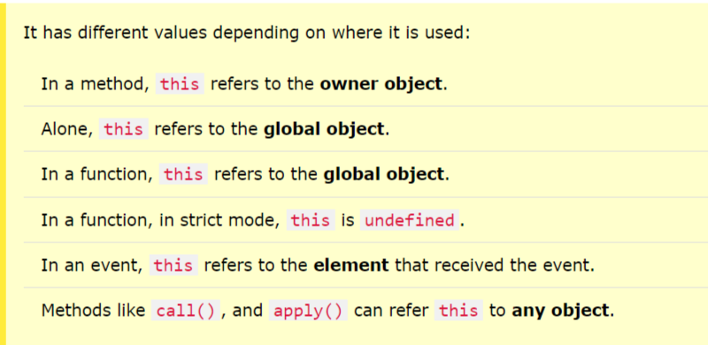
What is this?

Slide 4
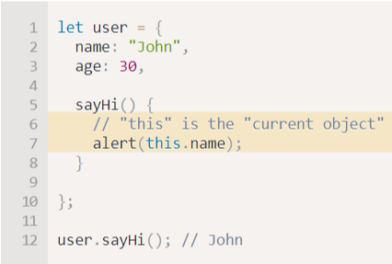
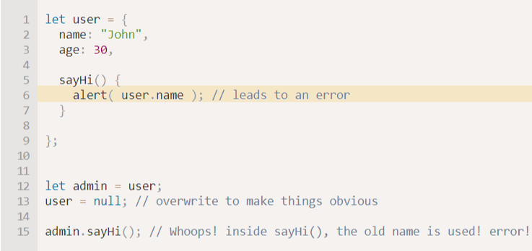
this in a Method
It’s common that an object method needs to access the information stored in the object to do its job.
For instance, the code inside user.sayHi() may need the name of the user. To access the object, a method can use the this keyword.
The value of this is the object “before dot”, the one used to call the method.

Slide 5


this Alone
When used alone, the owner is the Global object, so this refers to the Global object.
In a browser window the Global object is [object Window]:
In strict mode, when used alone, this also refers to the Global object [object Window]:

Slide 6
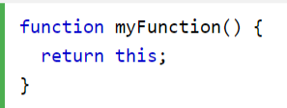
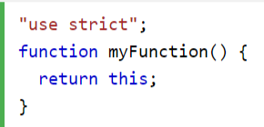
this in a Function
In a function, this refers to the Global object [object Window] :
JavaScript strict mode does not allow default binding.
So, when used in a function, in strict mode, this is undefined.

Slide 7
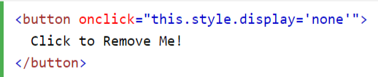
this in Event Handlers
In HTML event handlers, this refers to the HTML element that received the event:

Slide 8
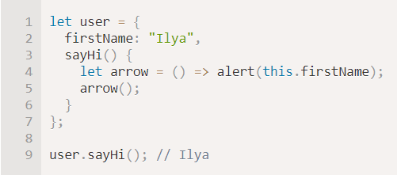
Arrow functions have no “this”
Arrow functions are special: they don’t have their “own” this. If we reference this from such a function, it’s taken from the outer “normal” function.
For instance, here arrow() uses this from the outer user.sayHi() method:

Slide 9


call()
There’s a special built-in function method func.call(context, …args) that allows to call a function explicitly setting this:
It runs func providing the first argument as this, and the next as the arguments.
These two calls do almost the same:
They both call func with arguments 1, 2 and 3. The only difference is that func.call also sets this to obj.

Slide 10
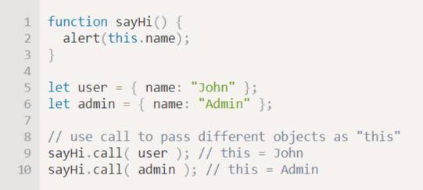
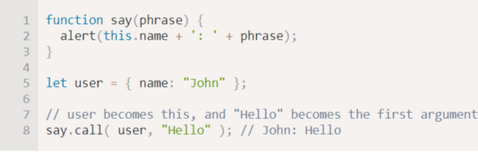
We call sayHi in the context of different objects:
We use call to call say with the given context and phrase:

Slide 11


apply()
Instead of func.call(this, ...arguments) we could use func.apply(this, arguments).
The only syntax difference between call and apply is that call expects a list of arguments, while apply takes an array-like object with them.

Slide 12

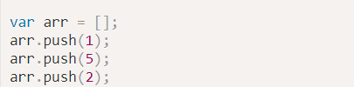
For example, in JavaScript there is a built-in function Math.max (a, b, c ...) that returns the maximum value from the arguments:
With apply, we could find the maximum in an arbitrary array, like this:

Slide 13
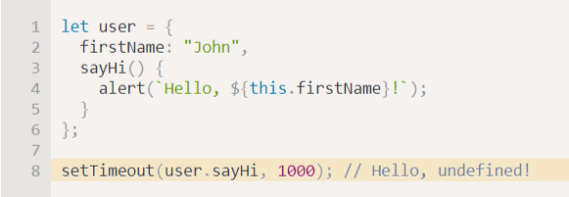

bind()
When passing object methods as callbacks, for instance to setTimeout, there’s a known problem: "losing this".
That’s because setTimeout got the function user.sayHi, separately from the object. The last line can be rewritten as:

Slide 14
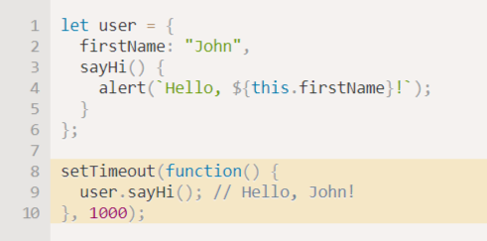
The simplest solution is to use a wrapping function:
Now it works, because it receives user from the outer lexical environment, and then calls the method normally.

Slide 15
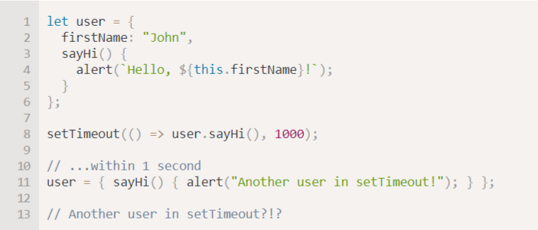
What if before setTimeout triggers user changes value? Then, suddenly, it will call the wrong object!

Slide 16
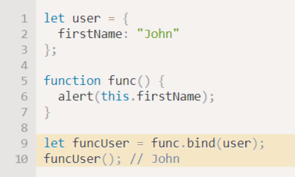
Functions provide a built-in method bind that allows to fix this.
The basic syntax is:
calling boundFunc is like func with fixed this.
For instance, here funcUser passes a call to func with this=user:

Slide 17
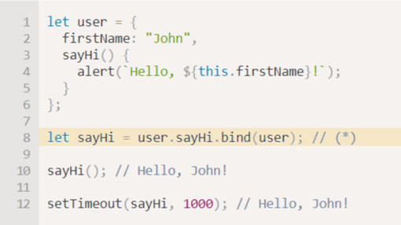
The sayHi is a “bound” function, that can be called alone or passed to setTimeout – doesn’t matter, the context will be right.

Slide 18
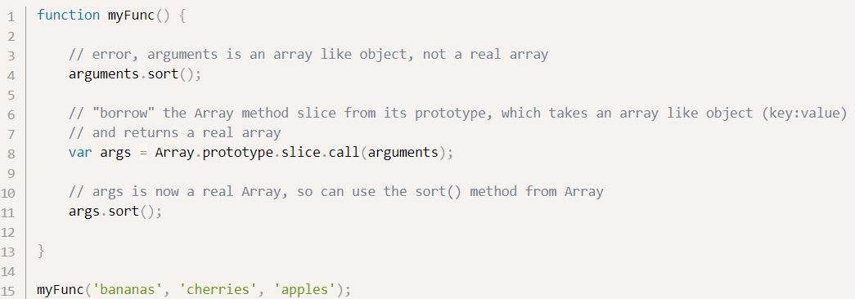
Borrowing methods
In JS, sometimes it’s desirable to reuse a function or method on a different object other than the object or prototype it was defined on. By using call(), apply() and bind(), we can easily borrow methods from different objects without having to inherit from them.

Slide 19
Resources
https://davidshariff.com/blog/borrowing-methods-in-javascript/
https://javascript.info/call-apply-decorators
https://javascript.info/bind#solution-2-bind
https://www.w3schools.com/

Slide 20
THANK YOU

