Slide 1
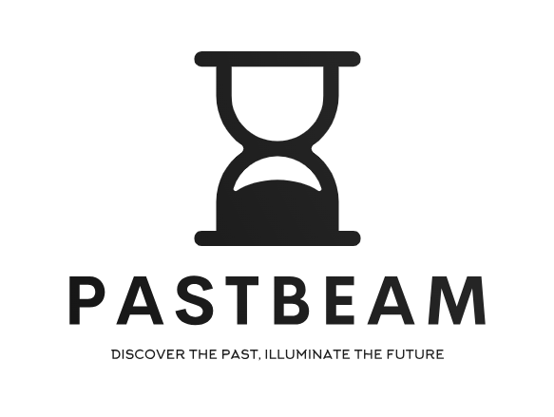
PastBeam
Prepared by Oleksiy Bunyak Nazariy Hreb Ihor Kashuba Valentin Martynovych Mykhailo Vuilov

Slide 2

Introduction
What is PastBeam? PastBeam is an innovative online platform that aims to shed light on historical events, figures, and stories, making them more accessible and understandable for future generations. It serves as an interactive timeline and a valuable resource for anyone interested in history.

Slide 3
Feasibility of Creation
Educational Value: A growing need for accessible and engaging historical content.
Technological Advancements: The increasing use of multimedia and interactive platforms makes it easier to present history in a more engaging way.
Cultural Preservation: With the risk of historical knowledge fading over time, PastBeam helps preserve and share critical events and stories for future generations.

Slide 4
Benefits
Interactive Learning: Users can explore history through interactive timelines, maps, and multimedia content.
Accessibility: Easy access to historical data from various eras and regions, available to anyone with an internet connection.
Educational Tools: Provides teachers, students, and history enthusiasts with valuable resources for research and learning.
Global Reach: Connects people from different parts of the world through shared historical knowledge.

Slide 5
Challenges and Limitations
Data Accuracy: Ensuring historical accuracy and avoiding misinformation can be challenging.
Content Volume: Gathering, verifying, and presenting historical data in a comprehensive yet engaging way requires significant effort.
Technological Limitations: Interactive features may require high processing power, which could limit accessibility for some users.

Slide 6
Competitors
History.com – A major player in the online history space, offering articles, videos, and historical archives.
Wikipedia – Provides general historical information but lacks deep engagement and multimedia resources.
Google Arts & Culture – Offers virtual tours and artifacts, focusing on art history rather than comprehensive historical narratives.
ChronoZoom – A tool for creating interactive timelines, though less focused on educational content.

Slide 7

Technologies Used
Backend: ASP.NET Core – for building a scalable and efficient web application.
Frontend: React.js – for a dynamic and responsive user interface.
Database: PostgreSQL – for storing and managing historical data.
Hosting & Deployment: Microsoft Azure – for cloud hosting and scalability.
Authentication: Identity Server or Firebase Auth – for secure user authentication.
Additional Tools:
Entity Framework Core – for database interaction.
Tailwind CSS – for modern and responsive UI styling.
WebSockets / SignalR – for real-time updates and interactive elements.

Slide 8

Conclusion and Future Outlook
Why Choose PastBeam? PastBeam is a unique platform that combines interactive learning with a focus on the preservation and accessibility of historical knowledge. As we continue to develop and expand the platform, we aim to offer even more features, such as virtual museum tours, community-driven content, and personalized history experiences.

Slide 9
Thank you for your attention!!!

