Slide 1
Course project
Transposition Cipher
By: Ihor Pakharenko. Head of the course project: Volodymyr Serdychenko

Slide 2
Aims and tasks
Aims
Tasks
To improve skills of writing C# code
To get some knowledge about ciphers
To create a program that lets the user to encipher and decipher text with columnar transposition cipher
To examine information sources
To implement columnar transposition cipher
To test the UI and the cipher itself of the created application

Slide 3
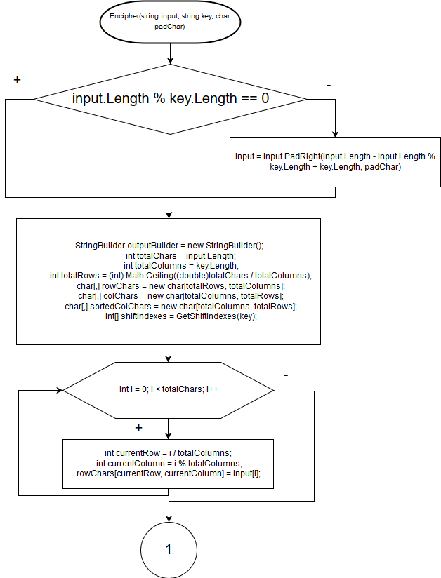
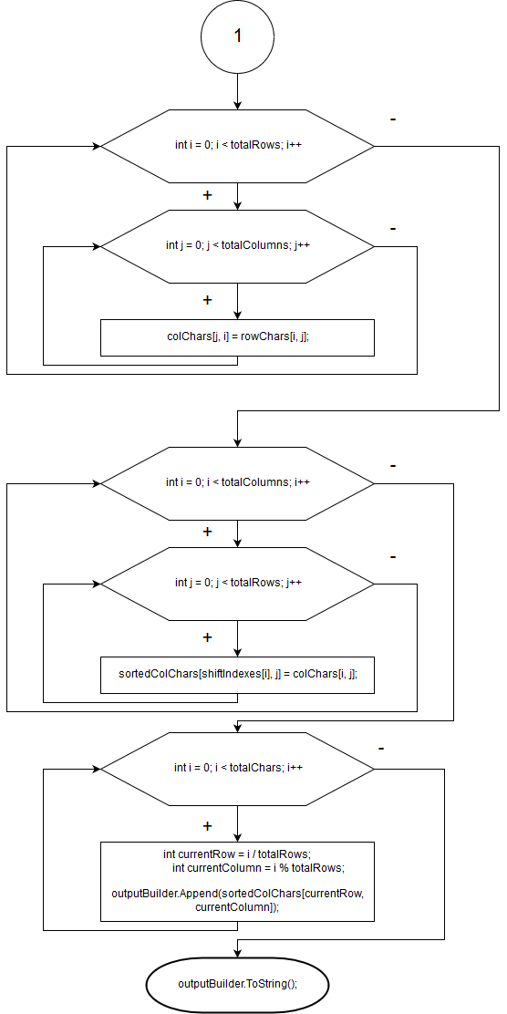
Encipher method flowchart
The basic principle of this algorithm is very simple. What we do here is:
Put every char of the input in a matrix
Transpose it
Change the column order in the matrix. The new order is defined by passed key
Make a string out of the matrix and return it

Slide 4
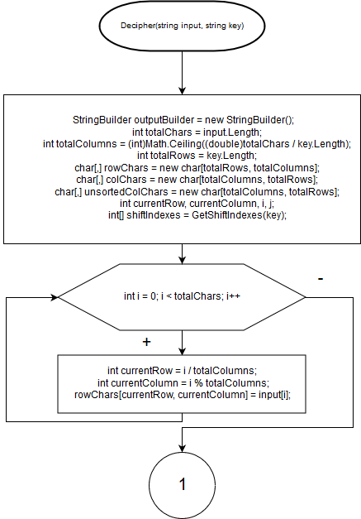
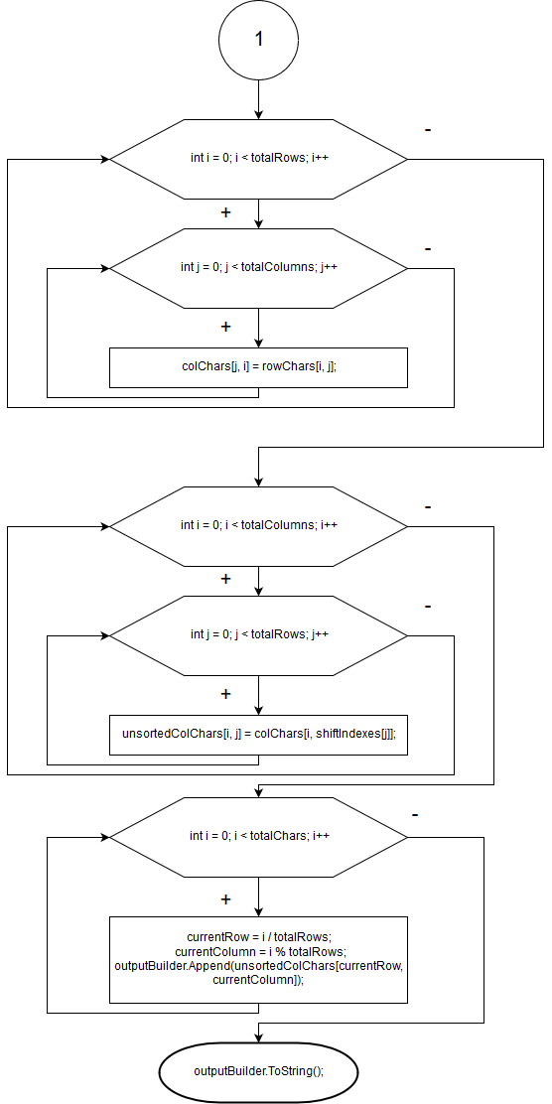
Decipher method flowchart
Here we are doing exactly the same as in Encipher, but we don`t sort the columns once more. Instead, we reverse this operation.

Slide 5
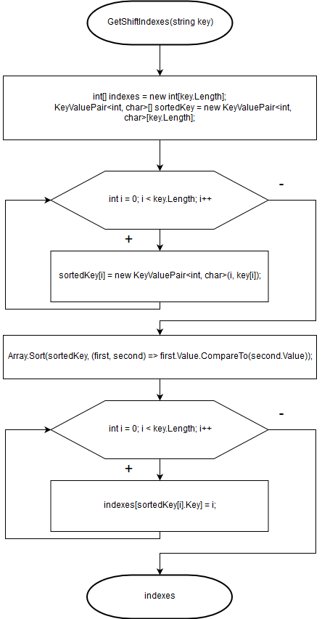
GetShiftIndexes method flowchart
This method sorts the passed key and returns an array of integers (like [4, 3, 0, 1, 2]) indicating the order of reading columns in the matrix.

Slide 6
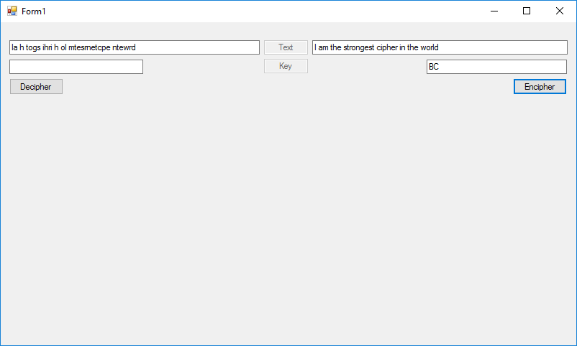
UI
The UI is very simple. It consists of two buttons (Decipher & Encipher) two fields for a key, one field for the text to encipher and one for the text to decipher. There are two more disabled text boxes in the middle of the window, just to add some clarity to the UI.

Slide 7
Summary
The application does its job. It lets the user to use the columnar transposition cipher for enciphering/deciphering any text messages of any length.
Though the cipher is very old and isn`t used for serious purposes anymore, it might be interesting for students starting to look into ciphers, because it is concise and intuitive.

