Slide 1

Stock Price Prediction based on Fundamental data BY The Machine
Creators:
Kevin Klare
Ihor Vodko

Slide 2
overview
Data Acquisition
Exploratory Data Analysis
K-Means Clustering
Neural Network: Predicting Stock Prices with Fundamental Data
Conclusions

Slide 3

Data Acquisition: SimFin.com

Slide 4
Data Acquisition
Downloaded financial data for nearly 1,600 US publicly traded stocks (excluded financial stocks)
5 Data Sets :
Income Statement
Balance Sheet
Cash Flow Statement
Stock prices
Industry and Sector codes
Five to ten years of data per stock

Slide 5
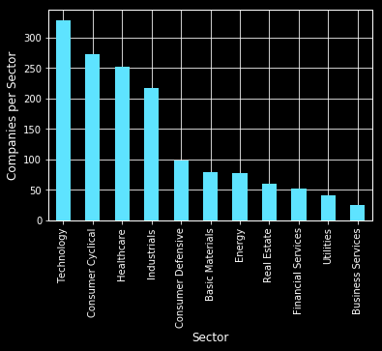
Number of stocks by sector

Slide 6
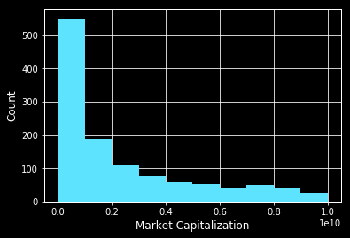
Market Capitalization of Individual stocks

Slide 7
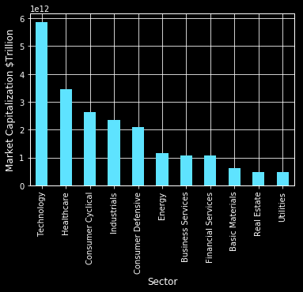
Total Sector market capitalization

Slide 8
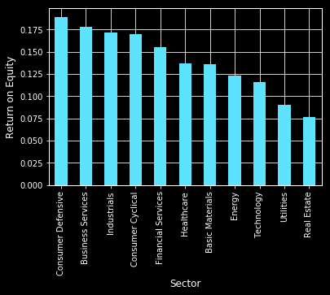
Median ROE by Sector

Slide 9
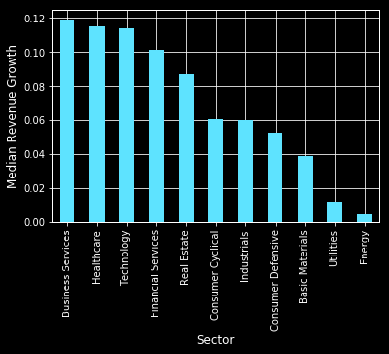
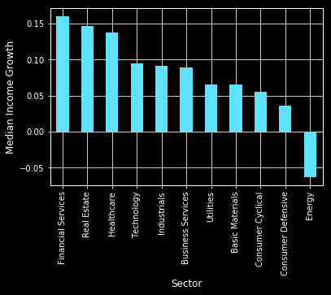
Median growth by Sector

Slide 10
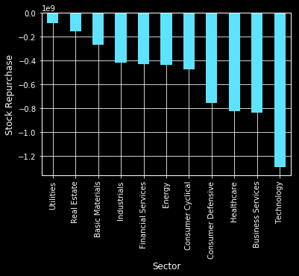
Stock Buybacks

Slide 11
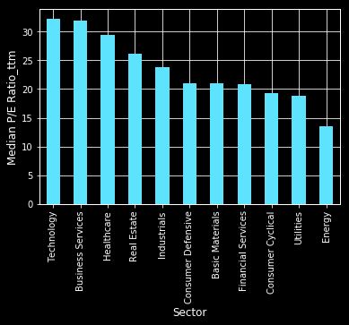
Median P/E Ratio by Sector

Slide 12
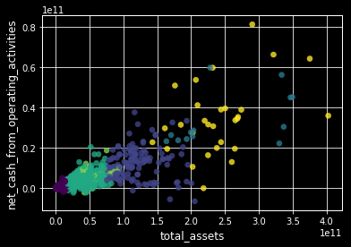
K-Means Clustering

Slide 13
The Model
DENSE NEURAL NETWORK

Slide 14
Network Description
4 dense layers
49, 24, 12, 6 nodes
Train set 5,457 observations for 629 companies
49 fundamental features from balance sheet, income statement and cash flow statement
number of epochs 300
50 batch size

Slide 15
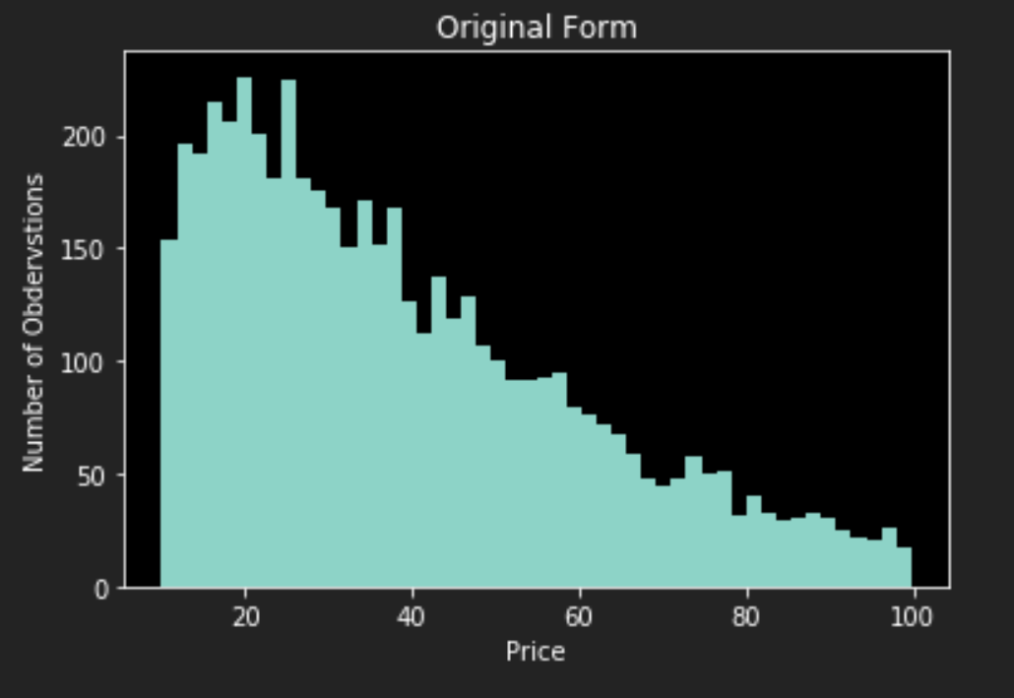
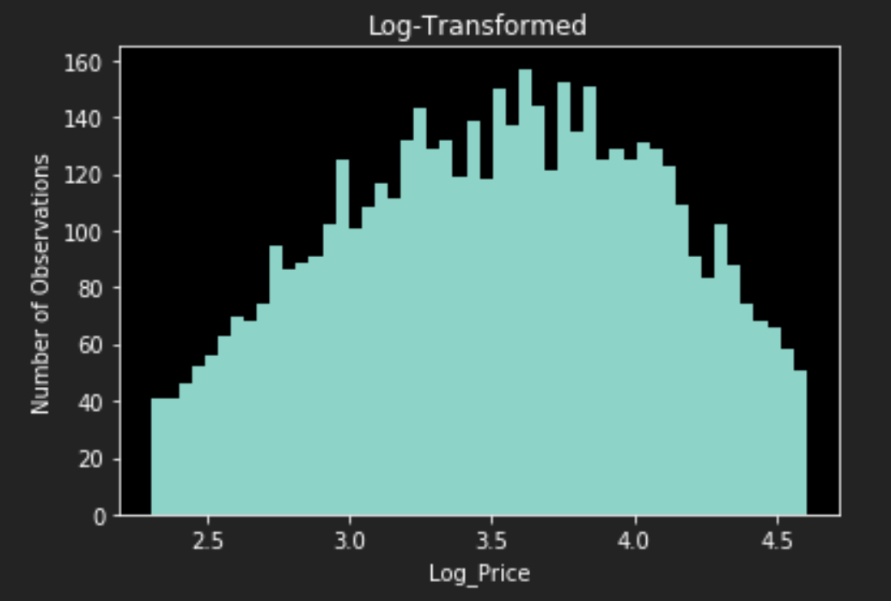
Train 1-Y forward Price

Slide 16
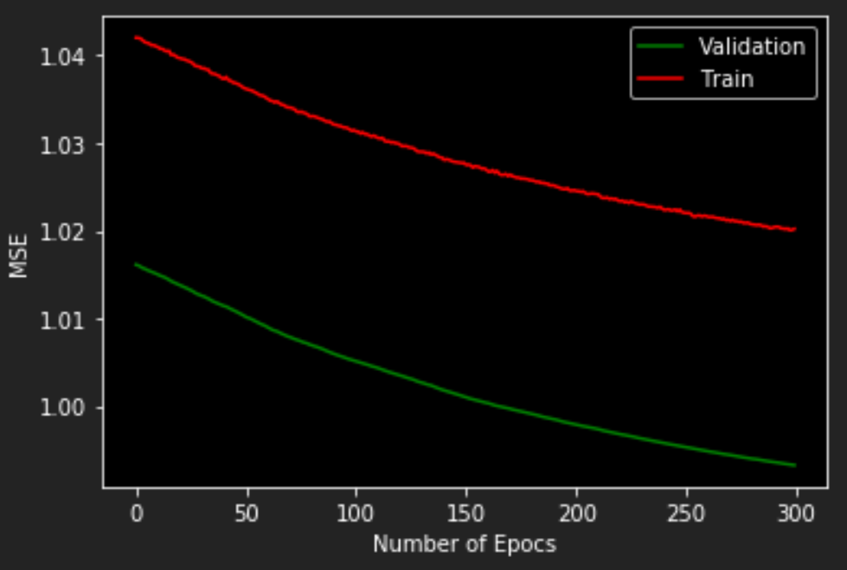
Train and validation error

Slide 17
300 epochs VS 3 Epochs
 | Highly Trained Model | Loosely Trained Model
MSE of standardized log price | 1.21 | 1.63
MSE of USD price | 709.58 | 4,866
Buy correct | 40% | 61%
Sell correct | 57% | 42%
Buy&Sell correct | 48% | 52%
Buy profit | 326 | 829
Sell profit | -748 | -245
Total profit | -422 | 584

Slide 18
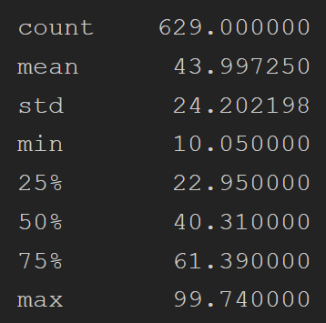
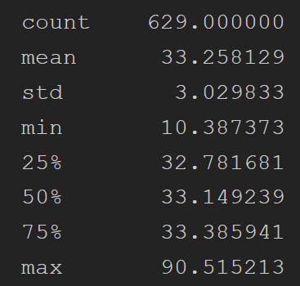
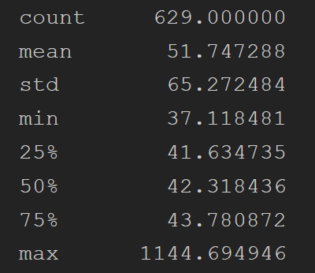
Actual price VS 300 epochs VS 3 Epochs

Slide 19
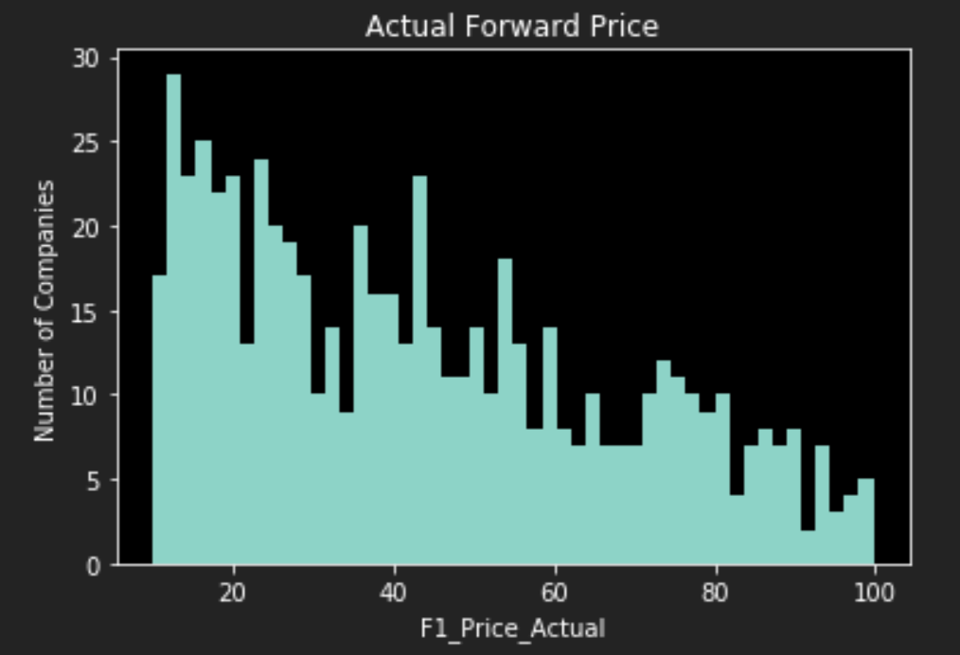
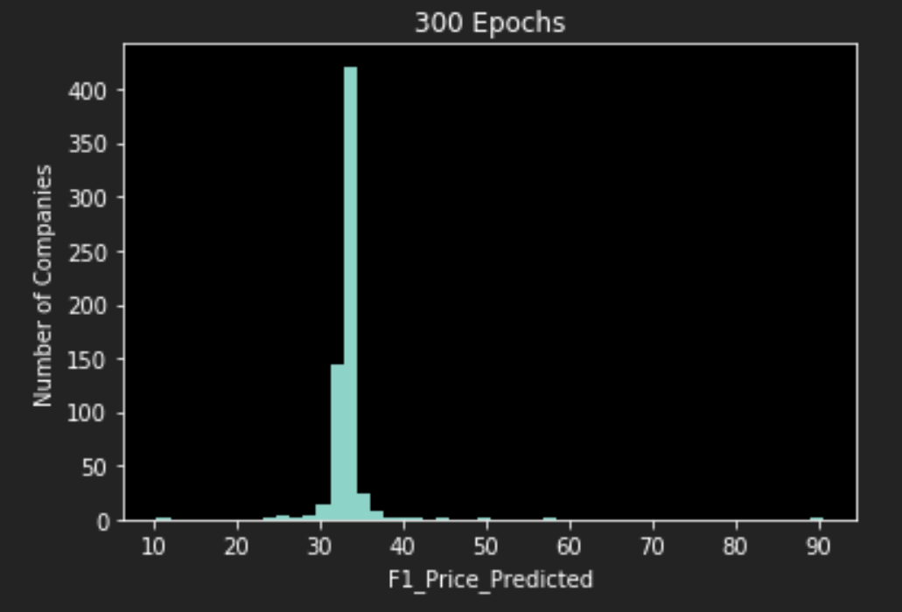
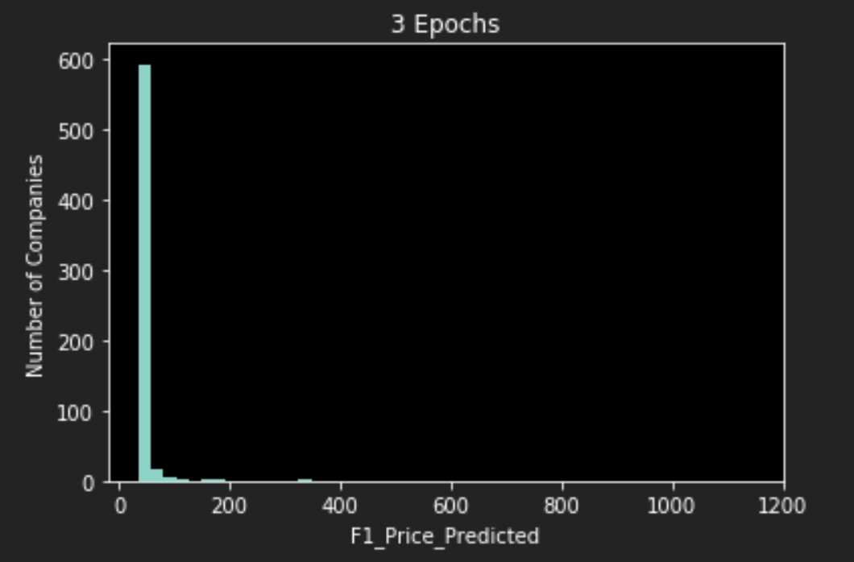
Actual price VS 300 epochs VS 3 Epochs

Slide 20
Example of cost function
P@0 = 100
Pf@1=105 decision to Buy
Scenario 1
Pact@1=115. Error is |115-105|=10, profit is 115-100=15
Scenario 2
Pact@1=98. Error is |98-105|=7, profit is 98-100=(-2)
Conclusion: lower price forecast error does not imply higher return

Slide 21
Binary classification buy/sell
0 Sell
1 Buy
Goal : Accuracy maximization
Scenario 1
Equal profit 1 from each prediction. 9 o f10 correct. Accuracy 90%. Profit from 9 correct 9*2=18, loss from 1 incorrect (-1)*1=(-1). Total 18+(-1)=17
Scenario 2
Real life, unequal profit from each prediction. 9 o f10 correct. Accuracy 90%. Profit from 9 correct 9*2=18, loss from 1 incorrect (-1)*20=(-20). Total 18+(-20)=(-2)
Conclusion: higher forecast accuracy does not imply higher return

Slide 22
Conclusion
NN fundamental stock price forecast requires recursive effect
Macro trend in the market has significant impact on the 1-year forecast
Stock to buy is easier to predict than to sell because of market inefficiency
Long/short portfolio return does not depend on the binary accuracy buy/sell
Magnitude of mispricing of incorrectly forecasted buy/sell stock is a key factor for portfolio return maximization
Customized cost function can potentially increase portfolio return

