Slide 1

Significance of market news analysis as a factor in a private company bankruptcy prediction
Case Study: Purdue Pharma L.C.
Author: Ihor Vodko

Slide 2
Key Points
Opioid crisis: general picture
Purdue Pharma L.C.: road to disaster
Web scrapping markets news
Data analysis for hidden insights
Conclusion
Further research

Slide 3

Opioid Crisis: General Picture
Opioids are drugs formulated to replicate the pain-educing properties of opium. They include both legal painkillers like morphine, oxycodone, or hydrocodone prescribed by doctors for acute or chronic pain, as well as illegal drugs like heroin or illicitly made fentanyl
In 2017, an estimated 1.7 million individuals in the United States suffered from substance use disorders related to prescription opioid pain relievers and 652,000 suffered from a heroin use disorder
During 2017, there were more than 70,200 overdose deaths in the United States and 47,600 of those overdose deaths involved opioids. More than 130 people died every day from opioid-related drug overdoses in 2016 and 2017, according to the US Department of Health & Human Services (HHS)

Slide 4

Opioid Crisis: Fast Facts
1861-1865 - During the Civil War, medics use morphine as a battlefield anesthetic. Many soldiers become dependent on morphine after the war
2015 - The DEA announces that it has arrested 280 people, including 22 doctors and pharmacists
2017 - Trump signs an executive order calling for the establishment of the President's Commission on Combating Drug Addiction and the Opioid Crisis
2018 - Attorney General Jeff Sessions announces a new opioid initiative: the Prescription Interdiction & Litigation (PIL) Task Force
2019 - The National Safety Council finds that, for the first time on record, the odds of dying from an opioid overdose in the United States are now greater than those of dying in a vehicle crash
2019 - The CDC releases preliminary data showing a 5.1% decline in drug overdoses during 2018

Slide 5

Purdue Pharma L.C.: Road to Disaster
Purdue Pharma L.P. manufactures pharmaceutical products. The company researches, develops, produces and markets prescription and over-the-counter medicines and health care products. Products include treatments for chronic and severe pain:
OxyContin, a control-released version of oxycodone;
HysinglaER, an extended release hydrocodone drug;
buprenorphine pain patch Butrans;
Develops opioid addiction therapies.
Company classification: Health Care -> Biotech & Pharma -> Specialty Pharma

Slide 6
Purdue Pharma L.C.: Road to Disaster
1995 - OxyContin, a long acting version of oxycodone, which slowly releases the drug over 12 hours, is introduced and aggressively marketed as a safer pain pill by manufacturer, Purdue Pharma
2007 - Purdue Pharma pleads guilty for misleadingly advertising OxyContin as safer and less addictive than other opioids
2010 - FDA approves an "abuse-deterrent" formulation of OxyContin, to help curb abuse. However, people still find ways to abuse it
2019 - More than 600 cities, counties and Native American tribes from 28 states file a federal lawsuit against eight members of the Sackler family, the family that runs Purdue Pharma
September 15, 2019 - Purdue files for bankruptcy as part of a $10 billion agreement to settle opioid lawsuits

Slide 7
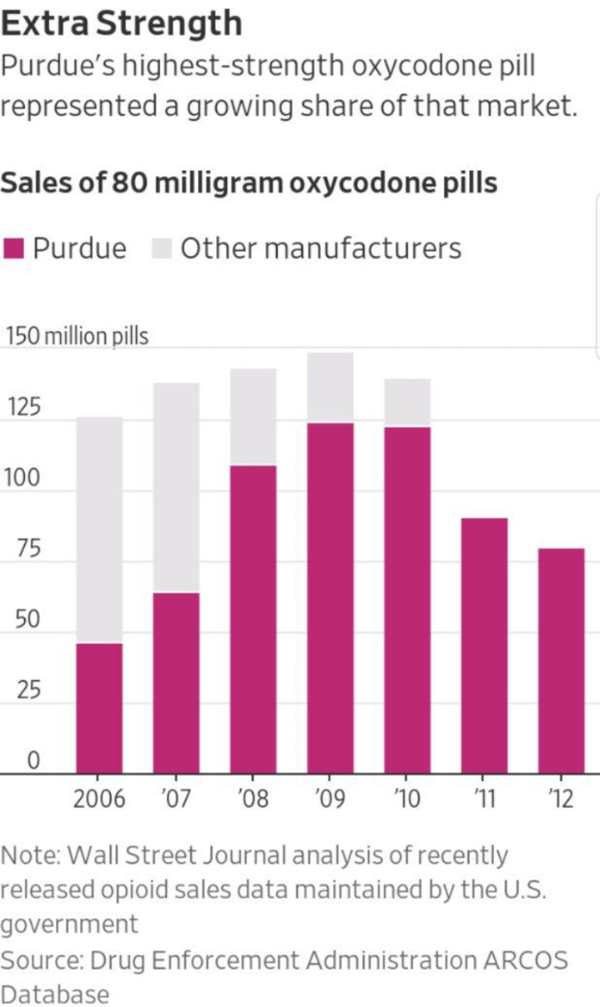
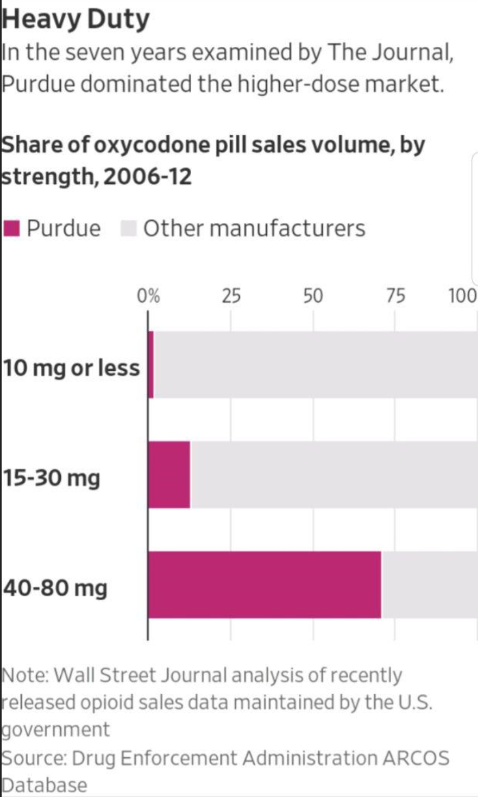
Purdue Pharma L.C.: Road To Disaster

Slide 8
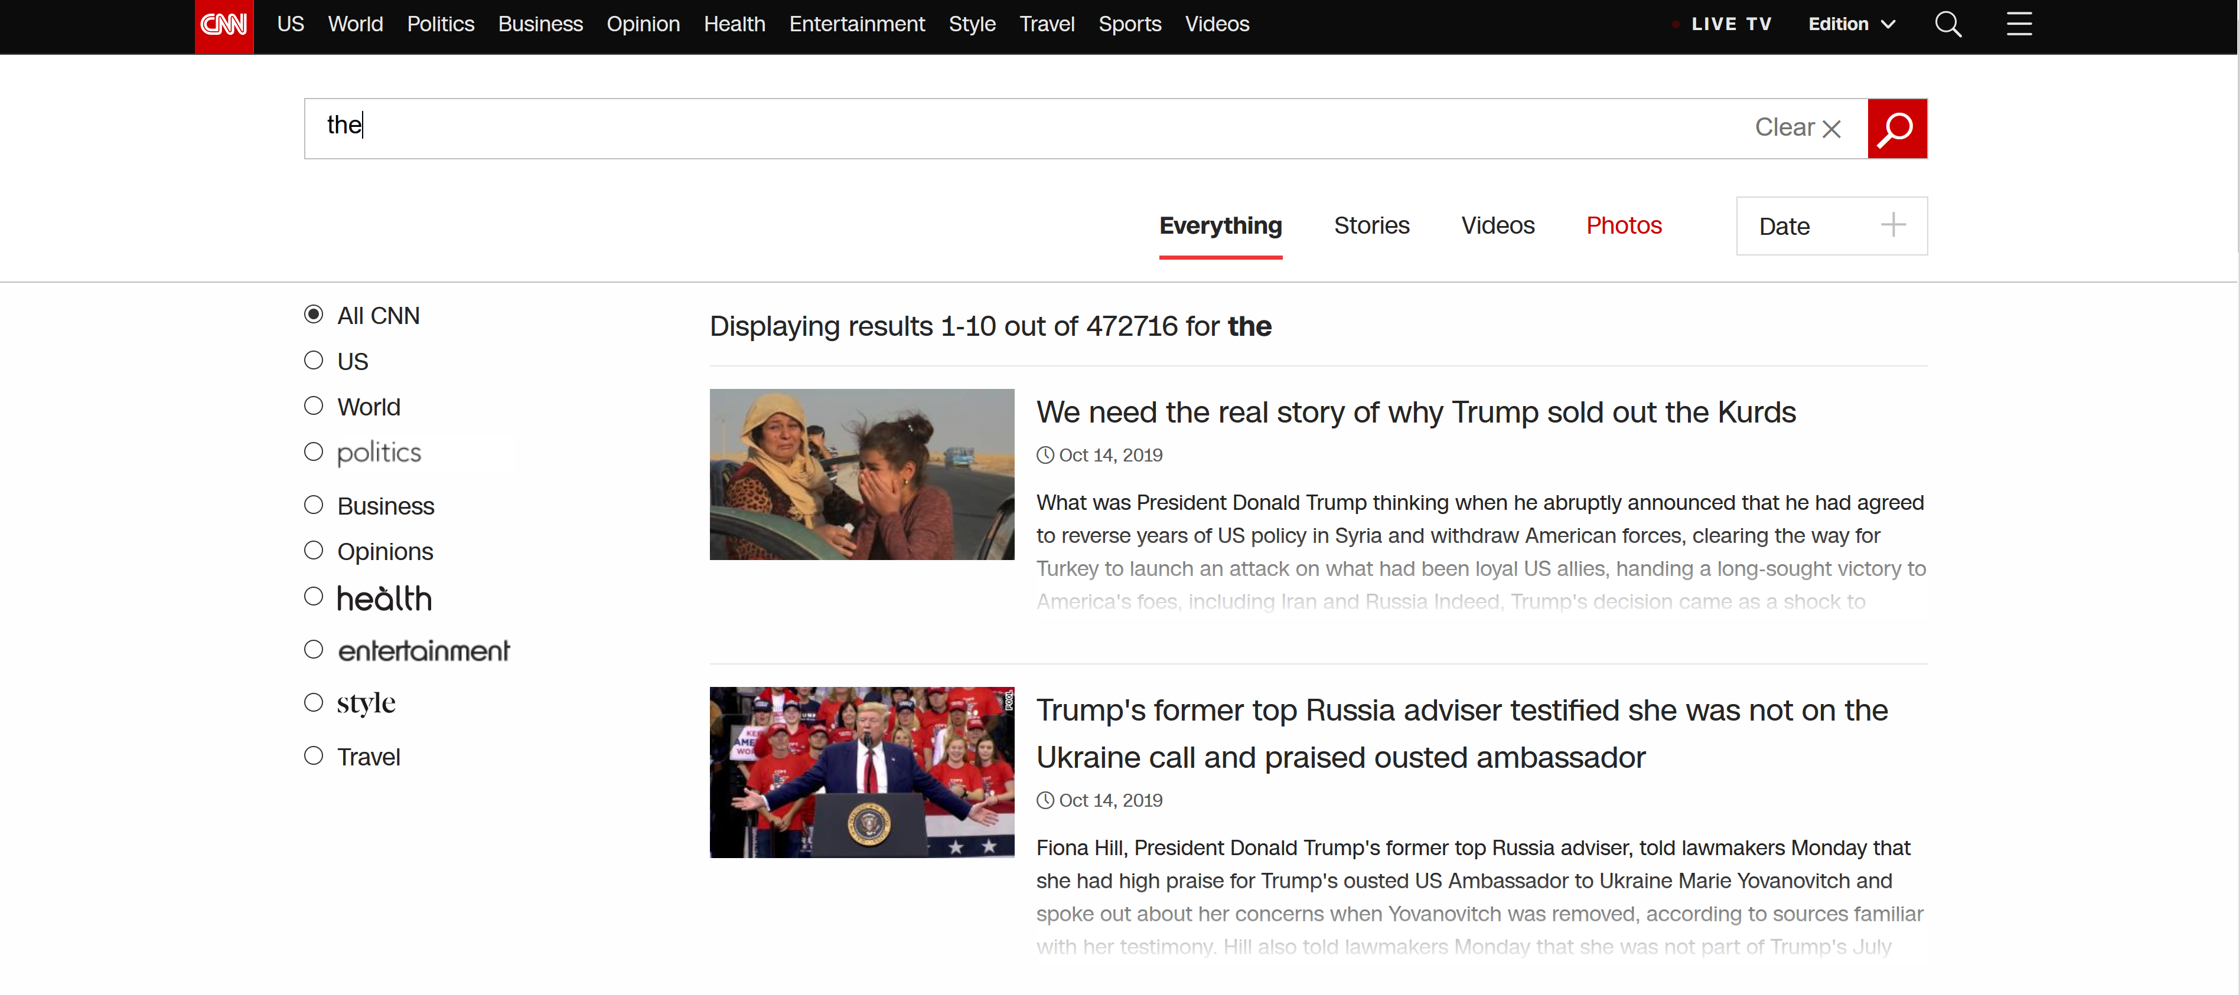
Web Scrapping Markets News

Slide 9
Web Scrapping Markets News
Period from 2011 Sep 26 to 2019 Sept 14 (a day before Purdue’s Chapter 11 bankruptcy filling)
Total number of articles 472,716
251 articles include a word “purdue”
1254 articles include a word “opioid”
2336 articles include a word “bankruptcy”

Slide 10
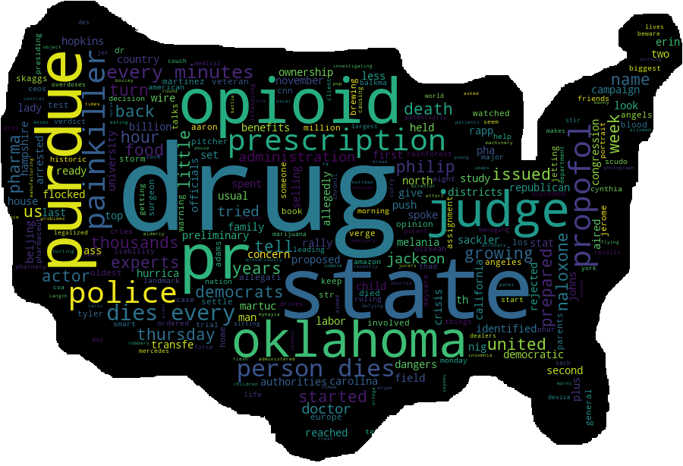
Data Analysis for Hidden Insights

Slide 11
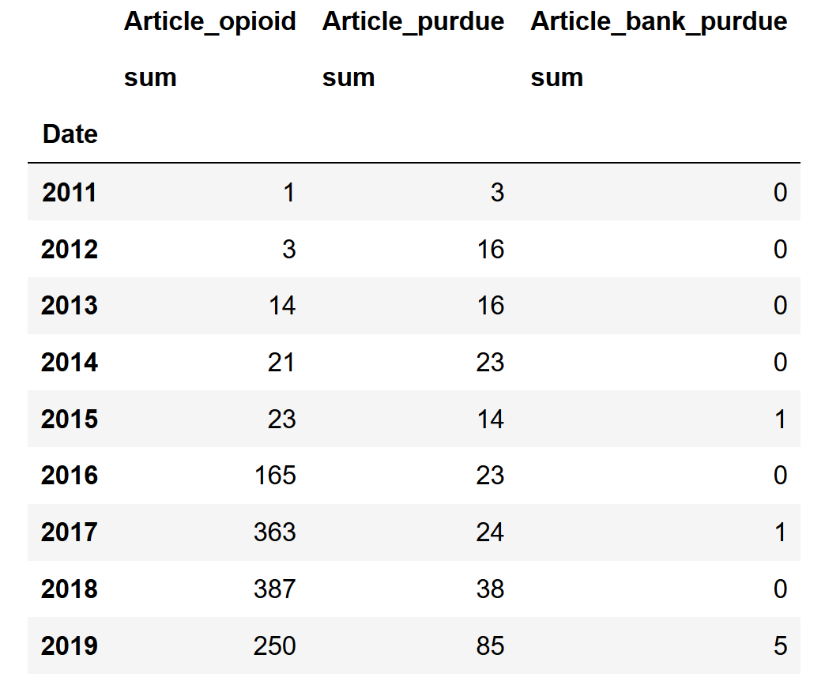
Data Analysis for Hidden Insights

Slide 12
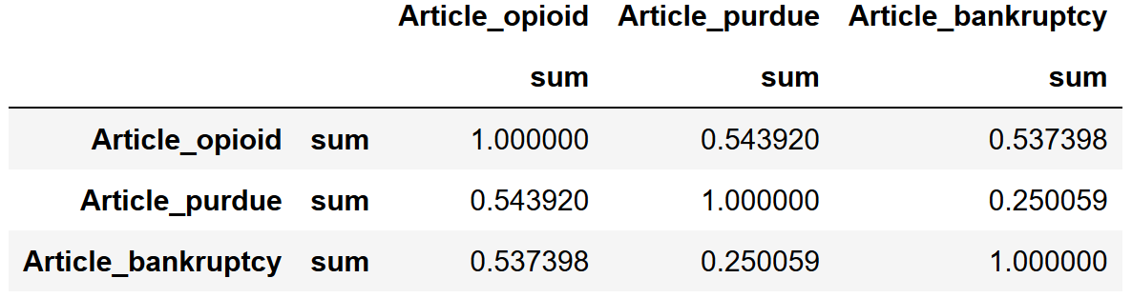
Data Analysis for Hidden Insights
Correlation Matrix

Slide 13
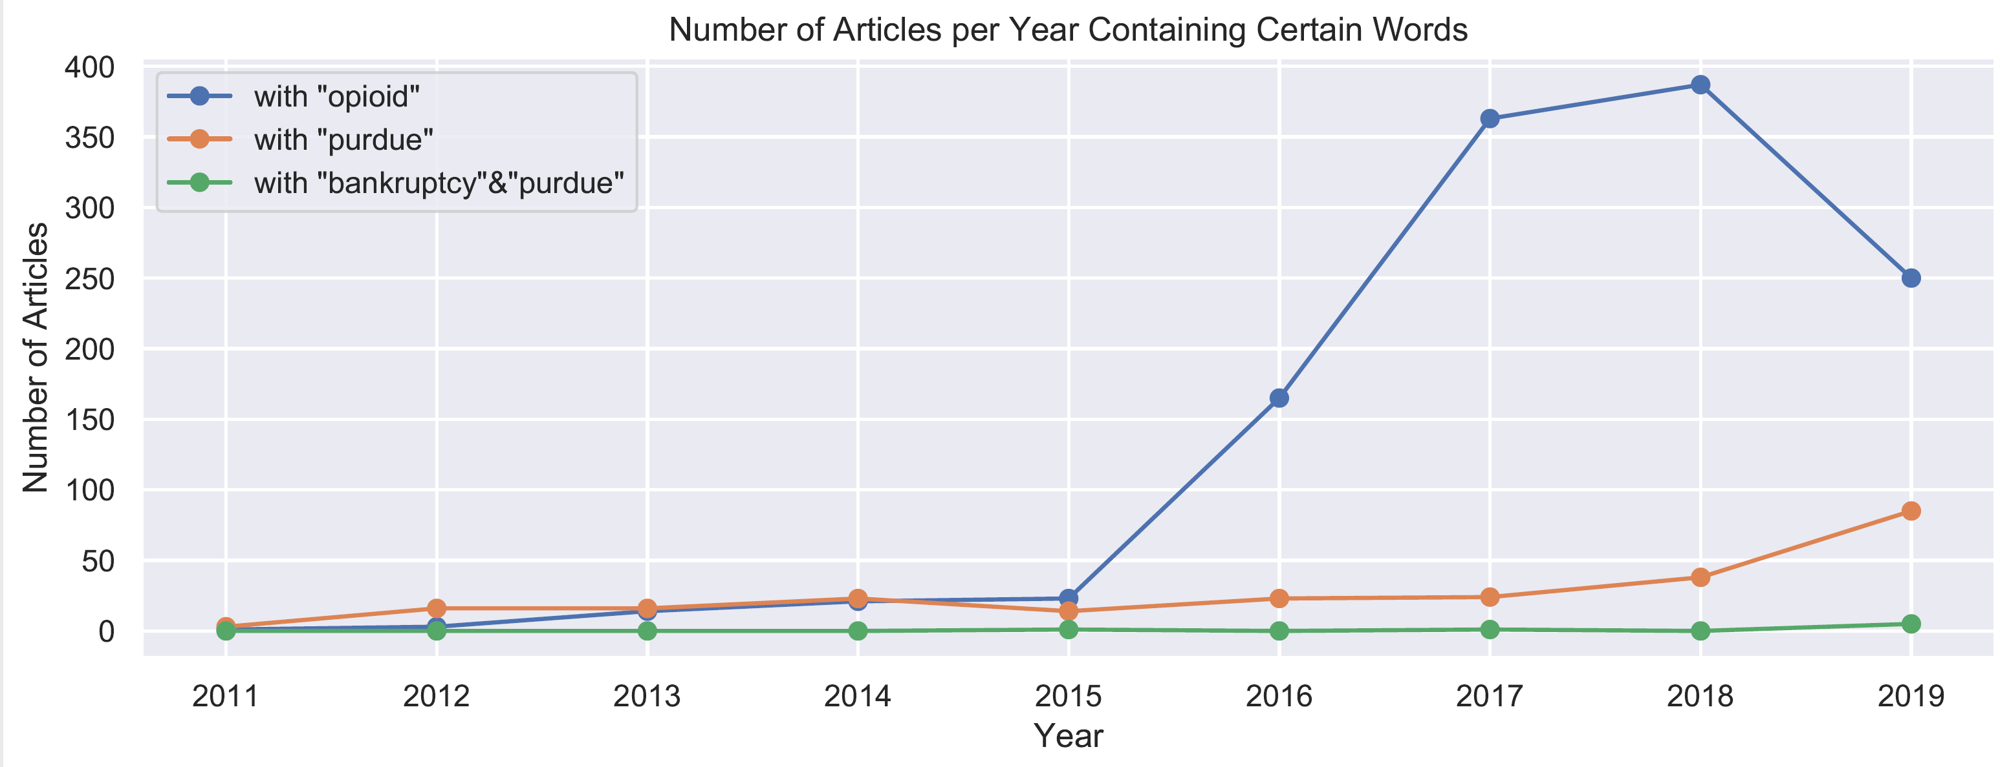
Data Analysis for Hidden Insights

Slide 14
Conclusion
news analysis factor could have significant predictive power
context analysis is too complex to perform without AI algorithms
news analysis factor is highly dependent on the current environment
costs associated with news analysis needs to be considered in the overall trading strategy due to high computational consumption

Slide 15

Further Research
increase data pool: scrape more news sources for data (big data)
increase sample size: predict other private companies’ bankruptcies
deploy NLP methods trained by machine learning and neural networks for context recognition
combine news factor with other factors in multivariable regression to increase model predictive power
build an algorithm for automated signal generation in real time based on high probability of company’s bankruptcy

Slide 16
Sources
https://www.cnn.com
https://www.wsj.com
https://www.bloomberg.com
http://threecrowsmagazine.com
https://www.nytimes.com

Slide 17

Thank you!
Email: ihorfinance@gmail.com
LinkedIn: www.linkedin.com/in/ihor-vodko

