Slide 1
How to improve seo, pagespeed insights score and accessibility of a website
Ihor Bilyk

Slide 2
Plan
What is CEO?
Why is SEO important?
Factors impacting ranking
Why page speed is important?
Ways to improve website speed
Accessibility

Slide 3
What is SEO?
Search engine optimization (SEO) is the process of affecting the visibility of a website or a webpage in Google’s organic (unpaid) search results through best practices of all current ranking factors.
The purpose of SEO is to improve a website’s rankings in the search results in order to increase the inbound traffic leading to better brand awareness, findability and visibility.

Slide 4
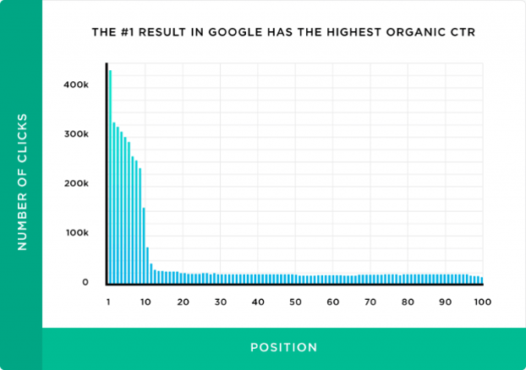
WHY IS SEO IMPORTANT?
In SEO, ranking refers to your content’s position on the search engine results pages. A #1 ranking means that when people search for a particular term, your webpage is the first organic result.
Appearing on the first page (within the top 10 results) is essential because 95% of people never make it past the first page.

Slide 5
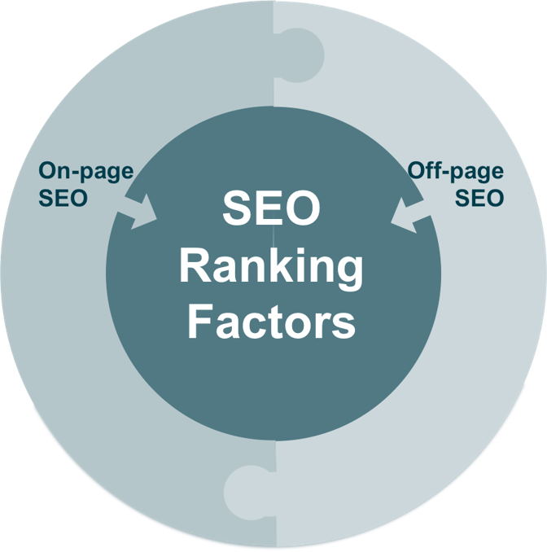
WHAT ARE THE FACTORS IMPACTING GOOGLE’S PAGE RANKING?
Google’s algorithm is secret and constantly changing, and the ranking factors are supposed to be a “black box”.
However, important ranking factors have been unveiled though ongoing test and case studies and can be divided into 2 groups: ON-SITE SEO VS. OFF-SITE SEO
On-page SEO refers to factors on your own website that you can optimize such as the underlying code and the content.
Off-page SEO refers to actions taken outside of your site to affect your site’s trustworthiness and authority by building the right inbound links and social signals.

Slide 6
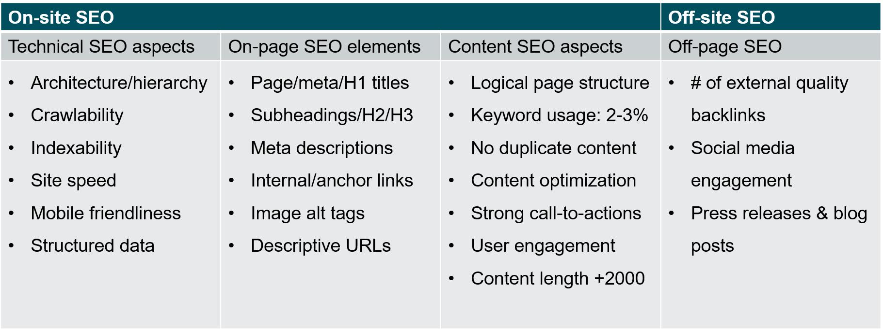
RANKING FACTORS – IN MORE DETAIL

Slide 7
TOP 10 RANKING FACTORS FOR GOOGLE
A secure and accessible website
(Mobile) page speed
Mobile friendliness
Domain age, URL, & authority
Optimized content
Technical SEO
User experience
Links
Social signals
Real business information

Slide 8
WHAT YOU CAN DO TO IMPROVE SEO?
Alt on images
Schema JSON-LD
Fix broken links
Valid hreflang
Valid rel=canonical
Document uses legible font sizes
Improve speed of the website

Slide 9
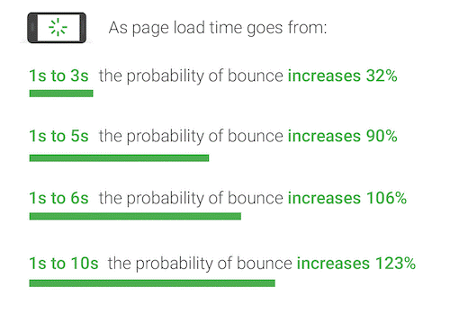
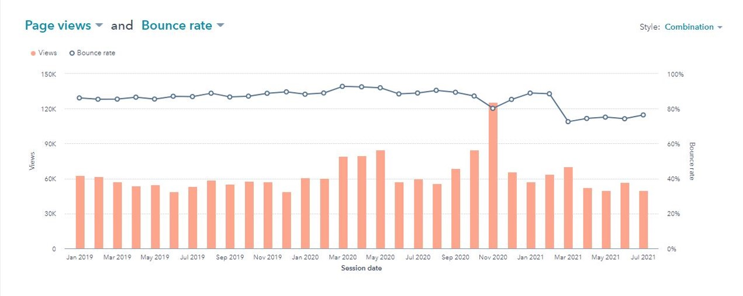
WHY PAGE SPEED IS IMPORTANT?

Slide 10
WHAT YOU CAN DO TO IMPROVE PAGE SPEED?
Analyze your website, use tools
Enable compression
Minify CSS, HTML, JavaScript
Eliminate render-blocking JavaScript
Optimize images
Use .webp
Properly Size Images
Lazy load img and div
Lazy load code
Prioritize above-the-fold content
Optimize fonts
Identifying critical css
Preconnect to Required Origins
Preload Key Requests

Slide 11
ACCESSIBILITY
BACKGROUND AND FOREGROUND COLORS HAVE A SUFFICIENT CONTRAST RATIO
PROPER FONT SIZES
LABELS AND TITLES
ARIA ATTRIBUTES

