Slide 1
Attention in Transformer

Slide 2
MOTIVATION
CONTEXT: We have a deep learning book
QUESTION: How CNN works?
How to answer to this question?
Approach 1: read all the book
Approach 2: read only the CNN chapter
The difference here is we focus on the part we wanted

Slide 3
The input sequence is first transformed into three different vectors : query, key, and value.
Every single word has inputted on a transformer go to have these 3 vectors
Query: Current token that the model is focusing on.
(what I’m look for)
Key: All the other tokens in the input sequence
(what I can offer)
Value: feature embeddings for each token
(what I actually offer)

Slide 4

The self-attention mechanism then computes the attention scores between the query vector and all key vectors using the dot product operation and scales the resulting scores by the square root of the dimensionality of the key vectors.
i,e

Slide 5
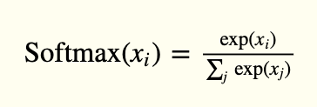
Where,
Q, K, and V are the query, key, and value matrices, respectively
Soft max function is to convert a vector into probability distribution
d_k is the dimensionality of the key vectors
Softmax equal to

Slide 6
