Slide 1
Design portfolio
STUDENT NAME : IHSANA FATHIMA .M
REGISTER NO AND NMID : 21D559B2C207B8D9BED49209357EED85
DEPARTMENT : BCA
COLLEGE : VIDHYA SAGAR WOMEN’S COLLEGE / UNIVERSITY OF MADRAS

Slide 2
PROJECT TITLE
    INTERACTIVE DIGITAL PROTFOLIO USING FRONTEND DEVELOPMENT

Slide 3
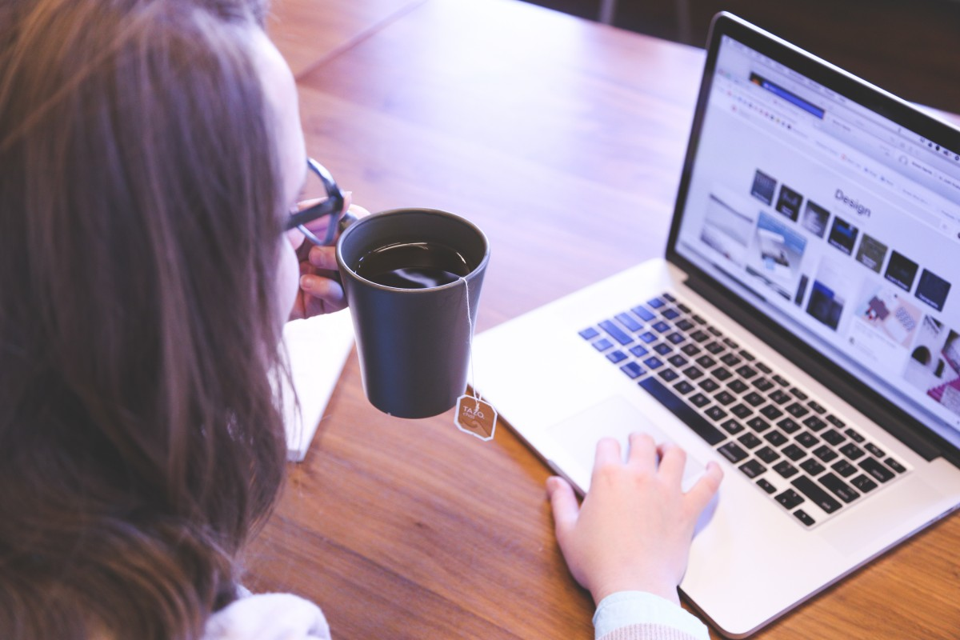
AGENDA
1.Problem Statement
2.Project Overview
3.End Users
4.Tools and Technologies
5.Portfolio design and Layout
6.Features and Functionality
7.Results and Screenshots
8.Conclusion
9.Github Link

Slide 4

Problem statement
Traditional resumes are static and not engaging.
Lack of personalization in paper/digital PDF resumes.
Difficult to update and share in real time.
Limited creativity and interactivity in normal resumes .
Growing demand for digital-first portfolios.
Recruiters prefer interactive, modern resume formats.
This Photo by Unknown Author is licensed under CC BY-SA-NC

Slide 5
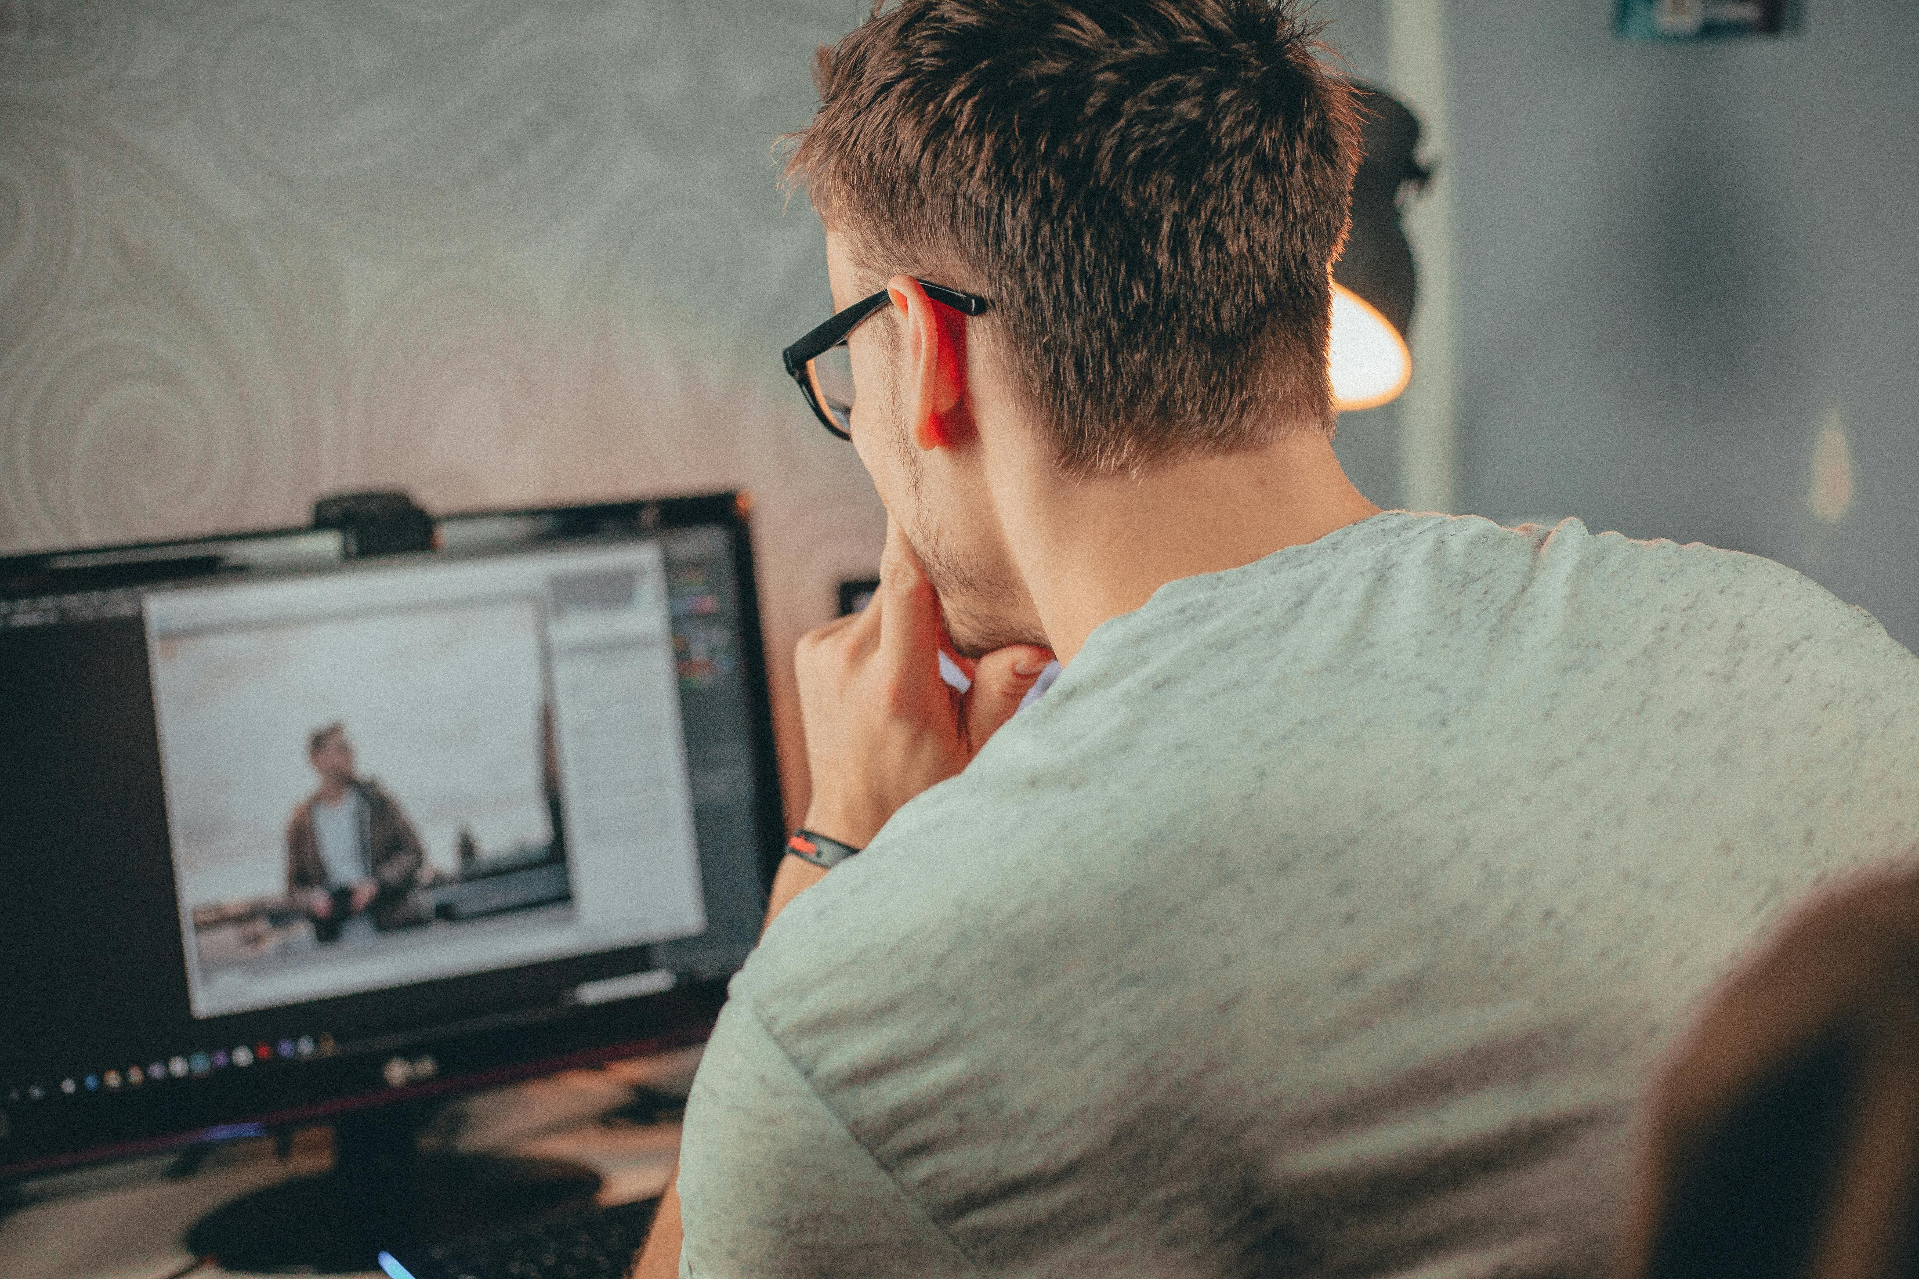
Project overview
This project is about creating an interactive digital portfolio using HTML, CSS, and JavaScript. It helps students and professionals to show their details like education, skills, projects, and contact information in a clear and attractive way. The portfolio is easy to use, works on both computer and mobile, and allows users to download the resume. It gives a professional look and can be shared with others through GitHub or a website link.

Slide 6

Who are the end users ?
Students – to showcase skills and projects.
Job Seekers – interactive resumes for interviews.
Freelancers – to display portfolios for clients.
Recruiters – quick access to candidate’s skills online.
This Photo by Unknown Author is licensed under CC BY-SA-NC

Slide 7
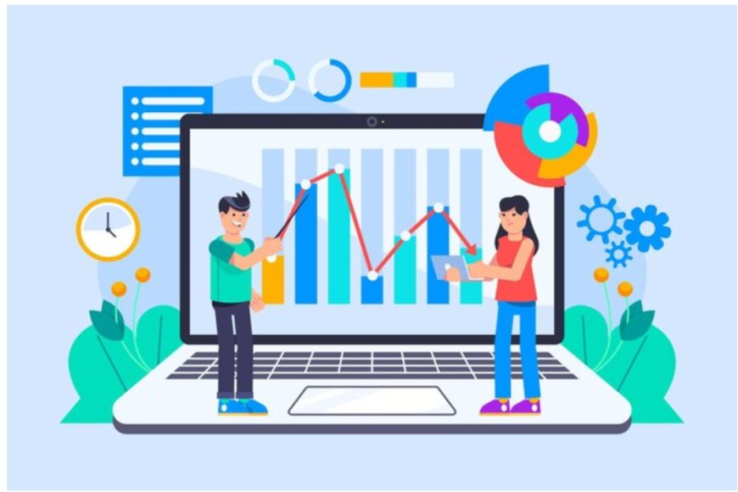
Tools and technologies
HTML5 → Structure of the webpage.
CSS3 → Styling and layout.
JavaScript (ES6) → Interactivity (animations, skill bars, buttons).
VS Code / CodePen → Development environment.
GitHub → Version control and portfolio hosting.
This Photo by Unknown Author is licensed under CC BY-SA

Slide 8
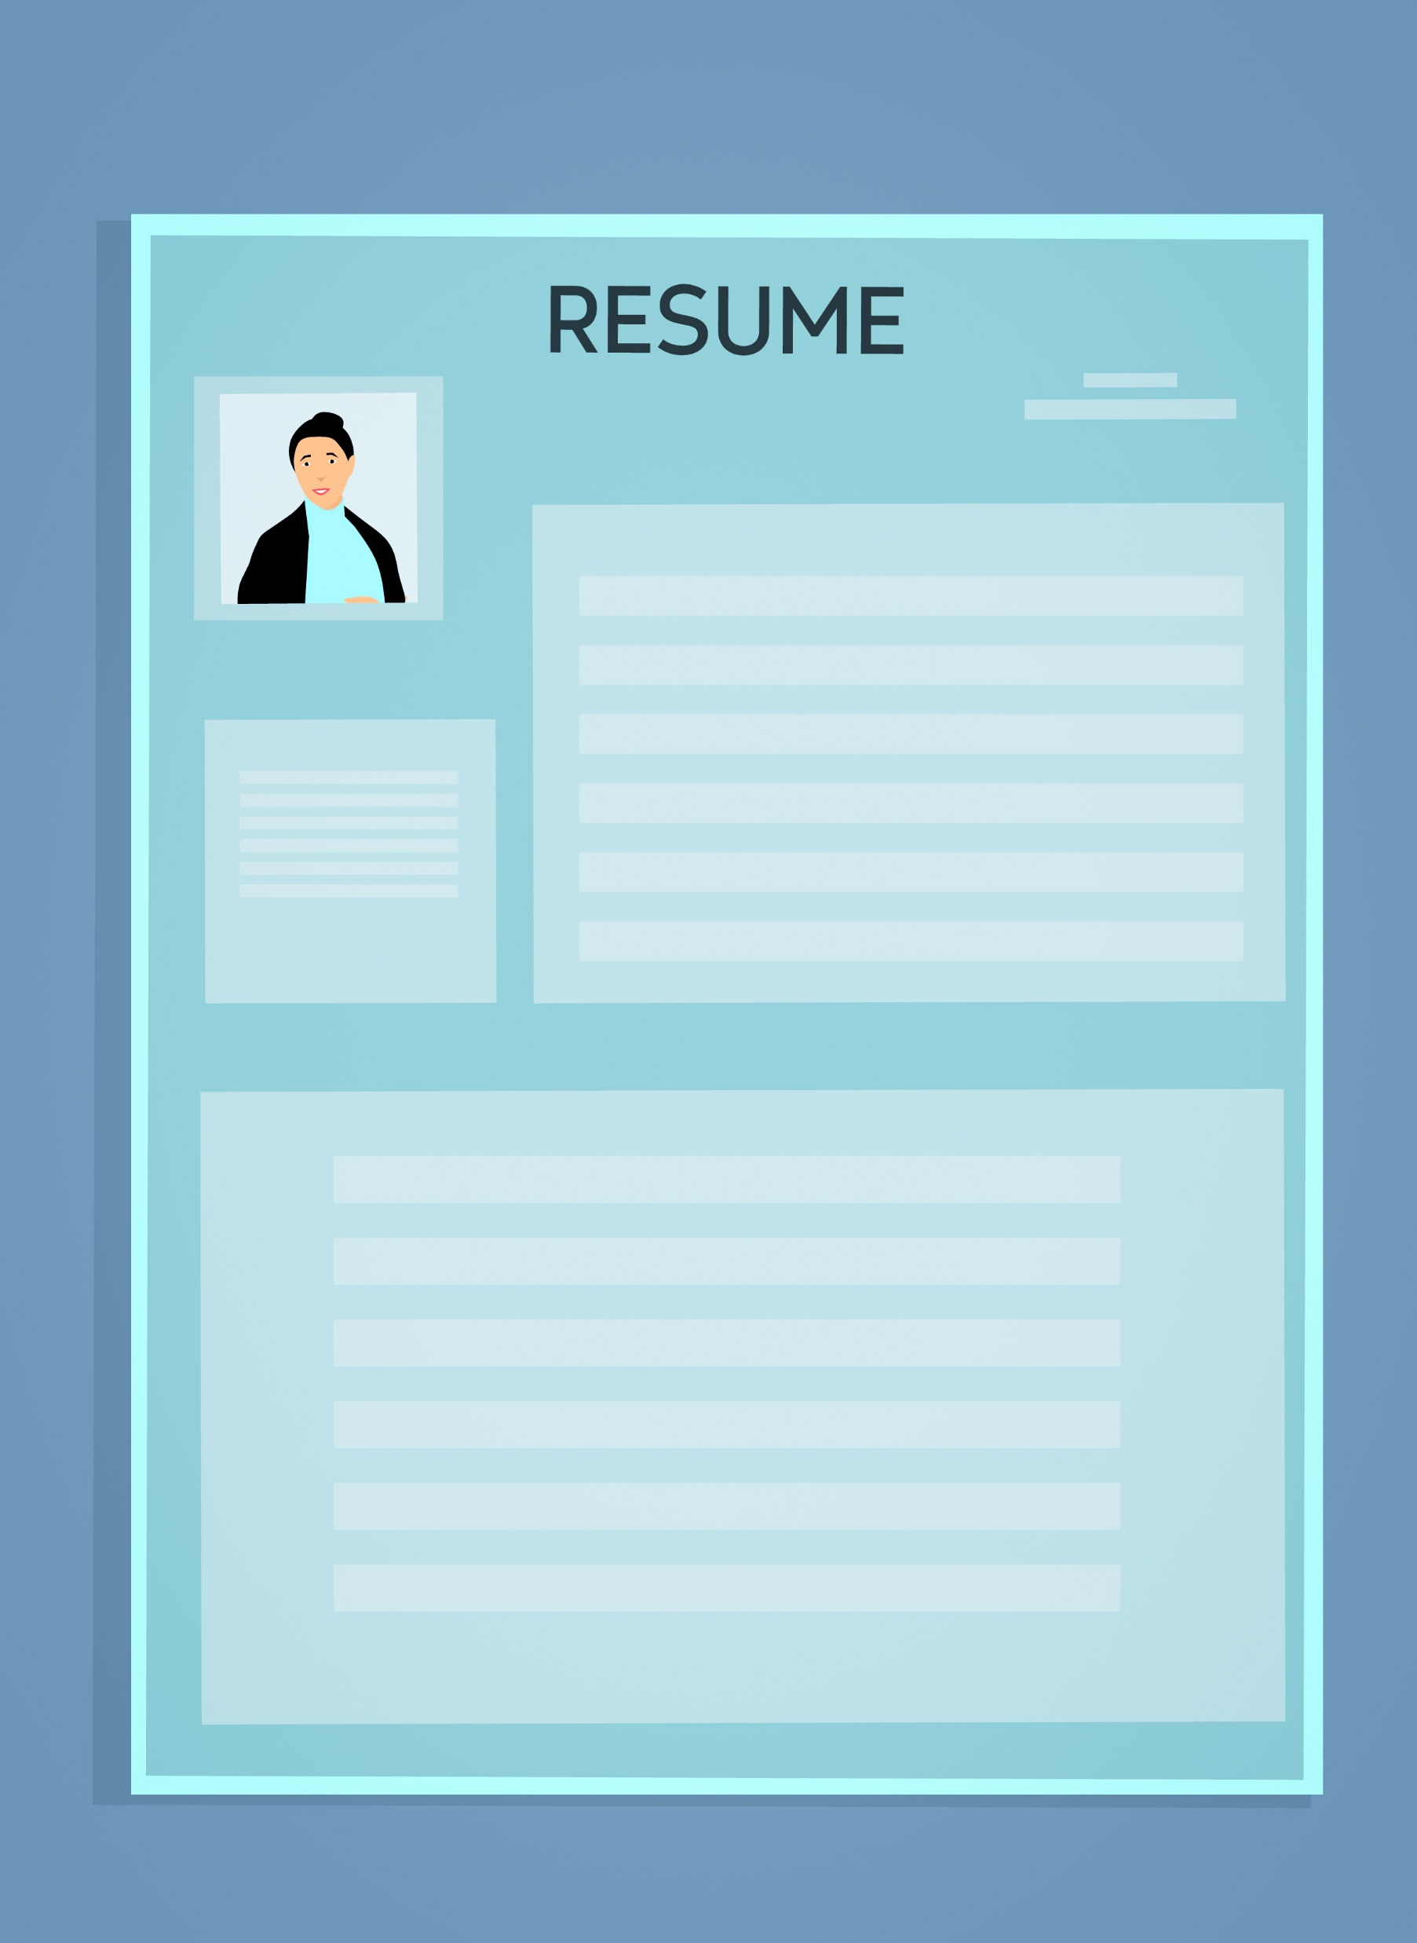
Portfolio design and layout
Two-column layout:
Left → Profile, Contact Info, About Me
Right → Education, Skills, Projects
Responsive Design → Works on desktop and mobile .
Colour Theme → Professional shades (Indigo, Teal, White).
Navigation → Simple and clean structure.

Slide 9
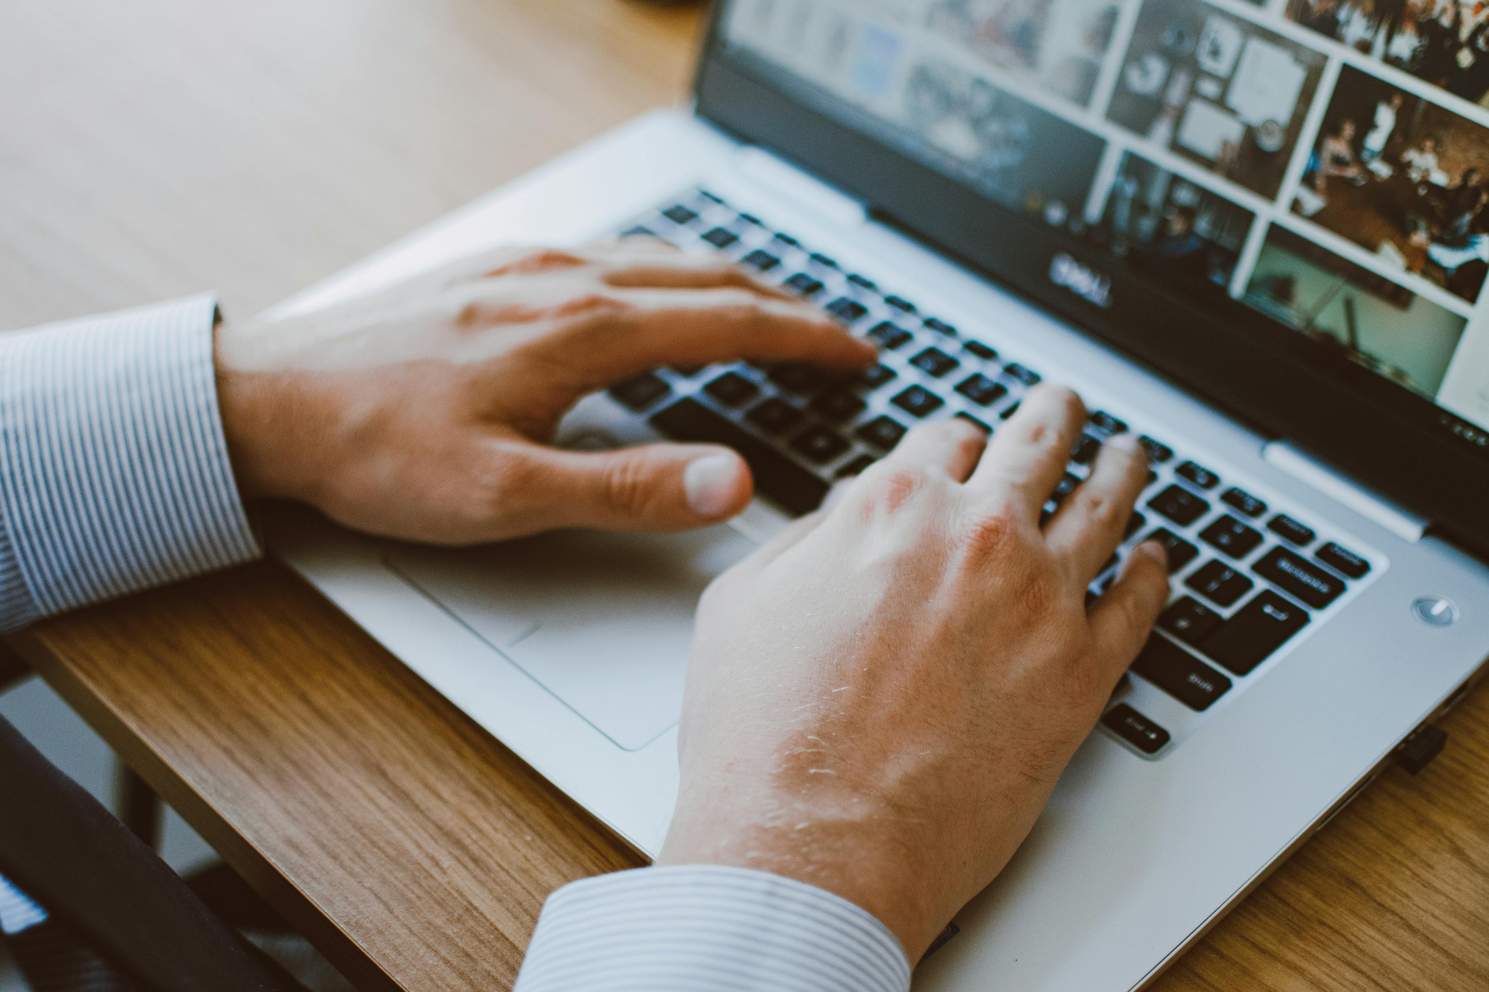
Features and functionality
Attractive profile section with personal details.
Animated skill bars showing technical abilities.
Download Resume button (save as PDF).
Easy-to-update design.
Responsive and mobile-friendly.
Shareable via GitHub/Live Link.

Slide 10
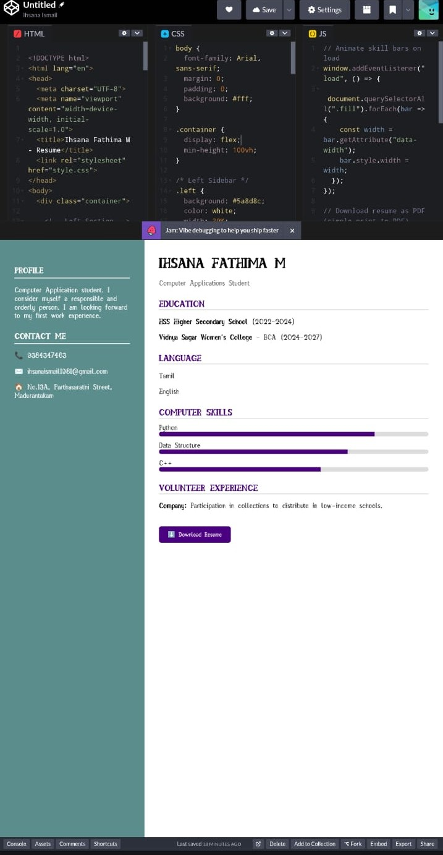
Result and screenshot
The project successfully created an interactive digital portfolio.
It helps in presenting personal, educational, and skill details in an attractive way.
The portfolio is responsive and works on both desktop and mobile.
It includes useful features like resume download and easy navigation.
This project improves professional presentation and career opportunities.6.

Slide 11

conclusion
This project is a simple and interactive digital portfolio made with HTML, CSS, and JavaScript. It helps to show details like education, skills, and experience in a clear way. The design works on both mobile and computer, making it easy for anyone to view. It also allows downloading the resume directly. Overall, the project is useful for students and professionals to share their profile in a professional manner .

Slide 12
Thank you!
2025 - ihsanaismail1981@gmail.com

