Slide 1
Are You Fit for HealthKit?
Igor Kantor
360iDev 2017
Demo App:
https://github.com/Iiiggs/AsthmaBuddy

Slide 2
Igor Kantor
iOS Dev, DaVita, Mobile Community of Excellence
Live in Denver, 4 years
7 month old baby girl
@Iiiggs

Slide 3

Notes:
We are in Colorado
Beautiful mounaints

Slide 4
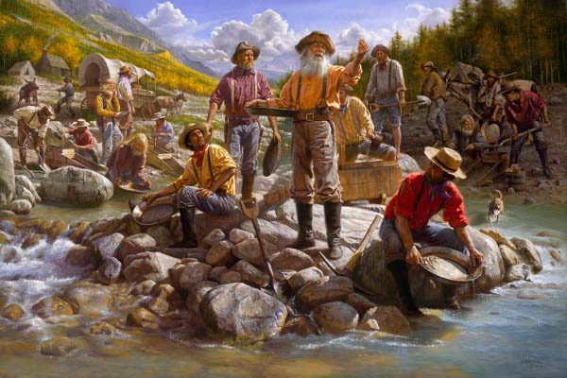
Notes:
- Gold rush played a part in getting people here starting in 1859

Slide 5
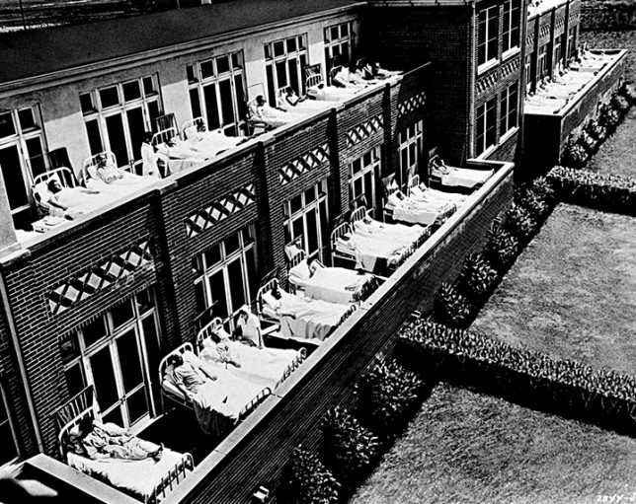
Notes:
- TB was top killer of Americans in late 1800s and early 1900s
No cure at the time, so healthcare providers urged people to head out of cities to places like Colorado
In the 1880s and 1890s, it is estimated that one-third of the people living in Colorado Springs had tuberculosis
By one estimate, 60 percent of the state’s population in 1925 came to Colorado because of TB.
Fortunately a cure was developed during WW II

Slide 6
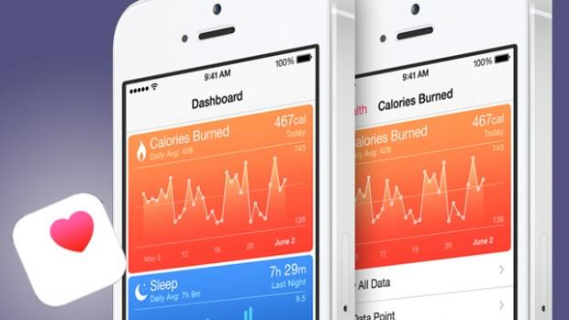
Notes:
Fortunately we have come a long way in both treatment of disease and wellness monitoring
Apple introduced HealthKit in 2014 with iOS 8

Slide 7
https://www.linkedin.com/pulse/connecting-ios-your-emr-using-healthkit-cda-part-two-eric-whitley

Slide 8
Roadmap
HealthKit Type System Explained
Building AsthmaBuddy with HealthKit, ResearchKit, MapKit
Get the sample code: https://github.com/Iiiggs/AsthmaBuddy
HIPPA Compliance and You

Slide 9
I. HealthKit Types Explained

Slide 10
HKHealthStore
Private data store on device
isHealthDataAvailable()
requestAuthorization(toShare: read:[…])
Notes:
The HealthKit store acts as your link to all the data managed by HealthKit. Use a HKHealthStore object to request permission to share or read HealthKit data. Once permission is granted, you can use the HealthKit store to save new samples to the store, or to manage the samples that your app has saved. Additionally, you can use the HealthKit store to start, stop, and manage queries.

Slide 11
HKObjectType (Abstract)
Concrete Subclasses
HKCharacteristicType – things that don’t change
HKActivitySummaryType - EXAMPLE
HKSampleType – measurement over time
Notes:
HealthKit uses HKObjectType instances to store type information about data saved in the HealthKit store.

Slide 12
HKCharacteristicType
biologicalSex
bloodType
dateOfBirth
[…]
Notes:
The HKCharacteristicType class is a concrete subclass of the HKObjectType class. HealthKit uses characteristic types to represent data that does not typically change over time. Unlike the other object types, characteristic types cannot be used to create new HealthKit objects. Instead, users must enter and edit their characteristic data using the Health app. Characteristic types are used only when asking for permission to read data from the HealthKit store.

Slide 13
HKSampleType (Type, Start Date, End Date)
Concrete Subclasses
HKCategoryType
HKCorrelationType
HKQuantityType
HKWorkoutType
HKDocumentType
Examples:
In Bed/Asleep/Awake
120/80 Blood Pressure
1,000 Steps between 7:45 and 9:00
Basketball beteween 10:30 and 12:30
Clinical Document Architecture (XML)
Notes:
CDA: http://searchhealthit.techtarget.com/definition/Clinical-Document-Architecture-CDA

Slide 14
HKSample Abstract
Type, Start, End
Saved in HealthKitStore
HKQuantitySample
HKCategorySample
HKDocumentSample
Notes:
A HealthKit sample represents a piece of data associated with a start and end time. If the sample represents data over a duration, the start time must be earlier than the end time. If the sample represents data at a particular instant, the start and end times can be the same.

Slide 15
HKUnit
let gramUnit = HKUnit.gram()
let meterUnit = HKUnit.meter()
let kiloMeterUnit = HKUnit.meterUnit(with: HKMetricPrefix.kilo)
let hourUnit = HKUnit.hour()
let decileter = HKUnit.literUnit(with: HKMetricPrefix.deci)
let deciletersPerHour = decileter.unitDivided(by: hourUnit)
deciliter
Notes:
The unit class supports most standard SI units (meters, seconds, and grams), SI units with prefixes (centimeters, milliseconds and kilograms) and equivalent non-SI units (feet, minutes, and pounds). HealthKit also supports creating complex units by mathematically combining existing units.
You use units when working with HealthKit quantities. Quantities store both the value (as a double data type) and its corresponding unit. You can then request the value from the quantity in any compatible units. For more information on working with quantities, see HKQuantity.
https://www.natashatherobot.com/healthkit-units/

Slide 16
HKQuantity
let twoGrams = HKQuantity(
unit: gramUnit,
doubleValue: 2.0
)
let threeMeters = HKQuantity(
unit: meterUnit,
doubleValue: 3.0
)
let fiveKilometers = HKQuantity(
unit: kiloMeterUnit,
doubleValue: 5.0
)
let feetIn5K = fiveKilometers.doubleValue(
for: HKUnit.foot()
)
let stonesIn2Grams = twoGrams.doubleValue(
for: HKUnit.stone()
)
Notes:
HealthKit uses quantity objects to store numerical data. Quantities store a value for a given unit. You can request the value in any compatible units. For example, if you can create a length property in feet, you can then request the value in meters. The quantity object automatically converts its value to the requested units, as needed.

Slide 17
HKWorkout
let workout1 = HKWorkout(
activityType: .basketball,
start: startDate,
end: endDate
)
let workout2 = HKWorkout(
activityType: .cycling,
start: startDate,
end: endDate,
workoutEvents: nil,
totalEnergyBurned: nil,
totalDistance: fiveKilometers,
metadata: nil
)
Notes:
The HKActivitySummaryType class is a concrete subclass of the HKObjectType class. Use activity summary type objects when requesting permission to read HKActivitySummary objects from the HealthKit store. To create an activity summary type, use the activitySummaryType()convenience method.

Slide 18
HKQuery
HKAnchoredObjectQuery - Get only new samples
HKCorrelationQuery - Query correlated samples
HKObserverQuery - Callback for new samples – also in background
HKSampleQuery - Query for sample data
HKSourceQuery - Sources (apps and devices) of sample type
HKStatisticsQuery - Aggregating (avg/min/max/sum) of sample type
HKStatisticsCollectionQuery - Aggregations with time interval
Notes:
The HKQuery class is the basis for all the query objects that retrieve data from the HealthKit store. The HKQuery class is an abstract class. You should never instantiate an HKQuery object directly. Instead, you always work with one of its concrete subclasses: HKAnchoredObjectQuery, HKCorrelationQuery, HKObserverQuery, HKSampleQuery, HKSourceQuery, HKStatisticsQuery, or HKStatisticsCollectionQuery objects.

Slide 19
HKSampleQuery
let workoutType = HKObjectType.workoutType()
let runPredicate =
HKQuery.predicateForWorkoutsWithWorkoutActivityType(HKWorkoutActivityType.Running)
let sampleQuery =
HKSampleQuery(
sampleType:workoutType ,
predicate: runPredicate,
limit: 100,
sortDescriptors: nil)
{ (sampleQuery, samples, error) in
// if no error, samples will be [HKWorkout]
}

Slide 20
HKStatisticsCollectionQuery
Notes:
https://developer.apple.com/documentation/healthkit/hkstatisticscollectionquery
https://developer.apple.com/documentation/healthkit/hkstatisticsquery

Slide 21
Missing In HealthKit
No HKQuantities arithmetic
Interop with other health systems
More HKDocumentSample formats
Image support
Notes:
Since the predicates are executed by the store, you are limited in the type of predicates that you can use. Specifically, HealthKit provides a number of predicate key paths (for example, HKPredicateKeyPathUUID and HKPredicateKeyPathMetadata). You can create predicates using only these key paths.

Slide 22
II. Build AsthmaBuddy
https://github.com/Iiiggs/AsthmaBuddy

Slide 23
Roadmap
Ask user for permissions to access characteristics + inhaler usage and to write inhaler usage
Retrieve user characteristics: gender and dob
Insert inhaler usage sample into HealthKit
Including location metadata
Retrieve inhaler usage
Visualize on line chart
Plot on map

Slide 24
Project Config and Navigation
Link HealthKit/MapKit/ResearchKit
HealthKit in Target’s Capabilities
Info.plist Usage Descriptions
HealthKit Share
HealthKit Update
Location Services - When In Use
Basic Navigation Using Two Embedded View Controllers

Slide 25
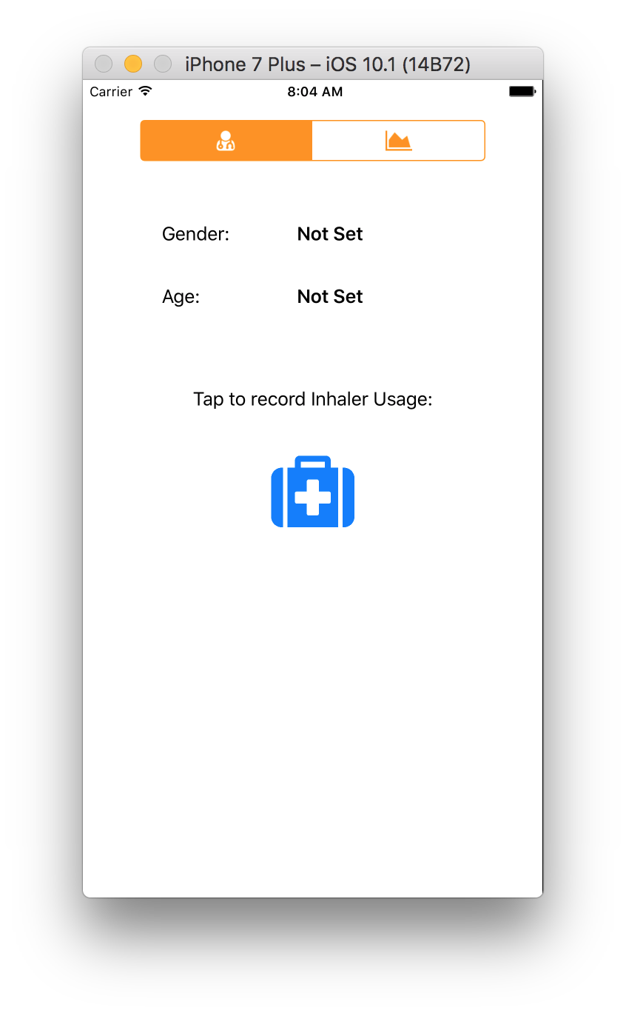
Shell App

Slide 26
Initialize HKHealthStore
class HealthKitAdapter: NSObject {
static let sharedInstance = HealthKitAdapter()
private let healthKitStore = HKHealthStore()
// [...]
}
HealthKitAdapter
Notes:
HealthKitAdapter

Slide 27
Request Authorization for HealthKit
//[STEP 1]: Authorization
let typesToShare : Set = [inhalerUsageQuantitityType]
let typesToRead : Set = [
inhalerUsageQuantitityType,
dobCharacteristicType,
genderCharacteristicType]
if(HKHealthStore.isHealthDataAvailable()){
self.healthKitStore.requestAuthorization(
toShare: typesToShare,
read: typesToRead,
completion: { (success, error) in
// notify view controllers about healthkit available
})
}
}
Re-copy code with highlighting

Slide 28
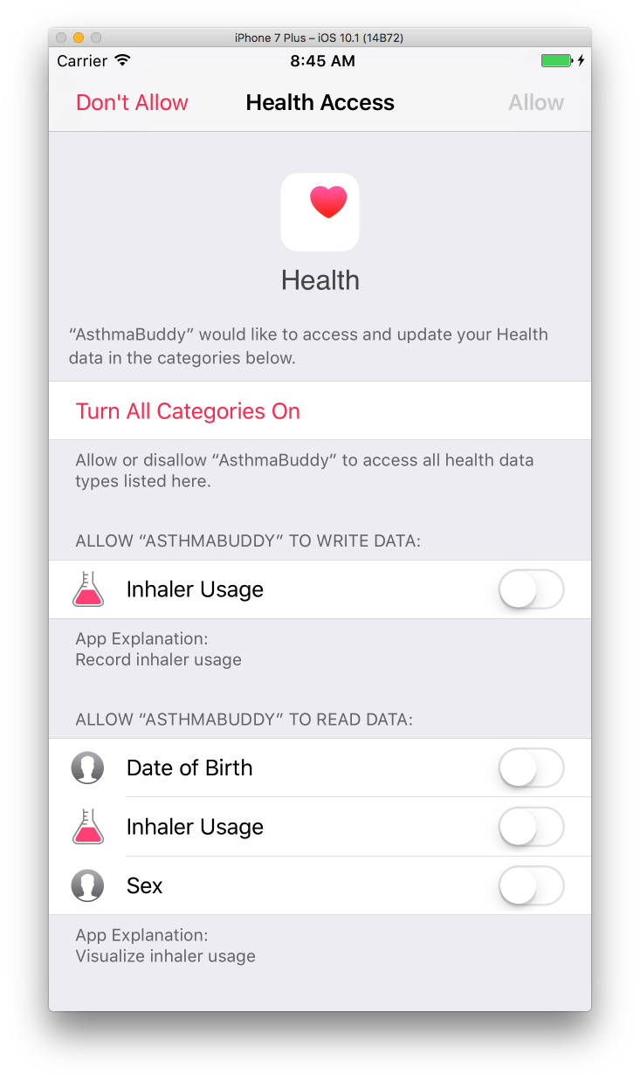
Authorization Sheet

Slide 29
Query Demographics from HealthKit
// [STEP 2]: Characteristic types
do {
let dob = try healthKitStore.dateOfBirthComponents().date!
let gender = try healthKitStore.biologicalSex()
// pass demos to ui
} catch {
// handle error
}

Slide 30
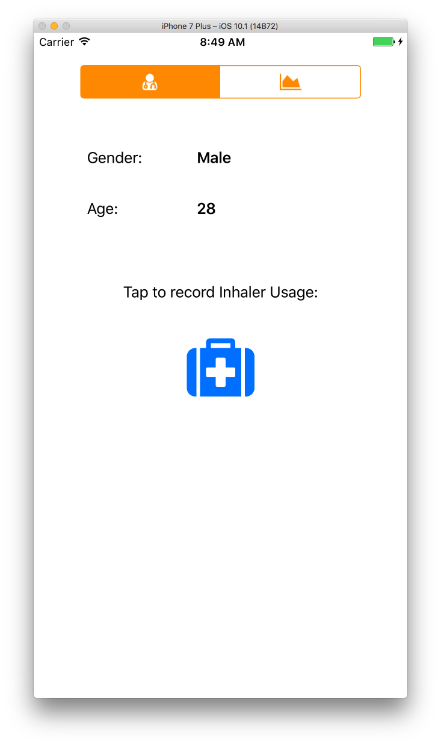
Demographics Screen
Notes:
If still not set, check health app, profile icon
Extra slide for Health app

Slide 31
Share samples to HealthKit
let sample = HKQuantitySample(
type: HKSampleType.quantityType(
forIdentifier: .inhalerUsage)!,
quantity: quantityOne,
start: date,
end: date
)
healthKitStore.save(sample) { (success, error) in
// handle success
}

Slide 32
Record usage
Notes:
If still not set, check health app, profile icon
Extra slide for Health app

Slide 33
Include some metadata
let coordinateString = "\(lat),\(lon)"
let sample = HKQuantitySample(
type: inhalerUsageQuantitityType,
quantity: quantityOne,
start: date,
end: date,
metadata: [usageLocationKey:coordinateString]
)
healthKitStore.save(sample) { (success, error) in
print("saved one use to health kit, with location")
}
Notes:
Metadata can only contain string, date or number. So only serializing coordinates from CLLocation

Slide 34
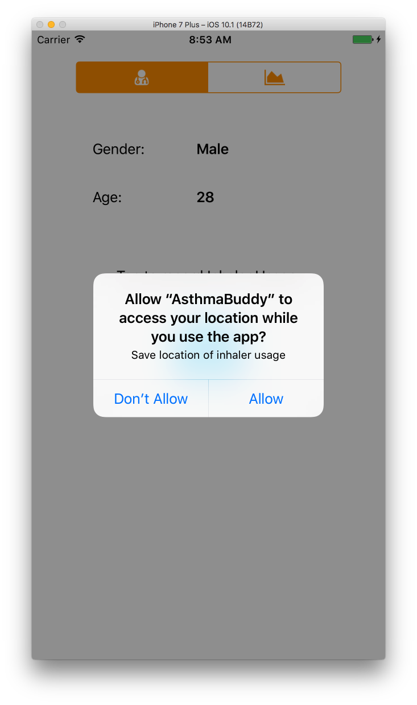
Inhaler Usage with Location
Notes:
Default location is Bay Area, if you want to use simulator, pick denver from list
On device, should be more scattered

Slide 35
Query Inhaler Usage from HealthKit
let query = HKSampleQuery(
sampleType: inhalerUsageQuantitityType,
predicate: nil,
limit: 100,
sortDescriptors: nil) { (query, samples, error) in
completion(samples as? [HKQuantitySample])
}
self.healthKitStore.execute(query)

Slide 36
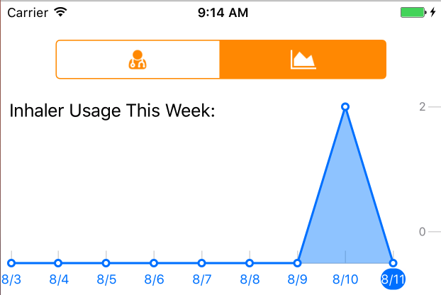
ResearchKit Charts
ORKLineGraphChartView
ORKValueRangeGraphChartViewDataSource
dataPointForPointIndex
numberOfDataPointsForPlotIndex
numberOfPlots
titleForXAxisAtPointIndex
Notes:
Was easy to work with
Research kit also has bar charts
If we don’t’ care about the class names, just leave them out
Trim out the status bar

Slide 37
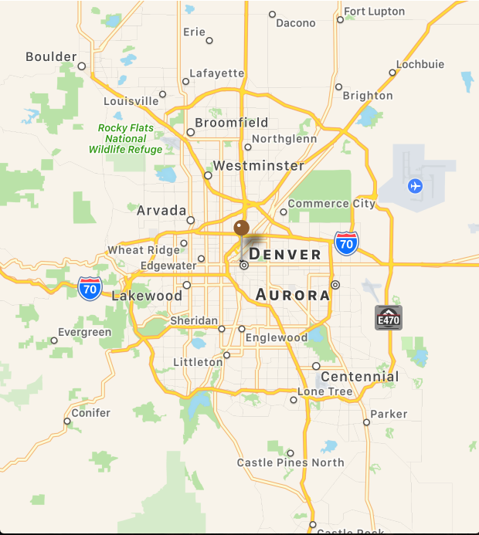
Map Visualization
MKMapView
MKMapViewDelegate
viewForAnnotation
extend HKQuantitySample implement MKAnnotation
Add annotations to MKMapView
Notes:
GPX with mountain drive

Slide 38
Demo
Notes:
Open AsthmaBuddy
Real device or simulator with GPX?

Slide 39
III. HIPAA And You

Slide 40
HIPPA Is…
Health Insurance Portability and Accountability Act
You must protect PHI
Minimize use and sharing of PHI
Agreements with Business Associates to safeguard PHI
Training and procedures to protect PHI
Notes:
passed in 1996, and among other things, outlines the requirements for the management of, storage and transmission of protected health information (PHI) in both physical and digital form

Slide 41
PHI
CHI
Billing information from your doctor
Email to your doctor's office about a medication or prescription you need.
Appointment scheduling note with your doctor's office
An MRI scan
Blood test results
Phone records
Examples of non-PHI data:
Number of steps in a pedometer
Number of calories burned
Blood sugar readings w/out personally identifiable user information (PII) (such as an account or user name)
Heart rate readings w/out PII
Not identifiable
Not shared with covered entity

Slide 42
Covered Entity and Business Associates
Covered Entity is anyone who provides treatment, payment and operations in healthcare.
Hospital
Dialysis Clinic
Doctor’s Office
Insurance Provider
Business Associate is a vendor or subcontractor who has access to PHI.
Email vendor
Cloud storage provider
Payment platform
Notes:
Covered Entities Include:
Doctor’s office, dental offices, clinics, psychologists,
Nursing home, pharmacy, hospital or home healthcare agency
Health plans, insurance companies, HMOs
Government programs that pay for healthcare
Health clearing houses

Slide 43
Technical Safeguards
Access Control Requirements
Unique User Identification (required): Assign a unique name and/or number for identifying and tracking user identity.
Emergency Access Procedure (required): Establish (and implement as needed) procedures for obtaining necessary ePHI during an emergency.
Automatic Logoff (addressable): Implement electronic procedures that terminate an electronic session after a predetermined time of inactivity.
Authentication (required): Implement procedures to verify that a person or entity seeking access to ePHI is the one claimed.
Encryption and Decryption (addressable): Implement a mechanism to encrypt and decrypt ePHI.
Transmission Security
Integrity Controls (addressable): Implement security measures to ensure that electronically transmitted ePHI is not improperly modified without detection until disposed of.
Encryption (addressable): Implement a mechanism to encrypt ePHI whenever deemed appropriate.
Audit and Integrity
Audit Controls (required): Implement hardware, software, and/or procedural mechanisms that record and examine activity in information systems that contain or use ePHI.
Mechanism to Authenticate ePHI (addressable): Implement electronic mechanisms to corroborate that ePHI has not been altered or destroyed in an unauthorized manner.

Slide 44
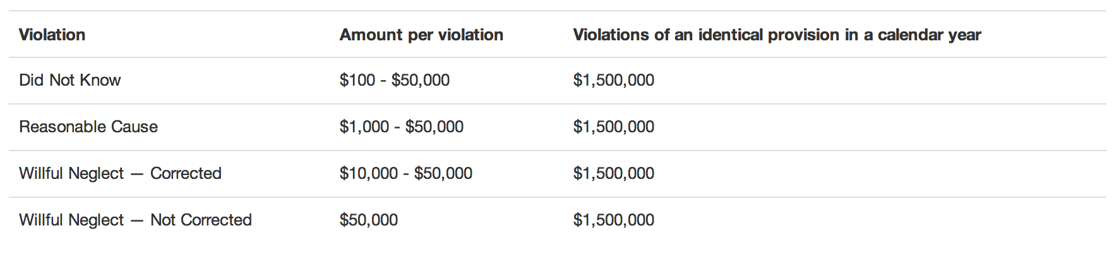
HIPPA Fines
Source: HHS, Federal Register.gov
Notes:
If you can pay these

Slide 45
Apps
Push Notifications
Emails/automated calls
Integrations
Encryption
Lock screen
Enabling remote wiping of lost phones
Notes:
Hosting
Network and application security
High-Availability and Redundancy
PaaS
TrueValut
AWS?

Slide 46
Thank you
DaVita (MCoE) is hiring iOS and DevOps: http://careers.davita.com

