Slide 1

On Stocks’ % Price change and Ratios: EDA
By Radjamin hukom

Slide 2
On the Data
Rows = 503 tickers of S&P500
Columns = Ticker + Beta + 12 financial ratios * 5 years + % Price Change = 63
Problems:
Missing values
Outliers

Slide 3
Financial Ratios
Ratio | Meaning | E(sign)
Beta | Indicates the stock’s risk relative to the market | -
EPS | Shows profitability per share | +
ROE | Measures how efficiently equity generates profit | +
ROA | Reflects how effectively assets generate profit | +
Gross Margin | Reveals profitability after production costs | +
Operating Margin | Indicates how well operations generate profit before interest and taxes. | +
Net Profit Margin | Shows overall profitability after all expenses | +
Cash Ratio | Assesses short-term liquidity | +
Current Ratio | Measures short-term financial health | +
Quick Ratio | Evaluates liquidity without relying on inventory | +
Asset Turnover | Shows how efficiently assets generate revenue | +
Inventory Turnover | Reflects how quickly inventory is sold | +
Receivables Turnover | Measures how fast credit sales are collected | +

Slide 4
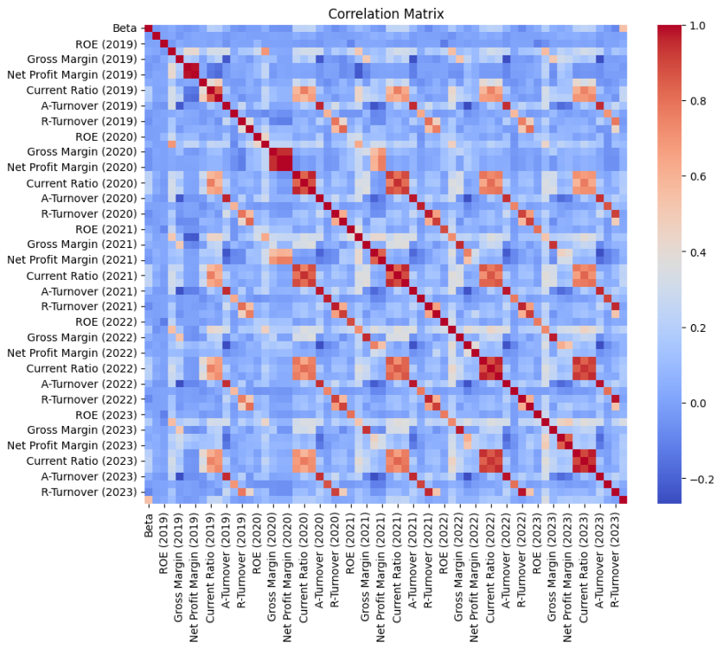
Important point:
There’s similar patterns over the years

Slide 5
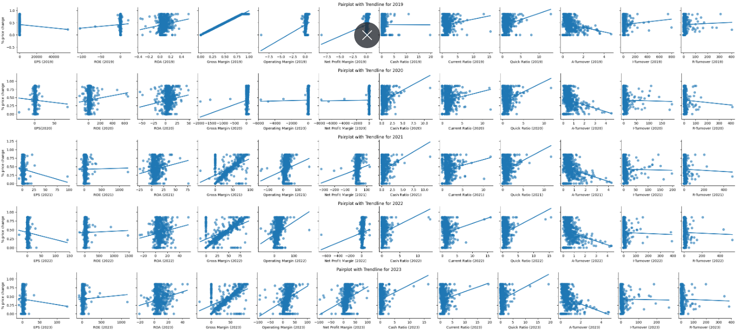

Slide 6
Ratios and % Price Change (Correlation)
Year | Ratio
2019 | Gross Margin***, Operating Margin, Net Profit Margin, Quick Ratio
2020 | Gross Margin**, Cash Ratio
2021 | Gross Margin**, Cash Ratio, Quick Ratio
2022 | Gross Margin**, Operating Margin
2023 | Gross Margin**, Operating Margin, Net Profit Margin

Slide 7
Ratios and % Price Change (Regression)
Year | <.05 | <.1
2019 | Gross Margin, Cash Ratio
2020 | ROA, Gross Margin, Current Ratio, Quick Ratio, A-Turnover | EPS, Net Profit Margin
2021 | Gross Margin Current Ratio, A-Turnover | EPS, Quick Ratio
2022 | Gross Margin, Operating Margin, Current Ratio, A-Turnover
2023 | Gross Margin, Operating Margin, Current Ratio, A-Turnover

Slide 8
Years Ranked by Adjusted R^2
2019: 0.996220
2022: 0.367828
2023: 0.350413
2021: 0.331874
2020: 0.241247

