Slide 1
Samsung
Innovation
Campus
Artificial Intelligence Course

Slide 2
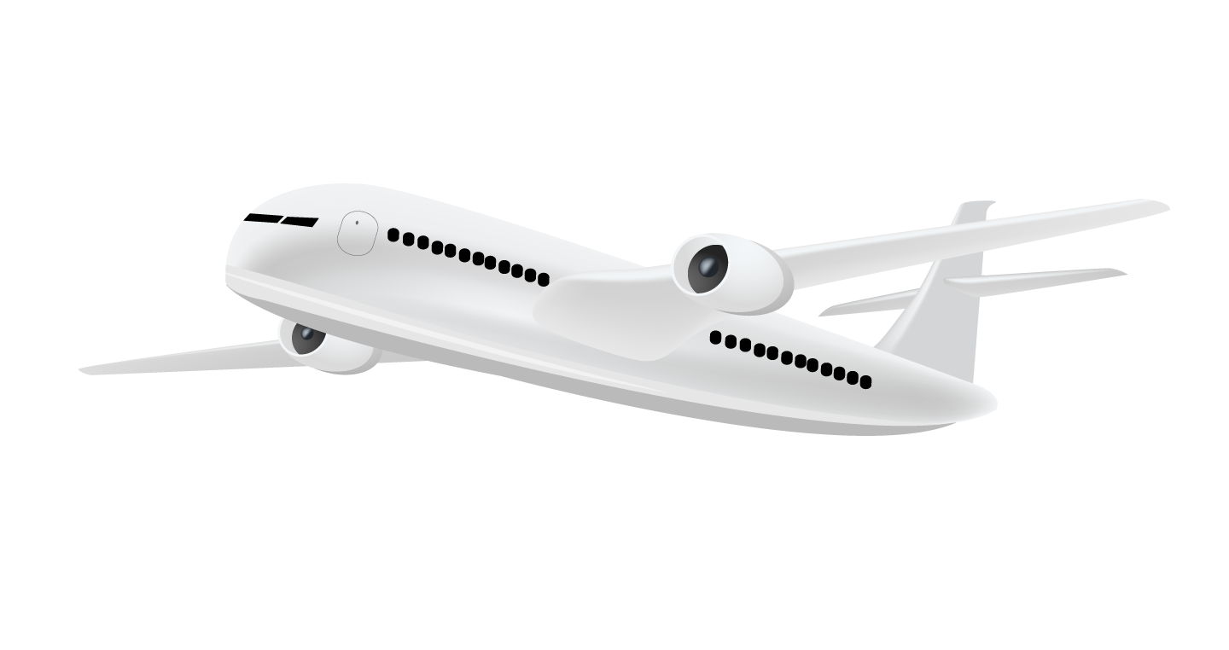
Airline Business Plan
Peter Yasser & Injy ElSherbini,
Egypt.
3 October 2022

Slide 3
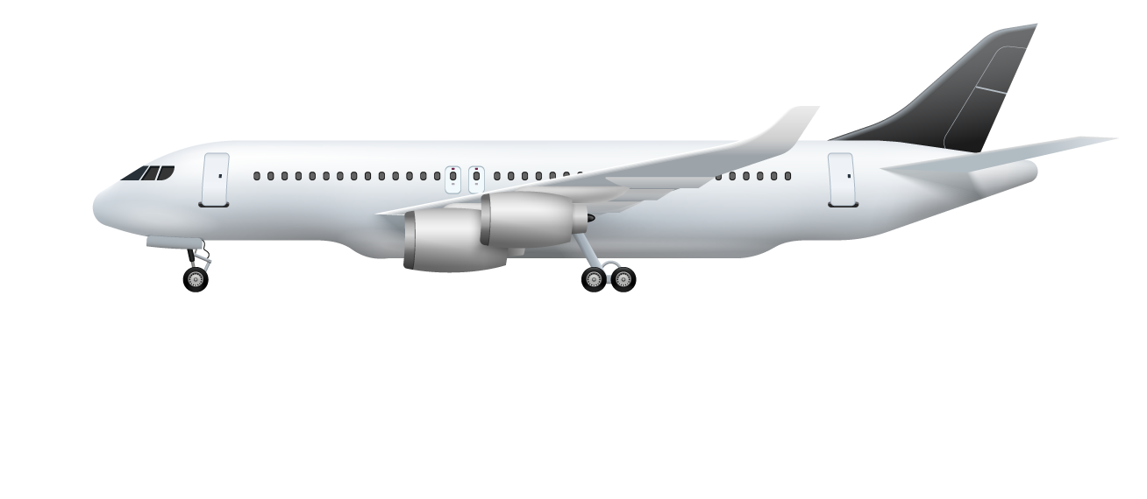
Our team
Peter Yasser
You can speak a bit about this person here
Injy ElSherbini
You can speak a bit about this person here
Supervised by
Ziad Omar
You can speak a bit about this person here

Slide 4
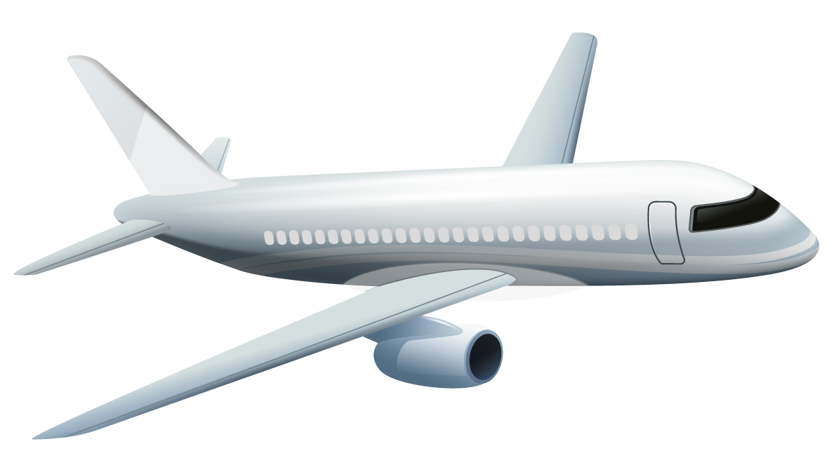
Table of contents
01
02
03
Introduction
Steps we followed
Data description
Problem VS. solution
What steps did we follow to make a business plan
What are we dealing with
04
05
06
The right model
Evaluating
Business plan
Choosing the best model
Is it really the right model
How can we make customers more satisfied

Slide 5

Let’s begin our flight!

Slide 6
01
Introduction
What do we want to achieve

Slide 7
Problem vs. solution
Problem
We need to know on which aspect of the services offered have to be emphasized more to generate more satisfied customers.
Solution
Use AI to predict whether a future customer would be satisfied with their service given the details of the other parameters values.

Slide 8
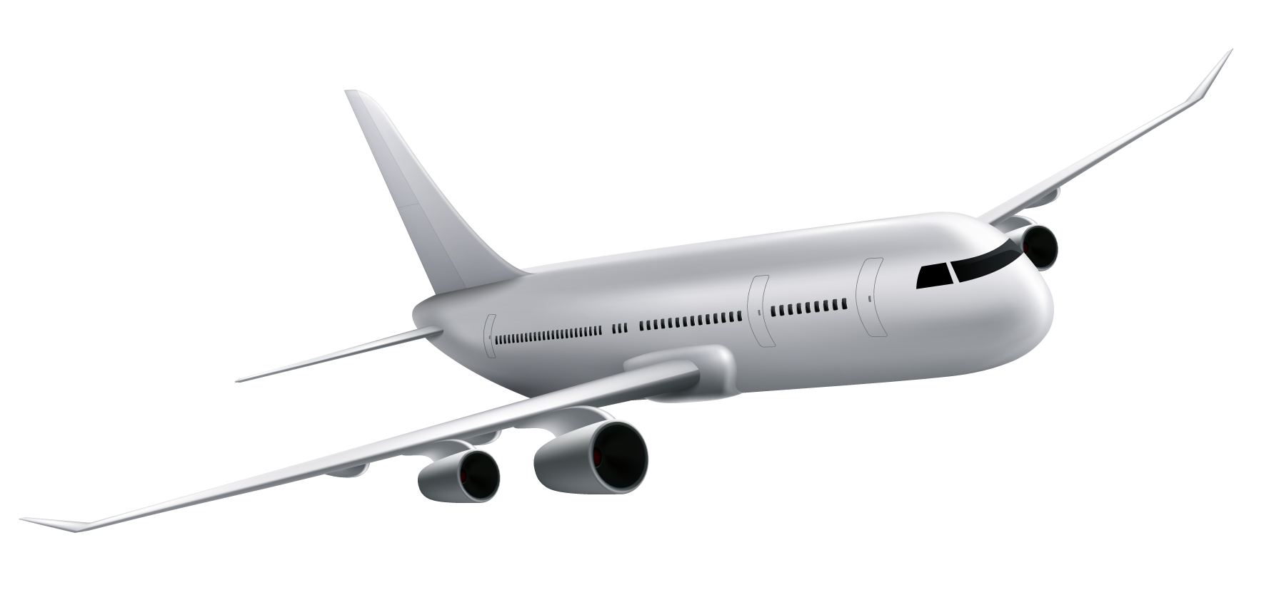
02
Steps we followed
How we can achieve it

Slide 9
Our process
Step 2
Step 4
Data cleaning and encoding
Deductions
Step 1
Step 3
EDA and visualization
Modeling and evaluating

Slide 10
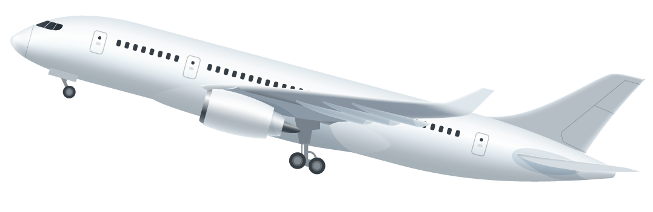
03
Data description
What are we dealing with

Slide 11

129,880
Customer feedback.

Slide 12
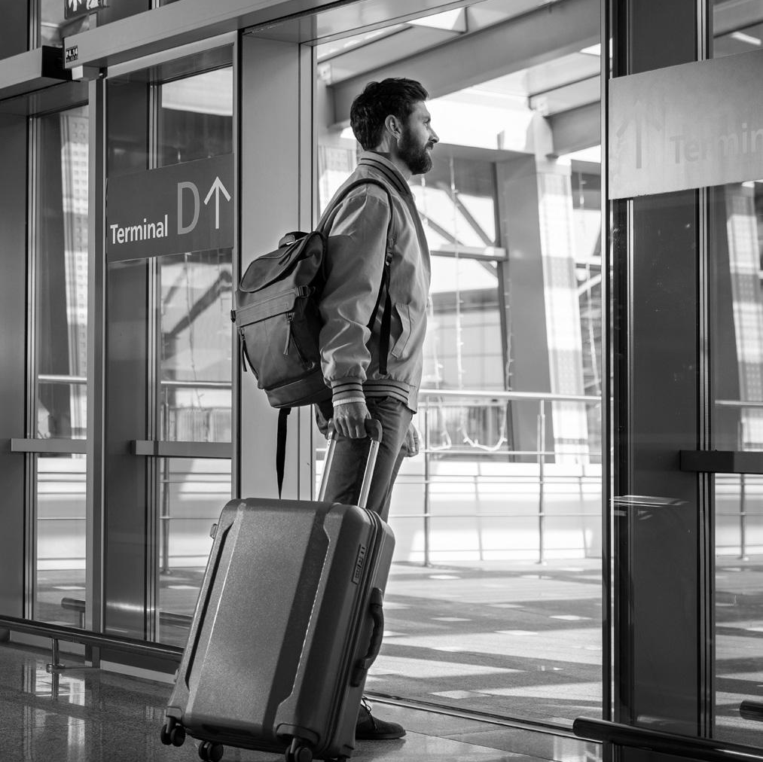
Our dataset has
23 columns (4 with outliers)
129,880 rows (393 with NULLs)
dtypes: float64(1), int64(17), object(5)

Slide 14
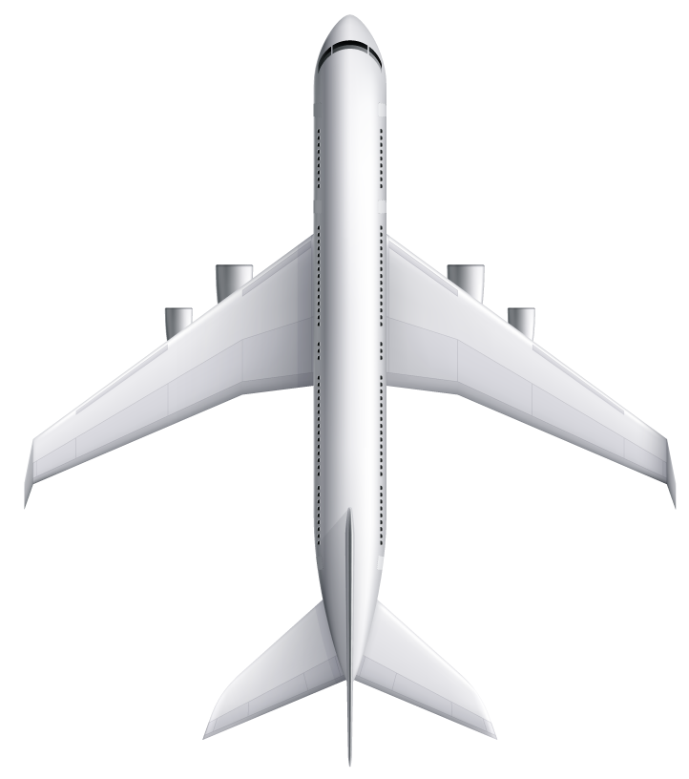
Thanks!
Any questions?

