Slide 1
Samsung
Innovation
Campus
Artificial Intelligence Course

Slide 2
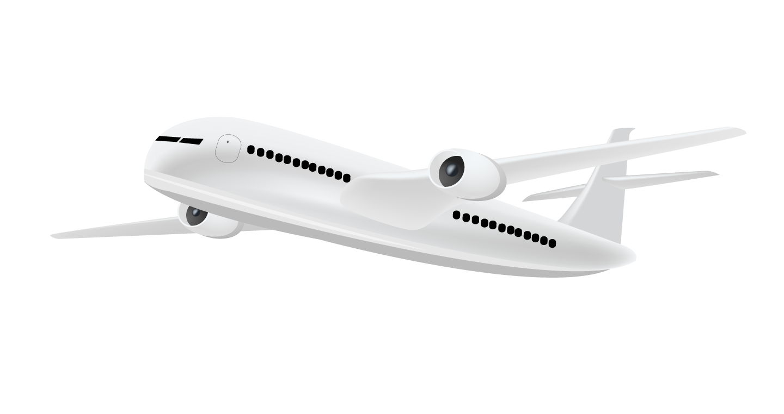
Airline Business Plan
Peter Yasser & Injy ElSherbini,
Egypt.
6 October 2022

Slide 3
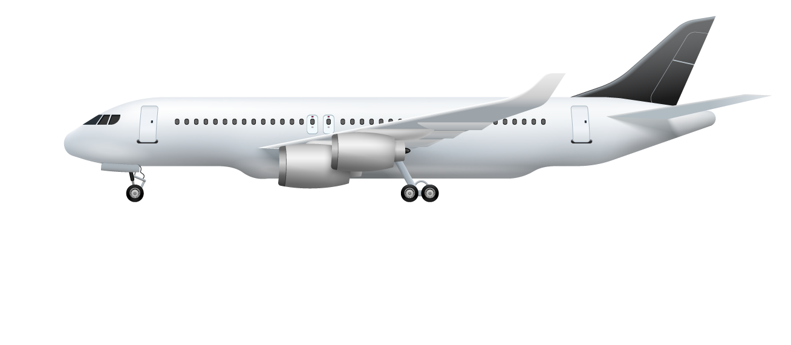
Our team
Peter Yasser
Engineering student
Injy ElSherbini
Computer science student
Supervised by
Ziad Omar
SIC facilitator

Slide 4
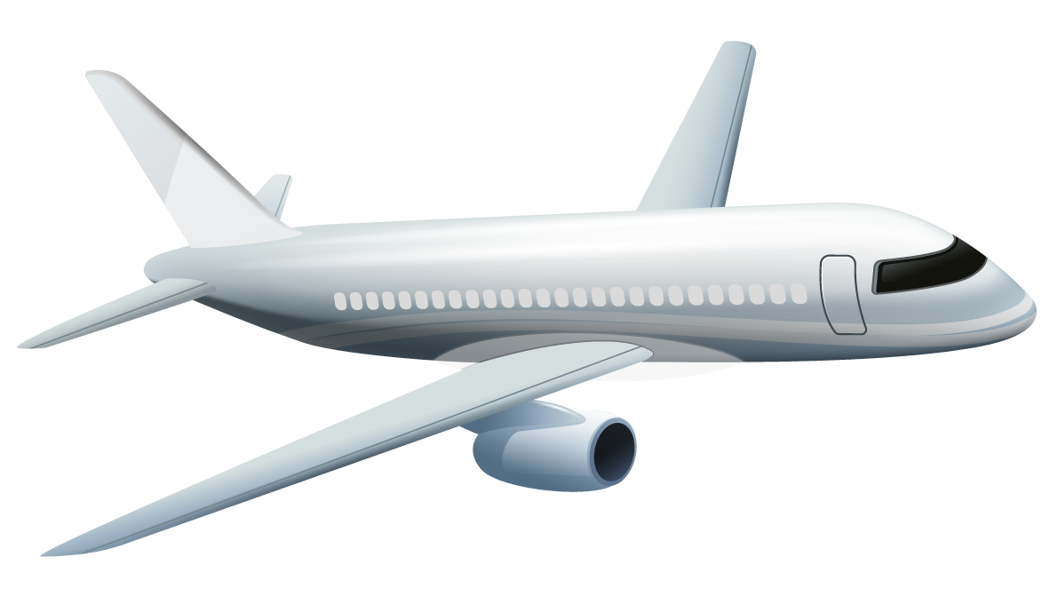
Table of contents
01
02
03
Introduction
Steps we followed
Data description
Problem VS. solution
What steps did we follow
What are we dealing with
04
05
06
EDA and deductions
The right model
Evaluating
Visualization and suggestions
Choosing the best model
Is it really the right model

Slide 5

Let’s begin our flight!

Slide 6
01
Introduction
What do we want to achieve?

Slide 7
Problem vs. solution
Problem
We need to know on which aspect of the services offered have to be emphasized more to generate more satisfied customers.
Solution
Use AI to predict whether a future customer would be satisfied with their service given the details of the other parameters values.

Slide 8
Our services
Online booking
Inflight Wi-Fi
Customers can book their tickets online
We offer wi-fi service in flight
Food and drink
Inflight entertainment
Customers can have food and drink inflight
Such as inflight TV and games
On-board service
Online boarding
Our flight attendants are always in service
Customers can choose their seats online

Slide 9
Our services (cont.)
Seat comfort
Cleanliness
We aim to make our customers comfortable
Keeping airplanes neat and clean
Baggage handling
Inflight service
Our rampers will carefully carry them
improve our customers' flying experience
Leg room service
Check in service
Our airplane seats has legroom
approve our customers to board an airplane

Slide 10
Target
Gender
Age range
< 20
9.4%
51%
Female
21-40
40%
49%
Male
41-60
41.3%
> 60
9.4%
Class
Business
Economy plus
Economy

Slide 11
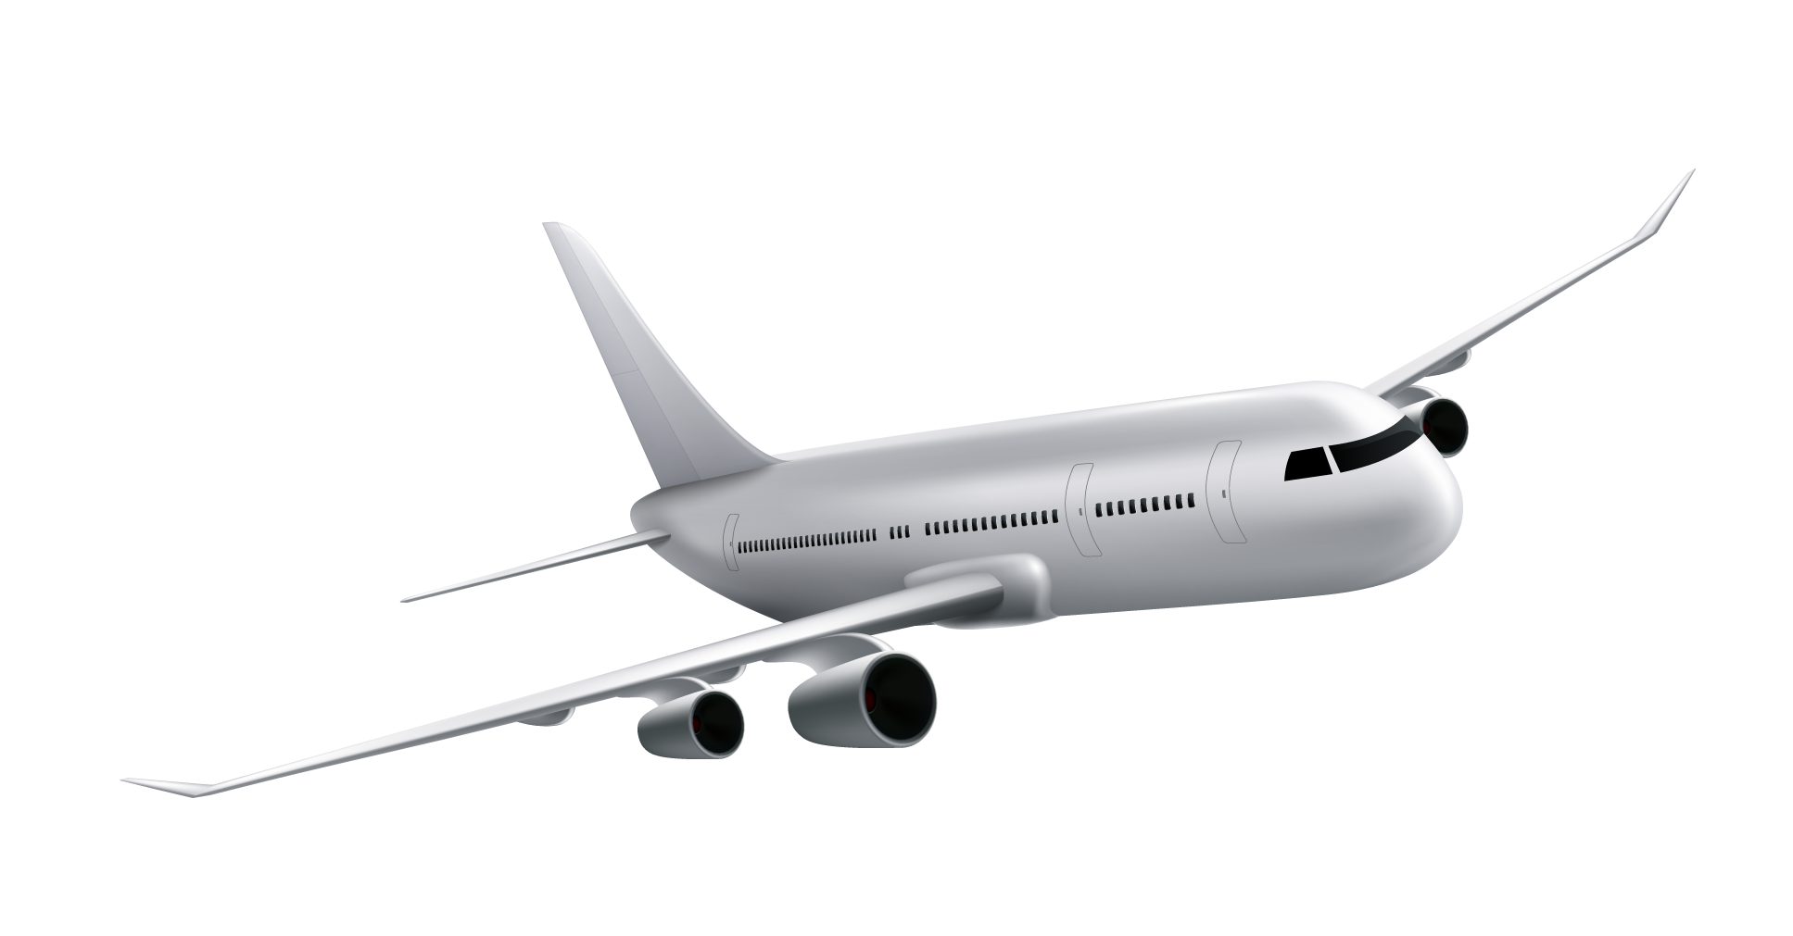
Satisfaction
Satisfied
Dissatisfied
54.7%
45.3%
More than 50% of our customers are satisfied with our services.
About 45% of our customers are dissatisfied with our services.

Slide 12
02
Steps we followed
How we can achieve it

Slide 13
Our process
Step 2
Step 4
Conclutions and some Recommendations
Modeling and evaluating
Step 1
Step 3
EDA and visualization
Data cleaning and feature engineering

Slide 14
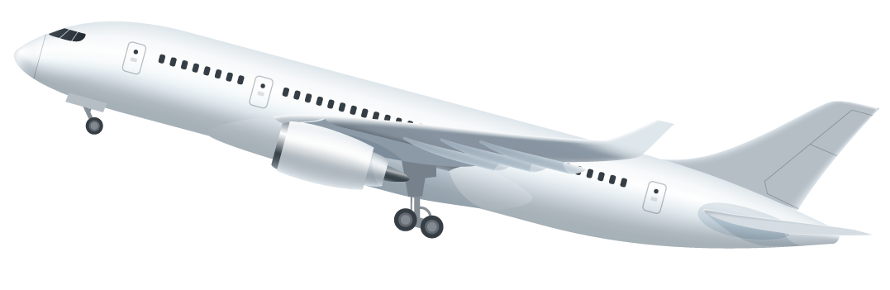
03
Data description
What are we dealing with

Slide 15

129,880
Customer feedback.

Slide 16
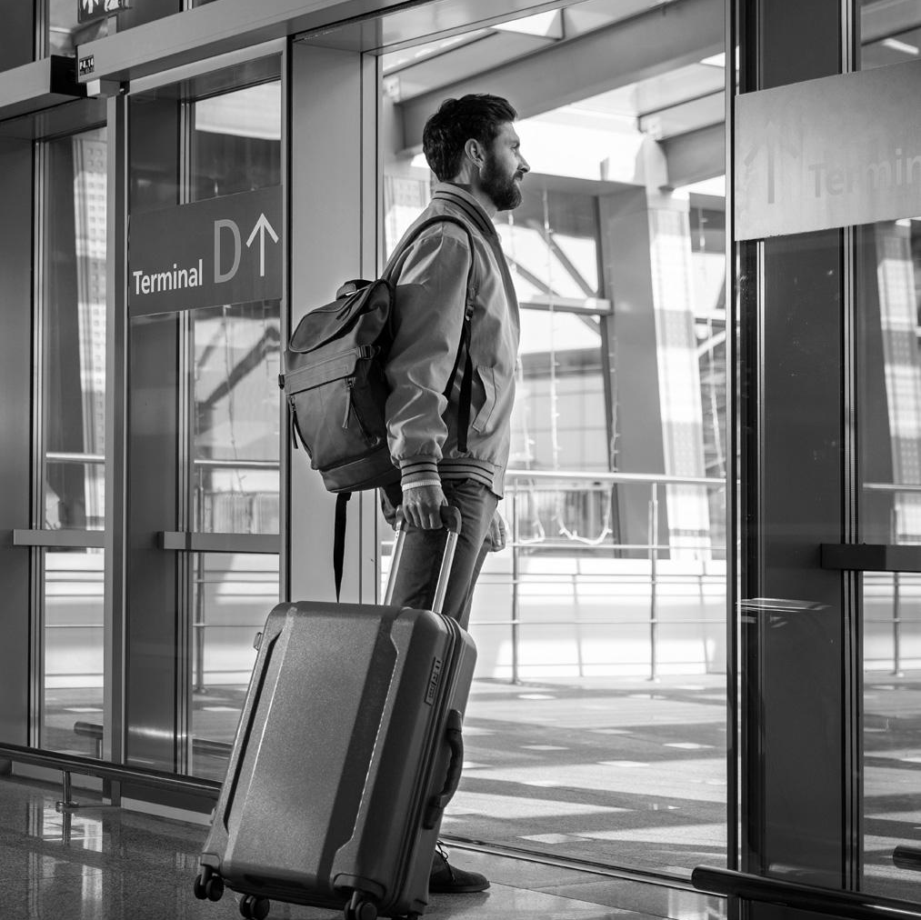
Our dataset has
23 columns
129,880 rows
dtypes: float64(1), int64(17), object(5)

Slide 17
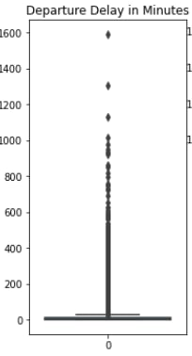
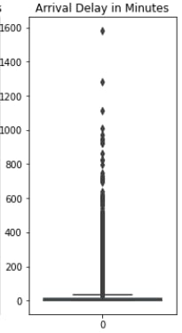
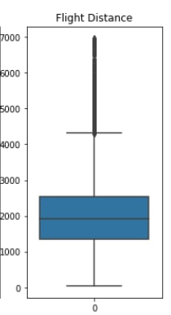
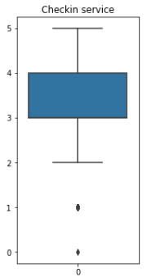
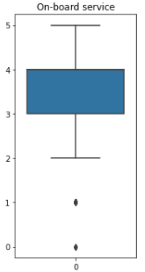
Outliers
Our dataset has 5 columns with outliers :
“Departure delay” , “Arrival delay” , “Flight distance” , “Checkin service” , and “On-board Service”

Slide 18
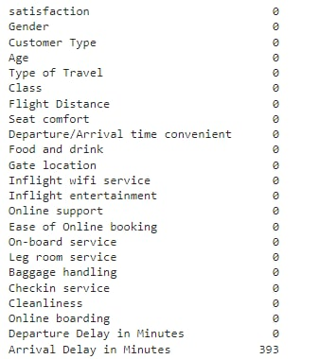
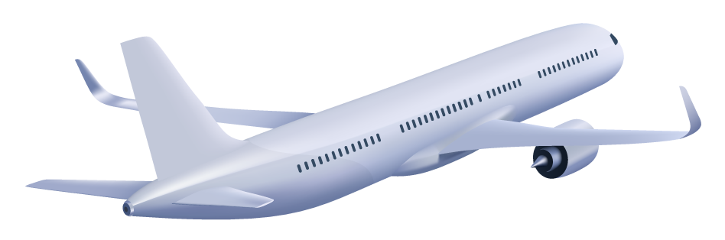
Nulls
Our dataset has Nulls in “Arrival delay in munites” column.

Slide 19
04
EDA and suggestions
How can we increse satisfaction level

Slide 20
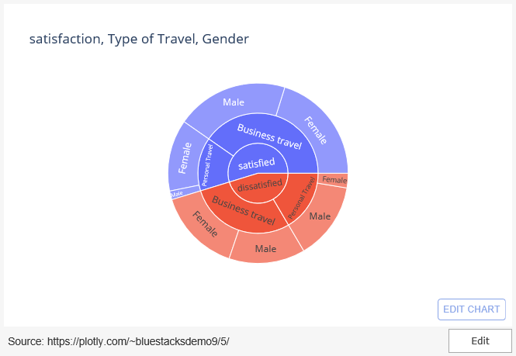
Relation between gender , type of travel and satisfaction
Apparently, “Men” are less satisfied in “Personal travel”

Slide 21
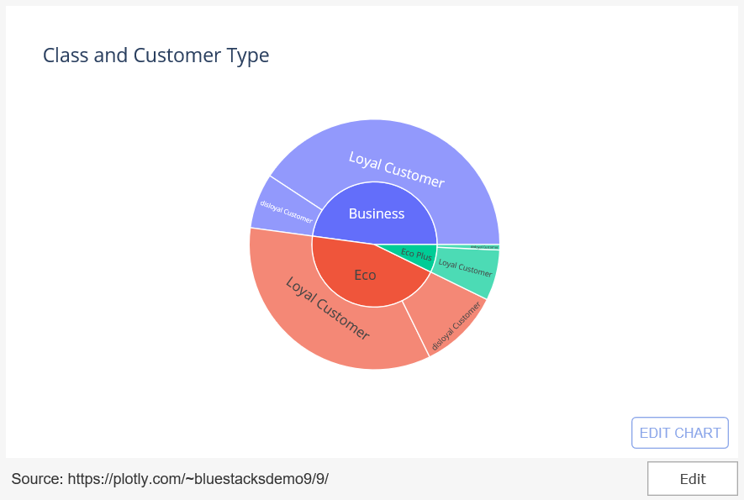
customer type analysis
Seems like we are not attracting new customers, as we have many “disloyal customers”

Slide 22
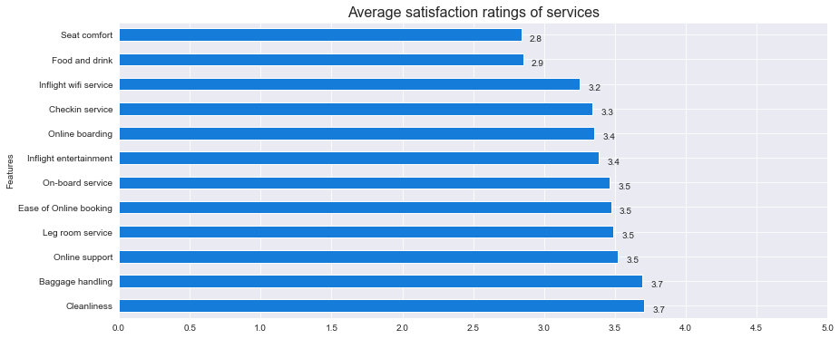
Services rating
Are our customers satisfied with our services?

Slide 23
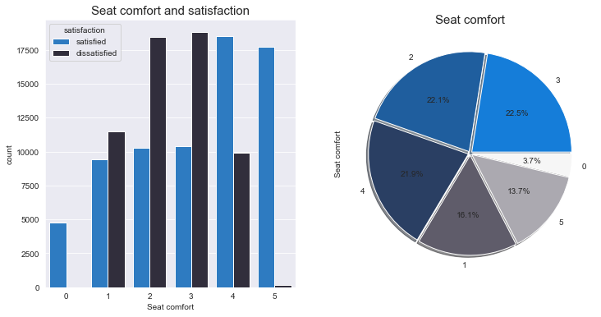
Seat comfort analysis
Apparently, there is a relation between “seat comfort” and “satisfaction level”

Slide 24
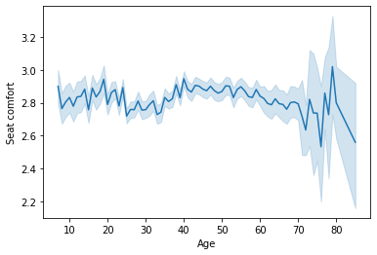
Seat comfort analysis (cont.)
We can say that most ages are not satisfied with “seat comfort”

Slide 25
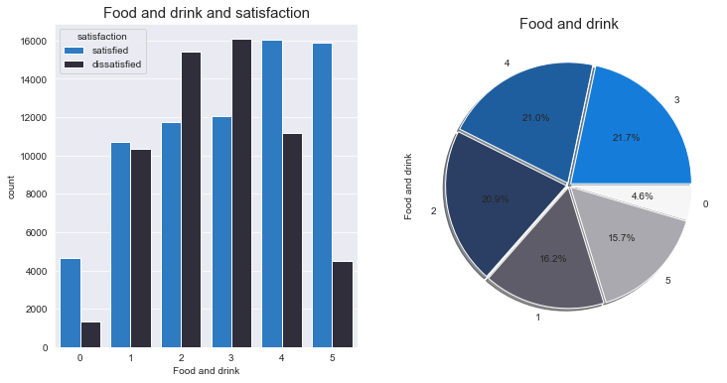
Food and Drink analysis
Apparently, there is a relation between “food and drink” and “satisfaction level”

Slide 26
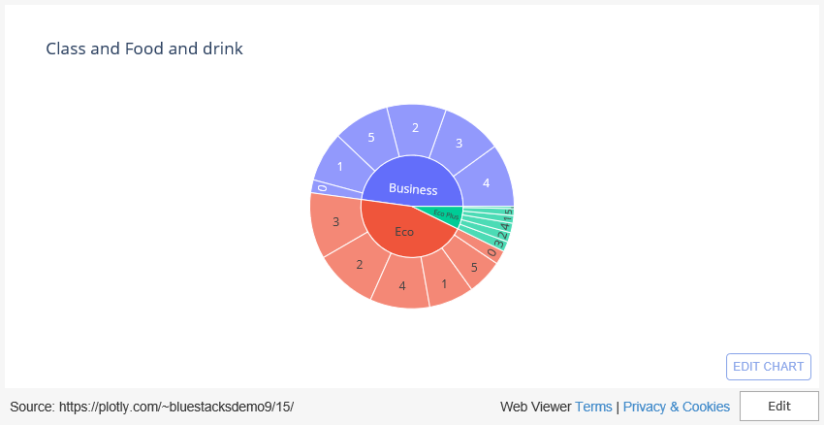
Food and Drink analysis (cont.)

Slide 27
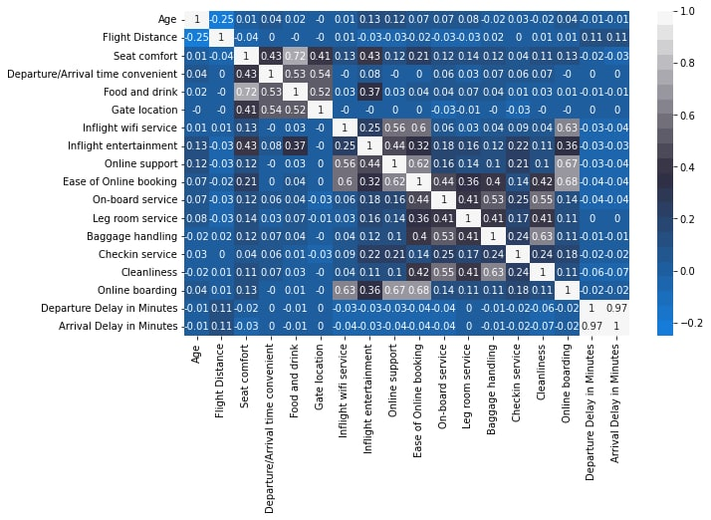
Heatmap to visualize correlation between variables

Slide 28
From the previous heat map
“Departure delay in minutes” and “Arrival delay in minutes” columns are highly positive correlated (0.97) as we have seen.
“Seat comfort” and “Food and drink” are positive correlated with ratio 0.72.
“Ease of Online booking” and “Online boarding” are positive correlated with ratio 0.68.
“Online boarding” and “Online support” are positive correlated with ratio 0.67.
“Cleanliness” and “Baggage handling” are positive correlated with ratio 0.63.
“ Online boarding” and “Inflight wi-fi service” are positive correlated with ratio 0.63.

Slide 29
Deductions and suggestions
Be aware with the difference between Males and Females satisfaction level
Advertise our company and services more
Upgrade our services, especially “seat comfort” and the “food and drink” as they have the least rating from our passengers.
Departure on time, as it affects satisfaction level very much

Slide 30
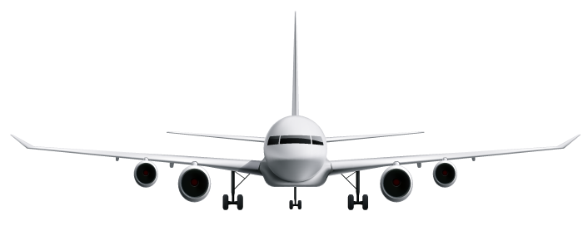
“Our ultimate objective is to make programs that learn from their experience as effectively as humans do.”
—John McCarthy

Slide 31
05
The right model
How did we choose this model

Slide 32
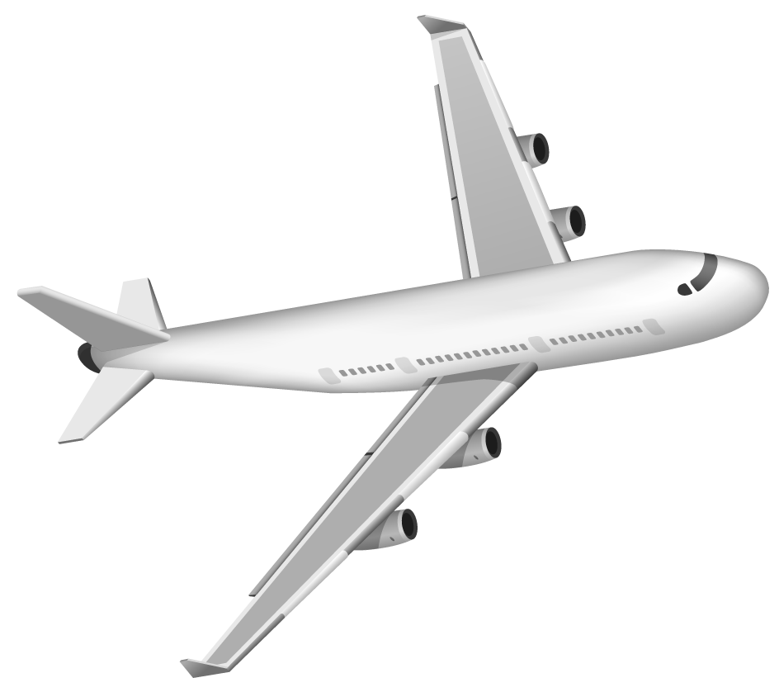
Feature engineering and encoding
We used “Feature wiz” which is an automated tool used in feature engineering.
Along with “Label Encoder” to encode categorical data into numerical.

Slide 33
Choosing best parameters
We used “Grid Search” to search for the best parameters to use in our model and found:

Slide 34
Models analysis
 |  | Random forest | XGB | Cat Boost
 | Accuracy (f1 score) | 94% | 96.3% | 95.2%
 | Percision (macro avg) | 93% | 96% | 95%
 | Recall (macro avg) | 93% | 96% | 95%

Slide 35
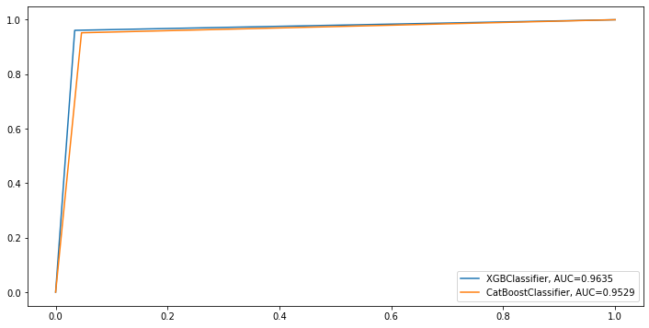
ROC curve for Best 2 models

Slide 36

So, We will go with XGBClassifier!

Slide 37
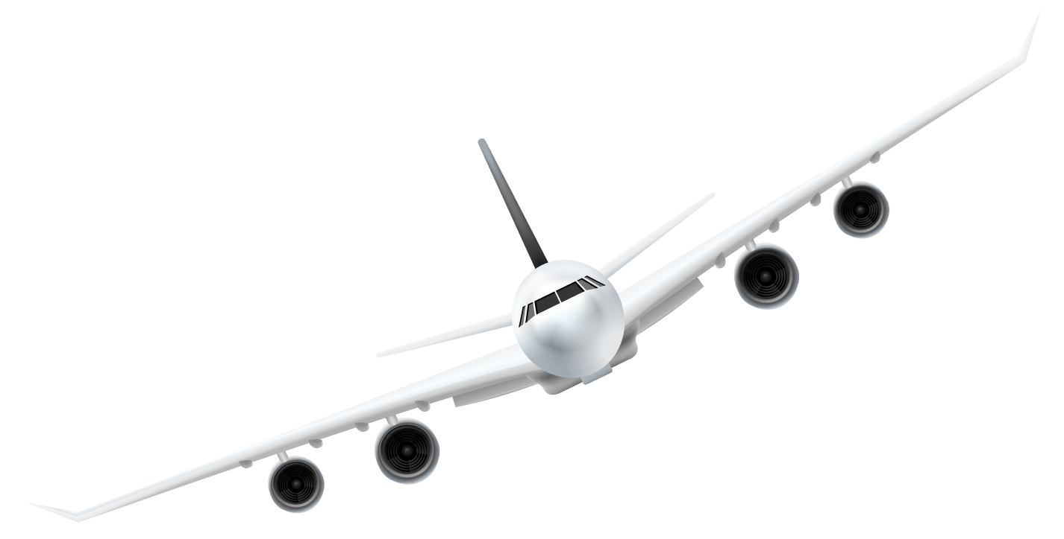
06
Evaluating
How do we know for sure it is the right model

Slide 38
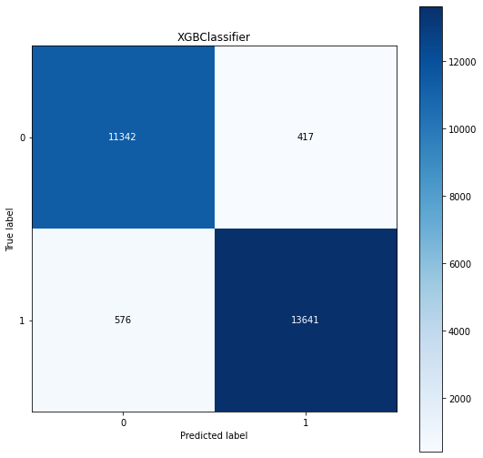
Confusion matrix

Slide 39
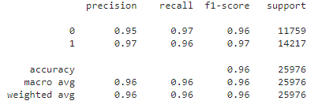
Classification report

Slide 40
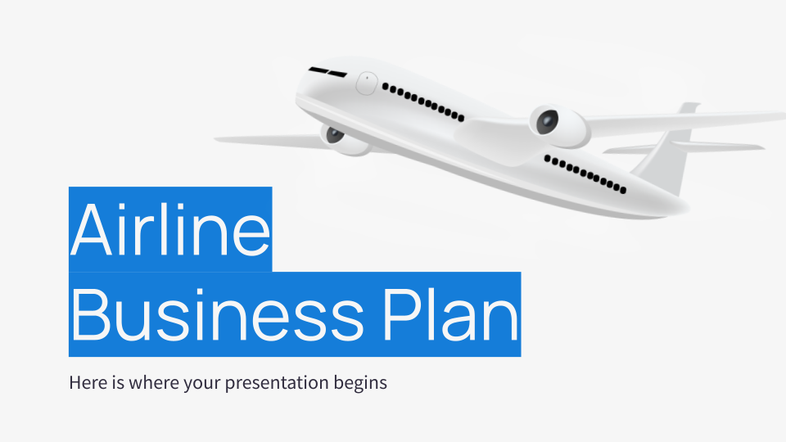


View source code

Slide 41
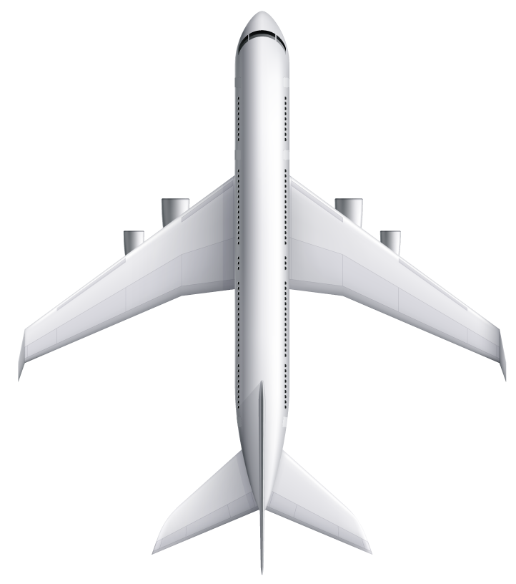
Thanks!
Any questions?

