Slide 1
Samsung
Innovation
Campus
Artificial Intelligence Course

Slide 2
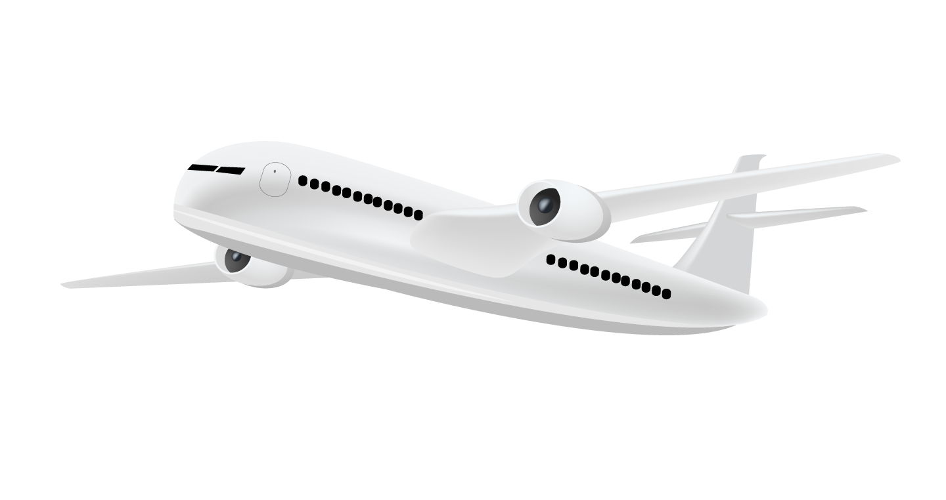
Airline Business Plan
Peter Yasser & Injy ElSherbini,
Egypt.
6 October 2022

Slide 3
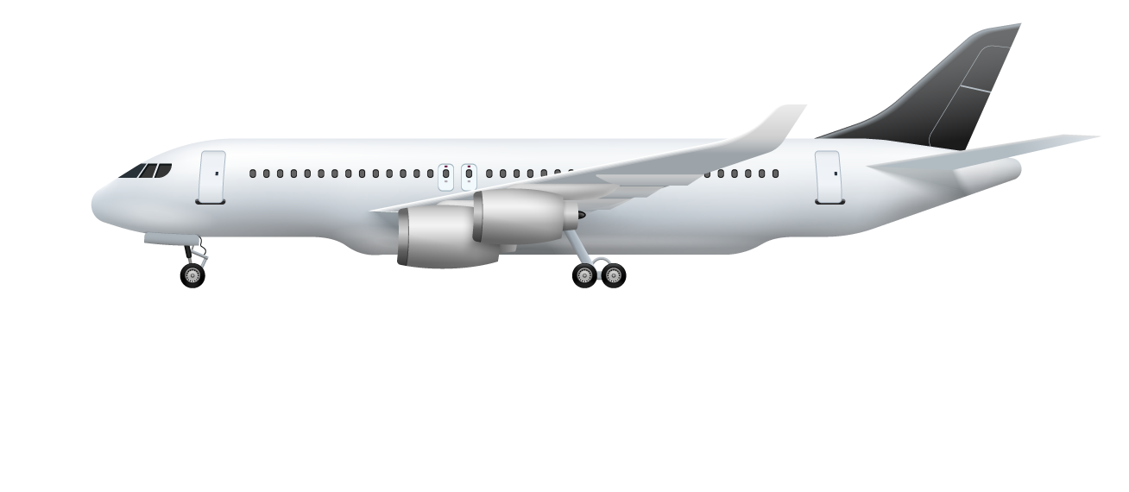
Our team
Peter Yasser
You can speak a bit about this person here
Injy ElSherbini
You can speak a bit about this person here
Supervised by
Ziad Omar
You can speak a bit about this person here

Slide 4
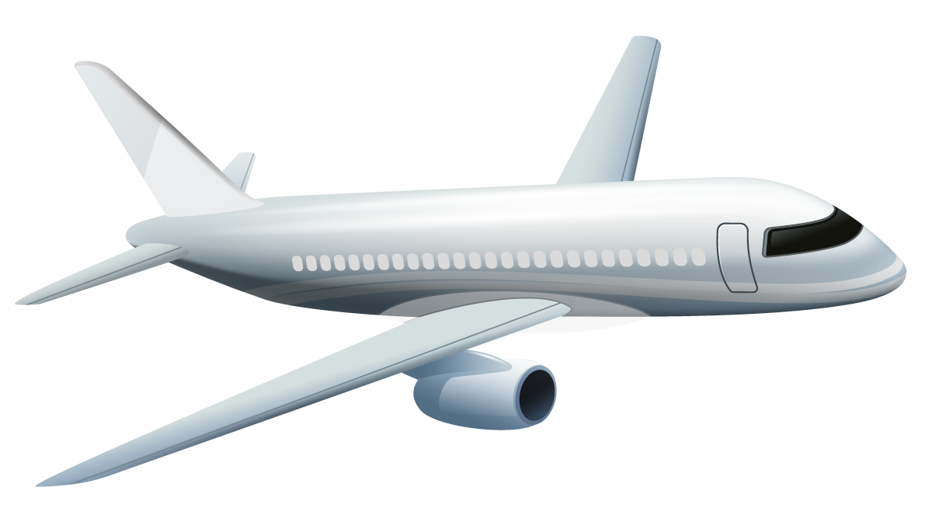
Table of contents
01
02
03
Introduction
Data description
Steps we followed
Problem VS. solution
What are we dealing with
What steps did we follow to make a business plan
04
05
06
The right model
Evaluating
Business plan
Choosing the best model
Is it really the right model
How can we make customers more satisfied

Slide 5
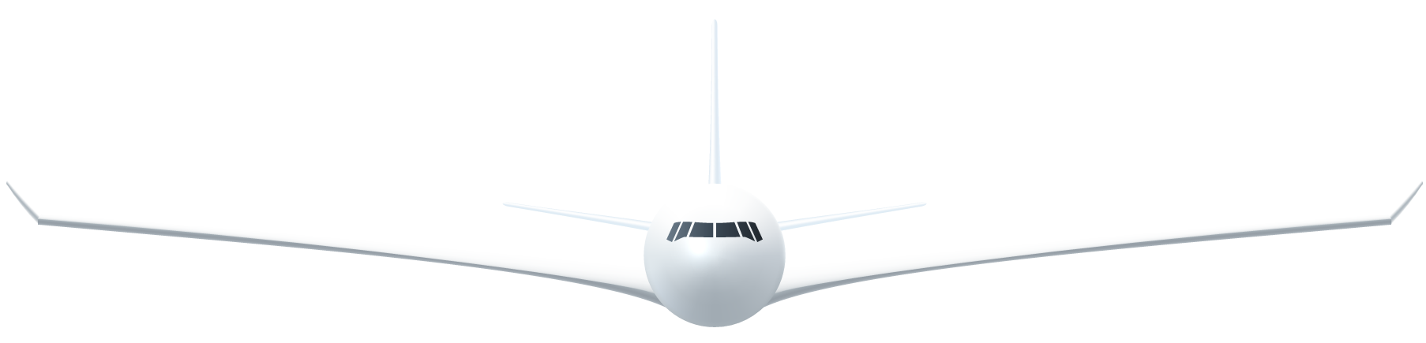
Let’s begin our flight!

Slide 6
01
Introduction
What do we want to achieve

Slide 7
Problem vs. solution
Problem
We need to know on which aspect of the services offered have to be emphasized more to generate more satisfied customers.
Solution
Use AI to predict whether a future customer would be satisfied with their service given the details of the other parameters values.

Slide 8
Target
Gender
Age range
< 20
9.4%
51%
Female
21-40
40%
49%
Male
41-60
41.3%
> 60
9.4%
Class
Business
Economy plus
Economy

Slide 9
Our services
Online booking
Inflight Wi-Fi
Mercury is the closest planet to the Sun
Jupiter is the biggest planet of them all
Food and drink
Inflight entertainment
Neptune is the farthest planet from the Sun
Earth is the only planet that harbors life
On-board service
Online boarding
Venus is the second planet from the Sun
The Moon is Earth’s only natural satellite

Slide 10
Our services (cont.)
Seat comfort
Cleanliness
Mercury is the closest planet to the Sun
Jupiter is the biggest planet of them all
Baggage handling
Inflight service
Neptune is the farthest planet from the Sun
Earth is the only planet that harbors life
Leg room service
Check in service
Venus is the second planet from the Sun
The Moon is Earth’s only natural satellite

Slide 11
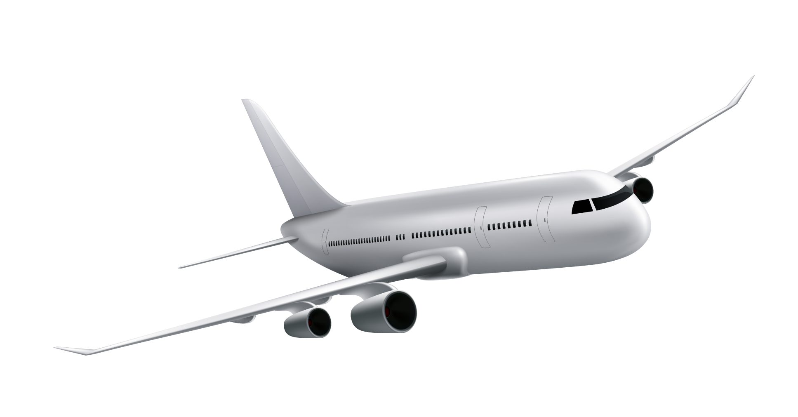
Satisfaction
Satisfied
Dissatisfied
54.7%
45.3%
More than 50% of our customers are satisfied with our services.
About 45% of our customers are dissatisfied with our services.

Slide 12
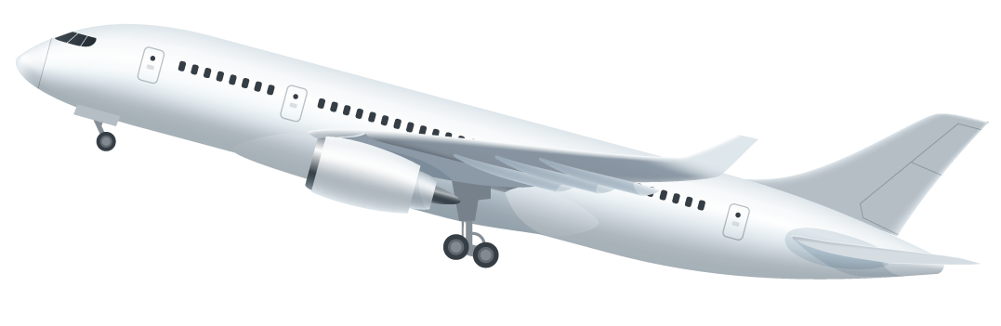
02
Data description
What are we dealing with

Slide 13

129,880
Customer feedback.

Slide 14
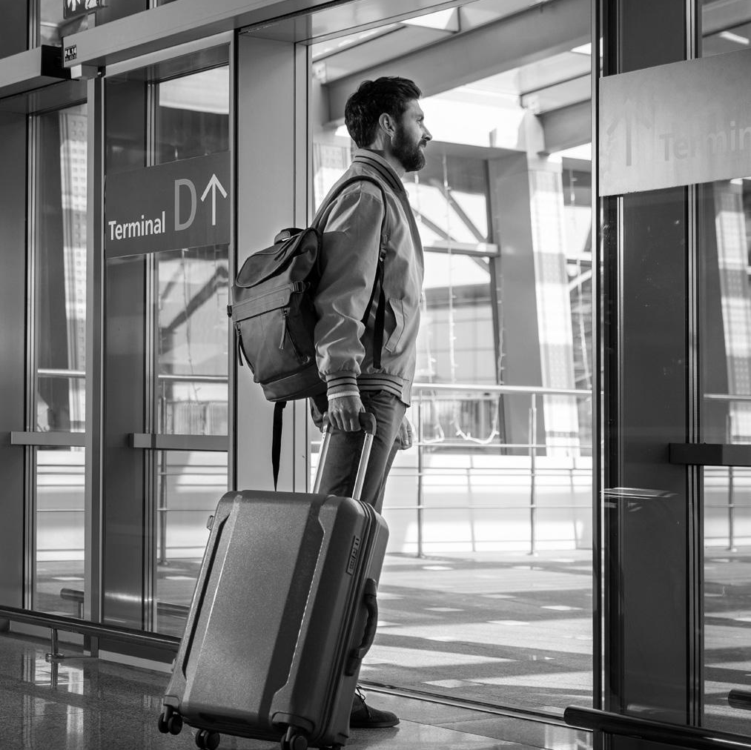
Our dataset has
23 columns (4 with outliers)
129,880 rows (393 with NULLs)
dtypes: float64(1), int64(17), object(5)

Slide 15
03
Steps we followed
How we can achieve it

Slide 16
Our process
Step 2
Step 4
Data cleaning and feature engineering
Deductions
Step 1
Step 3
EDA and visualization
Modeling and evaluating

Slide 17
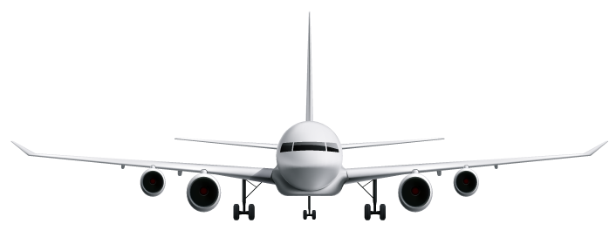
“Our ultimate objective is to make programs that learn from their experience as effectively as humans do.”
—John McCarthy

Slide 18
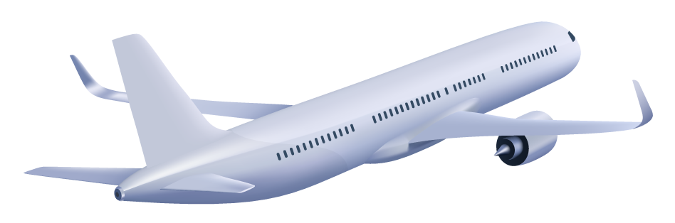
04
The right model
How did we choose this model

Slide 19
Models analysis
 |  | Random forest | XGB | Cat Boost
 | Accuracy (f1 score) | 94% | 96.3% | 95.2%
 | Percision (macro avg) | 93% | 96% | 95%
 | Recall (macro avg) | 93% | 96% | 95%

Slide 20
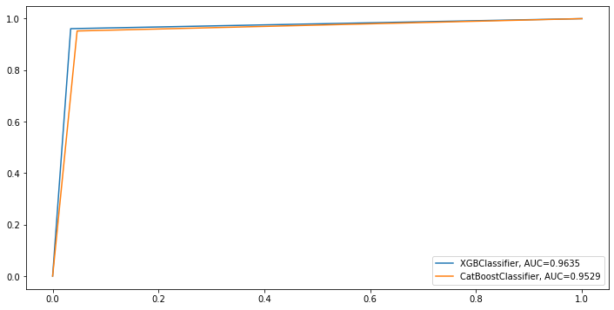
ROC curve for Best 2 models

Slide 21

So, We will go with XGBClassifier!

Slide 22
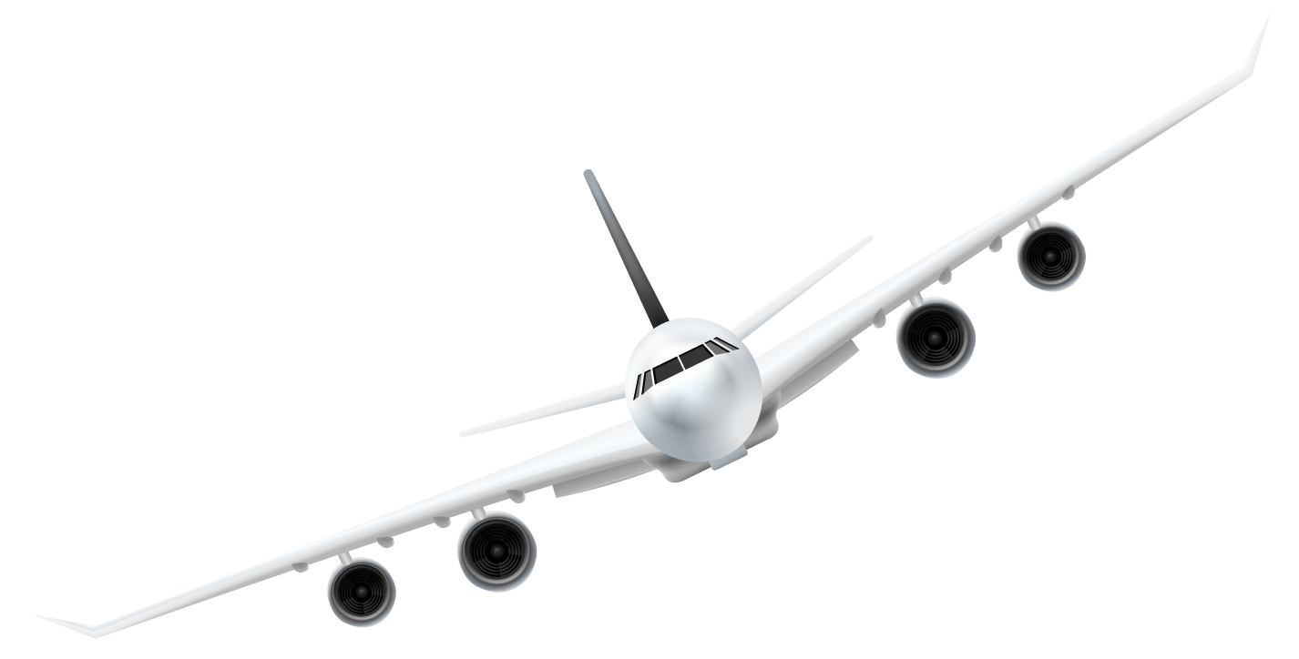
05
Evaluating
How do we know for sure it is the right model

Slide 23
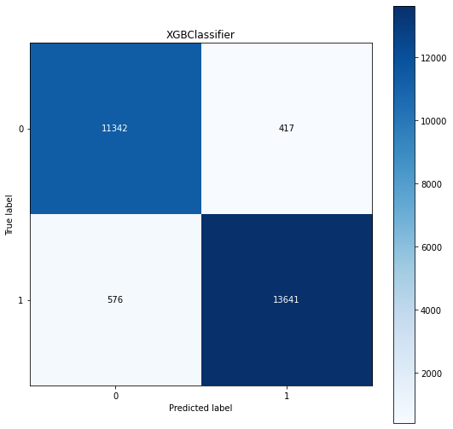
Confusion matrix

Slide 24
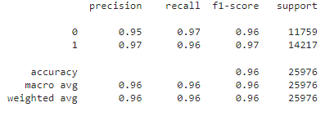
Classification report

Slide 25
06
Business plan
Use our deduction to make a plan

Slide 27
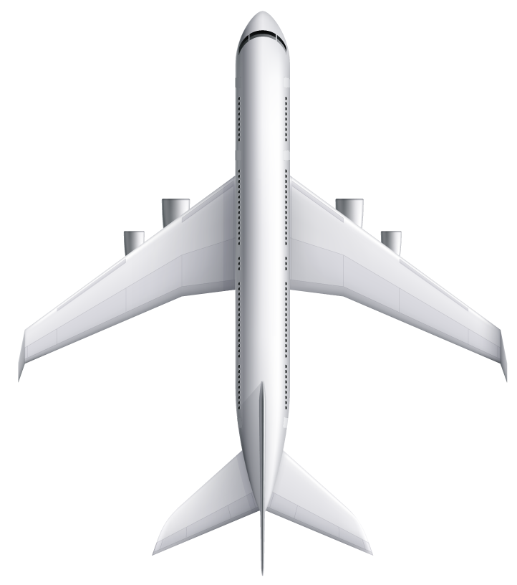
Thanks!
Any questions?

