Slide 1
Samsung
Innovation
Campus
Artificial Intelligence Course

Slide 2
Brain Tumor Detection
Egypt,
14-Nov-2022

Slide 3
Our Team
Injy ElSherbini
Computer Science student.
Nourhan Mahmoud
Engineering student.
Ziad Omar
Engineering student.
Our facilitator.

Slide 4
TABLE OF CONTENTS
Introduction
Data Description
1
2
You can describe the topic of the section here
You can describe the topic of the section here
Some Statistics
Preprocessing & Modeling
You can describe the topic of the section here
3
4
You can describe the topic of the section here
Deployment
Conclusions
You can describe the topic of the section here
5
6
You can describe the topic of the section here

Slide 5
Introduction
1
A brain diagnosing a brain?

Slide 6
Our Brain
The most complex organ of our body and therefore, the most important.
Contains billions of neural networks that interact to create human behavior.

Slide 7
ABOUT BRAIN TUMOR (Primary)
There are three types of primary brain tumors, about which we are concerned throughout this project:
Glioma
Meningioma
Pituitary Adenoma

Slide 8
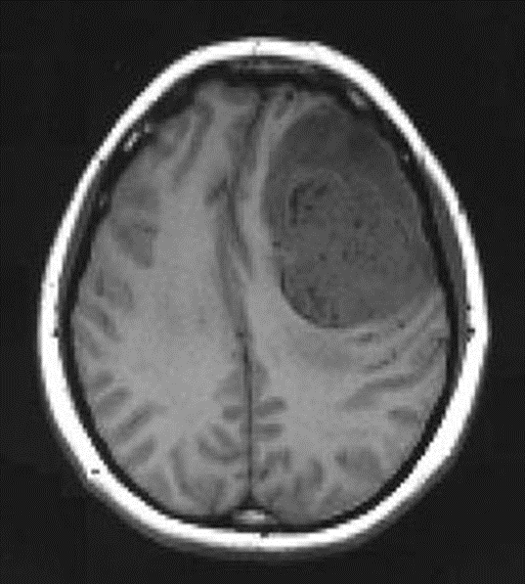
Glioma
Arise from the glial cells which surround the nerve cells in the brain.
They are the most numerous cells in the central nervous system.
(Left is right, right is left, bone is bright white, malignant tumor with contrast dye is grey) Midline shift, Google Images, http://www.ispub.com/xml/journals/ija/vol8n2/pregnant-fig1.jpg

Slide 9
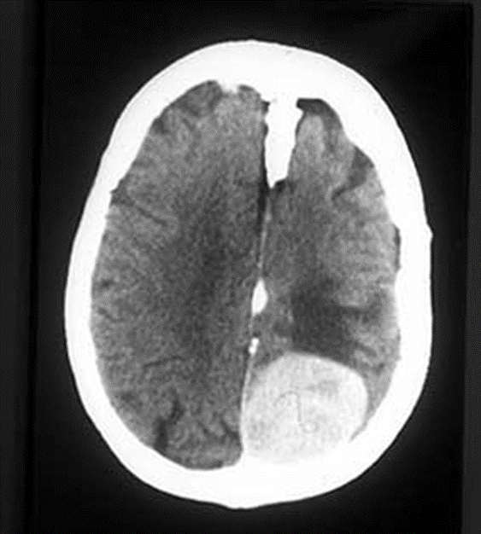
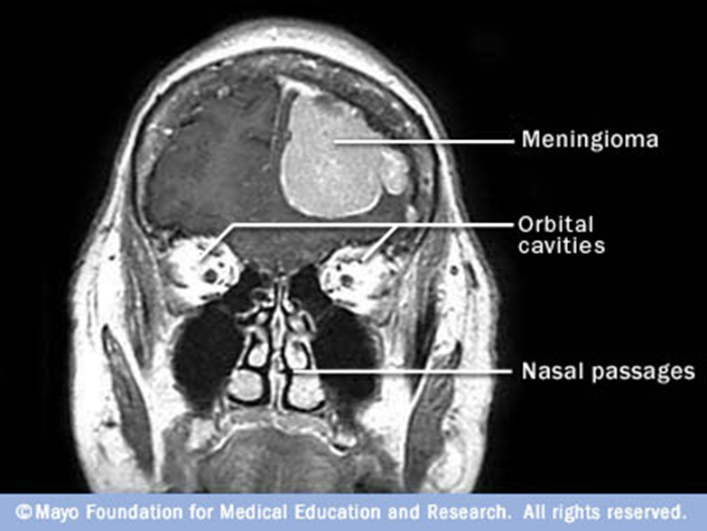
Meningioma
Most common type of primary tumor.
Arises from the meninges = the lining of the brain
Google Images, www.student.bmj.com (Left is right, right is left, bone is bright white)

Slide 10
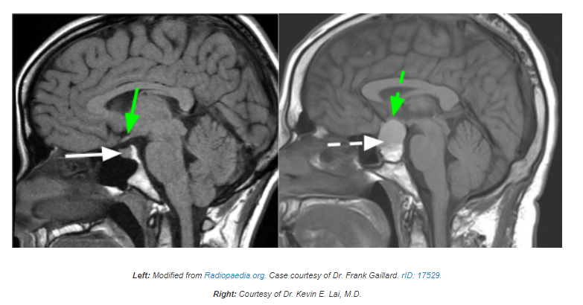
Pituitary Adenoma
Scientists aren’t sure of the exact cause of pituitary adenomas.
But some adenomas have been linked to accidental changes, or mutations in DNA

Slide 11
Data Description
2
What info do we have?

Slide 12
Our dataset contains more than
7,000
MRI images

Slide 13
These MRI images are divided into four classes:
No tumor
Glioma
Healthy
Malignant (cancerous)
Meningioma
Pituitary
Benign (non cancerous)
Benign (non cancerous)

Slide 14
Some Statistics
3
What do numbers tell us?

Slide 15
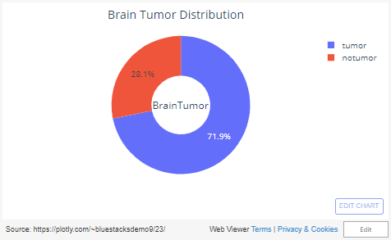
Analyzing a random sample, we found:

Slide 16
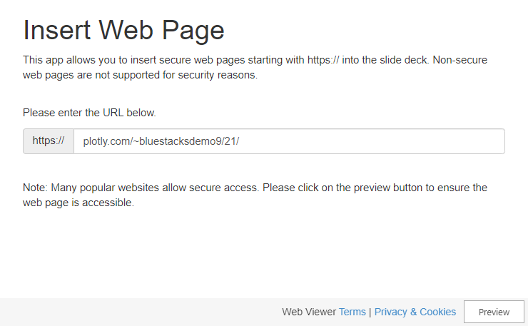
Analyzing a random sample, we found:

Slide 17

Analyzing a random sample, we found:

Slide 18
Preprocessing & Modeling
4
How did we deal with the all these data?

Slide 19
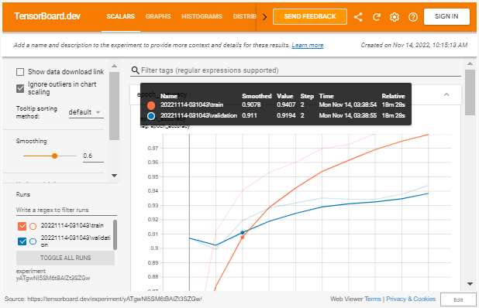

Slide 20
Deployment
5
How can patients benefit from our work?

Slide 21
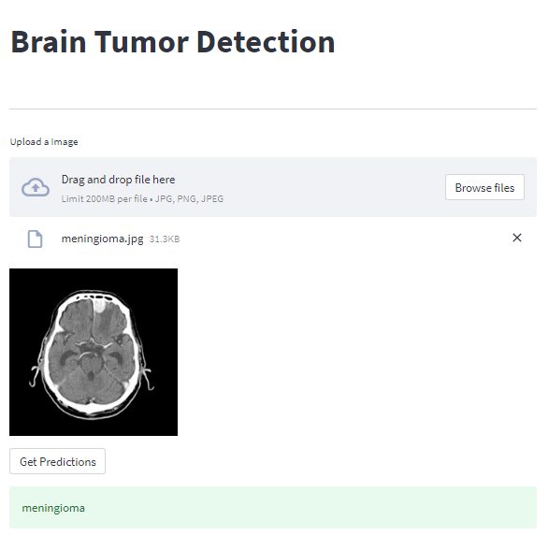
Our web app
Check it out!

Slide 22
Conclusions
6
Final words..

Slide 24



View Source Code

Slide 25
THANKS!
Any Questions?

