Slide 1
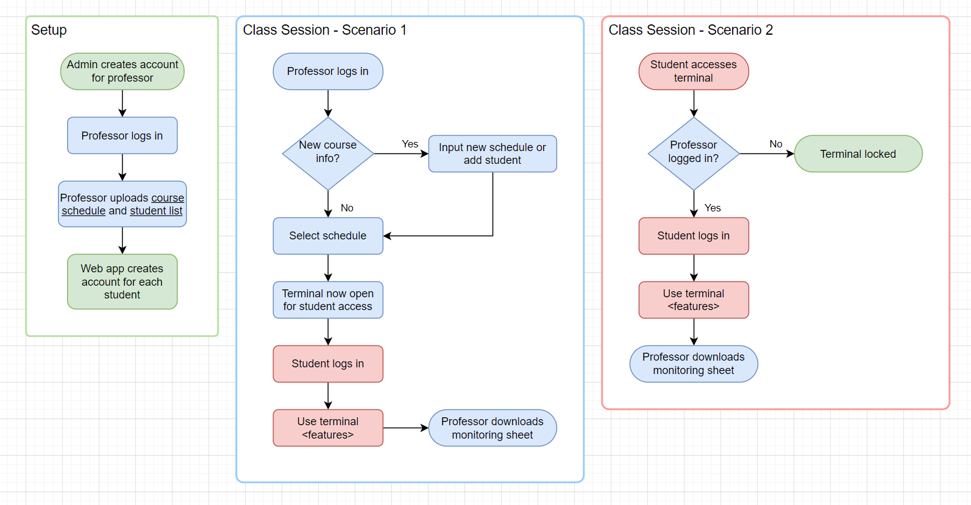

Slide 2
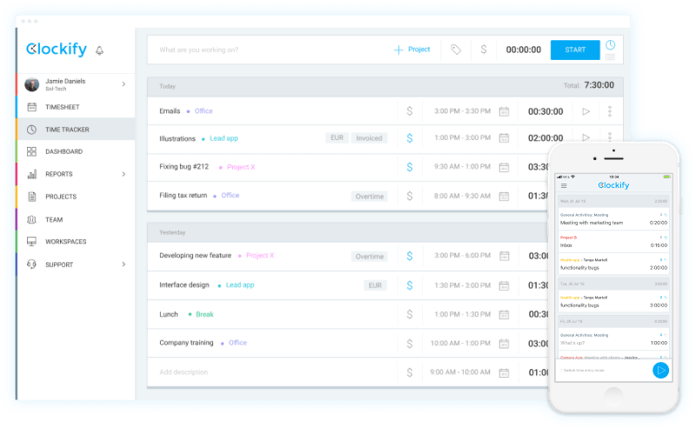
https://clockify.me/time-clock-app

Slide 3
