Slide 1
SäähänSopiva
Jenna Aalto, Samu Puumala, Joona Jalonen ja Iiro Anttila

Slide 2


Esittely

Slide 3


SäähänSopiva
Aims to help families, couples and people who struggle with decision making.
Offers fast ideas and decisions which helps especially if you are outside or in a large group of people who need ideas, fast!!
Potential customers include:
busy people
families who don’t have the time of the day to plan activities ahead
Couples who wan’t a touch of spontaneity
People who have issues coming up with ideas or decisions
Friendgroups
People who want to do something different

Slide 4

Soo.. What activities?
Säähänsopiva offers you activities based on the weather you input into the system
Activities vary from inside to outside, COUPLES TO FAMILIES
Activities are weather based and some of them are locked behind certain weather types, for an example
Snowy weather
Skiing
Building a snowman
Sunny weather
Sunbathing
Swimming

Slide 5
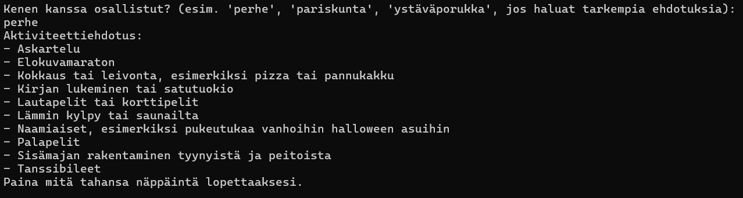
Technical development
The project was coded in c-sharp using visual studio 2022
Starts by asking the weather, you can choose which one from them matches
After that asks you if the weather is rough or mild (rainfall, snowfall or wind)
Finally asks you if you want specific reccomendations for families or friendgroups or couples but if you want reccomendations in general just press enter

Slide 6
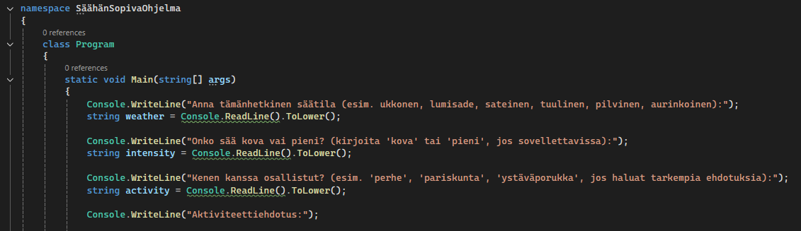
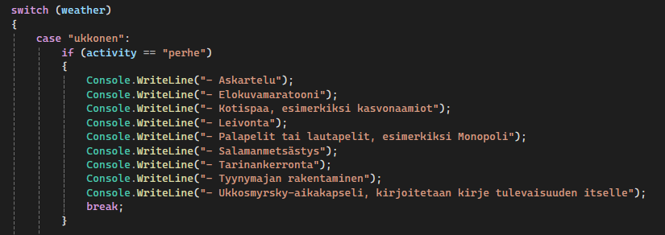
Code itself
Used a lot of if and else if
Lot of typing because of the activities
Activities were categorized by weather
Also categories for families, couples and friendgroups

Slide 7
demonstration

Slide 8

Reflection and conclusion
Coming up with the idea at the start was difficult but once we figured it out we were set in to complete it
If we were to do something differently, we would have started to do THE PROJECT sooner AND communicate better more often
Learning about what kind of a groupmember was fun and to implement it to the project built confidence

Slide 9
References
https://chatgpt.com/
Chatgpt was used for organizing the activities in alphabetical order.
Was also used to come up with a few ideas for activities.
Images:
https://pixabay.com/
https://pixabay.com/photos/thumbs-up-positive-gesture-thumb-4589867/
https://pixabay.com/photos/father-daughter-beach-family-daddy-656734/
https://pixabay.com/photos/women-beauty-outdoors-casual-8509637/

