Slide 1

Department of Computer Science and Engineering
Image Classification-Deep Learning Project in Python With Keras.
Course Code: CSE-475 (Machine Learning Lab)
Submitted by
Ijaj Mahmud Badhan
Reg. No.: 2016331005
4th year, 1st Semester
Submitted to
Dr. Md Forhad Rabbi
Associate Professor
Department of Computer Science and Engineering

Slide 2
Image Classification-Deep Learning Project in Python With Keras.
Ijaj Mahmud Badhan
Reg. No.: 2016331005
4th year, 1st Semester

Slide 3
Image Classification
Image classification is a fascinating deep learning project. Specifically, image classification comes under the computer vision project category.
The classification problem is to categorize all the pixels of a digital image into one of the defined classes.
Image classification is the most critical use case in digital image analysis.
Image classification is an application of both supervised classification and unsupervised classification.

Slide 4
How to Image Classify: What You Need to Know
Need Neural Network Knowledge
01
Need Algorithm Knowledge & Programming
03
Learn Image Data Analysis & Visualization
02
04
Classification using python and Keras.

Slide 5
02
Image Data Analysis & Visualization
Get a hold of Python from the very basic level to the advanced, thoroughly applied on imagel Data!

Slide 6
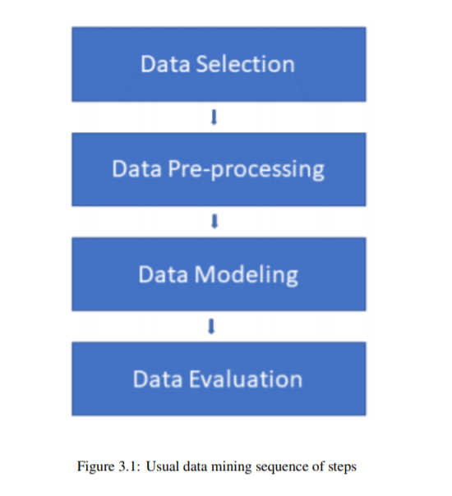
About Image Classification Dataset
CIFAR-10 is a very popular computer vision dataset. This dataset is well studied in many types of deep learning research for object recognition.
This dataset consists of 60,000 images divided into 10 target classes, with each category containing 6000 images of shape 32*32. The 10 different classes of this dataset are:
1. Airplane 2. Car
3. Bird 4. Cat
5. Deer 6. Dog
7. Frog 8. Horse
9. Ship 10. Truck

Slide 7
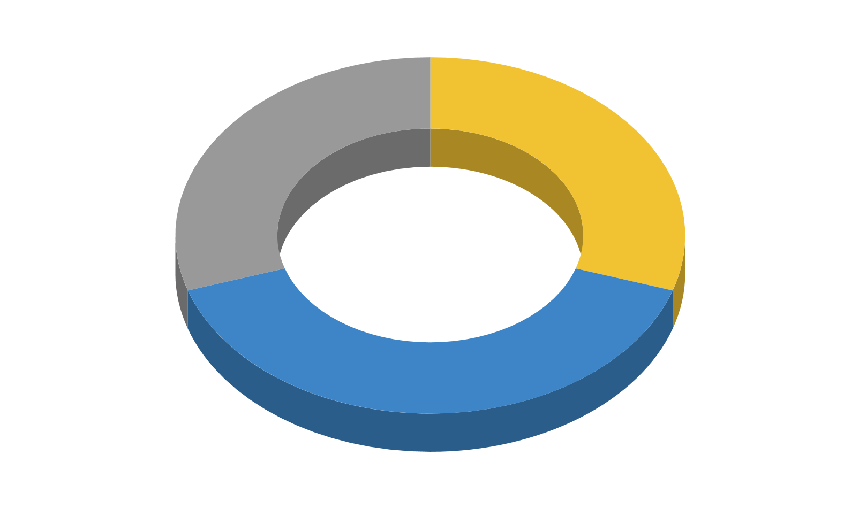
Data Mining Task
Classification
Regression
Clustering
Classification algorithms are used to assign classifications or labels to data that have never been classified or labeled before
instead of working with discrete data and mapping the results into categorical class labels, they deal with continuous values and return alternative outcomes.
This activity works with unlabeled data collections to try to detect commonalities between the records and then group the data into groupings called clusters.
We Use Classification Model….

Slide 8
03
Technical Background
Apply what you learn to real-life image data, how to analyze it, infer the data and conclude.

Slide 9
Technical Background
In Image classification we used both supervised classification and unsupervised classification.
In supervised classification, we select samples for each target class. We train our neural network on these target class samples and then classify new samples.
In unsupervised classification, we group the sample images into clusters of images having similar properties. Then, we classify each cluster into our intended classes.

Slide 10
Artificial Neural Network
An artificial neural network (ANN) is the piece of a computing system designed to simulate the way the human brain analyzes and processes information.
It is the foundation of artificial intelligence (AI) and solves problems that would prove impossible or difficult by human or statistical standards.

Slide 11
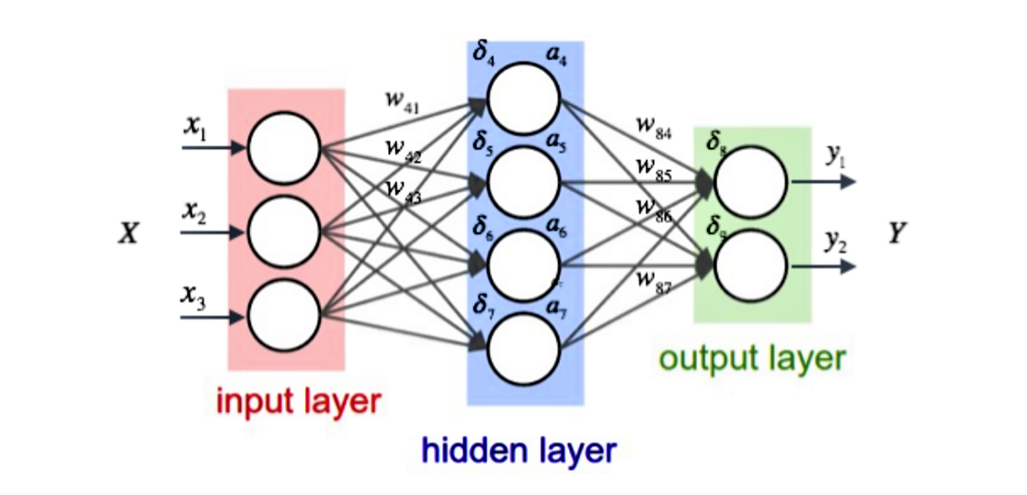

Slide 12
Application Stacks and Deployment
The prerequisite to develop and execute image classification project is :-
Keras
Tensorflow installation.

Slide 13
04
Development and
Evaluation
Comprehend the most useful Linux features and methodologies for image Data Analysis.

Slide 14
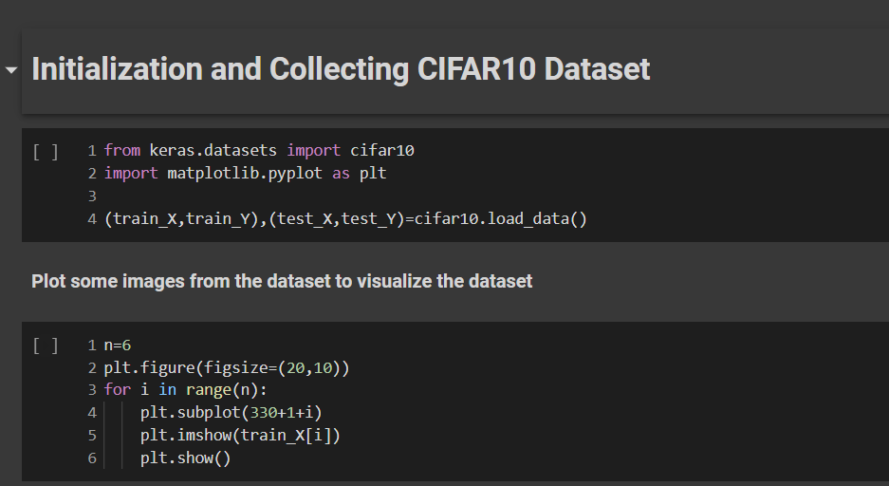
Development and Evaluation:

Slide 15
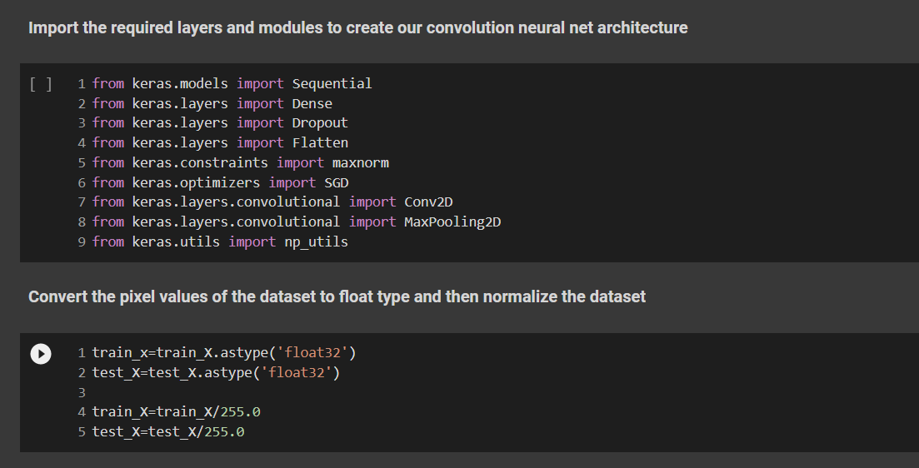

Slide 16
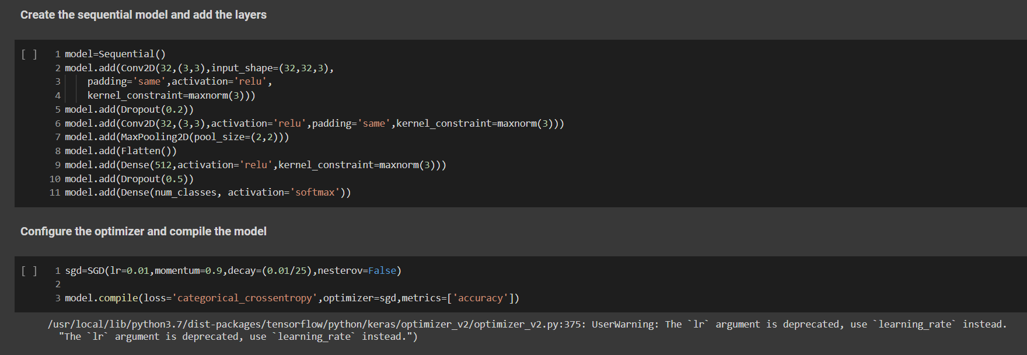
Development and Evaluation:

Slide 17
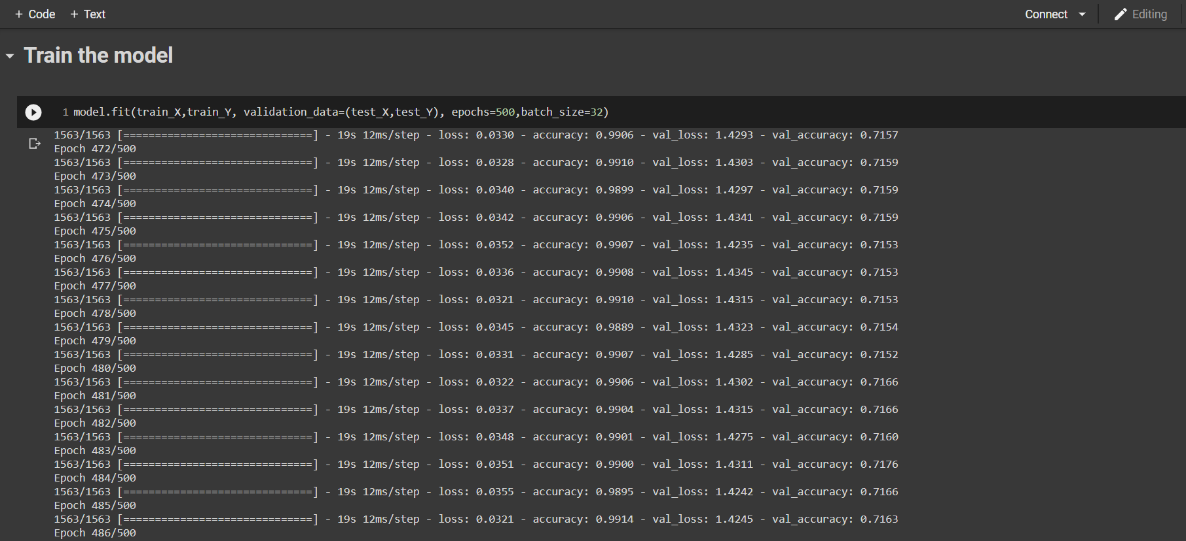

Slide 18
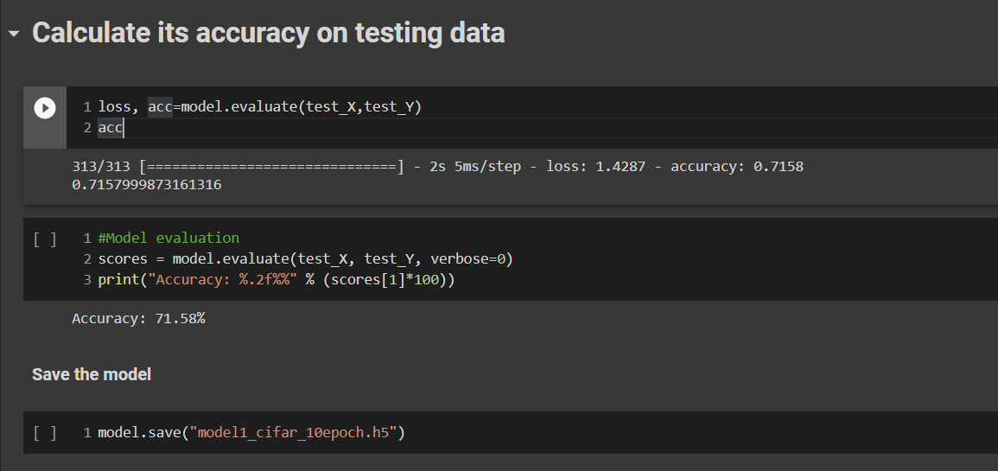
Development and Evaluation:

Slide 19
Summary, what we have done so,Far...
To Summarize our work….

Slide 20
Summary...
The objective of the image classification project was to enable the beginners to start working with Keras to solve real-time deep learning problems.
In this keras deep learning Project, we talked about the image classification paradigm for digital image analysis. We discuss supervised and unsupervised image classifications.
Then it explains the CIFAR-10 dataset and its classes. Finally, we saw how to build a convolution neural network for image classification on the CIFAR-10 dataset.

Slide 21
Thank You!

