Slide 1
Real-Time Fraud Intelligence Console
Risk scoring | Evidence-led triage | AI investigation | Workflow auditability | Portfolio scan
Ijaz Mohamed Ali Kakkod | Executive product walkthrough package
41 / 41
10 M rows
27
Validation checks
Portfolio scan evidence
API endpoints
8 routes
7 services
Video
Analyst screens
Local runtime
External walkthrough
PostgreSQL | Redpanda | Redis | n8n | Ollama | FastAPI | Next.js
Notes:
Opening slide. The six tiles are concrete, verifiable figures.
41/41: scripts/verify_release_readiness.py
10M: scripts/benchmark_portfolio_scan.py
27 endpoints: OpenAPI surface at /docs
8 routes: Next.js routing table
7 services: Docker Compose topology
Video: external walkthrough package, not committed to the repo.
Frame this as a complete, inspectable fraud intelligence workflow built on a production-style local runtime. Not a proof-of-concept. Not a dashboard.

Slide 2
PROBLEM
Fraud Triage Breaks Between Score and Decision
01
02
03
04
Scores
Queues
Cases
Portfolios
without evidence
without prioritisation
without traceability
without scale view
Notes:
Four operational gaps the console addresses.
1. Risk scores are generated but not routed into structured review queues. Analysts see a number, not a case.
2. Evidence is available in transaction records but not grouped by signal type. Analysts re-derive context the system already knows.
3. Fraud operations teams have no single audit trail connecting score, verdict, investigation brief, and workflow event to a case record.
4. Portfolio-level review requires batch scoring, risk-tier filtering, and selective promotion. Row-by-row inspection does not scale.
Each card is a solved problem in the current product.

Slide 3
PRODUCT PROMISE
One Connected Fraud Decisioning Workflow
1
2
3
4
5
6
7
8
Transaction
>
Scoring
>
Routing
>
Review Queue
>
Case Dossier
>
AI Brief
>
Verdict
>
Audit Trail
Portfolio Scan:
Bulk CSV ingestion > Chunked scoring > Risk-tier filtering > Paginated review > Cursor-streamed export > Case promotion
The console connects model scores to analyst-controlled fraud decisions, with a full audit trail on every case.
41/41 release readiness checks pass across all workflow stages.
Notes:
The eight-stage workflow is the product architecture in visual form.
Each stage is a distinct product surface with a defined role and a clear handoff.
Transaction event -> Hybrid scoring (XGBoost + rules + boosts) -> Decision routing -> Review queue (P0-P3) -> Case dossier (evidence grouped by layer) -> Investigation brief (async LLM, advisory) -> Analyst verdict (required, captured) -> Audit trail (every event timestamped and case-linked).
Portfolio scan is a parallel workflow: bulk ingestion, risk-tier review, and selective case promotion.
All eight stages are implemented, connected, and inspectable in source code.

Slide 4
ARCHITECTURE
Modular Architecture With Clear Service Boundaries
FastAPI
Next.js
Redpanda
27 REST endpoints
8 analyst screens
Event streaming
PostgreSQL
Redis
n8n
Persistence layer
Idempotency cache
Workflow automation
Ollama
XGBoost Model
Docker Compose
Local LLM inference
Scoring artifact
Runtime orchestration
Production-style local runtime | Independent, inspectable services | Clear path to cloud equivalents
Notes:
Nine-component service topology.
FastAPI: 27 REST endpoints covering scoring, cases, investigation, workflow, audit, portfolio.
Next.js (React 18): 8 analyst-facing screens from command center to portfolio scan.
Redpanda (Kafka-compatible): 2 topics: score.results and cases.investigate.
PostgreSQL v16: 5-table persistence model for predictions, cases, events, reports, scans.
Redis: request_id idempotency with 24-hour TTL.
n8n: webhook dispatch and callback recording for case workflow automation.
Ollama: local LLM runtime (phi3 or llama3) for investigation brief generation.
XGBoost model artifact: scikit-learn pipeline, offline-trained, deterministic inference.
Docker Compose: orchestrates all 9 components on a single local machine.
Each managed-cloud equivalent is documented in docs/DEPLOYMENT_STRATEGY.md. The path from local runtime to cloud-managed services is well-defined for each component.

Slide 5
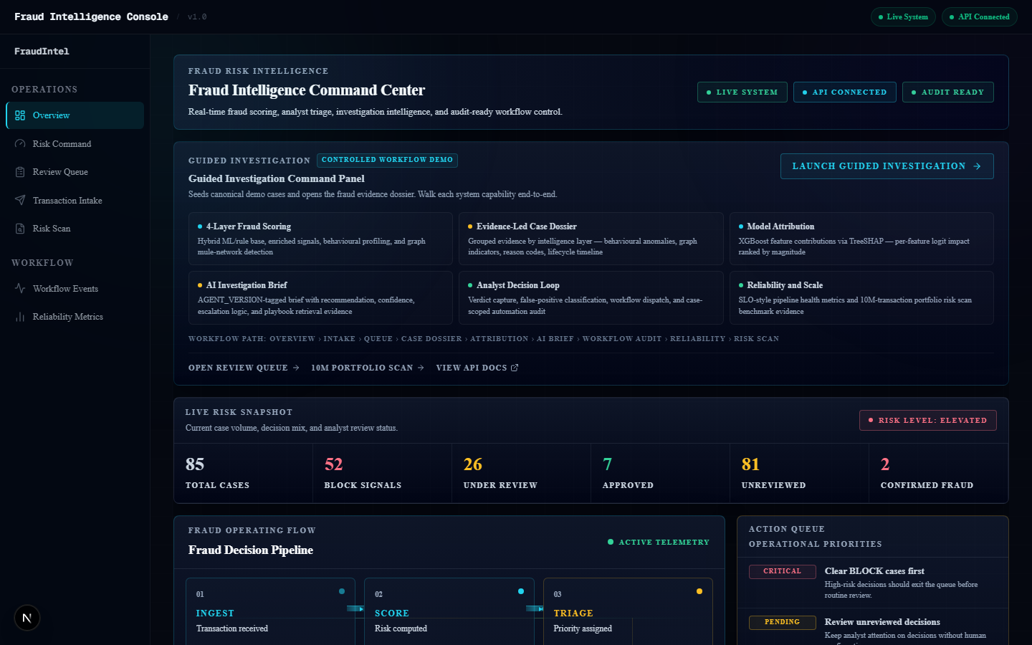
ANALYST WORKFLOW
From Command Center to Case Decision
1
Command Center
Operational state at a glance
2
Review Queue
P0-P3 priority ranking
3
Case Dossier
Evidence by scoring layer
4
Verdict Capture
Analyst decision. Audit trail updated.
Notes:
The analyst workflow across the first four stages.
Command Center (/): KPI strip, 6-stage pipeline map, stale case alerts, system connectivity health. Operational awareness before opening any case.
Review Queue (/queue): Cases ranked P0-P3 by score band. Inline score bars. Status filters for pending, in-progress, and escalated. Queue ordered by tier first, score descending within tier.
Case Dossier (/cases/[id]): Signals grouped by origin layer. Model attribution section shows score contribution per layer. Lifecycle timeline shows full case state history.
Verdict Capture: POST /review-case/{case_id}. Verdict options: CONFIRM_FRAUD, FALSE_POSITIVE, ESCALATE, APPROVE. Notes field. Timestamps and writes workflow audit event on submit.
Screenshot shows the command center at http://localhost:3000.

Slide 6
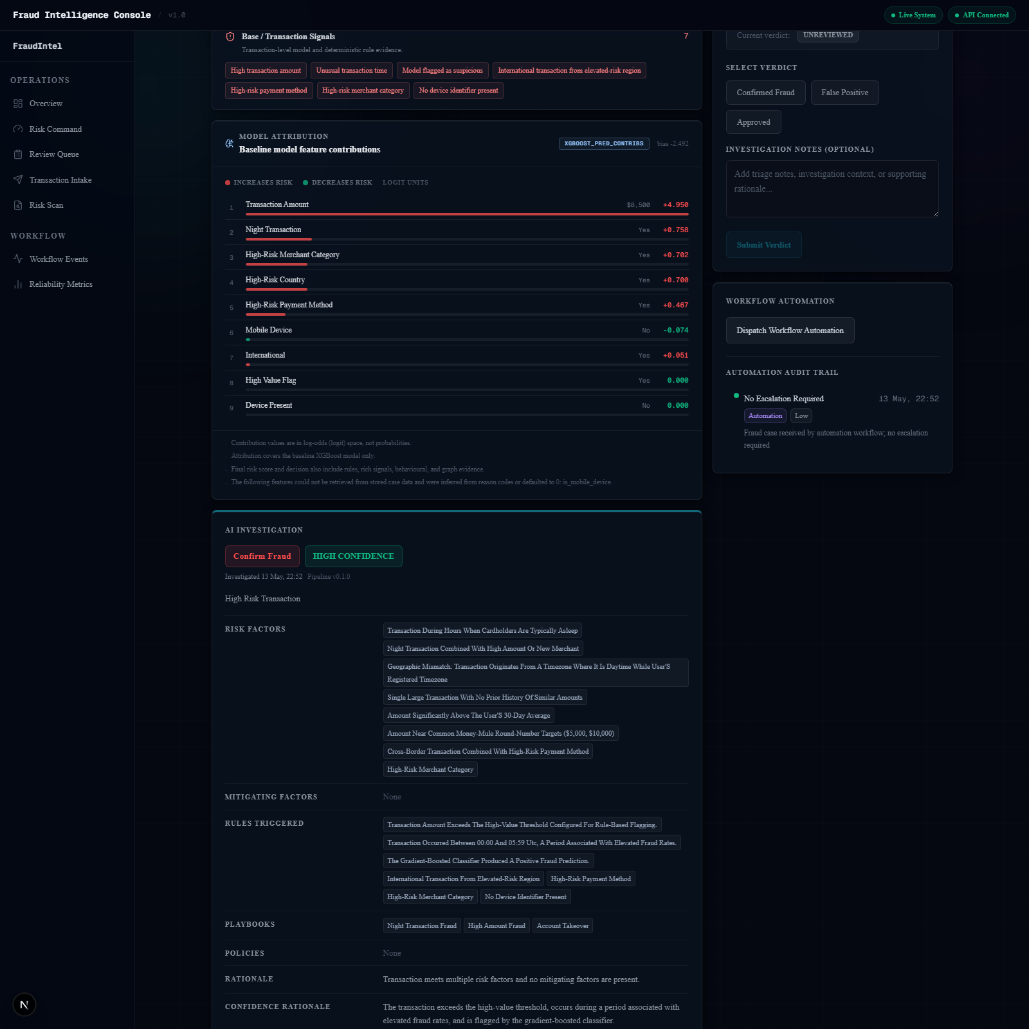
EVIDENCE AND INVESTIGATION
Evidence-Led Review With Analyst Ownership
Base Signals
Amount, time, rule flags, reason codes
Rich Signals
Device, geo, velocity, merchant risk
Behavioural
30-day deviation, new device and country
Graph Intelligence
Shared devices and transaction flow patterns
AI Brief
Validated output. Every brief version-tracked.
Analyst Verdict
Required final step. Updates the audit trail.
Notes:
The evidence-led investigation model.
Evidence is grouped into four signal layers, each corresponding to a scoring engine stage:
Base signals: amount, time, model prediction flag, rule flags, reason codes.
Rich signals: device trust, geo distance anomaly, velocity, merchant risk, chargeback history.
Behavioural signals: 30-day entity deviation, new device, new country, unusual channel.
Graph intelligence: shared device across accounts, counterparty fan-in and fan-out.
Investigation brief is generated async via Redpanda -> Ollama -> PostgreSQL.
Schema-validated on every call. Retry with error feedback appended on failure.
AGENT_VERSION stored on every InvestigationReport row: immutable link between brief and agent config.
No automated path from LLM recommendation to case action.
POST /review-case/{case_id} is the required final step.
Screenshot shows the AI investigation panel with brief output fields.

Slide 7
PORTFOLIO BENCHMARK
10M-Row Portfolio Scan Evidence
10 M
8.42 M
4.19 s
6.99 ms
1.64 GiB
0
Synthetic rows processed
P1 filter query count
P1 filter response time
Export time to first byte
Cursor-streamed export
OOM events and API restarts
What it demonstrates:
Chunked ingestion
Indexed page queries
Streaming export
Priority triage at scale
Full CSV never loaded into API memory
Sub-second tier filters at 8M+ rows
API memory stays flat at 1.64 GiB output
Risk-tier filters and case promotion
Notes:
Portfolio benchmark results from scripts/benchmark_portfolio_scan.py.
All metrics are measured, repeatable, and verifiable in source code.
10M synthetic rows: full ingestion and export cycle completed without OOM or restart.
8.42M P1 filter: paginated count query across 8.42M qualifying rows.
4.19s: P1 filter response time including paginated count at that scale.
6.99ms: export time to first byte. Reflects cursor readiness, not full materialisation.
1.64 GiB: full streaming export with flat API memory throughout.
0 OOM events or API restarts: stability evidence across the full cycle.
Three architecture properties produce these numbers:
Chunked ingestion: CSV never fully loaded into API heap.
Composite index (scan_id, risk_tier, id): sub-second filtered pages.
Server-side PostgreSQL cursor: API memory stays flat during export.
POST /risk-scan/{id}/promote/{row_id} elevates flagged rows to review-queue cases.

Slide 8
LATENCY STRATEGY
Keep Scoring Fast. Move Heavy Work Async.
Fast Synchronous Path
Asynchronous Paths
Feature extraction
Investigation Brief
Redpanda -> Ollama -> PostgreSQL
XGBoost inference
Portfolio Scan
Rule engine evaluation
Chunked worker -> indexed PostgreSQL
Scale Strategy
Decision routing
Redis caching: Deduplicate repeat requests. 24-hour window.
PostgreSQL persistence
Horizontal API workers: Add capacity as request volume grows.
Independent consumers: Investigation and portfolio scale separately.
Notes:
Latency architecture.
Synchronous scoring path (fast, deterministic):
Feature extraction (signals grouped by layer into scoring context)
XGBoost inference (offline-trained artifact, deterministic output)
Rule engine (threshold and flag evaluation, reason codes emitted)
Decision routing (BLOCK, REVIEW, APPROVE)
PostgreSQL write + Redpanda event dispatch
Asynchronous paths (heavy workloads isolated from scoring throughput):
Investigation brief: POST /cases/{id}/investigate -> Redpanda -> investigation-consumer -> Ollama
Portfolio scan: POST /risk-scan -> chunked ingestion worker -> indexed PostgreSQL
Scale strategy:
Redis idempotency: deduplicate repeated requests by request_id, 24-hour TTL.
Horizontal API scaling: scoring workers are stateless and CPU-bound.
Independent consumer scaling: investigation and portfolio consumers scale on Redpanda partitions.
Observability: reliability metrics surface latency pressure before SLO breach.
Latency design is based on current service topology and async path separation. Specific p95 values require load testing against a target infrastructure.

Slide 9
SCALE PATH
Scale Path to High-Volume Decisioning
1
Local reproducible runtime
2
Containerised stateless workers
3
Managed data layer
4
Cached deduplication at scale
5
Queue-backed async workers
6
Observability and SLOs
7
Resilience planning
Each layer scales independently.
Notes:
Seven-stage scale path from local runtime to high-volume fraud decisioning.
Stage 1 is fully delivered in the current product.
Stages 2 through 7 represent the architecture roadmap that current service boundaries support.
Stage 1: 9-service Docker Compose stack. 41/41 validation and 10M benchmark verified.
Stage 2: Stateless API workers behind a load balancer. Scoring scales horizontally.
Stage 3: Managed PostgreSQL, Redis, Redpanda, and object storage per cloud provider.
Stage 4: Repeat request caching via Redis. API autoscales on queue depth.
Stage 5: Investigation and portfolio consumers scale on Redpanda partition count.
Stage 6: Latency SLOs, score drift detection, agent version lineage tracking, alerting.
Stage 7: Multi-region reads, circuit breakers, consumer offset recovery, LLM failover.
The architecture separates fast scoring, async investigation, portfolio processing, and audit persistence so each layer can scale independently.
This slide presents the scale architecture supported by current service boundaries. Each stage builds on the previous. Specific throughput targets require load testing against a target infrastructure.

Slide 10
INTEGRATION EXPANSION PATH
Integration Expansion Path
Decision Package
decision
BLOCK / REVIEW / APPROVE
risk_score
External Platform
Integration Expansion Path
Final clipped [0, 1]
Payment processor
POST /fraud/decision
model_score
>
>
XGBoost base layer
Risk engine
One API returns the full fraud decision package
reason_codes
Case management
Array of fired reason codes
case_id
Assigned case reference
Current surface: 27 endpoints across scoring, cases, investigation, workflow, audit, portfolio, and reliability.
audit_trace
docs/INTEGRATION_API_BLUEPRINT.md
Audit event reference
next_action
Recommended analyst action
Notes:
Integration expansion path.
The current product exposes 27 endpoints across six API surface areas: scoring, cases, investigation, workflow, audit, and portfolio.
The next integration layer is a consolidated external-facing decision facade: POST /fraud/decision.
This facade sits in front of existing service boundaries and returns a unified decision package.
The consolidated facade is the next integration layer over the existing scoring, case, investigation, workflow, reliability, and portfolio API surfaces.
Before external exposure, the facade requires: authentication (JWT or API key), rate limiting, TLS, API key rotation, secrets management, and monitoring.
The complete integration specification is in docs/INTEGRATION_API_BLUEPRINT.md.
Integration targets: payment platforms, fraud operations tools, risk engines, and case management systems.

Slide 11
DEPLOYMENT STRATEGY
Protect Product Quality Before Public Cloud
Current Inspection Package
Cloud Scale Package
GitHub repo with full source
Auth and RBAC (design documented)
External video walkthrough
TLS, ingress, managed certificates
Docker Compose local runtime
Managed PostgreSQL and Redis
All 9 services validated
Managed message broker
41/41 checks and 10M benchmark
Horizontally scaled API workers
Reviewer access: localhost:3000
Observability, secrets, SLO alerting
Full-stack cloud should be built deliberately, not forced onto fragile free tiers.
Notes:
Deployment strategy rationale.
The full technology stack includes: database, message broker, cache, workflow automation, LLM inference, backend API, frontend, and monitoring.
Free-tier cloud deployments frequently underrepresent system quality: services sleep on inactivity, state is lost on restart, and resource constraints mask throughput characteristics that are core to the product story.
The production deployment path is fully documented in docs/DEPLOYMENT_STRATEGY.md with a 30-item hardening checklist, cost category matrix, and five-option deployment matrix.
Cost estimates require provider-specific verification. The cost categories listed are the infrastructure components that carry recurring cost in any full-stack production deployment.
Current inspection package is zero-cost and fully self-contained.

Slide 12
EXECUTIVE CLOSE
What Reviewers Should Take Away
End-to-end fraud intelligence workflow
Nine connected stages. All implemented.
Hybrid scoring with evidence
Reason codes per layer. Fully traceable.
Analyst-controlled case decisioning
AI brief advisory. Verdict always required.
Audit-ready workflow trail
Timestamped, sourced, case-linked.
Clear path to scale and integration
7-stage roadmap. Integration facade designed.
From isolated scores to evidence-led fraud decisioning.
Notes:
Five core takeaways for executive and senior technical reviewers.
1. End-to-end fraud intelligence workflow: scoring feeds triage, triage feeds investigation, investigation feeds verdict, verdict writes the audit trail. All nine stages implemented and connected.
2. Hybrid scoring with evidence: XGBoost base score combined with rule engine, rich signal boost, behavioural deviation layer, and graph topology boost. Each layer emits distinct reason codes visible in the case dossier.
3. Analyst-controlled case decisioning: the AI brief is advisory. Analyst verdict via POST /review-case/{case_id} is always the required final action. No automated path from recommendation to case action.
4. Audit-ready workflow trail: every case action, automation event, and n8n callback is timestamped, sourced, and case-linked in PostgreSQL.
5. Clear path to scale and integration: scale path documented across 7 stages, integration facade designed, deployment strategy with 30-item hardening checklist.
Reviewer inspection path:
fraud-console/src/scoring/ - scoring engine
fraud-console/src/investigation/reasoner.py - AI brief layer
scripts/benchmark_portfolio_scan.py - portfolio benchmark
scripts/verify_release_readiness.py - 41/41 validation
docs/SYSTEM_SNAPSHOT.md - full system reference
docs/INTEGRATION_API_BLUEPRINT.md - integration design

