Slide 1





Table of Contents
Introduction
Topology-Based versus Position-Based Approaches
Topology-Based Routing Protocols
Reactive Routing Approach
Hybrid Routing Approach
Comparison
Position-Based Routing
Principles and Issues
Location Services
Forwarding Strategies
Comparisons
Hybrid Routing Protocols
❐
Signal Stability Routing
Power Aware Routing
Associativity-Based Routing
QoS Routing
Conclusion and Future Directions
1

Slide 2








Illustration of Multi-hop
Each colMor repAreseNnts rEangeTof
transmission of a device
A
S
A
S
B
B
D
D
MH S uses B to communicate with MH D
Due to movement of MHs, S now uses A and B to reach D
2

Slide 3
Routing Protocols
Topology- Based
-
Depends on the information about existing links
Proactive ( or table- driven)
■
■
❐
❐
Traditional distributed shortest- path protocols Maintain routes between every host pair at all times
Based on periodic updates; High routing overhead Example: DSDV ( destination sequenced distance vector)
❐
❐
■
Reactive ( On-Demand) protocols
❐
❐
❐
Determine route if and when needed
Source initiates route discovery
Example: DSR ( dynamic source routing)
■
Hybrid protocols
❐
Adaptive: Combination of proactive and reactive
Copyright © 2006,EDrx. CaamrlospCloerd:eirZoRandPPr(ozf. oDhnaremarPo. Augtraiwnagl, Apllrroigthots creoserlv)ed.
3

Slide 4
Routing Approaches
Topology-Based
Depends on the information about existing links
to forward
packets
■
Position- Based Approaches Sender uses location service to
determine the position of Destination node
■
[ Physical location of each or some nodes determine their
own position through GPS or some other positioning technique]
Topology-Based
■
Proactive (or table- driven)
❐
❐
❐
Node experiences minimal delay whenever a route is needed May not always be appropriate for high mobility
Distance- vector or link-state routing
■
Reactive ( or on-demand)
❐
❐
Consume much less bandwidth
Delay in determining a route can be substantially large
■
Hybrid protocols
❐
MHs determine their own position through GPS
❐
Position- based routing algorithms overcome some of the
Copyright © 200^{l}6^{i},^{m}Dr^{i}.^{t}Cªa^{t}rl^{i}oºs^{n}C^{s}ordeiro and Prof. Dharma P. Agrawal, All rights reserved.
4

Slide 5
Proactive Routing Approaches
■
Destination-Sequenced Distance-Vector (DSDV) Protocol
A proactive hop-by-hop distance vector routing protocol
Requires each MH to broadcast routing updates
periodically
Every MH maintains a routing table for all possible destinations and the number of hops to each destination
Sequence numbers enable the MHs to distinguish stale routes from new ones
To alleviate large network update traffic, two possible
types of packets: full dumps or small increment packets
The route labeled with the most recent sequence number is always used
In the event that two updates have the same sequence number, the route with the smaller metric is used in order to optimize (shorten) the path
5

Slide 6
Destination-Sequenced
Distance-tfector (DSDtf)
Assume that MH X receives routing information from Y about a route to MH Z
X Y Z
Let S(X) and S(Y) denote the destination sequence number for MH Z as stored at MH X, and as sent by MH Y with its routing table to node X, respectively
6

Slide 7
Destination-
Sequenced Distance-
MH X take^{tf}s t^{e}he^{ct}foºll^{r}ow⁽in^{D}g s^{S}te^{D}ps:^{tf)}
X Y
Z
If S(Y) > S(X), then X ignores the routing information received from Y
If S(Y) = S(X), and cost of going through Y is smaller than the route known to X, then X sets Y as the next hop to Z
If S(Y) < S(X), then X sets Y as the next hop to Z, and S(X) is updated to equal S(Y)
7

Slide 8
Proactive Routing
The W^{A}i^{p}re^{p}le^{r}ssºRªo^{c}ut^{h}in^{e}g^{s}Protocol
■
A table-driven protocol with the goal of maintaining routing information among all MHs
Each MH maintains four tables: Distance, Routing,
Link-cost, and the Message Retransmission List (MRL) tables
Each entry in MRL contains the sequence number of the update message
MHs keep each other informed of all link changes
through the use of update messages
MHs learn about their neighbors from acknowledgments and other messages
If a MH does not send any message for a specified time period, it must send a hello message to ensure connectivity
8

Slide 9
Proactive Routing
■ Top_{A}olo_{p}g_{p}y _{r}B_{o}r_{a}oa_{c}d_{h}c_{e}a_{s}st based on Reverse Path
Forwarding Protocol
Considers broadcasting topology information (including link costs and up/down status) to all MHs
Each link-state update is sent on every link of the network though flooding
Communication cost of broadcasting topology can be reduced if updates are sent along spanning trees
Messages are broadcast in the reverse direction along the directed spanning tree formed by the shortest paths from all nodes to source
Messages generated by a given source are broadcast in the reverse direction along the directed spanning tree formed by the shortest paths from all MHs (nodes) to the source
9

Slide 10
Proactive Routing
The^{A}O^{p}pt^{p}im^{r}iºzeªd^{c}L^{h}in^{e}k^{s} State Routing Protocol
Based on the link state algorithm
All links with neighboring MHs are declared and are flooded in the entire network
Minimizes flooding of this control traffic by
using only the selected MHs, called multipoint relays
Only normal periodic control messages sent
Beneficial for the traffic patterns with a large subset of MHs are communicating with each other
Good for large and dense networks
An in-order delivery of its messages is not needed as each control message contains a sequence number

Slide 11
Proactive Routing Approaches
Multipoint Relays
Minimize the flooding of broadcast packets in the network by reducing duplicate retransmissions in the same region
Each MH selects a set of neighboring MHs, to retransmit its packets and is called the multipoint relays (MPRs)
This set can change over time and is indicated by the selector nodes in their hello messages
Each node selects MPR among its one hop bi-
directional link neighbors to all other nodes that are two hops away

Slide 12
Illustration of Multipoint
Relays
Retransmitting node or multipoint relays
N
One hop node NOT selected for relays
Two hop nodes

Slide 13
Dynamic Source Routing
When MH S wants to send a packet to MH D, but does not know a route to D, MH S initiates a route discovery
Source node S floods Route Request (RREQ)
Each MH appends own identifier when forwarding RREQ

Slide 14






Route Discovery in DSR
Y
Broadcast transmission
Z
[S]
E
F
B
C
M
L
J
A
G
H
[D]
K
I
N
Represents transmission of RREQ
[S] Represents the source; [D] represents the
destination
Copyright © 2006, Dr. Carlos Cordeiro and Prof. Dharma P. Agrawal, All rights reserved.
14

Slide 15









Route Discovery in DSR
Y
Z
[S]
[S,E]
E
F
B
C
M
L
J
A
[S,C] G
H
[D]
K
I
N
Node H receives packet RREQ from two neighbors: potential for collision
[X,Y] Represents list of identifiers appended to RREQ

Slide 16











Route Discovery in DSR
Y
Z
[S]
E
F [S,E,F]
B
C
M
L
J
A
G
H
[D]
[S,C,G]
K
I
N
Node C receives RREQ from G and H, but does not forward it again, because node C has already forwarded RREQ once

Slide 17











Route Discovery in DSR
Y
Z
[S]
E
F
[S,E,F,J]
B
C
M
L
J
A
G
H
[D]
K
I
[S,C,G,K]
N
Nodes J and K both broadcast RREQ to node D
Since nodes J and K are hidden from each other, their transmissions may collide

Slide 18





Route Discovery in DSR
Y
Z
[S]
E
[S,E,F,J,M]
M L
F
B
C
J
A
G
H
[D]
K
I
N
Node D does not forward RREQ, because node D is the intended target of the route discovery

Slide 19
Route Discovery in DSR
Destination D on receiving the first RREQ, sends a Route Reply (RREP)
RREP is sent on a route obtained by reversing the route appended to received RREQ
RREP includes the route from S to D on which RREQ was received by MH (node) D

Slide 20



Route Discovery in DSR
Hop1 Hop3
Hop4
Hop2
7
<1,3,5>
<1>
2
<1,2>
5
<1,3,5,7>
Source
1
<1>
Destination
1
8
<1,3>
<1>
3
6
<1,4,6>
4₄
<1,4>
(a) Building Record Route During Route Discovery
7
2
5
Source 1
3
⁸ Destination
<1,4,6>
6
<1,4,6>
4
<1,4,6>
(b) Propagation of Route Reply with the Route Record

Slide 21
Ad Hoc On-Demand Distance Vector Protocol (AODV)
AODV supports the use of symmetric channels
If a source MH moves, it reinitiates route discovery protocol to find a new route
If a MH along the route moves, its upstream neighbor notices the move and propagates a link failure notification message to each of its active upstream neighbors
These MHs propagate link failure notification to their upstream neighbors, until the source MH is reached
Hello messages can be used to maintain the local connectivity in the form of beacon signals
Designed for unicast routing only, and multi-path is not supported

Slide 22
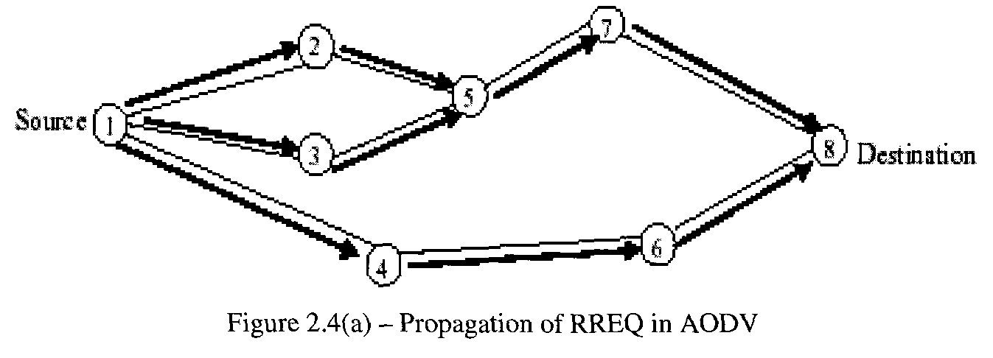
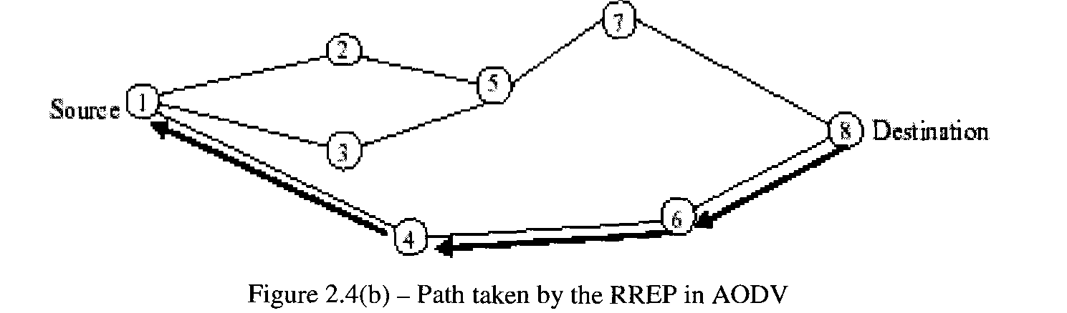

Slide 23
Temporarily Ordered Routing Algorithm (TORA)
■
TORA is a highly adaptive loop-free
distributed routing algorithm based on the concept of link reversal
TORA minimizes reaction due to topological changes
Algorithm tries to localize messages in the
neighborhood of changes
TORA exhibits multipath routing capability Can be compared with water flowing downhill towards a sink node
The height metric is used to model the routing state of the network
Nodes maintain routing information to one-
■
■
■
■
■
■
hop neighbors
Copyright © 2006, Dr. Carlos Cordeiro and Prof. Dharma P. Agrawal, All rights reserved.

Slide 24
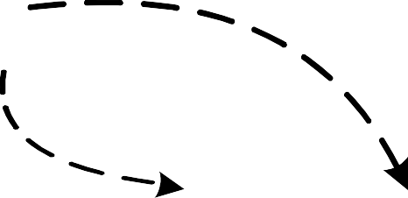

TORA (Cont’d)
Source
Height = 3
Height = 2
Height = 1
Height = 0
Destination
Illustration of TORA height metric
Copyright © 2006, Dr. Carlos Cordeiro and Prof. Dharma P. Agrawal, All rights reserved.

Slide 25
TORA (Cont’d)
■
The protocol performs three basic functions:
Route creation
Route maintenance
Route erasure
A separate directed acyclic graph (DAG) is maintained by each node (MH) to every destination
Route query propagates through the network till it
reaches the destination or an intermediate node containing route to destination
This node responds with update and sets its height to a value greater than its neighbors
When a route to a destination is no longer valid, it adjusts
its height
When a node senses a network partition, it sends CLEAR packet to remove invalid routes
Nodes periodically send BEACON signals to sense the link status and maintain neighbor list
■
■
■
■
■
■

Slide 26
TORA (Cont’d)
2
7 (-,-)
(-,-)
5
(-,-)
Source
1
3
8
Destination
(-,-)
4
(-,-)
(-,-)
(0,0)
6 (-,-)
Propagation of the query message
2
(0,3)
7
(0,1)
5
(0,2)
1
3
8
(0,0)
Source
(0,3)
4
(0,2)
Destination
(0,3)
6
(0,1)
Node’s height updated as a result of the update message
25

Slide 27
TORA Characteristics
■
The height metric in TORA depends on logical time
of a link failure
The algorithm assumes all nodes to be synchronized TORA has 5-tuple metric:
Logical time of link failure
Unique ID of the node that defined the new reference level
A reflection indicator bit
A propagation ordering parameter
Unique ID of the node
The first three elements together describe the reference level
Oscillation can occur using TORA, similar to count- to-infinity problem
TORA is partially reactive and partially proactive
■
■
■
■
■

Slide 28
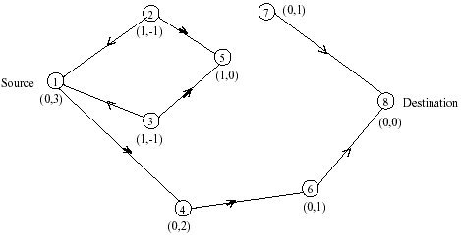
Maintenance in TORA
Route

Slide 29
Hybrid Routing
Zone RAoutpinpg rPoroatoccohl e(ZsRP):
❐
❐
Hybrid of reactive and proactive protocols
Limits the scope of proactive search to the node’s local neighborhood
The node need to identify all its neighbors which are one hop
away
Nodes local neighborhood is defined as a routing zone with a given distance
All nodes within hop distance at most d from a node X are
said to be in the routing zone of node X
All nodes at hop distance exactly d are said to be peripheral nodes of node X’s routing zone
Intra-zone routing: Proactively maintain routes to all nodes within the source node’s own zone
Inter-zone routing: Use an on-demand protocol (similar to DSR or AODV) to determine routes to outside zone
❐
❐
❐
❐
❐
❐

Slide 30
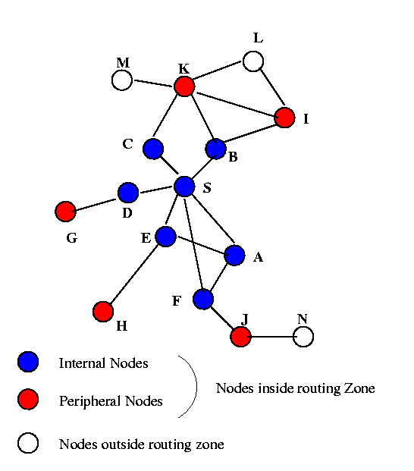
Zone Routing Protocol
(
ZRP)
Radius of routing zone = 2

Slide 31
Hybrid Routing Approaches
■
Interzone routing protocol (IERP) is responsible
■
Uses a query-response mechanism by exploiting the structure of the routing zone, through a process known as bordercasting Bordercast is more expensive than the broadcast flooding used in other reactive protocols as there are many more border nodes than neighbors
Cost of bordercast redundancy reduced by suppressing
mechanisms based on query detection, early termination and loopback termination
Source generates a route query packet with source node’s ID and request number
Sequence of recorded node Ids specifies an accumulated route
from the source to the current routing zone
If the destination is in routing zone, a route reply is sent back to source, along the path specified by reversing the accumulated route
If the destination does not appear in the node’s routing zone,
the node bordercasts the query to its peripheral nodes
■
■
■
■
■
■

Slide 32
Hybrid Routing Approaches
Fisheye State Routing (FSR):
Uses a multi-level Fisheye scopes to reduce routing update overhead in large networks
It helps to make a routing protocol scalable by gathering data on the topology, which may be needed soon
FSR tries to focus its view on nearby changes by observing them with the highest resolution
in time and changes at distant nodes

Slide 33
Hybrid Protocols
Landmark Routing (LANMAR) with group mobility:
Combines the features of FSR and landmark routing
Uses a landmark to keep track of each set of nodes that move together
Borrows the notion of landmarks to keep track of logical subnets
The MHs exchange the link-state and topological
information only with their immediate neighbors
It also piggybacks a distance vector with size equal to the number of logical subnets and thus landmark nodes
A modified version of FSR used for routing by maintaining routing table within the scope and landmark nodes

Slide 34
Hybrid protocols
Cluster-based Routing (CBRP):
❐
This is a partitioning protocol emphasizing support for unidirectional links
Each node (MH) maintains two-hop topology information to define clusters
Each cluster includes an elected cluster head, with which each member node (MH) has a bi-directional link
In addition to exchanging neighbor information for cluster formation, nodes must find and inform their cluster head(s) of status of “gateway” nodes
Cluster infrastructure is used to reduce the cost of disseminating the request
When a cluster head receives a request, it appends its ID and a list of adjacent clusters and rebroadcasts it
Each neighboring node which is a gateway to one of these adjacent clusters unicasts the request to appropriate cluster head
❐
❐
❐
❐
❐
❐

Slide 35
An Overview of
Protocol
Route ChFaloord aforcteDreliaysfotr icMsult ipath
Routing
Protocol
Acquisition
Computed a priori
Route Discovery
No
Route Discovery
No
Capability
Upon Route Failure
Flood route updates throughout the network
Ultimately, updates the routing tables of all nodes by exchanging MRL between neighbors Route error propagated up to the source to erase invalid path
Route error broadcasted to erase multipath
DSDV
No
Computed a priori
WRP
No
No
No
On-demand, only when needed
Yes, aggressive use
of caching may Yes
reduce flood
Yes, conservative use of cache to reduce route discovery delay Usually only one flood for initial DAG construction
Only outside a source's zone
Not explicitly, as the technique of salvaging may quickly restore a route
Not directly, however, multipath AODV (MAODV)
protocol includes this support
DSR
On-demand, only when needed
Yes
AODV
Yes, once the DAG is
constructed, Yes multiple paths
are found
Only if the destination is
Error is recovered locally and only when alternative routes are not available
Hybrid of updating nodes' tables within a zone and
On-demand, only when needed
TORA
ZRP Hybrid
outside the No
propagating rout₃e ₄
Copyright © 2006, Dr. Carlos Cordeiro and Prof. Dh^{s}aºrm^{ur}a^{c}P^{e}.^{'s}A^{z}gºra^{n}w^{e}al, All rights reserved.
error to the source

Slide 36
Position Based Routing
Routing protocols that take advantage of location information
Can be classified according to how many MHs have the service
Forwarding decision by a MH is essentially based on the position of a packet’s destination and the position of the MH’s immediate one-hop neighbor

Slide 37
Position Based Routing
Three main packet forwarding schemes:
Greedy forwarding
Restricted directional flooding
Hierarchical approaches
For the first two, a MH forwards a given packet to one (greedy forwarding) or more (restricted directional flooding) one-hop neighbors
The selection of the neighbor depends on the
optimization criteria of the algorithm
The third forwarding strategy forms a hierarchy in order to scale to a large number of MHs

Slide 38
Position Based Routing
Classification criteria for existing approaches:
Location Service
Some-for some
Some-for-all
All-for some
All-for-all
Forwarding Strategy
Greedy forwarding
Restricted directional
+
flooding
Next-hop selection
Recovery strategy
Copyright © 2006, Dr. Carlos Cordeiro and Prof. DharmaPH. Agireawral,aArll crighhtsirecsearveld.
37

Slide 39
Location Services
■
■
MHs register their current position with this service
When a node does not know the position of a desired communication partner, it contacts the location service and requests that information
In classical one-hop cellular network, there are dedicated position servers, with each maintaining position information about all MHs
In MANETs, such centralized approach is viable only as an eternal service
■
■
❐
First, it would be difficult to obtain the location of a position server if the server is a part of the MANET
Second, since a MANET is dynamic, it might be difficult to
have at least one position server within a given MANET
❐

Slide 40
Distance Routing Effect Algorithm for Mobility
■
Within Distance Routing Effect Algorithm for Mobility (DREAM) framework, each MH maintains a position database that stores the location information about other MHs
An entry in the position database includes a MH identifier, the direction of and distance to the MH, as well as a time value when this information has been generated
A MH can control the accuracy of its position information available to other MHs in two ways:
By changing the frequency at which it sends position
updates and is known as temporal resolution
By indicating how far a position update may travel before it is discarded which is known as spatial resolution
■
■

Slide 41


Distance Effect in DREAM
■
Temporal resolution of sending updates is coupled with the mobility rate of a MH, i.e., the higher the speed is, more frequent the updates will be
Spatial resolution is used to provide accurate position information in the direct neighborhood of a MH and less accurate information at nodes farther away
Costs associated with accurate position information at remote MHs can be reduced since greater the distance separating two MHs is, slower they appear to be moving with respect to each other
■
■
❐
For example, from MH A’s perspective, the change in direction will be greater for MH B than for MH C
C
A B
C
B

Slide 42
Quorum-Based Location
InfSoremravtioincuepdates (write operations) are sent to a
■
subset (quorum) of available nodes, and information requests (read operations) are referred to a potentially different subset
When these subsets are designed such that their intersection is nonempty, it is ensured that an up-to- date version of the sought-after information can always be found
A set of MHs is chosen to host position databases
Next, a virtual backbone is constructed among the MHs of the subset by utilizing a non-position-based ad hoc routing algorithm
A MH sends position update messages to the nearest backbone MH, which then chooses a quorum of
■
■
■
■
backbone MHs to host the position information
41

Slide 43













Quorum-Based Location
Servi¹ce
A
D
6
2
C
B
4
S
5
3
❑
MH D sends its updates to node 6, which might then select quorum A with nodes 1, 2, and 6 to host the information
For example, MH 4 might, choose quorum B, consisting of MHs 4, 5, and 6 for the query
Larger the quorum set is, higher the cost for position updates and queries are
Can be configured to operate as all-for-all, all-for-some, or some-for-some
❑
❑
❑
approach
42

Slide 44





Grid Location Service
■
Divides the area that contains the MANET into a hierarchy of squares, forming a so called quad tree
Each node maintains a table of all other MHs within the local first-order square Establishes near MH IDs, defined as the least ID greater than a MH’s own ID Position information of 10 is available at nodes 15, 18, 73
■
■
■
■
Second order squares Nodes 14, 25, and 29 are selected to host the node 10’s_{Quer}
position
78 y
36
43
Location update
3₃1₁
25
29
64
57
10
15
4488
8₈0₀
56
18
73
34
14
34
14

Slide 45
Homezone
Two almost identical location services have been proposed independently
Both use the concept of a virtual Homezone where position information for a node is stored
By applying a well-known hash function to the node identifier, it is possible to derive the position C of the Homezone for a node
All nodes within a disk of radius R centered
at C have to maintain position information for the node

Slide 46











Greedy Packet Forwarding
r indicates the maximum transmission range of node S
C
S
B
D
r
A
Sender includes an approximate position of the recipient in the packet
This information is gathered by an appropriate location service
Intermediate node forwards packet to a neighbor lying in the direction of recipient
This process can be repeated until recipient has been reached
A good strategy when sender cannot adjust the transmission signal
Copy_{s}ri_{t}g_{r}h_{e}t ©_{ng}20_{th}06, Dr. Carlos Cordeiro and Prof. Dharma P. Agrawal, All rights reserved.
45

Slide 47
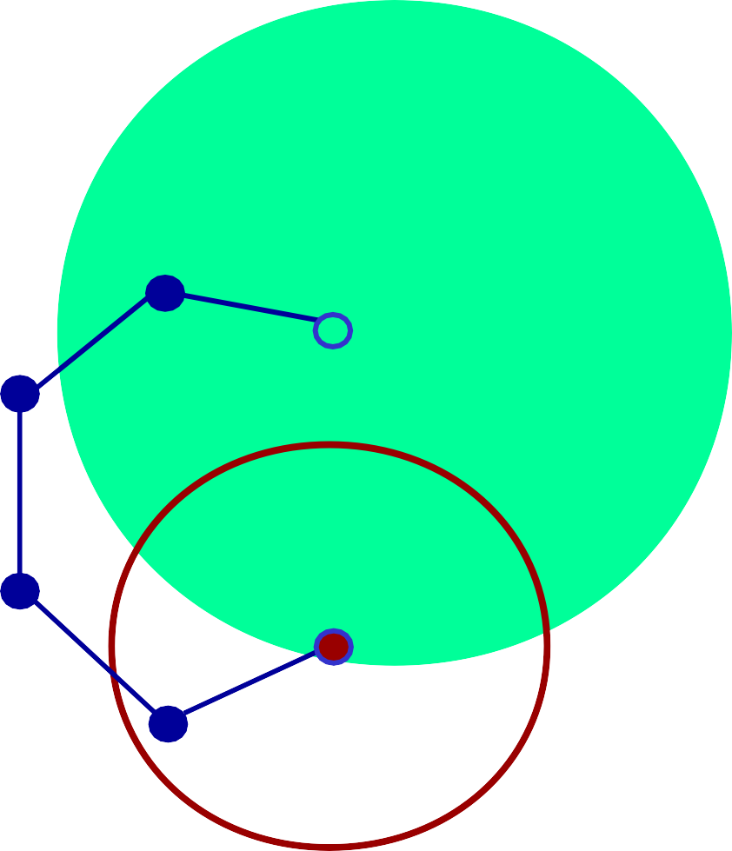
Greedy Packet
Forwarding (Compass Routing)
Forwarding packets in which the neighbor closer to the straight line between sender and destination is selected
■ It is possible to let the sender randomly select one of the nodes closer to the destination than
Greedy routing may fail to find a path between a sender and a destination, even though one does exist
To counter this problem, the packet should be forwarded to the node with the least backward (negative) progress
However, this raises the problem of looping
D
S
Copyright © 2006, Dr. Carlos Cordeiro and Prof. Dharma P. Agrawal, All rights reserved.
46

Slide 48




Greedy Perimeter Stateless Routing
BasePd ornoptlaoncaor glraph traversal
■
■
Nodes do not have to store any additional information
A packet enters the recovery mode when it arrives at a local maximum It returns to greedy mode when it reaches a node closer to the destination
The graph formed by a MANET is generally not planar as shown
A
■
B
■
D
C
■
An edge between two nodes A and B is included in the graph only if the intersection of the two circles with radii equal to the distance between node A and B around those two nodes does not contain any other nodes
The edge between nodes A and C would not be included in the planar subgraph since nodes B and D are contained in the intersection of the
C_{c}o_{i}p_{r}y_{c}rig_{l}h_{e}t_{s}© 2006, Dr. Carlos Cordeiro and Prof. Dharma P. Agrawal, All rights reserved.
47

Slide 49












Planar Graph Traversal
A simple planar graph traversal is used to find a path toward the destination
Forward packet on faces of planar subgraph progressively closer to the destination
On each face from node S toward node D, the packet is forwarded along the interior of the face: forward the packet on the next edge counterclockwise from the edge on which it arrived
Algorithm guarantees that a path will be found in case at least one exists
The header of a packet contains additional information such as the position of the node, the position of the last intersection that caused a face change, and the first edge traversed on
D
S
the current face
Copyright © 2006, Dr. Carlos Cordeiro and Prof. Dharma P. Agrawal, All rights reserved.
48

Slide 50
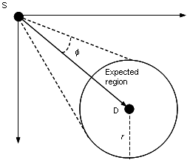
Restricted Directional
Flooding
Sender node S of a packet with destination node D forwards the packet to all one-hop neighbors that lie “in the direction of node D”
Expected region is a circle around position of node D as it is known by node S
■
“Direction towards node D” is defined by the line between nodes S and D and the angle φ

Slide 51

Expected Zone Routing
Location-Aided Routing (LAR) uses position information to enhance the route discovery phase of reactive ad hoc routing approaches
LAR uses this position information to restrict the flooding to a certain area called request zone at the time of route discovery
If node S knows that node D travels with average speed v, then the expected zone is the circular region of radius v(t₁ - t₀), centered at
location L
Expected zone is only an estimate made by node S to determine a region that potentially contains D at time t₁
■
■
■
■
v (t₁ – t₀)
L
L

Slide 52
Expected Zone Routing
■
■
■
■
Request zone can be defined based on the expected zone
Node S defines a request zone for the route request
A node forwards a route request only if it belongs to the request zone To increase the probability to reach node D, the request zone should include the expected zone
Additionally, the request zone may also include other regions around the request zone
■
A(X_{S}, Y_{d}+R)
P(X_{d}, Y_{d}+R)
B(X_{d}+R, Y_{d}+R)
R
Q(X_{d}+R, Y_{d})
D(X_{d}, Y_{d})
Expected zone I(X_{i}, Y_{i})
J(X_{j}, Y_{j})
S(X_{S}, Y_{S})
C(X_{d}+R, Y_{S})
Request zone
Copyright © 2006, Dr. Carlos Cordeiro and Prof. Dharma P. Agrawal, All rights reserved.
51

Slide 53
Relative Distance Micro- Discovery Ad Hoc Routing
■
Relative Distance Micro-discovery Ad Hoc Routing (RDMAR) routing protocol, an adaptive and scaleable routing protocol, is well suited in large mobile networks whose rate of topological changes is moderate
Design is a typical localized reaction to link failures in a
very small region of the network near the change Desirable behavior is achieved through the use of a flooding mechanism for route discovery, called Relative Distance Micro-discovery (RDM)
An iterative algorithm calculates an estimate of their RD
given their previous RD, an average nodal mobility and information about the elapsed time since they last communicated
Query flood is then localized to a limited region of the
network centered at the source node of the route discovery and with maximum propagation radius that equals to the estimated relative distance
■
■
■
■

Slide 54
Relative Distance Micro- Discovery Ad Hoc Routing
■
Packets are routed between the stations of the network by using routing tables which are stored at each station
Each routing table lists all reachable destinations, wherein for each destination j, it includes: the “Default Router” field
“Time_Last_Update” (TLU) field that indicates the time since the node last
received routing information for j
“RT_Timeout” field which records the remaining amount of time before the route is considered invalid
“Route Flag” field which declares whether the route to j is active
■
■
■
■
Two main algorithms are:
■
Route Discovery
When an incoming call arrives at node i for destination node j and there is no route available, i initiates a route discovery phase
Either to flood the network or limit discovery in a smaller region of the network
Route Maintenance
Upon receipt of a data packet, first processes the routing header, forwards the packet to the next hop, and send an explicit message to examine whether a bi-directional link can be established with the previous node
■

Slide 55
Hierarchical Routing
Complexity of the routing algorithm can be reduced tremendously by establishing some form of hierarchy
Terminodes Routing
■
■
Combines hierarchical and position-based routing with two levels of hierarchy
Packets are routed according to a proactive distance vector scheme if the destination is close to the sending node
Once a long distance packet reaches the area close to the recipient, it continues to be forwarded by means of the local routing algorithm
To prevent greedy forwarding, the sender includes a list of positions in the packet header
■
■
Grid Routing
■
■
Position-based hierarchical routing
A proactive distance vector routing protocol is used at the local level, while position- based routing is employed for long-distance packet forwarding
Packets that are addressed to a position-unaware node arrives at a position-aware proxy Then forwarded according to the information of the proactive distance vector protocol
As a repair mechanism for greedy long-distance routing, a mechanism called Intermediate Node Forwarding (INF) is proposed
If a forwarding node has no neighbor with forward progress, it discards the packet and sends a notification to the sender of the packet
■
■
■
■

Slide 56
Other Position-based
Routing
The GPS-based systems do not provide good accuracy inside the building and the surrounding area can be classified in the following five categories:
■
Typical office environment with no line-of-sight (NLOS) with 50ns delay spread
Large open space with 100ns delay spread with NLOS
Large indoor or outdoor space with 150ns delay spread with NLOS
Large indoor or outdoor space with line-of-sight and 140ns delay spread
Large indoor or outdoor space with NLOS and 250ns delay spread
■
■
■
■

Slide 57
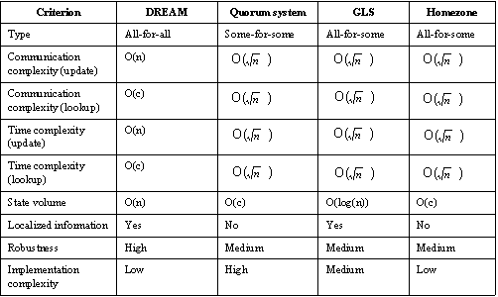
Location
Comparison of
Services

Slide 58
Comparison of location
DRE_{s}A_{e}M_{rv}is_{i}f_{c}u_{e}nd_{s}amentally different from other
■
position services, as it requires all MHs to maintain position information about every other MH
The time required to perform a position update in DREAM is a linear function of the diameter of the network, leading to a complexity of O( n )
Quorum system requires the same operations for position updates and position lookups
Quorum system depends on a non-position-based ad hoc routing protocol
Each node in GLS and Homezone selects a subset of all available nodes as position servers
■
■
■
■

Slide 59
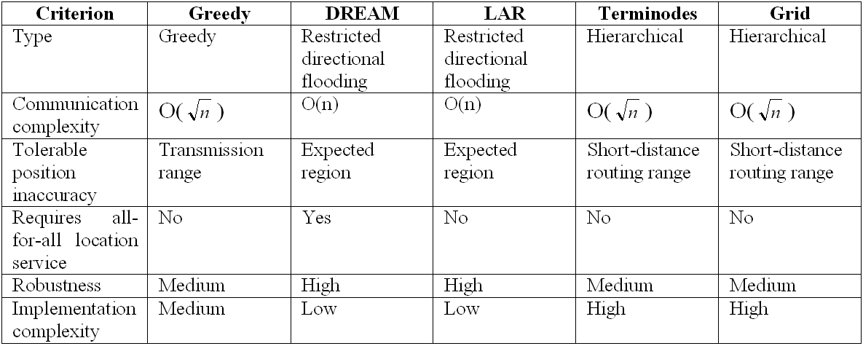
Comparison of forwarding schemes (n = number of
nodes)

Slide 60
Summary of Forwarding
ComSmcuhniecamtionescomplexity indicates the average number of
■
one-hop transmissions required to send a packet from one node to another node with known position
Need to tolerate different degrees of inaccuracy with regard to the position of the receiver
Forwarding requires all-for-all location service criterion Robustness is high if the failure of a single MH does not prevent the packet from reaching its destination Greedy forwarding is efficient, with a communication
complexity of O( n ), and is well suited for use in MANETs with a highly dynamic topology
The face-2 algorithm and the perimeter routing of GPSR are currently the most advanced recovery strategies
Restricted directional flooding, as in DREAM and LAR, has communication complexity of O(n) and therefore does not scale well for large networks with a high volume of data transmissions
■
■
■
■
■
■

Slide 61
Signal Stability Routing
On-dPemraondtSoigcnaol Sltability-Based Adaptive Routing protocol (SSR)
■
selects routes based on the signal strength (weak or strong) between nodes and a node’s location stability
The net effect is to choose routes that have “stronger” connectivity Two cooperative protocols used: Dynamic Routing Protocol (DRP) and Static Routing Protocol (SRP)
DRP is responsible for the maintenance of Signal Stability Table
(SST) and the Routing Table (RT)
DRP passes the packet to the SRP which passes the packet up the stack if it is the intended receiver, or looks up in the routing table for the destination
If no entry is found in the routing table, a route search process is initiated
If there is no route reply received at the source within a specified timeout period, the source changes the PREF field in the packet
header to indicate that weak channels have been accepted
■
■
■
■
■
■

Slide 62
Other Routing Protocols
Power Aware Routing
❐
Power-aware metrics are used for determining routes in MANETs
A shortest-cost routing algorithm reduces the cost/packet
of routing packets by 5 - 30 percent over shortest-hop routing
Mean time to node failure is increased significantly, while packet delays do not increase
❐
❐
Associativity-Based Routing
❐
❐
Objective: to derive long-lived routes for ad hoc networks A route is selected based on a metric that is known as the degree of association stability
Periodically generated beacon signifies existence
The three phases are: Route discovery; Route reconstruction (RRC); and Route deletion
RRC may consist of partial route discovery, invalid route
erasure, valid route updates, and new route discovery
❐
❐
❐

Slide 63


QoS Routing
■
All routing protocols proposed either for routing along shortest available path or within some system-level requirement
Such paths may not be adequate for QoS required applications Shortest path route A-B-H-G will have a lower bandwidth The path A-B-C-D-E-F-G will have a minimum bandwidth of 4
Shortest path
■
■
■
A
4
QoS satisfying path
D
B
5
5
A QoS routing example in a MANET
6
3
4
E
G
4
5
Numbers represent available
3
4
F
J
I
H
1
bandwidth
Copyright © 2006, Dr. Carlos Cordeiro and Prof. Dharma P. Agrawal, All rights reserved.
62

Slide 64
Core Extraction
Distributed Ad Hoc
Routing
Core Extraction: A set of nodes is elected to form the core that maintains the local topology of the nodes in its domain and performs route computation
Link State Propagation: Propagates bandwidth availability information of stable links to all core nodes
Route Computation: Establishes a core path from the domain of the source to the domain of the destination
■
■
■
Incorporating QoS in Flooding-based Route Discovery
■
To limit the amount of flooding, a logical ticket-based probing algorithm with imprecise state model for discovering a QoS-aware routing path
A probing message is split into multiple probes and forwarded to different next-hops, with each child probe containing a subset of the tickets from their parents
When one or more probe(s) arrive(s) at the destination, the hop-by-hop path known and delay/bandwidth information can be used to reserve QoS-satisfying path
■
■

Slide 65
QoS support using Bandwidth
Calculations
Involves end-to-end bandwidth calculation and allocation
Source node can determine the resource availability for supporting the required QoS
Need to know how to assign the free slots at each hop
Time slots 1, 2, and 3 are free between nodes A and B, and slots 2, 3, and 4 are free between nodes B and C
There will be collisions at node B if node A tries to use all three slots 1, 2, and 3 to send data to node B while node B is using one or both slots 2 and 3 to send data to node C
❐
Need to divide common free slots 2 and 3 between the two links
A
B
Slots (1, 2, 3)
Slots (2, 3, 4)
C

Slide 66
Multi-path QoS Routing
■
Suitable for ad hoc networks with very limited bandwidth for each path
Algorithm searches for multiple paths for the QoS route Adopts the idea of ticket-based probing scheme
Enhances routing resiliency by finding node/edge disjoint paths when link and/or node fail
Another approach is to use extension of AODV to determine a backup source-destination routing path if the path gets disconnected frequently due to mobility or changing link signal quality
A backup path can be easily piggybacked in data packets
■
■
■
■
■

Slide 67
Conclusions and Future
Directions
■
Routing is undoubtedly the most studied aspect of ad hoc networks
Yet, many issues remain open such as more robust security solutions, routing protocol scalability, QoS support, and so on ….
Integration of MANETs and infrastructure-based networks such as the Internet will be an important topic in wireless systems beyond 3G
Availability of Dynamic Host Configuration Protocol (DHCP) servers many not be practical to get IP addresses
Nodes (MHs) have to resort to some heuristic to obtain their IP addresses
Routing algorithms for MANETs are equally applicable to sensor networks except for low mobility, much larger number of sensor nodes and use of small battery
■
■
■
■
■

