Slide 1
SECURITY

Slide 2
Introduction
Security is one of the most important principles , since security need to be pervasive through the system.
Security Policy
Security policy is just a statement about what is allowed and not allowed to do in a system.
Security Mechanism
Security mechanism is a procedure how to implement the security policy. It is said to be a tool, methodology or procedures for security enforcement.

Slide 3
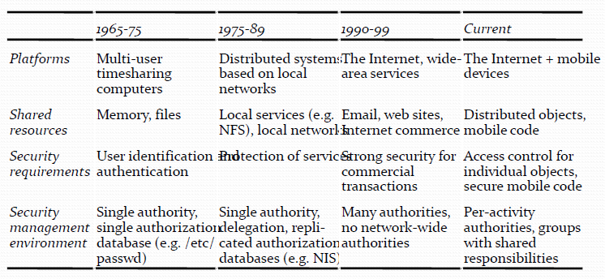
Historical context: the evolution of security needs

Slide 4
Threats and Attacks
Threat : is a possible danger that might exploit a vulnerability to breach security and thus cause possible harm.

Slide 5
Classes of threats
Leakage: Refers to the acquisition of information by unauthorized recipients.
Tampering: Refers to the unauthorized alteration of information.
Vandalism: Refers to interference with the proper operation of a system without gain to the perpetrator.

Slide 6
Attack : is any attempt to destroy, expose, alter, disable, steal or gain unauthorized access to or make unauthorized use of an asset.
Methods of attacks
Eavesdropping: Obtaining copies of messages without authority.
Masquerading: Sending or receiving messages using the identity of another principal without their authority.
Message tampering: Intercepting messages and altering their contents before passing them on to the intended recipient. The man-in-the-middle attack is a form of message tampering
Replaying: Storing intercepted messages and sending them at a later date.
Denial of service: Flooding a channel or other resource with messages in order to deny access for others.

Slide 7
Information leakage
Information Leakage is an application weakness where an application reveals sensitive data, such as technical details of the web application, environment, or user-specific data.
The approach taken is to assign security levels to information and channels and to analyze the flow of information into channels with the aim of ensuring that high-level information cannot flow into lower-level channels.

Slide 8
Securing electronic transactions
Email
Purchase of goods and services
Banking transactions
Micro-transactions
Transactions such as these can be safely performed only when they are protected by appropriate security policies and mechanisms.

Slide 9
Security policies for Internet vendors and buyers lead to the following requirements for securing web purchases:
Authenticate the vendor to the buyer, so that the buyer can be confident that they are in contact with a server operated by the vendor with whom they intended to deal.(authentication)
Keep the buyer’s credit card number and other payment details from falling into the hands of any third party and ensure that they are transmitted unaltered from the buyer to the vendor.(leakage)
If the goods are in a form suitable for downloading, ensure that their content is delivered to the buyer without alteration and without disclosure to third parties.(tampering)
Authenticate the identity of the account holder to the bank before giving them access to their account.(Access Control)

Slide 10
Designing secure systems
Security is about avoiding disasters and minimizing mishaps.
To demonstrate the validity of the security mechanisms employed in a system, the system’s designers must first construct a list of threats – methods by which the security policies might be violated – and show that each of them is prevented by the mechanisms employed.

Slide 11
Overview of Security Techniques
This introduces the reader to some of the more important techniques and mechanisms for securing distributed systems and applications.

Slide 12
Worst case Assumptions & Design Guidelines

Slide 13
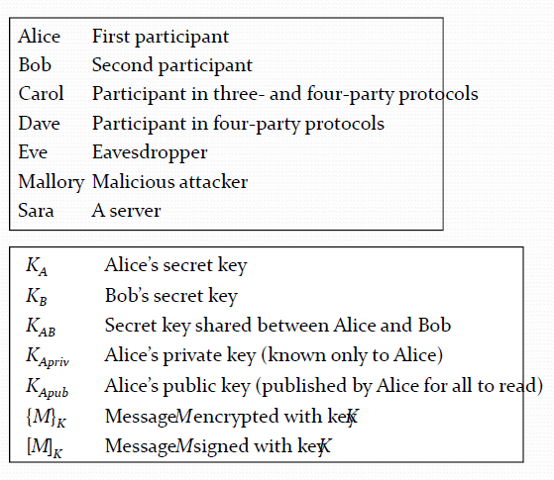
Security Notations

Slide 14
Cryptography
Encryption is the process of encoding a message in such a way as to hide its contents.
Secure algorithms for encrypting and decrypting messages are all based on the use of secrets called keys.
Two main classes of encryption algorithm
shared secret keys
public/private key pairs

Slide 15
Uses of cryptography
Secrecy and integrity
Cryptography is used to maintain the secrecy and integrity of information whenever it is exposed to potential attacks.
It maintains the secrecy of the encrypted message as long as the decryption key is not compromised.
It also maintains the integrity of the encrypted information, provided that some redundant information such as a checksum is included and checked.

Slide 16
Scenario 1. Secret communication with a shared secret key: Alice wishes to send some information secretly to Bob. Alice and Bob share a secret key KAB.
1. Alice uses KAB and an agreed encryption function E(KAB, M) to encrypt and send any number of messages {Mi}KAB to Bob.
2. Bob decrypts the encrypted messages using the corresponding decryption function D(KAB, M).
Issues:
Key distribution: How can Alice send a shared key KAB to Bob securely?
Freshness of communication: How does Bob know that any {Mi} isn’t a copy of an earlier encrypted message from Alice that was captured by Mallory and replayed later?

Slide 17
Authentication
Cryptography is used in support of mechanisms for authenticating communication between pairs of principals.
key is known only to two parties.

Slide 18
Scenario 2: Authenticated communication with a server
Bob is a file server;
Sara is an authentication service.
Sara shares secret key KA with Alice and secret key KB with Bob.
Alice sends an (unencrypted) message to Sara stating her identity and requesting a ticket for access to Bob.
Sara sends a response to Alice. {{Ticket}KB, KAB}KA. It is encrypted in KA and consists of a ticket (to be sent to Bob with each request for file access) encrypted in KB and a new secret key KAB.
Alice uses KA to decrypt the response.
Alice sends Bob a request R to access a file: {Ticket}KB, Alice, R.
The ticket is actually {KAB, Alice}KB. Bob uses KB to decrypt it, checks that Alice's name matches and then uses KAB to encrypt responses to Alice.

Slide 19
Scenario 3. Authenticated communication with public keys
Bob has a public/private key pair <KB_{pub}, KB_{priv}>
Alice obtains a certificate that was signed by a trusted authority stating Bob's public key Kb_{pub}.
Alice creates a new shared key KAB, encrypts it using Kbpub using a public‐key algorithm and sends the result to Bob.
Bob uses the corresponding private key KB_{priv} to decrypt it.
(If they want to be sure that the message hasn't been tampered with, Alice can add an agreed value to it and Bob can check it.)

Slide 20
Mallory might intercept Alice’s initial request to a key distribution service for Bob’s public‐key certificate and send a response containing his own public key. He can then intercept all the subsequent messages.

Slide 21
Digital signatures
Cryptography is used to implement a mechanism known as a digital signature.
This is similar to conventional signature, verifying to a third party that a message or a document is an unaltered copy of one produced by the signer.
This can be achieved by encrypting the message called a digest – using a key that is known only to the signer.
A digest is a fixed-length value computed by applying a secure digest function.
The resulting encrypted digest acts as a signature that accompanies the message.
The originator generates a signature with their private key, and the signature can be decrypted by any recipient using the corresponding public key.

Slide 22
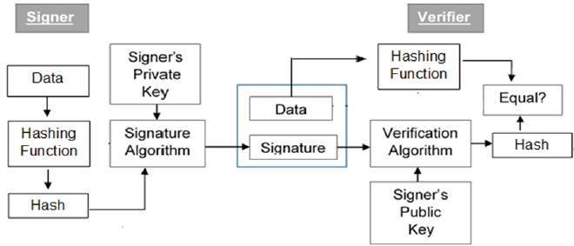
Model of Digital Signature

Slide 23
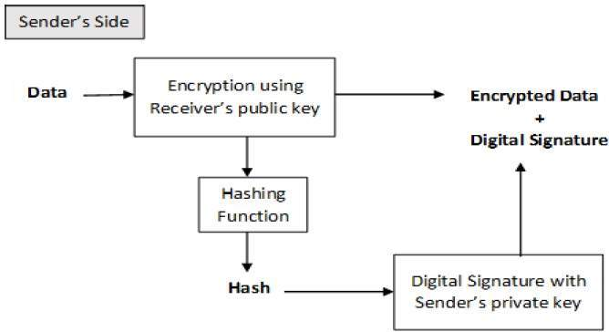
Encryption

Slide 24
Scenario 4 Digital signatures with a secure digest function
Alice wants to publish a document M in such a way that anyone can verify that it is from her.
Alice computes a fixed‐length digest of the document Digest(M).
Alice encrypts the digest in her private key, appends it to M and makes the resulting signed document
(M, {Digest(M)}KA_{priv}) available to the intended users.
Bob obtains the signed document, extracts M and computes Digest(M).
Bob uses Alice's public key to decrypt {Digest(M)}Ka_{priv} and compares it with his computed digest. If they match, Alice's signature is verified.

Slide 25
Certificates
A digital certificate is a document containing a statement (usually short) signed by a principal.
Scenario 5. The use of certificates:
Bob is a bank.
Bob needs to authenticate his customers before he gives them access to their accounts.

Slide 26
Alice wants the certificate from her bank stating her bank account number.
Alice’s bank account certificate
1. Certificate type: Account number
2. Name: Alice
3. Account: 6262626
4. Certifying authority: Bob’s Bank
5. Signature: {Digest(field 2 + field 3)}KBpriv).
Alice could use this certificate when shopping to certify that she has an account with Bob’s Bank.
The certificate is signed using Bob’s private key, KBpriv.
A vendor, Carol, can accept such a certificate for charging items to Alice’s account provided that she can validate the signature in field 5.

Slide 27
Carol needs to have Bob’s public key.
Assume that Fred represents the Bankers Federation, one of whose roles is to certify the public keys of banks. Fred could issue a public-key certificate for Bob.
Public-key certificate for Bob’s Bank
1. Certificate type: Public key
2. Name: Bob’s Bank
3. Public key: KBpub
4. Certifying authority: Fred – The Bankers Federation
5. Signature: {Digest(field 2 + field 3)}KFpriv).

Slide 28
Access control
Historically, the protection of resources in distributed systems has been largely service-specific. Servers receive request messages of the form <op, principal, resource>.
In object-oriented distributed systems there may be many types of object to which access control must be applied, and the decisions are often application-specific.

Slide 29
Protection domains
A protection domain is an execution environment shared by a collection of processes: it contains a set of
<resource, rights> pairs.
Lists the resources that can be accessed by all processes executing within the domain and specifying the operations permitted on each resource.

Slide 30
Cryptographic algorithms
The encryption transformation is defined with two parts, a function E and a key K. The resulting encrypted message is written {M}K .
E(K, M) = {M} K
Decryption is carried out using an inverse function D, which also takes a key as a parameter. For secret-key encryption, the key used for decryption is the same as that used for encryption:
D(K, E(K, M)) = M

Slide 31
Symmetric (secret key)
E(K, M) = {M}K
D(K, E(K, M)) = M
Same key for E and D
M must be hard (infeasible) to compute if K is not known.
Usual form of attack is brute‐force: try all possible key values for a known pair M,{M}K. Resisted by making K sufficiently large ~ 128 bits.

Slide 32
Asymmetric (public key)
Separate encryption and decryption keys: Ke, Kd
D(Kd. E(Ke, M)) = M
depends on the use of a trap‐door function to make the keys.
A trap-door function is a one-way function with a secret exit – it is easy to compute in one direction but infeasible to compute the inverse unless a secret is known.
Notes:
An example of a simple mathematical trapdoor is "6895601 is the product of two prime numbers. What are those numbers?" A typical solution would be to try dividing 6895601 by several prime numbers until finding the answer. However, if one is told that 1931 is one of the numbers, one can find the answer by entering "6895601 ÷ 1931" into any calculator.

Slide 33
Block Ciphers
Most encryption algorithms operate on fixed-size blocks of data;
64 bits is a popular size for the blocks.
A message is subdivided into blocks, the last block is padded to the standard length if necessary and each block is encrypted independently.
The first block is available for transmission as soon as it has been encrypted.

Slide 34
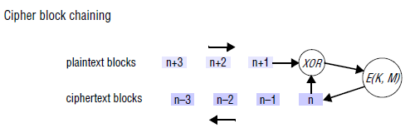
Cipher block chaining

Slide 35
Stream ciphers
Stream ciphers are encryption algorithms that can perform encryption incrementally, converting plain text to cipher text one bit at a time.

Slide 36
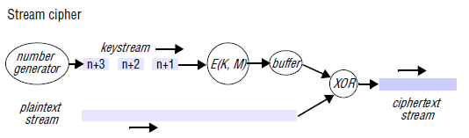

Slide 37
Symmetric key encryption algorithm
Symmetric-key algorithms are a class of algorithms for cryptography that use trivially related, often identical, cryptographic keys for both decryption and encryption.
Types of symmetric-key algorithms
stream ciphers
block ciphers

Slide 38
RC4 : An Example of Symmetric Algorithm
RC4 designed in 1987 by RSA (Ron Rivest, Adi Shamir, and Leonard Adleman) .
symmetric key encryption algorithm .
Stream Cipher .

Slide 39
Symmetric encryption algorithms
TEA (Tiny Encryption Algorithm)
The TEA algorithm uses rounds of integer addition, XOR (the ^ operator) and bitwise logical shifts (<< and >>) to achieve diffusion and confusion of the bit patterns in the plaintext.
The plaintext is a 64-bit block represented as two 32-bit integers in the vector text[]. The key is 128 bits long, represented as four 32-bit integers.
The use of XOR and shifted portions of the text provides confusion, and the shifting and swapping of the two portions of the text provides diffusion.

Slide 40
DES
The encryption function maps a 64-bit plaintext input into a 64-bit encrypted output using a 56-bit key.
The algorithm has 16 key-dependent stages known as rounds, in which the data to be encrypted is bit-rotated by a number of bits determined by the key.
Triple-DES (or 3DES) is frequently used.
This involves applying DES three times with two keys, K1 and K2:
E3DES(K1, K2, M)= EDES (K1, EDES (K2, EDES(k1,M)))

Slide 41
IDEA
It uses a 128-bit key to encrypt 64-bit blocks.
Its algorithm is based on the algebra of groups and has eight rounds of XOR, addition modulo 2^16 and multiplication.
For both DES and IDEA, the same function is used for encryption and decryption: a useful property for algorithms that are to be implemented in hardware.

Slide 42
Public-key (asymmetric) algorithms
The keys Ke and Kd are a pair of very large numbers, and the encryption function performs an operation, such as exponentiation on M, using one of them. Decryption is a similar function using the other key.
RSA

Slide 43
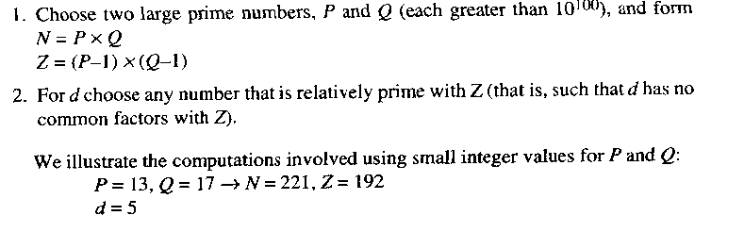
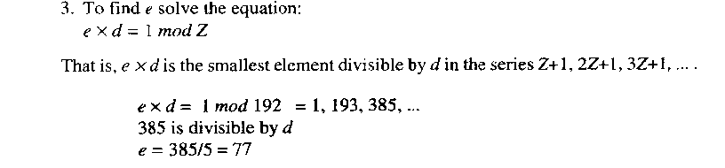
RSA ALGORITHM (Rivest, Shamir and adleman)- example: GENERATING PUBLIC KEY

Slide 44
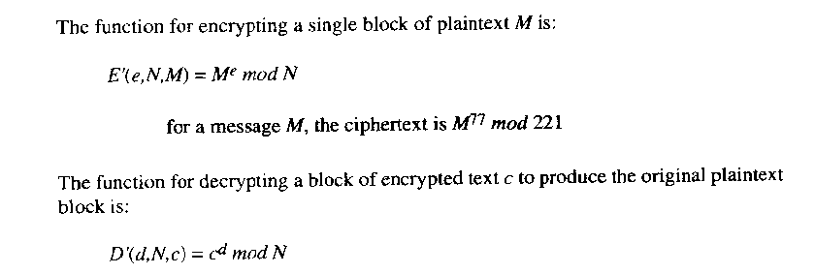
RSA

Slide 45
Encryption & Decryption
Suppose if M=2 Encrypt & Decrypt using RSA
E=Me ModN
E=2⁷⁷Mod 221
=(151115727451828646838272)Mod221=32
D=E^{d}ModN
D=(32)⁵Mod221=(33554432)Mod221=2(M)

Slide 46
Encryption & Decryption
If M=3 Encrypt & Decrypt using RSA
E=Me ModN
E=3⁷⁷Mod 221
=( 5.4744010894202193820771559335698e+36)Mod221=165
D=E^{d}ModN
D=(165)⁵Mod221=( 122298103125)Mod221=3

