Slide 1
Student Results Management System
1
Presented By
Md. Ikbal Hossain
ID: 201611044021
Batch: 44th(Day)
Supervised By
Md. Sohel Mojumder
Lecturer ,Department Of CSE
BANGLADESH UNIVERSITY

Slide 2
Abstract :
2
The project titled “STUDENT RESULT MANAGEMENT SYSTEM” is a web based application developed to maintain the results of the students.
This project contains three modules. register/login module, admin module and student module. Admin module is used to create and manage the subjects ,classes and Add the students and their results. Student module used to provide the results of the students and can download the results.
Registered users can access the database of the students.
which will provide details about subjects, classes, results, And student can download results .which is useful for the students.

Slide 3
EXISTING SYSTEM
3
Existing process of the getting information for the student is done manually.
All the wanted information need to be provided by the administration.
If the students want to know the results of the particular subject so their should wait for long time because work done manually.
The information about their courses , results and other information accessing is not possible.

Slide 4
PROPOSED SYSTEM
4
We have successfully proposed the “STUDENT RESULT MANAGEMENT SYSTEM” for replacing the manual work of the administration.
By this application student can easily access the modules like student results and courses other information required to student.
This application is flexible and can easily access by the student .
So the time taken for getting the information will be reduces.

Slide 5
SYSTEM REQUIREMENT
5
○ Hardware Requirement and
○ Software Requirement

Slide 6
SOFTWARE REQUIREMENTS
6
○ Front-End Design : HTML , CSS, JS, Bootstrap
○ Back-End Database : Microsoft SQL Server, PHP

Slide 7
Modules
7
1.Student Module
2.Admin Module

Slide 8
Student Module
8
2.Student Module:
students can view the results.
student can download the results..

Slide 9
Admin Module
9
3.Admin Module:
Create and manage the subjects , classes and can add the students
and their results of the students.
Reports for various modules
Update or deleting the admin information

Slide 10
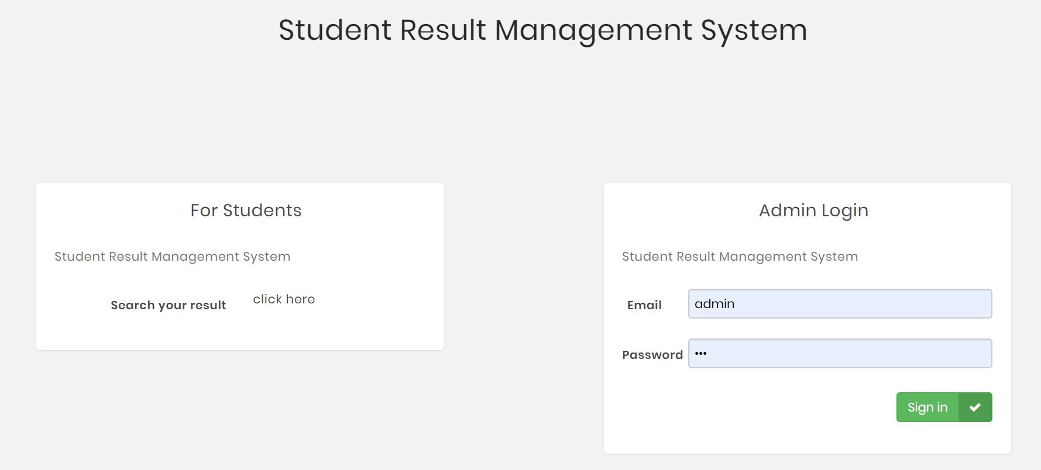
index
10

Slide 11
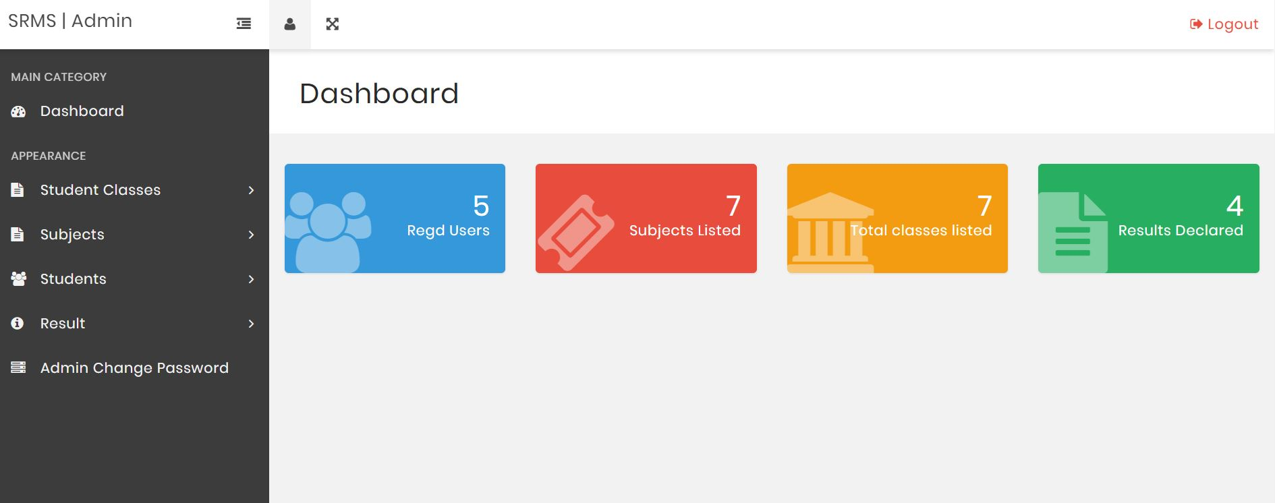
Dashboard
11

Slide 12
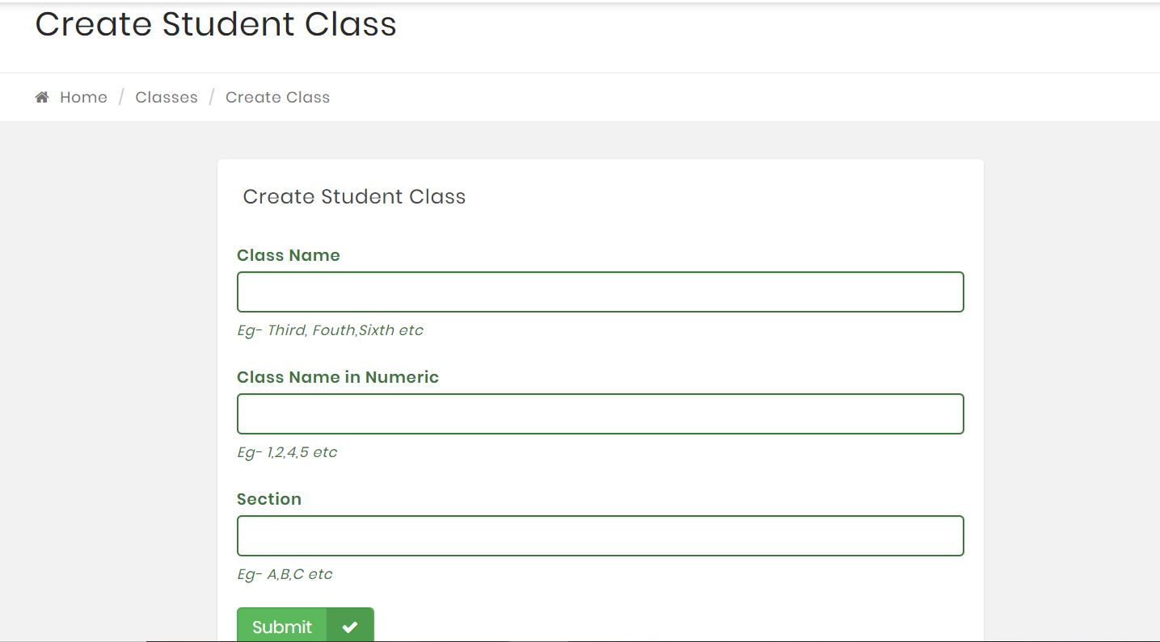
Student Create
12

Slide 13
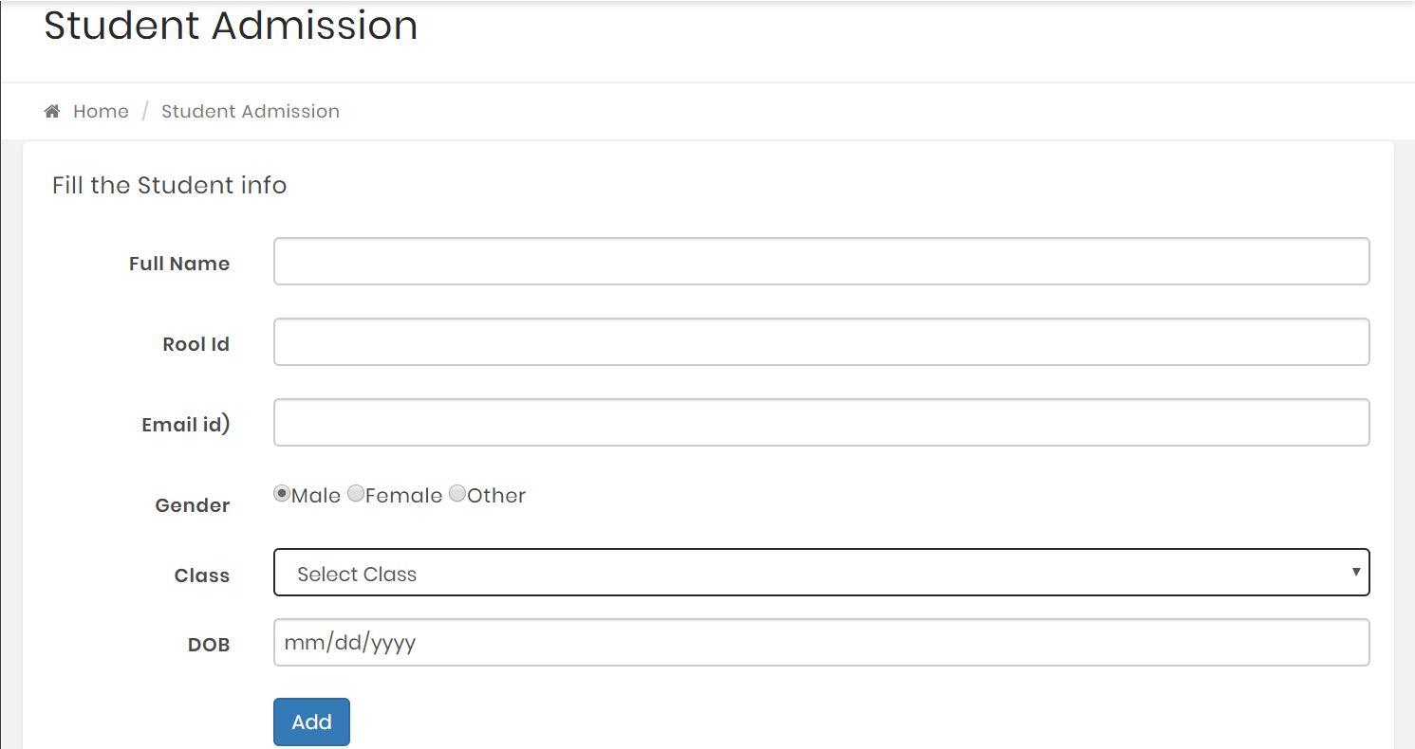
Student Admission
13

Slide 14
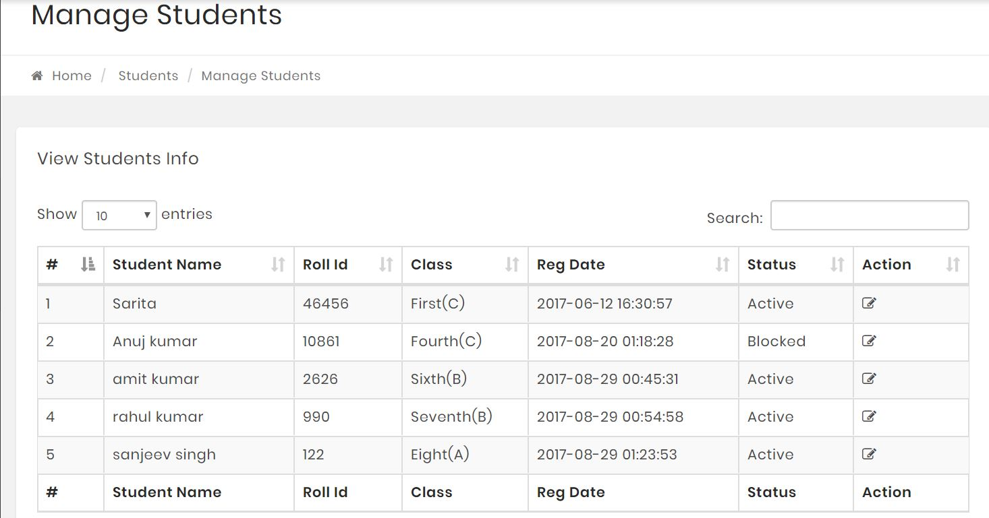
Manage Student
14

Slide 15
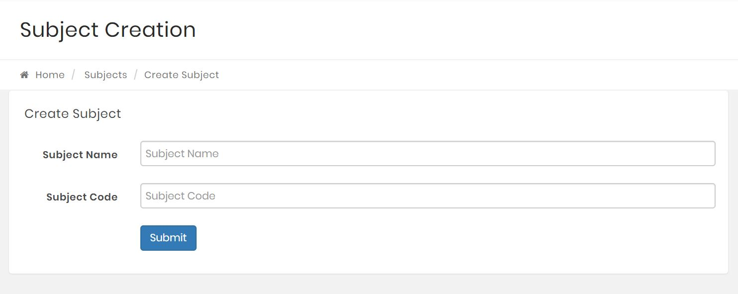
Subject Create
15

Slide 16
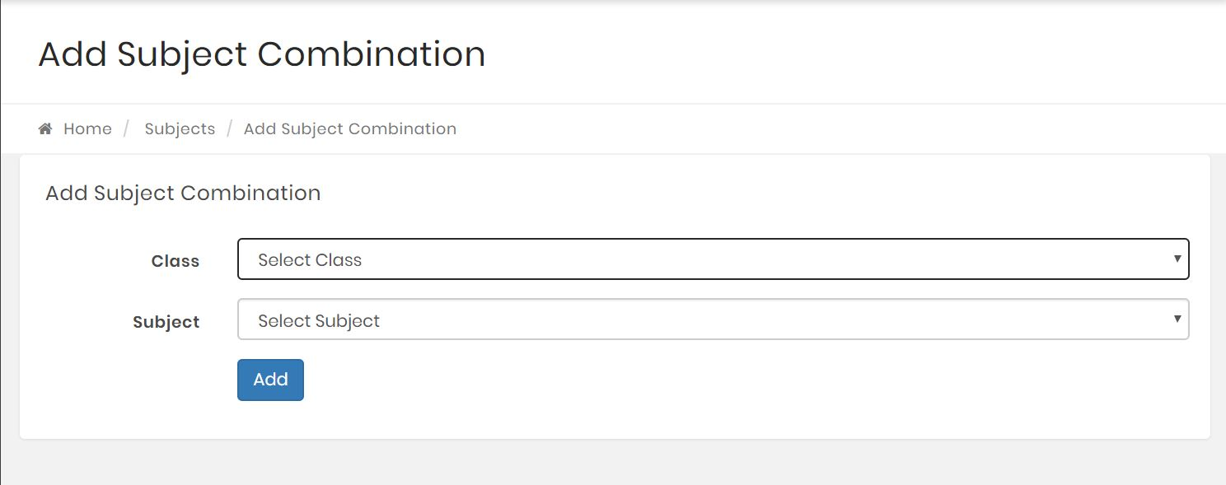
Subject Combination
16

Slide 17
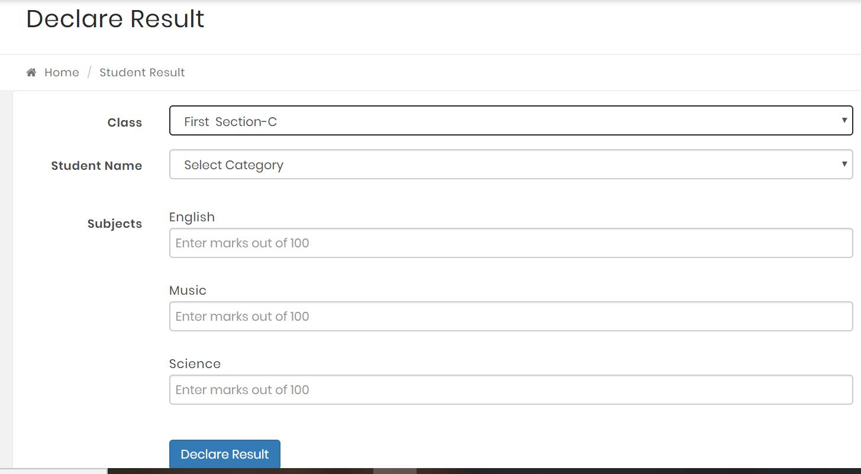
Result Declare
17

Slide 18
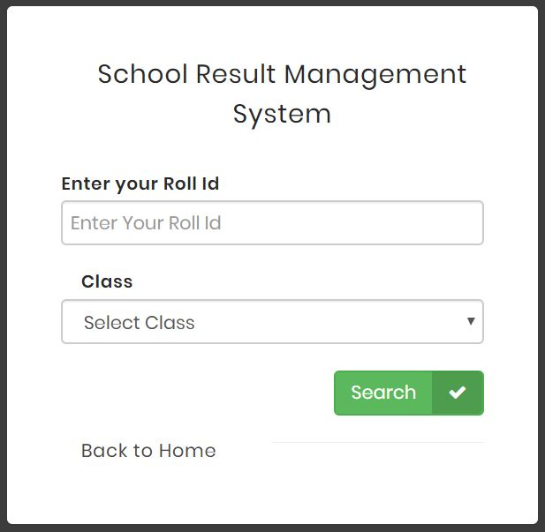
Result Search
18

Slide 19
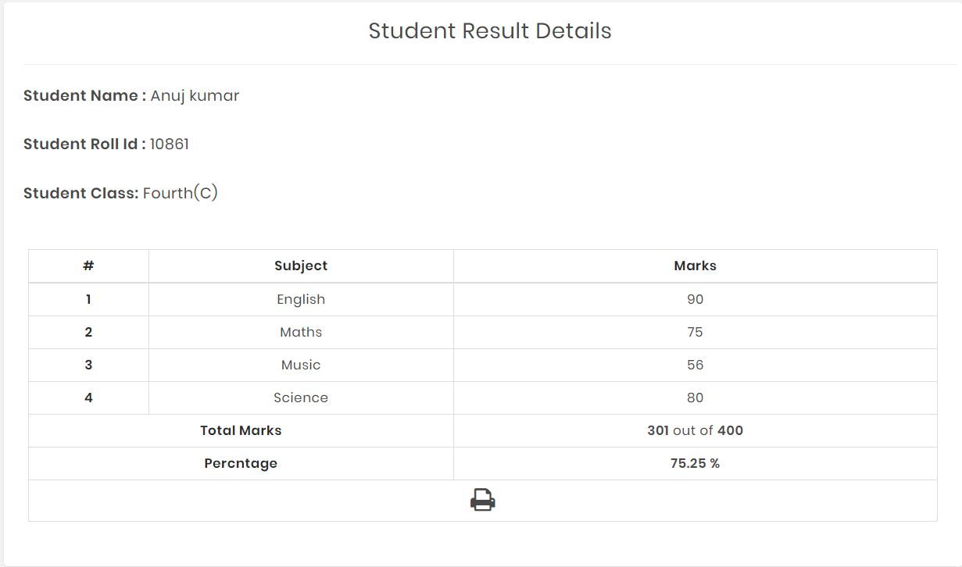
Student Result Details
19

Slide 20
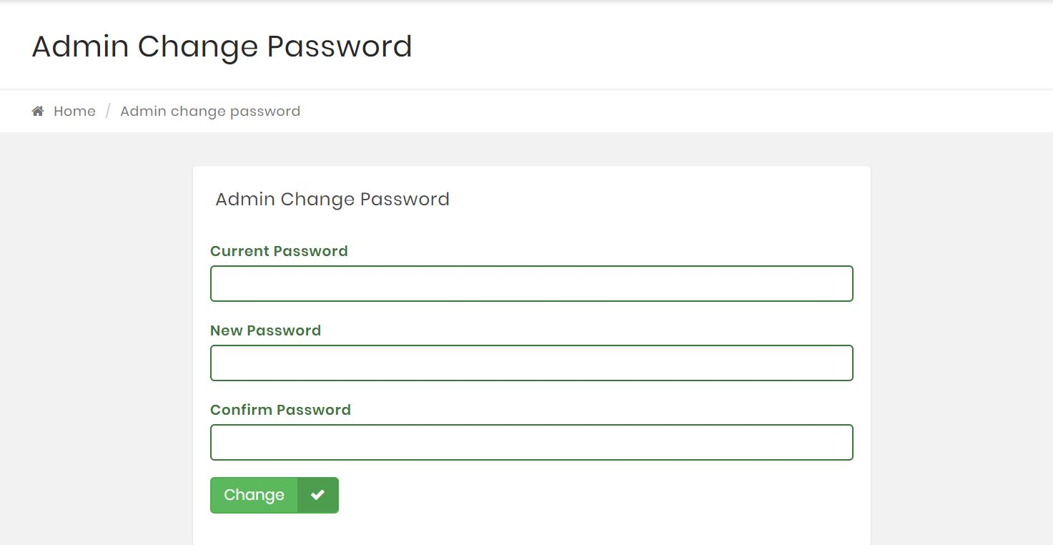
Admin Change Password
20

Slide 21
THANK YOU
21

