Slide 1


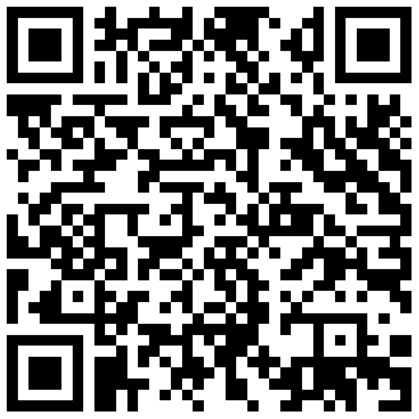
An approach to the study of the social perception of science based on the representational model of measurement
Ramón Iker Soria Royuela
Ana Muñoz van den Eynde
Unai Coto Suárez
Science, Technology and Society Research Unit - CIEMAT

Slide 2
Typical limitations of Social Studies of Science (SSS) research with surveys
Surveys do not record real behaviours.
There is an underlying difficulty in accessing certain population groups (Ellard-Gray et al., 2015; Shield and Rehm, 2012).
They are dependent on the mode of administration (Holbrook et al., 2003).
Little room for manoeuvre in participants' responses.
Other types of measurement error and bias (Groves, 2005).

Slide 3
Current challenges of (SSS) survey research
Methodological side:
Decline in survey response rate (Luiten et al, 2020).
Attrition in online surveys.
Evidence of the negative results of long questionnaires (Fan and Yan, 2010).
The effect of cognitive effort in A/D questionnaires (Höhne et al, 2017).
Increased prices.
Theoretical side:
A need for theoretical models to explain public understanding of science (Pardo and Calvo, 2002)
Conceptual problems with measurements already in place (Pardo and Calvo, 2004)

Slide 4


What is Item Response Theory?
Feature | Classical Test Theory (CTT) | Item Response Theory (IRT)
Model Basis | True score and error | Relationship between latent trait and item response
Unit of analysis | The test is the unit of anlysis | The item is the unit of anlysis
Score Interpretation | Total or subscale scores | Latent trait (θ)
Assumptions | Equal item contribution, uncorrelated errors | Monotonicity, local independece and unidimensionality (depending on the model)
Measurement Precision | Assumed constant across all levels of ability | Varies with the level of the latent trait
$$X_{jg}=τ_{jg}+E_{jg}$$
Formula 1. Classical Test Theory equation
$${P(X}_{vih}=1)=\frac{exp⁡(α_{i}\left(hθ_{v}+β_{ih}\right))}{∑_{l=0}^{k_{i}}exp⁡(α_{i}\left(lθ_{v}+β_{ih}\right))}$$
Formula 2. Generalized Partial Credit Model a model of IRT

Slide 5
Why Item Response Theory?
1
2
3
Can produce accurate measurements with few items, reducing both the length of the questionnaire and the economic expense (Molinengo et al, 2023).
Generates scales with items invariant to specific sub-populations (Mair, 2018).
Eliminates ambiguities in the selection of items with similar wording or that measure similar concepts (Edwards et al., 2018).

Slide 6
An application of IRT: PIKA-CID project
SOCIAL CONTEXT
INDIVIDUAL DIFFERENCES
IMAGE OF SCIENCE
Interest
Perception
Knowledge
Actions

Slide 7
A step-by-step approach to the social perception of science
Survey fieldwork 1
Survey fieldwork 2
For each dimension of PIKA-CID an online survey is conducted with approximately 50 to 60 variables and 600 observations.
With the items selected in Phase 3 a joint online survey will be launched comprising all dimensions of PICA-CDI.
Phase 1. Literature research
Phase 2. Survey 1
Phase 3. Item selection
Phase 4.
Survey 2
Phase 5. Analysis of the end model
Scale selection
Application of IRT
Data analysis
A literature search is conducted using the Web of Science to construct the scales. Selected articles suggested by the research team are also added.
Instead of selecting the best items with TCT, an IRT item selection protocol is applied based on the existing literature.
In this phase the PICA model and the effect of Context and Individual Differences is tested on the model as a whole and on the individual dimensions.

Slide 8
Perception
5 scales and 50 items
5 scales and 18 items
Interest
5 scales and 50 items
5 scales and 20 items
Knowledge
4 scales and 49 items
4 scales and 16 items
Results from phases 1 to 3
Actions
7 scales and 50 items
5 scales and 20 items
Context
7 scales and 65 items
7 scales and 27 items
Individual Differences
7 scales and 50 items
7 scales and 16 items
PICA-CID
42 scales and 364 items
42 scales and 117 items

Slide 9
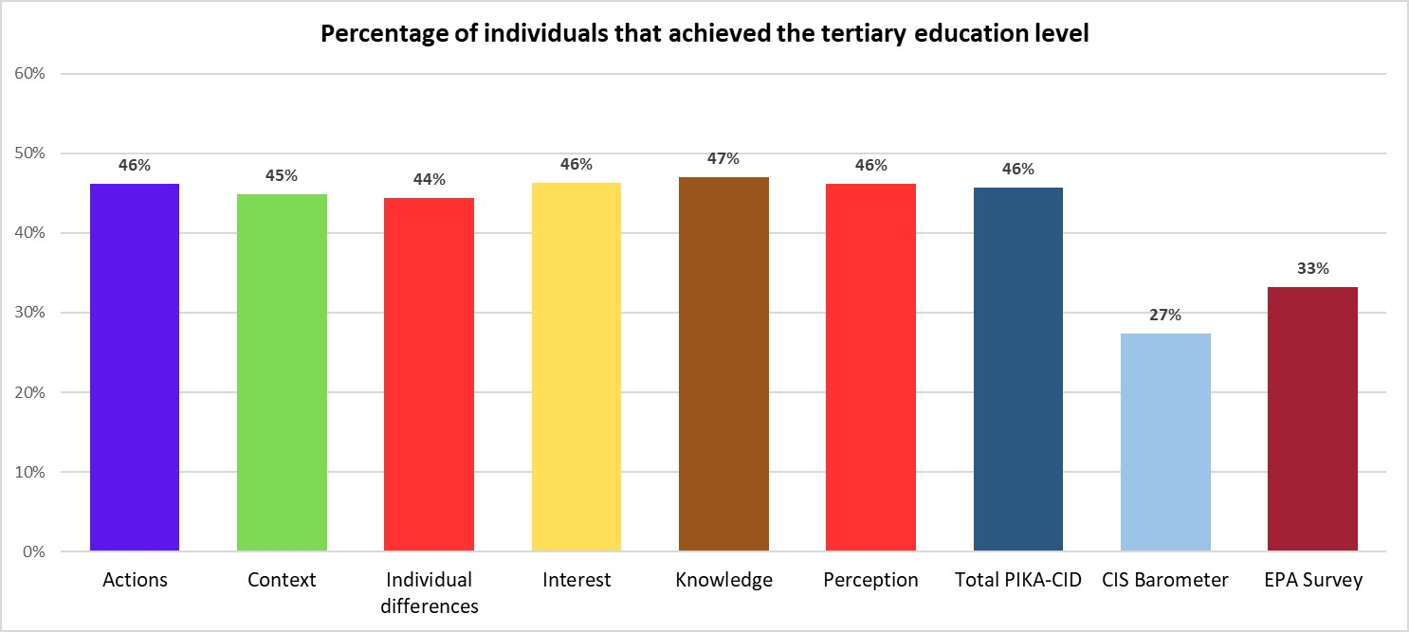
Skewed sample
Current limitations of the study
Certain subpopulations are underrepresented.
Low sample size.
Faulty questionnaire design
The Knowledge dimension design is flawed with a response pattern that difficult statistical analysis.
IRT may not be adequate for scales such as Social Class.
An exercise in honesty
Existing response patterns
In spite of our data cleaning efforts we have the suspicion of response patterns in the central response categories.
Incomplete model
It is impossible to account for all the variables that are part of both the social context and the psychological factors.

Slide 10
Upcoming phase: probabilistic survey
Specifications
Improvements
Online panel of Spanish residents over 18 years old.
Sample: 1000 people with a confidence level of 95% and a sampling error of +/- 3.1%.
Bigger and more representative sample size.
Redesigned questionnaire with the input of the previous phase.
Tools to detect response patterns included.
Analysis of paradata and metadata.

Slide 11
Thank you
Questions and comments
Contact information: RamonIker.Soria@ciemat.es

