Slide 1
Applying SHACL to DmfA declarations: a small experiment
Christophe Debruyne

Slide 2
Content
Context: Glossary, XML Schema Definition (XSD) and external sources A mini-vocabulary for DmfA declarations Translating from DmfA XML to RDF SHACL rules Demonstration Summary
Attention: We are not going to replace DmfA and the glossary. The intention is to demonstrate the possibilities of SHACL for the validation of DmfA declarations. DmfA offers us a very complex matter with which we can demonstrate all the functionalities of SHACL.

Slide 3
Context

Slide 4
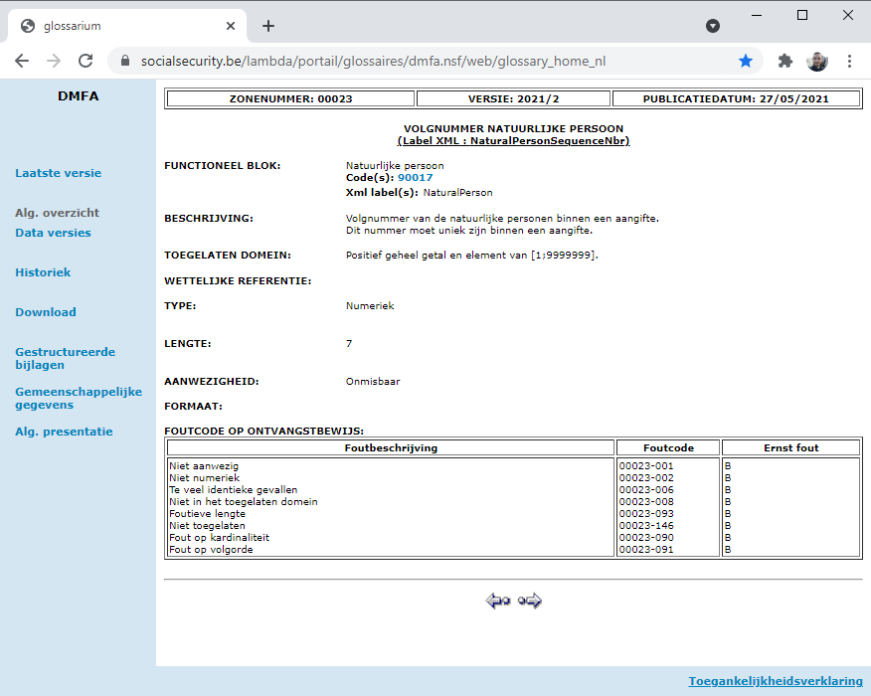
Glossarium
Information about entities (called blocks), relationships and attributes in HTML, PDF, XML, and TXT The glossary contains information on validation rules. Simple rules about totality (must exist) and length are structured, but many rules are described in natural language and fall outside the expressiveness of XML. These must be tested by an application. In my humble opinion: encoding bias. The model is aimed at producing an XSD.
NaturalSequenceNbr is an attribute of the entity person. Sequence numbers are unique within a declaration, but this is not tested by XSD. An application must test this.
Source: https://www.socialsecurity.be/lambda/portail/glossaires/dmfa.nsf/web/glossary_home_nl

Slide 5
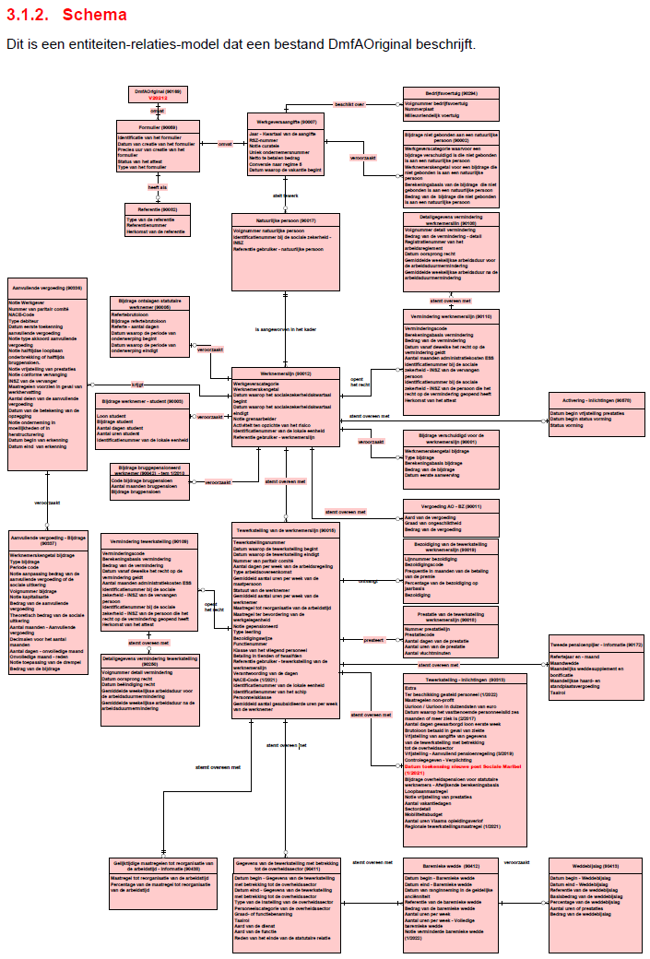
Glossarium
29 entities (functional blocks) 28 relationships between entities (hierarchy of the blocks) 215 attributes (but not all is used) Some attributes are historical and documented, but their use is "forbidden"
ERD of a DmfA declaration

Slide 6
A vocabulary for DmfA declarations

Slide 7
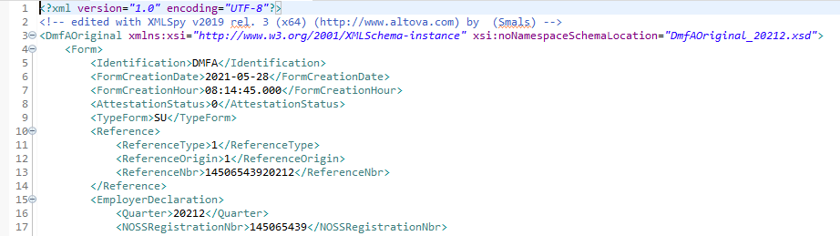
Why an ontology vocabulary? (*)
A direct mapping is a direct translation of data to RDF. The resulting RDF reflects the structure of the source, in this case the XML. Relationships in XML are implicit (see e.g. relationship between Form and Reference).
Although a direct mapping with SHACL is possible, the SHACL rules would not be intuitive: "Do we think in functions of entities or relationships?" Consequently, a simple vocabulary seemed appropriate to me.
Attribute with value of entity Form
Relationship between Form and Reference: here the name of the type is also the relationship.
(*) A vocabulary is a "light" ontology. Few axioms and rules, but rich enough to distract interesting things. Examples are class hierarchies, role hierarchies, domains and ranges.

Slide 8
Generating a vocabulary: entities
Glossary contains XML documentation that we can process automatically
Using a Jupyter Notebook (see GitLab)
Creating types with:
BFLabelsXMLdmfa20212FR.xml
FBLabelsXMLdmfa20212NL.xml
Documentation in NL, FR, and EN.
ont:CompanyVehicle a owl:Class ;
rdfs:label "Company Vehicle"@en,
"Véhicule de société"@fr,
"Bedrijfsvoertuig"@nl ;
dc:identifier "90294" .

Slide 9
Generating a vocabulary: attributes
Glossary contains XML documentation that we can process automatically
Creating attributes with:
ZonesLabelsXMLdmfa20212FR.xml
ZonesLabelsXMLdmfa20212NL.xml
Documentation in NL, FR, and EN.
Encoding errors in XML require some preprocessing.
ont:ReducedScaleSalaryNotion a owl:DataProperty ;
rdfs:label "Reduced Scale Salary Notion"@en,
"NOTION TRAITEMENT BARÃMIQUE RÃDUIT"@fr,
"NOTIE VERMINDERDE BAREMIEKE WEDDE"@nl ;
dc:identifier "01235" ;
.

Slide 10
Generating a vocabulary: entity-attributes
Glossary contains XML documentation that we can process automatically
Relationships between entities and attributes: VersCplt_BFdmfa20212FR.xml
VersCplt_FBdmfa20212NL.xml
Only the relationships needed.
ont:ReducedScaleSalaryNotion a owl:DataProperty ;
rdfs:label "Reduced Scale Salary Notion"@en,
"NOTION TRAITEMENT BARÃMIQUE RÃDUIT"@fr,
"NOTIE VERMINDERDE BAREMIEKE WEDDE"@nl ;
rdfs:domain ont:ScaleSalary ;
dc:identifier "01235" ;
.

Slide 11
Generating a vocabulary: entity-attributes
Glossary contains XML documentation that we can process automatically
Documentation of the attributes:
VersCpltdmfa20212FR.xml
VersCpltdmfa20212NL.xml
Documentation in NL and FR.
ont:ReducedScaleSalaryNotion a owl:DataProperty ;
rdfs:label "Reduced Scale Salary Notion"@en,
"NOTION TRAITEMENT BARÃMIQUE RÃDUIT"@fr,
"NOTIE VERMINDERDE BAREMIEKE WEDDE"@nl ;
rdfs:domain ont:ScaleSalary ;
dc:identifier "01235" ;
rdfs:comment "Zone qui … réduit."@fr, "Zone … is."@nl ;
rdfs:isDefinedBy "1 = traitement barémique réduit"@fr,
"1 = verminderd baremieke wedde"@nl ;
ont:function "Traitement barémique"@fr, "Baremieke wedde"@nl ;
ont:length 1 ;
ont:presence "Obligatoire si …."@fr, "Verplicht indien …."@nl ;
ont:type "Alphanumérique"@fr, "Alfanumeriek"@nl ;
.

Slide 12
Generating a vocabulary: relationships
We processed relationships between entities manually using the ERD.
We could use the XSD, but relationships in XSD had no names. Furthermore, there are relationships with the same names. In the long run, it is better to make a distinction (at least at the level of the vocabulary).
A CSV file was created, and it was transformed:
ont:R_9000790294 rdfs:label "has"@en,
"dispose de"@fr,
"beschikt over"@nl ;
rdfs:domain ont:EmployerDeclaration ;
rdfs:range ont:CompanyVehicle .
Note that I combine the codes of two entities for the computer label of the relationship. In this way, different "has" relationships are different.
FROM | TO | LABELNL | LABELFR | LABELEN
90169 | 90059 | omvat | reprent | contains
90059 | 90082 | heeft als | a comme | has
90059 | 90007 | omvat | comprent | contains
90007 | 90294 | beschikt over | dispose de | has
… | … | … | … | …

Slide 13
From a DmfA XML declaration to RDF

Slide 14
From XML to RDF
Based on the XML file FI.DMFA.101141.20210604.02500.T.1.1 (supplied by Smals)
Used 11 of the 29 entities. So not everything was mapped.
Mapping using RML (https://rml.io/) the "successor" of R2RML for relational databases, CSV, JSON, XML,...
The mapping is simple, it is almost a one-on-one mapping. Data types such as xsd:string, xsd:integer, xsd:date,... must be supplied. To be supplemented here and there when SHACL rules are completed.

Slide 15
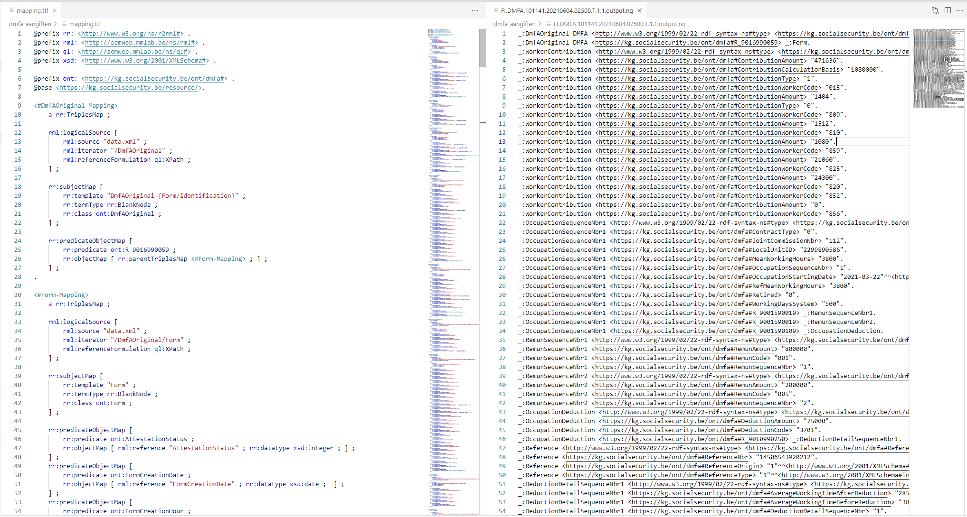
From XML to RDF
Because we are going to validate declarations locally and do not have enough information, entities of different DmfA documents will receive the same identifier.
If we are going to validate a collection of declarations, then we have to change the approach a bit (e.g., with a UUID). This is for the mapping and the application, and not for the SHACL rules.

Slide 16
SHACL rules

Slide 17
Generating SHACL
The generation of SHACL from the glossary is limited (type, length, etc.). There was enough for one form of a skeleton but:
Contradictions between glossary and rules
Sometimes errors in the XSD (?!)
Inconsistent approach to some constraints (such as length—exact length vs. maximum length)
The skeleton therefore contains errors (beyond my abilities) and everything has to be tested and refined manually. I only gained a little time because of this... So I removed the code for the skeleton. This process can be better aligned with the generation of the XSD.

Slide 18
SHACL: examples
kg:DmfAOriginalCountInstancesShape: a document must contain exactly 1 entity of the type ont:DmfAOriginal, otherwise we do not have a declaration.
kg:DmfAOriginalShape: a ont:DmfAOriginal must contain at least 1 ont:Form.
kg:DmfAOriginalCountInstancesShape a sh:NodeShape ;
rdfs:comment "A graph should have exactly one instance of ont:DmfAOriginal" ;
sh:targetNode ont:DmfAOriginal ;
sh:property [
sh:message "Graph does not contain exactly one instance of ont:DmfAOriginal" ;
sh:path [ sh:inversePath rdf:type ] ;
sh:maxCount 1 ;
sh:minCount 1 ;
] ;
. ] ;
kg:DmfAOriginalShape a sh:NodeShape ;
rdfs:comment "Property Shape for DmfAOriginal (code)" ;
sh:targetClass ont:DmfAOriginal ;
sh:property [
rdfs:comment "ont:DmfAOriginal must have at least one ont:Form." ;
sh:minCount 1 ;
sh:path ont:R_9016990059
.
?
rdf:type
ont:DmfA
Original

Slide 19
SHACL: voorbeelden
kg:FormShape
Constraints on relationships with DmfAOriginal, Reference, and EmployerDeclaration Constraints over the attributes
We now choose a number of interesting attributes!
kg:FormShape a sh:NodeShape ;
rdfs:comment "Property Shape for Form (code)" ;
sh:targetClass ont:Form ;
sh:property [
rdfs:comment "Each ont:Form must belong to exactly one ont:DmfAOriginal." ;
sh:maxCount 1 ; sh:minCount 1 ;
sh:path [ sh:inversePath ont:R_9016990059 ; ] ;
] ;
sh:property [
rdfs:comment "ont:Form has at most one ont:Reference." ;
sh:maxCount 1 ;
sh:path ont:R_9005990082 ;
] ;
sh:property [
rdfs:comment "Each ont:Form has exactly one ont:EmployerDeclaration." ;
sh:maxCount 1 ; sh:minCount 1 ;
sh:path ont:R_9005990007 ;
] ;
sh:property kg:AttestationStatusShape ;
sh:property kg:FormCreationDateShape ;
sh:property kg:FormCreationHourShape ;
sh:property kg:IdentificationShape ;
sh:property kg:TypeFormShape ;
.

Slide 20
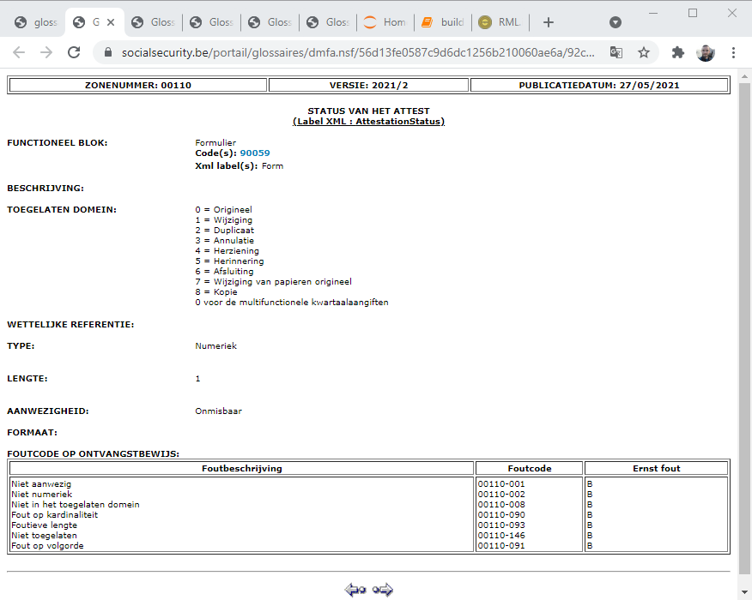
SHACL: examples
kg:AttestationStatusShape a sh:PropertyShape ;
rdfs:comment "Property Shape for AttestationStatus (code)" ;
sh:path ont:AttestationStatus ;
sh:datatype xsd:integer ;
sh:minCount 1 ;
sh:maxCount 1 ;
sh:minLength 1 ;
sh:maxLength 1 ;
sh:minInclusive 0 ;
sh:maxInclusive 8 ;
.

Slide 21
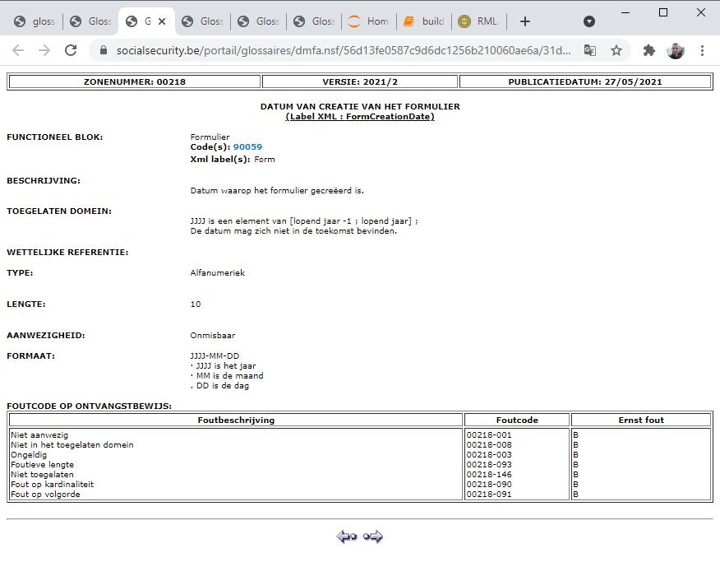
SHACL: examples
kg:FormCreationDateShape a sh:PropertyShape ;
rdfs:comment "Property Shape for FormCreationDate (code)" ;
sh:path ont:FormCreationDate ;
sh:datatype xsd:date ;
sh:maxLength 10 ;
sh:minLength 10 ;
sh:pattern "\\d{4}-\\d{2}-\\d{2}" ;
sh:sparql [
sh:message "Year beyond [current year - 1, current year]." ;
sh:prefixes <> ;
sh:select """
SELECT $this (ont:FormCreationDate AS ?path) ?value
WHERE {
$this ont:FormCreationDate ?value .
BIND ( YEAR( ?value ) AS ?y1 )
BIND ( YEAR( NOW() ) AS ?y2 )
FILTER ( !( ?y2 - ?y1 = 0 || ?y2 - ?y1 = 1 ) )
}""" ;
] ;
.
We use the expressiveness of the graph query language
In this preview, the sh:pattern is actually superfluous, because this is a condition of the xsd:date datatype.

Slide 22
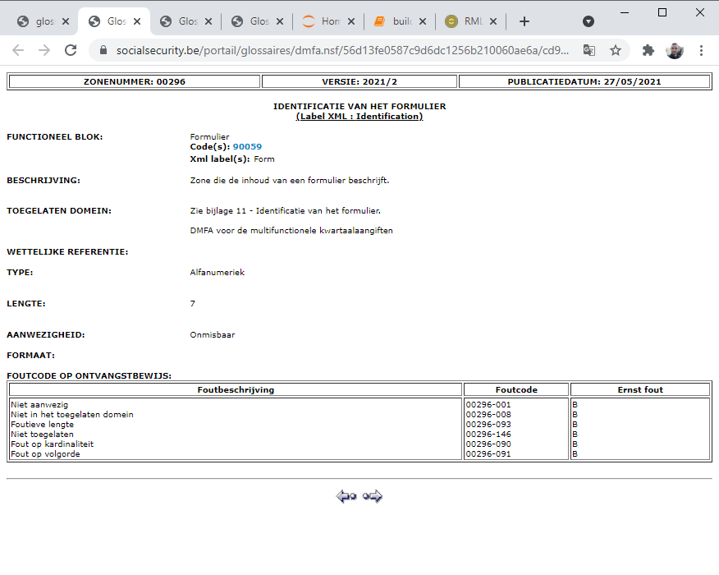
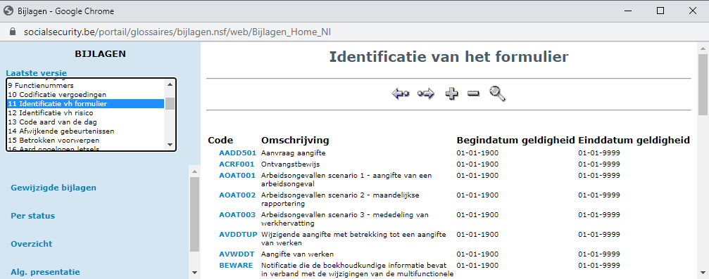
SHACL: examples
This is an example of how the different identification types in RDF can be represented:
kg:IdentificationTypeDMFA a ont:IdentificationType ;
rdfs:label "DMFA" ;
rdfs:comment "Multifunctionele ... werkgever" ;
ont:validFrom "1900-01-01"^^xsd:date ;
ont:validTo "9999-01-01"^^xsd:date ;
.
With such representations in our data graph (or even knowledge graph) we can:

Slide 23
SHACL: voorbeelden
kg:IdentificationShape a sh:PropertyShape ;
rdfs:comment "Property Shape for Identification (code)" ;
sh:path ont:Identification ; sh:datatype xsd:string ;
sh:maxLength 7 ; sh:minCount 1 ; sh:maxCount 1 ;
# Geldige waarden komen van bijlage 1
sh:in ( "AADD501" "ACRF001" ... "ZIMA006" ) ;
# De geldige waarden hebben ook een geldigheidsdatum,
# we demonstreren dit voor 1 entiteit
sh:sparql [
sh:message "Date not within valid interval of document type" ;
sh:prefixes <> ;
sh:select """
SELECT $this (ont:Identification AS ?path) ?value
WHERE {
$this ont:Identification ?value .
$this ont:FormCreationDate ?date .
?idtype a ont:IdentificationType ; rdfs:label ?value ;
ont:validFrom ?from ; ont:validTo ?to .
FILTER ( !( ?date >= ?from && ?date <= ?to ) )
}""" ;
] .

Slide 24
A small demonstration

Slide 25
Demonstratie
By means of the TopBraid library
Data graph = DmfA declaration in RDF + extra data Shapes graph
Focus on calculation control number

Slide 26
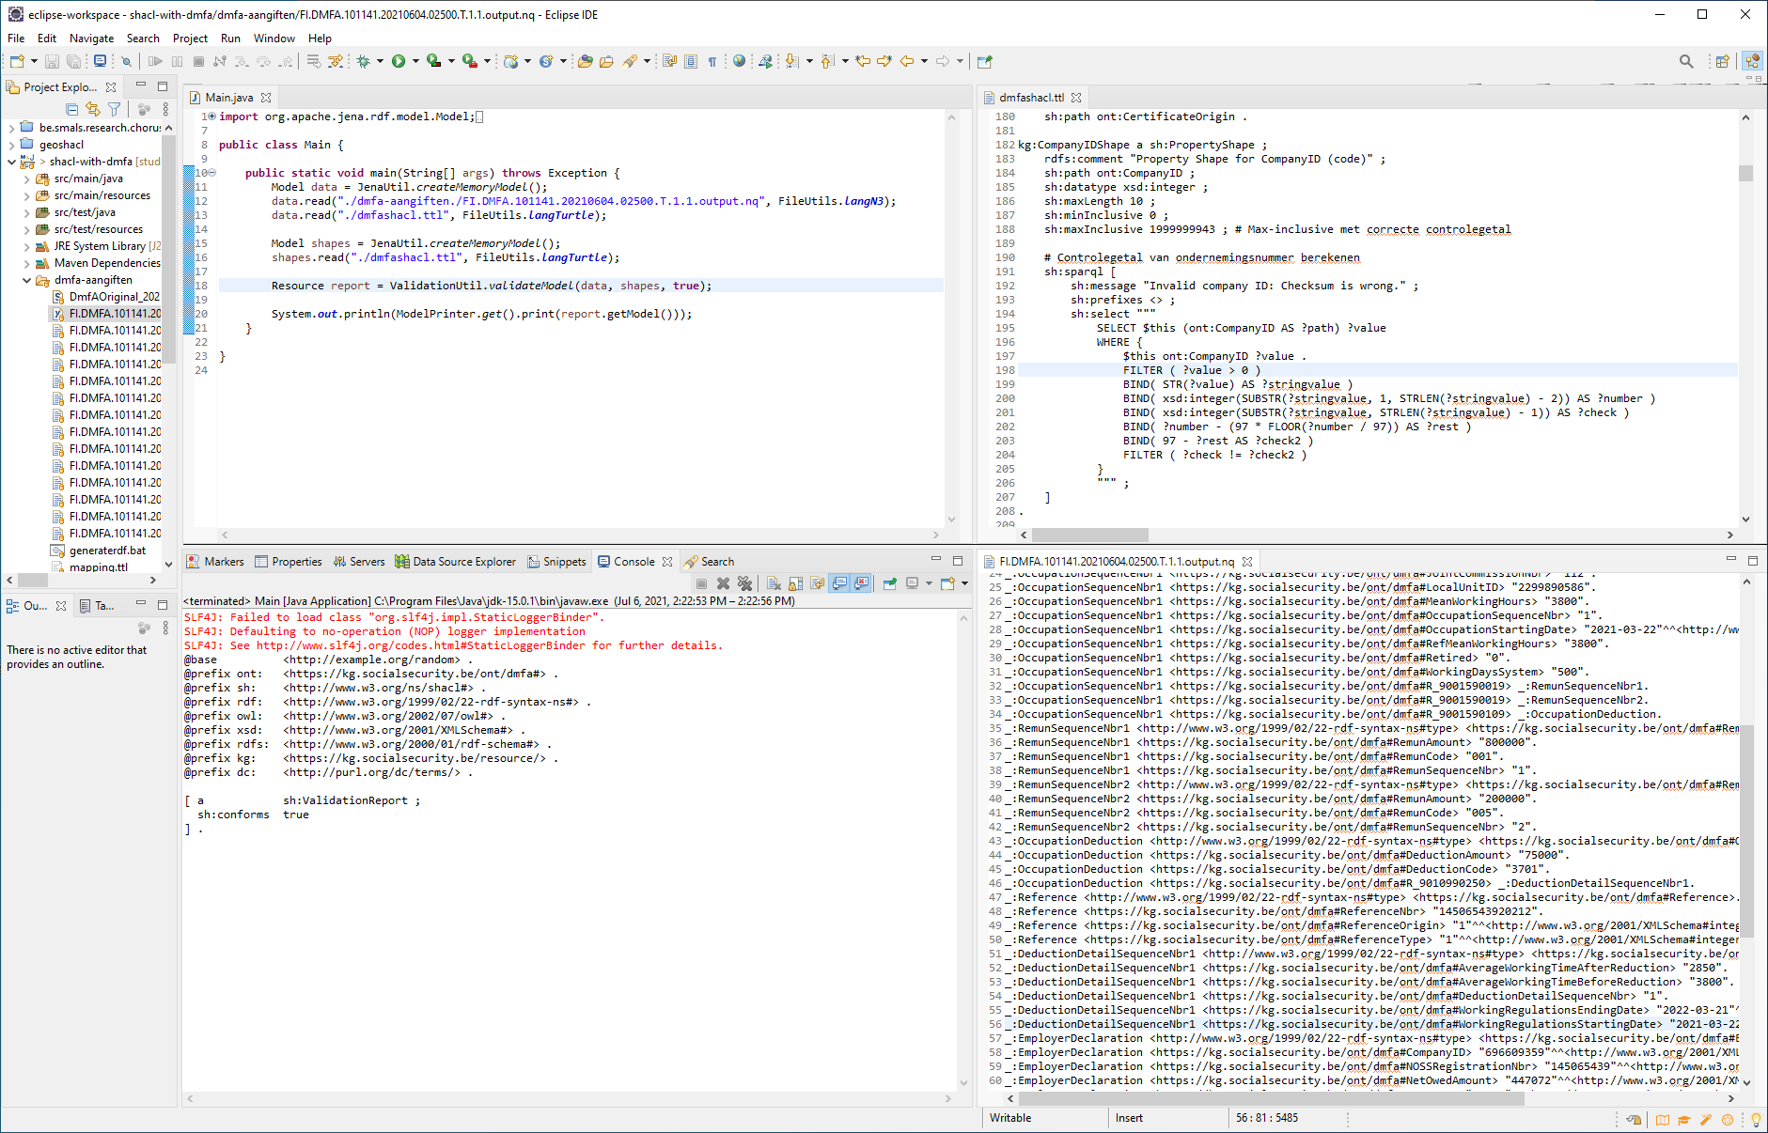
Shapes Graph
Controle nummer is OK
Data Graph
Validation Report

Slide 27
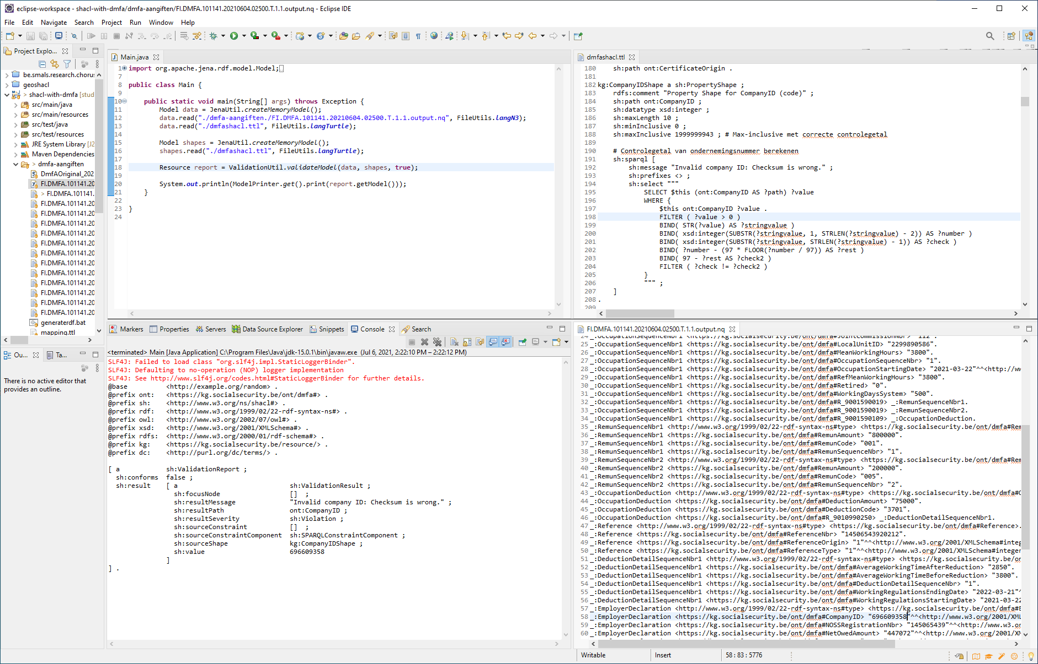
Shapes Graph
Controle nummer Is niet OK
Data Graph
Validation Report

Slide 28
SHACL: examples
kg:CompanyIDShape a sh:PropertyShape ;
rdfs:comment "Property Shape for CompanyID (code)" ;
sh:path ont:CompanyID ; sh:datatype xsd:integer ; sh:maxLength 10 ;
sh:minInclusive 0 ; sh:maxInclusive 1999999943 ; # Max-inclusive met correcte controlegetal
# Controlegetal van ondernemingsnummer berekenen (ofwel 0, ofwel correct volgens berekening_
sh:sparql [
sh:message "Invalid company ID: Checksum is wrong." ;
sh:prefixes <> ;
sh:select """
SELECT $this (ont:CompanyID AS ?path) ?value
WHERE {
$this ont:CompanyID ?value .
FILTER ( ?value > 0 )
BIND( STR(?value) AS ?stringvalue )
BIND( xsd:integer(SUBSTR(?stringvalue, 1, STRLEN(?stringvalue) - 2)) AS ?number )
BIND( xsd:integer(SUBSTR(?stringvalue, STRLEN(?stringvalue) - 1)) AS ?check )
BIND( ?number - (97 * FLOOR(?number / 97)) AS ?rest )
BIND( 97 - ?rest AS ?check2 )
FILTER ( ?check != ?check2 )
} """ ;
] .
Check company numbers! This rule can later be generalized so that it can be reused within an organization.

Slide 29
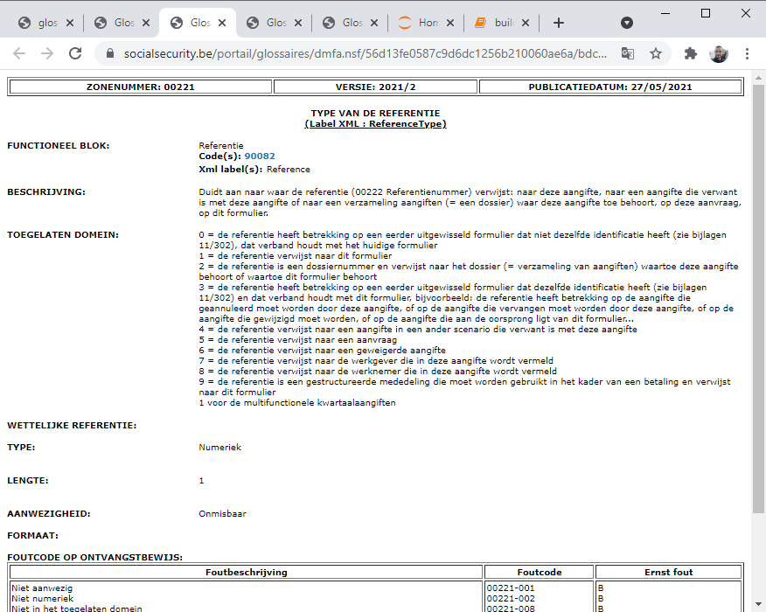
Into the future?
Some descriptions refer not only to external data (see example Appendix 11), but also to past declarations.
This experiment involves local validation. Can we validate globally? In theory, yes, but then we have to store all declarations in a graph.

Slide 30
Summary

Slide 31
Summary
Validating DmfA declarations as RDF is feasible
The generation of SHACL must be "aligned" with the generation of XSD Sharing SHACL rules, like sharing the XSD, would allow third parties to validate their data locally.
SHACL is even more expressive than XSD
SHACL and the vocabulary is compatible with JSON-LD (a JSON serialization of RDF), which is only in more contemporary Web environments (cfr. Flanders)
SHACL can even validate declarations against a KG (future?)

