Slide 1

Project Name : Task Management System
Project member
Henok
Baya
Babita
Sandeep

Slide 2
Purpose
A task management application for managing projects, tasks and teams in an enterprises.
1. Creates project, distribute tasks to the team members.
2. Monitors task progress; open, progress and close.
3. Task assignment and reminder notifications.
4. Team members communication

Slide 3
Task management system has four domain models !
Project
Team member
Task
Team
Projects have list of tasks.
Project Tasks has three states which is Active, Progress and Complete.
Tasks have active time to ending time.
Project have a team.
Team has team members.

Slide 4
Technologies
Spring Security
JPA/ Hibernate
RESTful
AOP
MVC
Email
MySQL

Slide 5
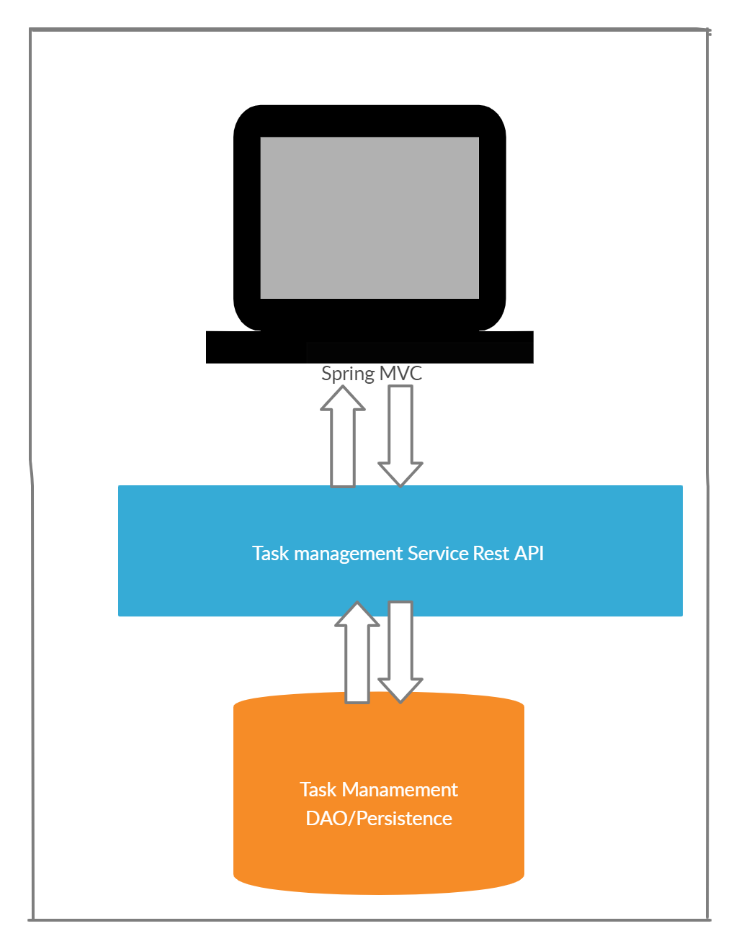
Project Architecture

Slide 6
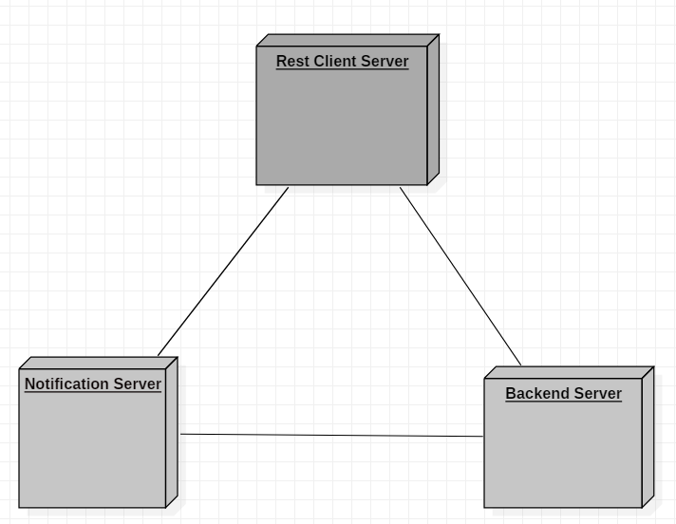

Slide 7
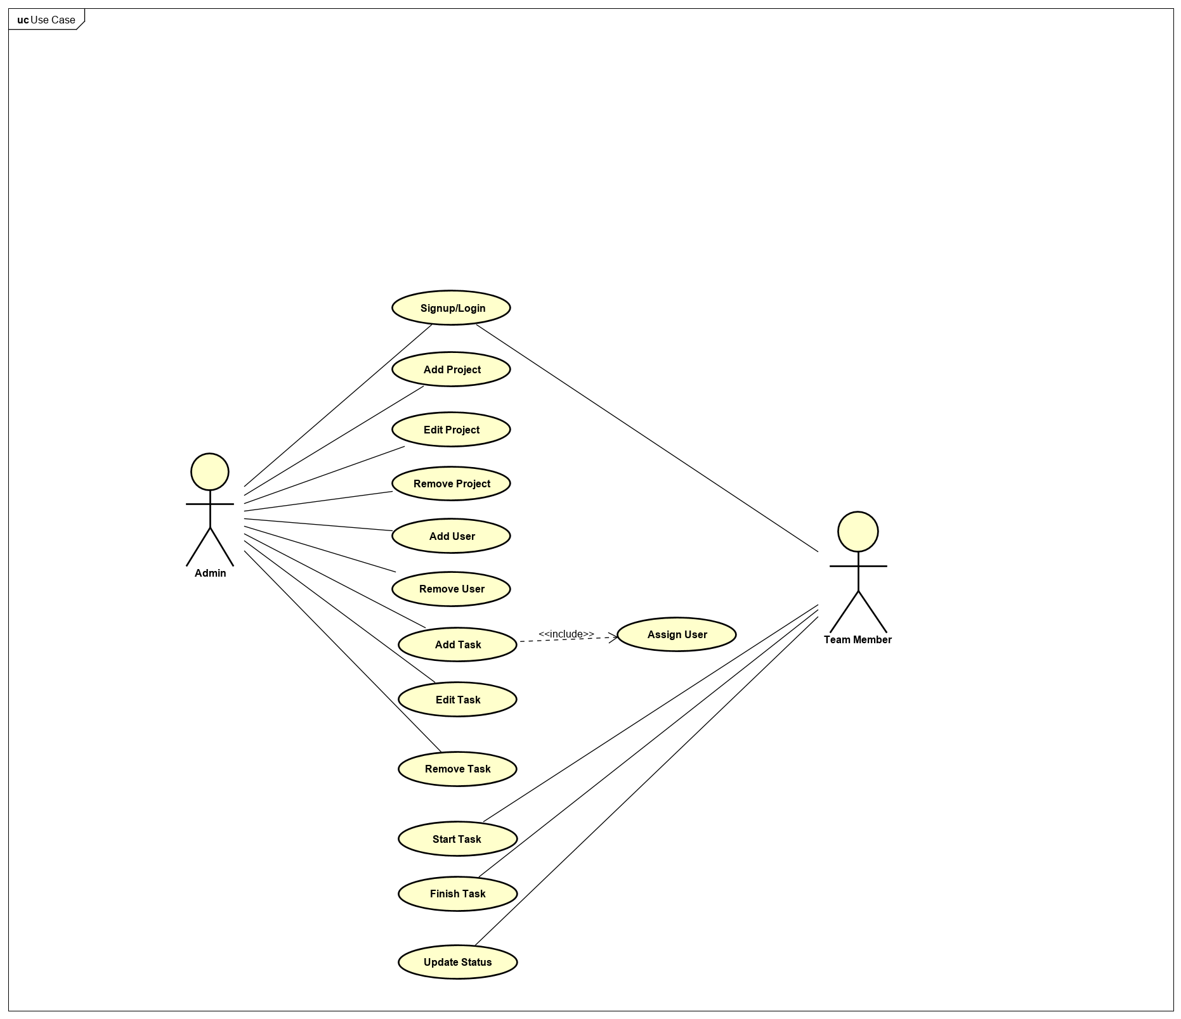
Use Case Diagram

Slide 8
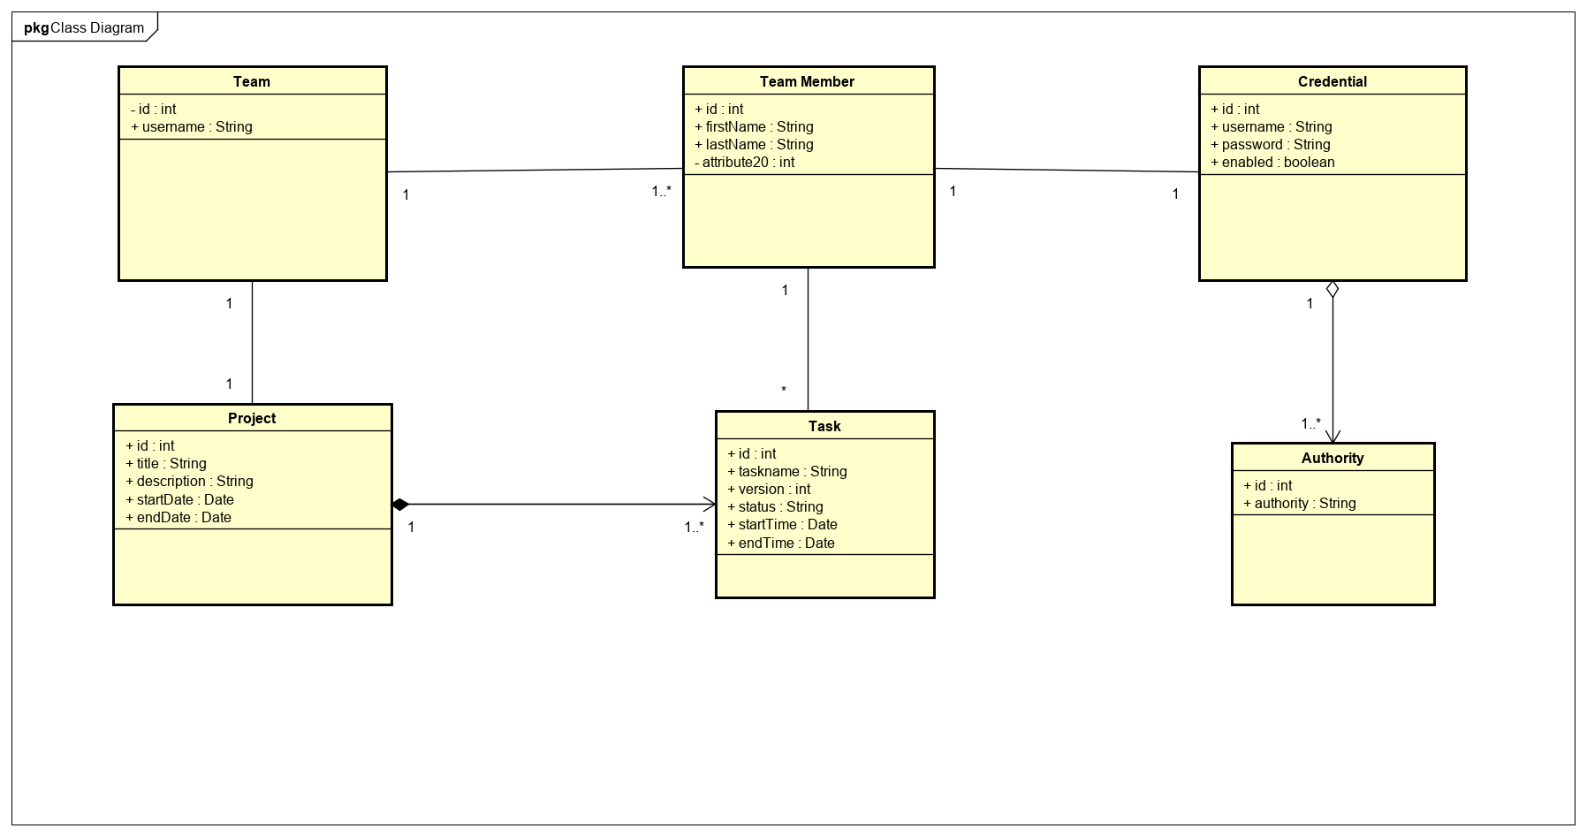
Class Diagram

Slide 9
Difficulties
Time and work management
ORM implementation
Application Integration
Configuration

