Slide 1

Autobiography of Rahab Gakundi Majira
Welcome to my life story, a journey of perseverance, growth, and finding purpose. This autobiography delves into my experiences, challenges, and triumphs.

Slide 2
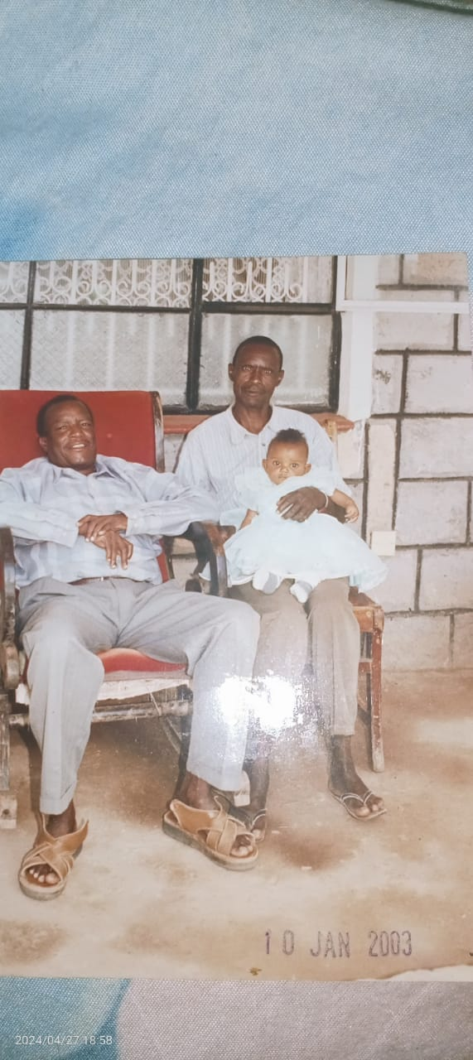
Early Life
1
Humble Beginnings
Born on August 14, 2002, I grew up in a modest environment surrounded by warmth and love.
2
Resilience and Perseverance
My family instilled values of determination and perseverance, guiding me through uncertainties.
3
Early Experiences
Childhood memories are etched in my mind, shaping my character and forging a strong spirit.

Slide 3
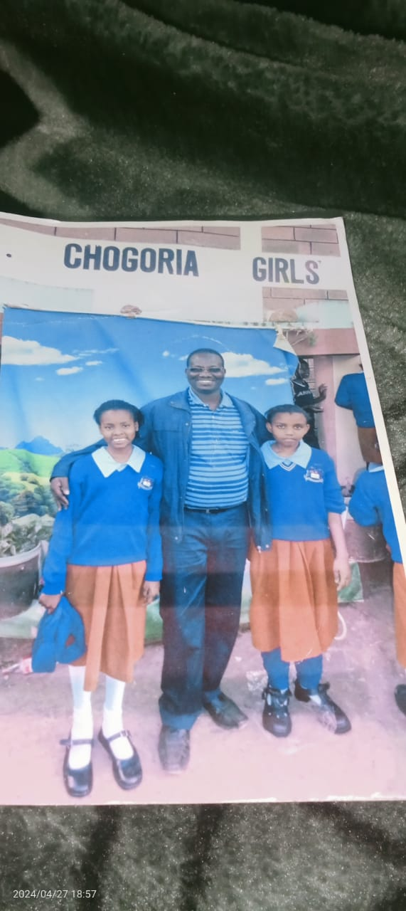
Education
Academic Journey
Achievements and Experiences
Overcoming Setbacks
My academic journey was filled with dedication and a thirst for knowledge, leading me through various levels of education.
Challenges presented opportunities for resilience and learning, shaping my character and pushing me to excel.
I've achieved academic milestones, experiencing both successes and setbacks that fueled my growth.

Slide 4
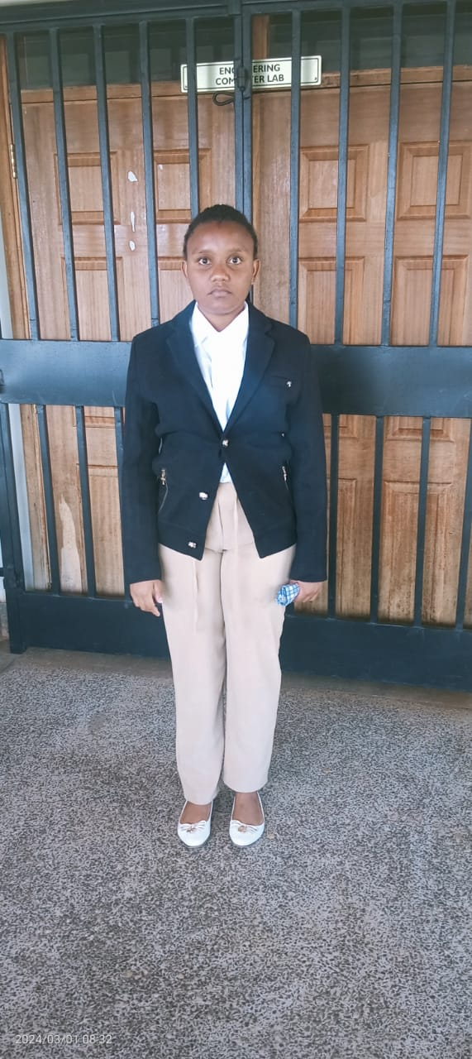



Professional Journey
Career Path
I embarked on a professional journey, taking on diverse roles and embracing challenges with enthusiasm.
Significant Accomplishments
Through hard work and dedication, I've achieved milestones in my career, leaving a positive mark on the industry.
Notable Projects
I've been involved in impactful projects that have made a difference, contributing to the field and community.

Slide 5
Challenges and Overcoming Them
Personal Challenges
Professional Challenges
Overcoming Strategies
I've encountered personal obstacles, but through self-reflection and support, I've overcome them with strength.
Professional challenges have tested my abilities, but I've embraced them as opportunities for growth and learning.
Resilience, adaptability, and a positive mindset have been key to overcoming challenges and achieving success.

Slide 6
Personal Growth and Achievements
Academic Accomplishments
Hobbies and Milestones
Achieving academic milestones has brought immense joy and a sense of accomplishment, validating my efforts.
Pursuing my hobbies has brought me joy and balance, enriching my life and personal growth.

Slide 7
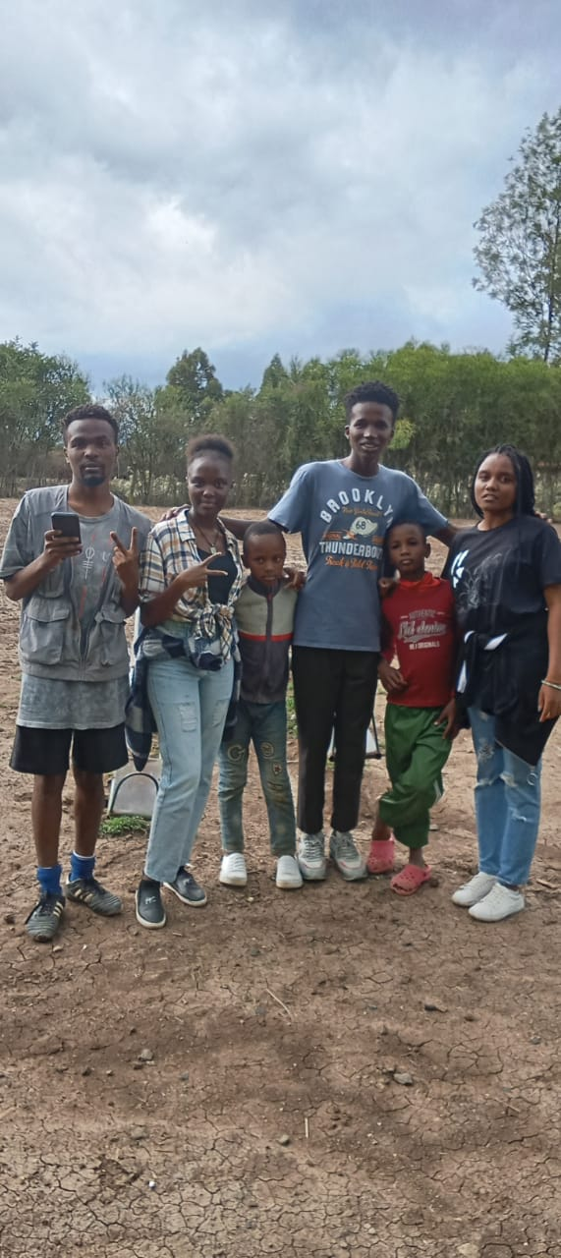
Community and Contributions
Community Involvement
Volunteer Work
Societal Impact
I've actively participated in community service, seeking ways to contribute to a better society.
My volunteer work has provided opportunities to help others and make a positive difference.
These contributions have deepened my sense of purpose and fostered a spirit of giving back.

Slide 8
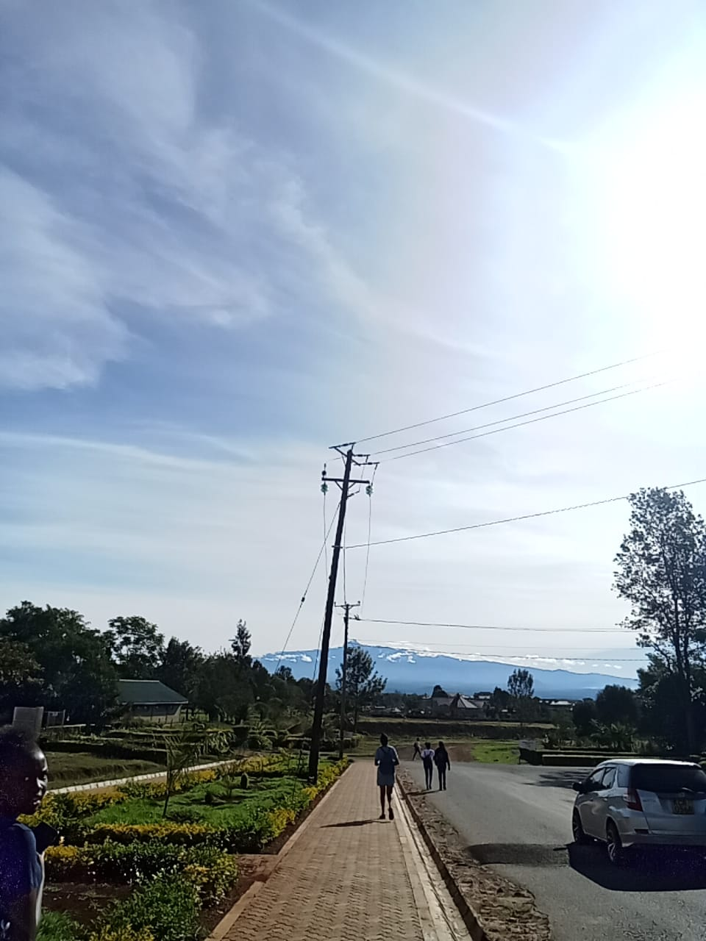



Future Goals
Aspirations
I aspire to continue learning and growing, reaching for new heights in my professional journey.
Long-Term Goals
I have ambitious long-term goals that I am actively pursuing, fueled by passion and dedication.
Vision for the Future
My vision for the future is bright, filled with opportunities to make a lasting impact and leave a legacy.

Slide 9
Closing Remarks
This autobiography is a testament to the power of resilience and the beauty of personal growth. I am grateful for the journey, the challenges, and the lessons learned. Thank you for joining me.

