Slide 1
TEXNOPOS

Slide 2
FRONTEND

Slide 3
HTML

Slide 4
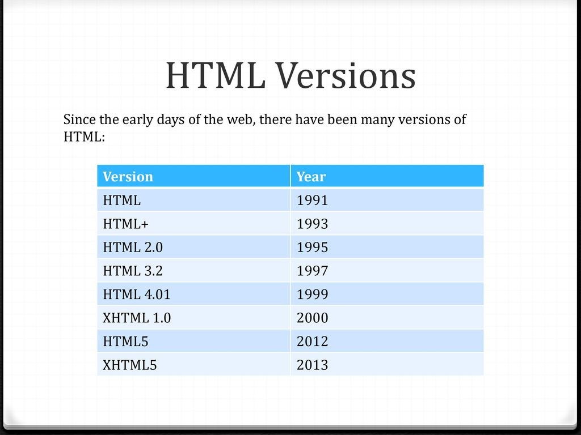
HTML – Hyper Text Markup Language

Slide 5
HTML – Programmalastiriw tili emes!

Slide 6
HTML – Page structure
<DOCTYPE html> - Web browserdegi hu’jjet tu’rinnin’ deklaratsiyasi (html 5 - version);
<html> </html> - Html hu’jjetinin’ tiykarg’i ata “tag”leri;
<head> </head> - Html hu’jjetinin’ bas ta’repi (mag’luwmatlar ha’m derekler);
<body> </body> - Html hu’jjetinin’ bizge ko’rinetug’in ta’repindegi mag’luwmatlardi shig’ariw ushin

Slide 7
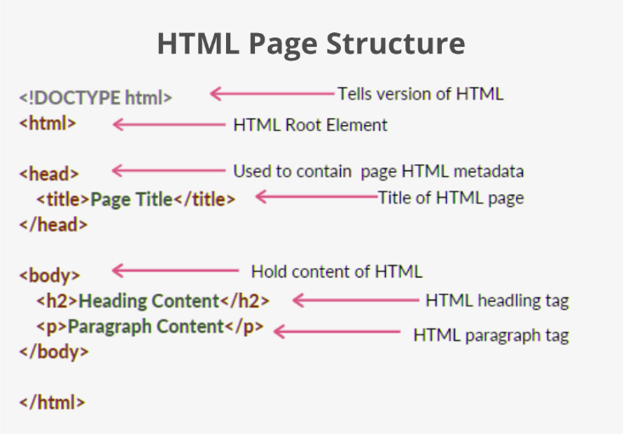
HTML – Page structure

Slide 8
TAG

Slide 9
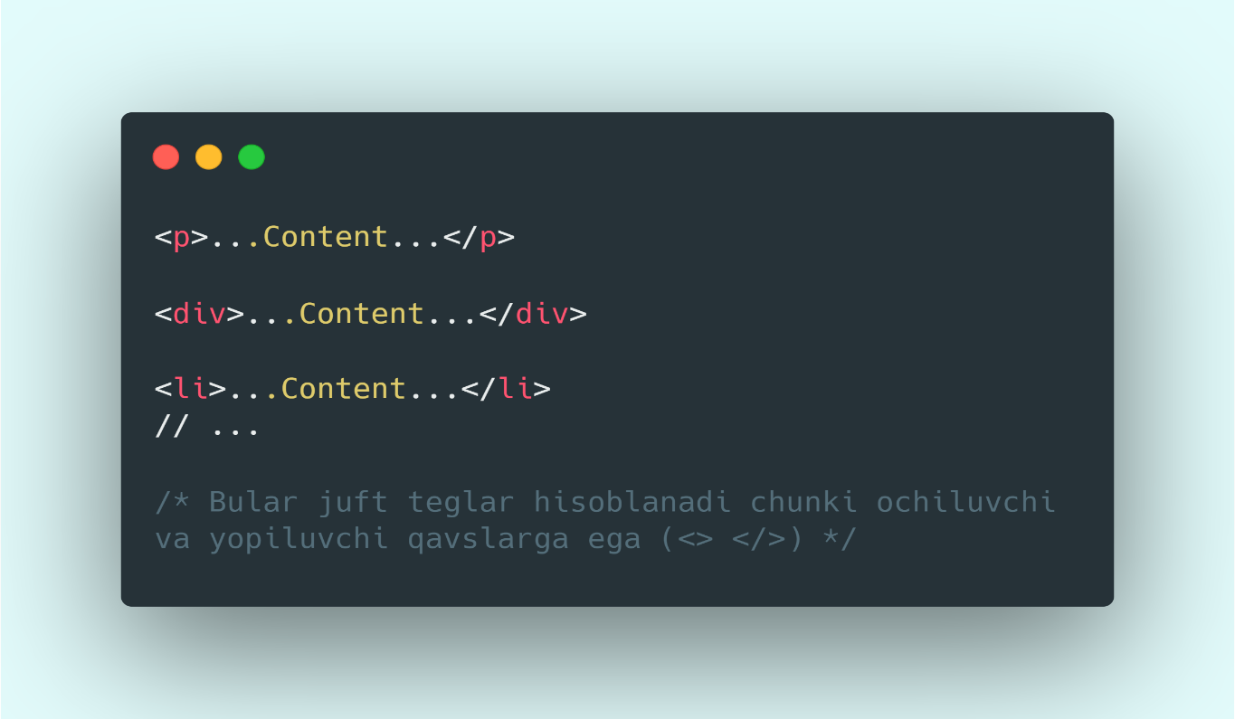
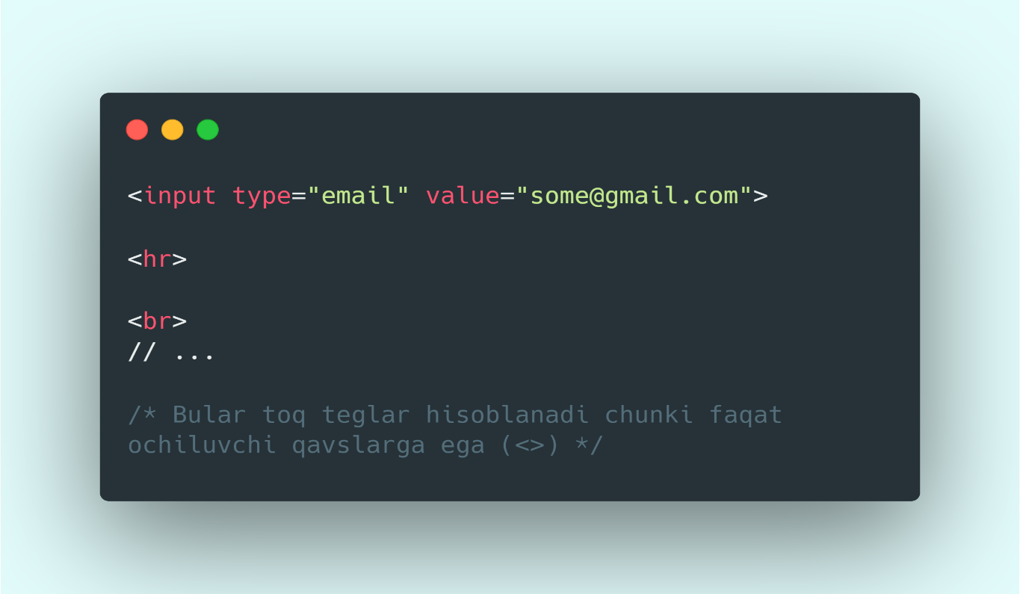
HTML teglerinin’ tu’rleri

Slide 10
Bu’gingi tanisatug’in teglerimiz
<p></p> - Tekst kiritiw ushin
<b></b> - So’zlerdi qalin’ formatta jaziw ushin
<strong></strong> -A’hmiyetli (!important) so’zler ushin
<i></i> - So’zlerdi qiya formatta jaziw ushin
<em></em> - Qalin’ formatta qiysaytip jaziw ushin

Slide 11
<small></small> - kichik yozuv yozish uchun;
<u></u> - ostiga chizish uchun (<ins></ins> ham);
<del></del> - (delete) ustidan chizish uchun;

