Slide 1
Kirisiw

Slide 2
Programma ha’m programmalastiriw?
Programma - bul qandaydur mashqalani sheshiw, waziypani orinlaw ushin arnawli sintaksis ja’rdeminde jazilg’an kodlar ja’mlenbesi.
Mashqalalardi sheshiw ushin mobile, web, desktop, ha’m tag’i basqa qurilmalarg’a programma jaratiladi.

Slide 3
Programmalarg’a misallar
Kassadag’i pip-pip qilip shtrix koddi oqiytug’in qurilmadag’i programma
Islep shig’ariw ya’ki biznes iyelerinin’ esabatlarin, kirdi – shiqti, kirim ha’m g’arejetlerin esaplap beriwshi programma
Telefonimizdag’i telegram, Instagram, tiktok qa uqsag’an programmalar
Click, payme h.t.b to’lem sistemalari

Slide 4
Programmalastiriw tarawlarg’a bo’linedi!

Slide 5
Programmisttin’ qaysi taraw iyesi ekenin bilmey turip og’an waziypa aytpan’!
Misal ushin: Telegram aship ber, Google akkount jaratip ber, telefonimdi formatlap beri)

Slide 6
Programmalastiriw tarawlari
Mobile development
Web development
Desktop development
AI development
…

Slide 7
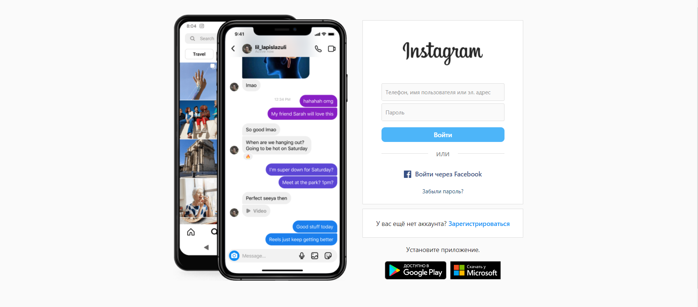
Web programmalarg’a misal

Slide 8
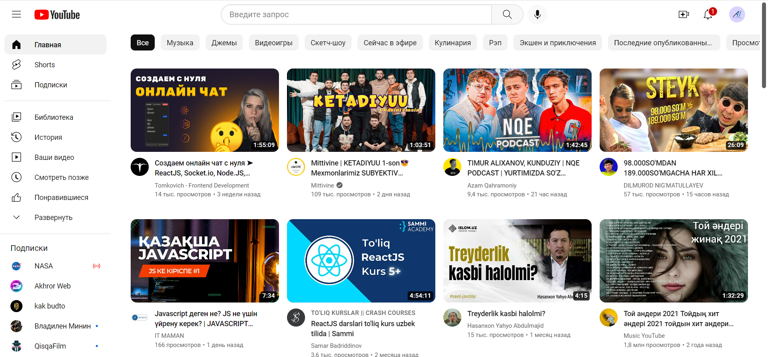

Slide 9
Frontend & Backend

Slide 10
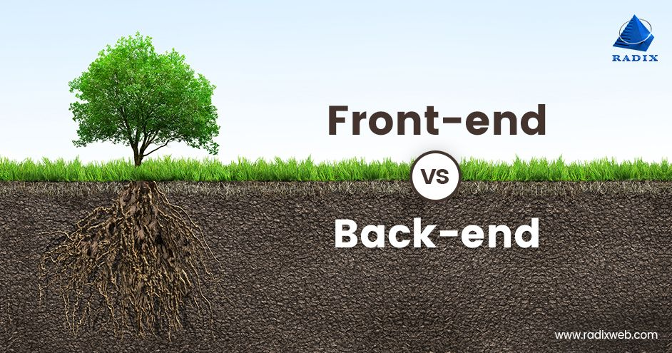

Slide 11
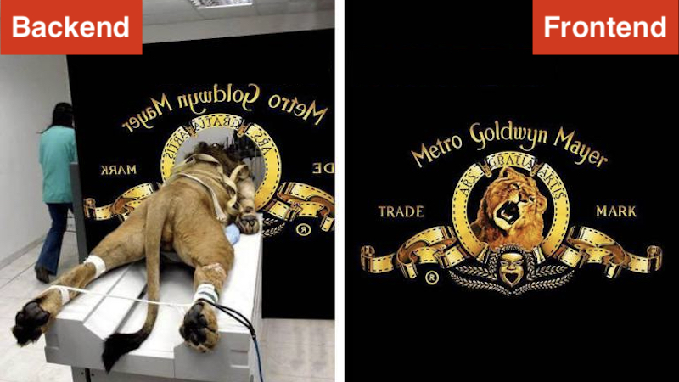

Slide 12







Biz u’yrenetug’in texnologiyalar

Slide 13
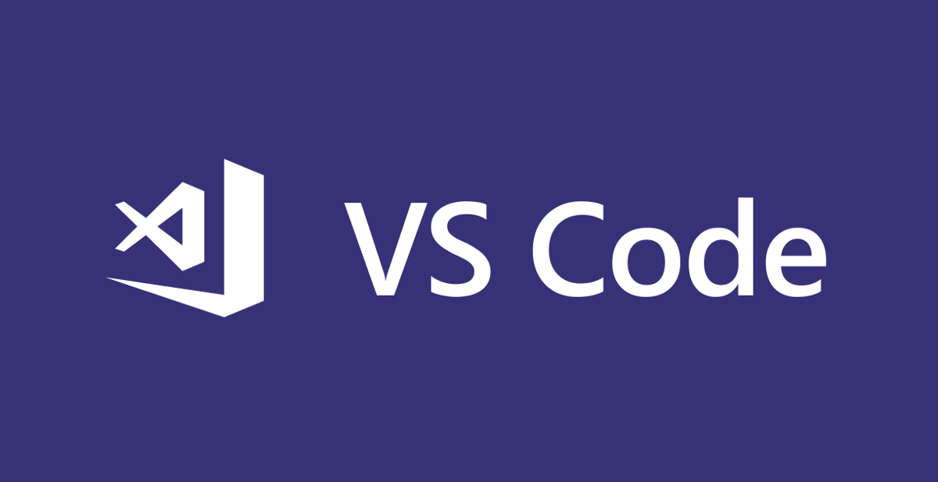

Kod redaktorlari

