Slide 1
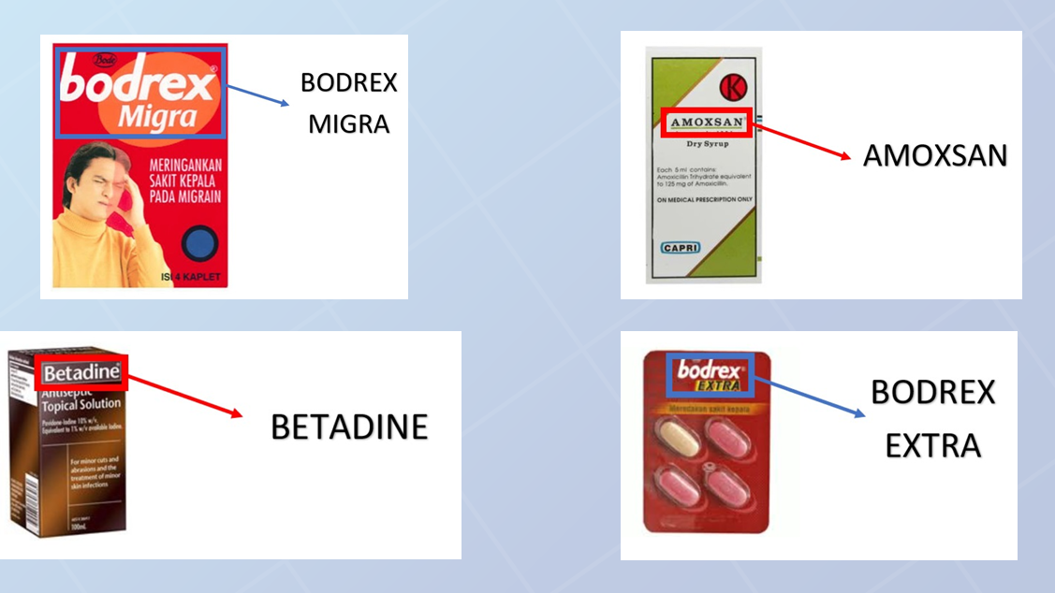
Images-based Drug Search Engine using OCR and Levenshtein Algorithm Spelling Correction
Source Code: https://github.com/edutjie/drug-ocr

Slide 2

Problem Background
In healthcare, the multitude of drug brands poses a challenge for professionals who must swiftly and accurately identify them. This is crucial for administering the right medication, preventing adverse reactions, and ensuring optimal patient outcomes. The diversity of drugs makes quick identification essential for pharmacists, nurses, and physicians.
To address this, Optical Character Recognition (OCR) technology is increasingly employed, automating the process and aligning with the broader trend of digitization in healthcare.

Slide 3
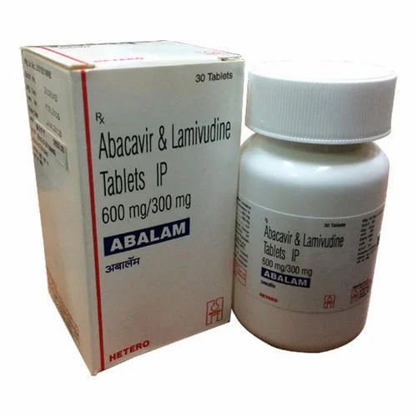
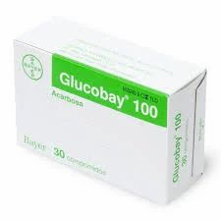
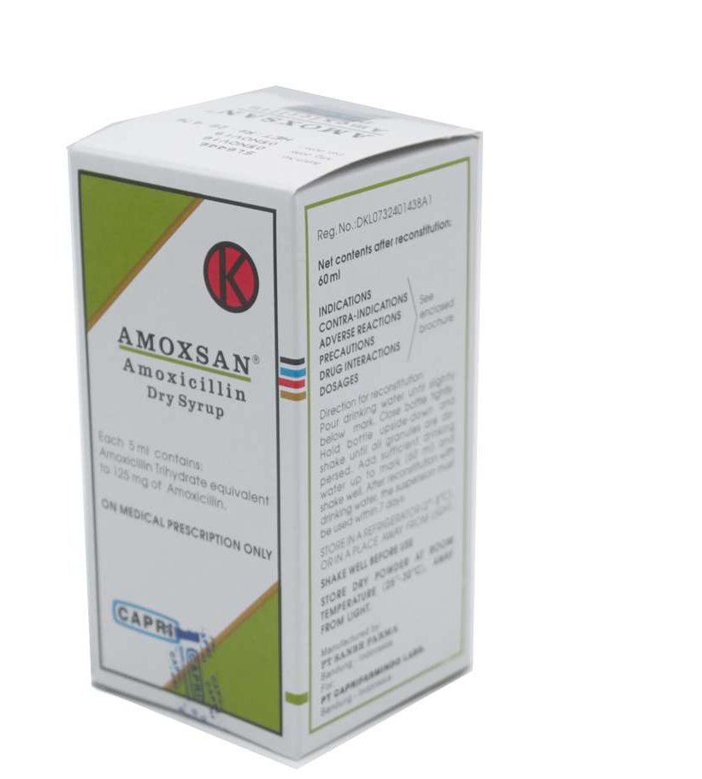
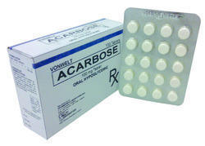
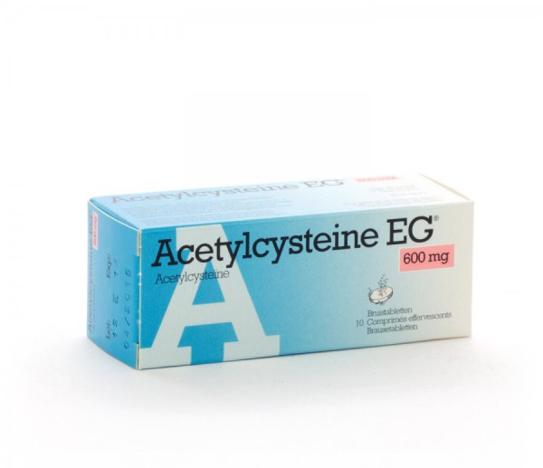
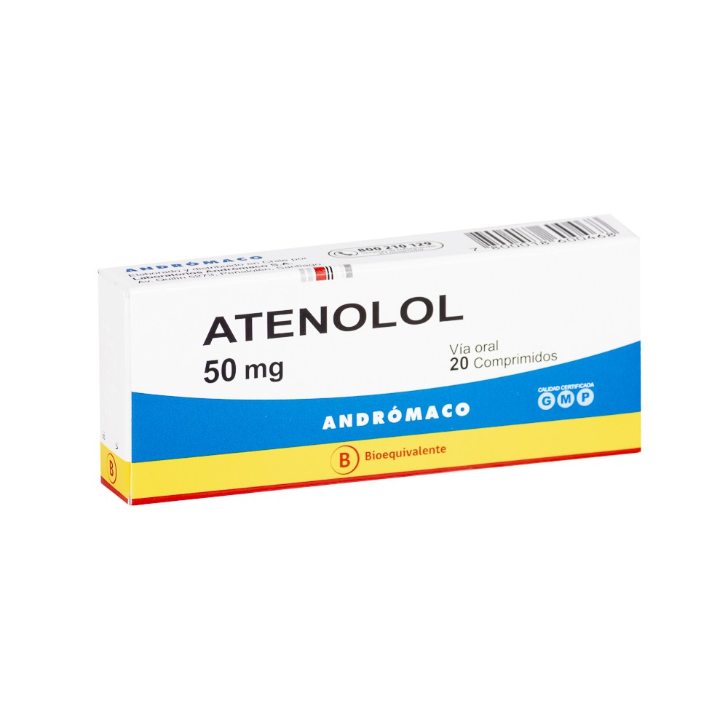
Dataset
Train Dataset
Test Dataset

Slide 4
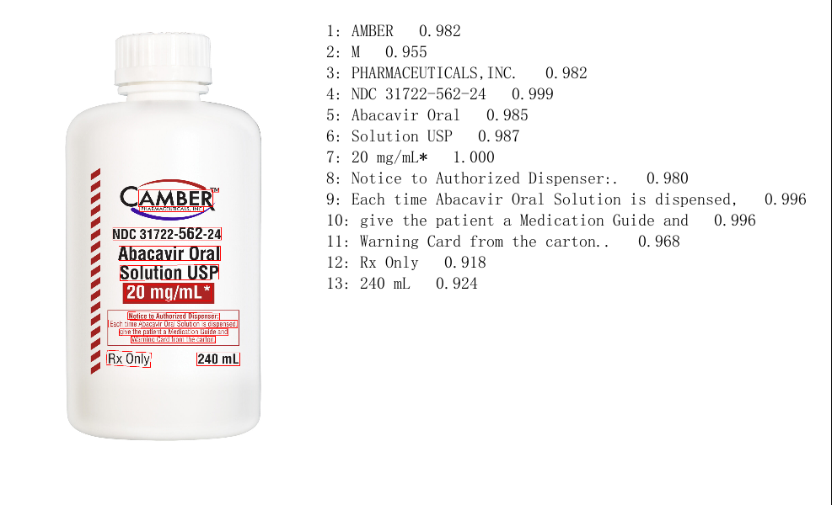
OCR Model
We’re using PaddleOCR as the pretrained model
Problem:
There are some words on the brand that can’t be detected
Detects all word on the packaging

Slide 5
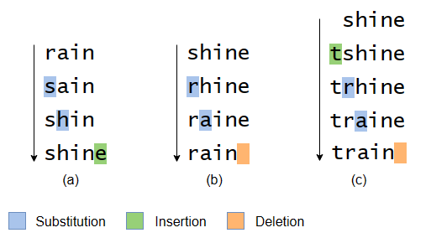
Solution? Spelling Correction
Utilize Levenshtein Distance Algorithm to find the closest brand from the database (all brands from training dataset) with the detected words

Slide 6
Brand Database
Collect all the brands from train dataset to create a database
Brands
ABACAVIR
ACARBOSE
ACETYLCYSTEINE
…

Slide 7
Modeling & Results
Metrics | Score
Accuracy | 82.57%
WER | 0.19475
CER | 0.16757
Based on the results, there are still some error. We can improve the result by doing post-evaluation on the dataset and prediction.

Slide 8
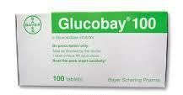
Post Evaluation: Inconsistency in brand names (1)
Example
Glucobay
Has the same meaning as Acarbose
Else
Has the same meaning as Acarbose
Precose
Humira
Has the same meaning as Adalimumab
Mallinckrodt
Has the same meaning as Codipront
Ensidol
Has the same meaning as Etodolac
Anafranil
Has the same meaning as Etodolac
There are some drug images that don’t have the brand name that should be predicted, but it has the same meaning as the brand that should be predicted.

Slide 9
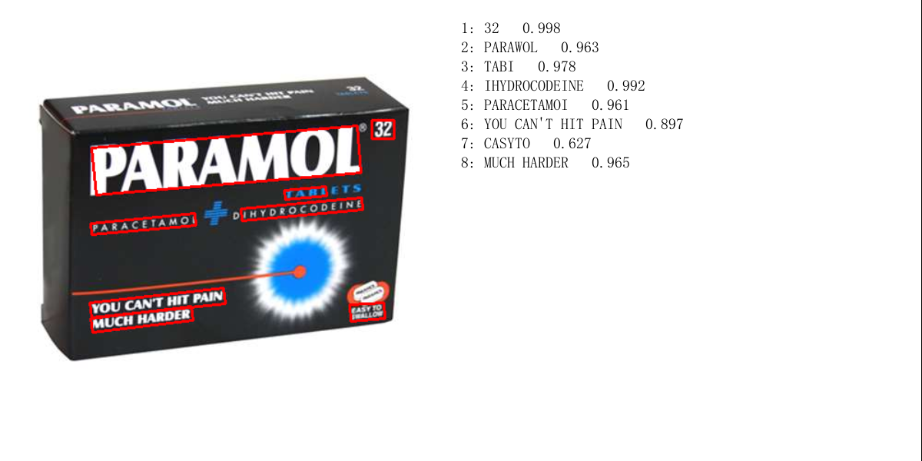
Post Evaluation: Inconsistency in brand names (2)
The expected label is “Paramol Forte” but the given image only has “Paramol” text on it. So we have to handle it!

Slide 10
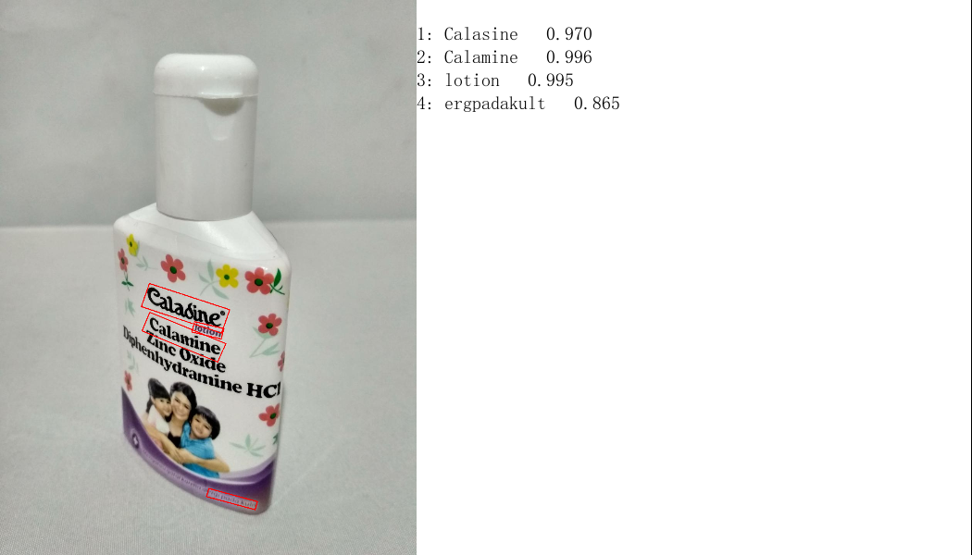
Post Evaluation: Tricky label (1)
It can be seen in the image below, that the word "Caladine" (which is wrongly predicted by the model to be Calasine) is separated from the word "Lotion", so this can cause the edit distance of "Caladine" to "Caladine Lotion" to be further away.
Whereas in the word "Calamine", there is also the word "Calamine" in the database so the edit distance becomes closer.
To solve this problem, the word "Calamine" can be removed from the detected text, so that the closest word is the correct one.

Slide 11
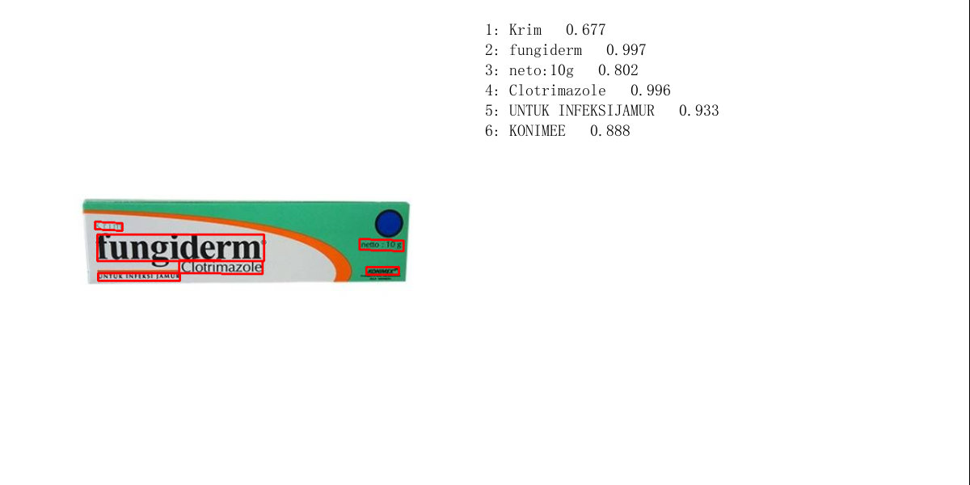
Post Evaluation: Tricky label (2)
On the drug “Fungiderm”, it says “Clotrimazole”. The problem is that “Clotrimazole” is a drug that is on our database so spelling correction can be off.
The solution is to remove “Clotrimazole” from the detected text

Slide 12
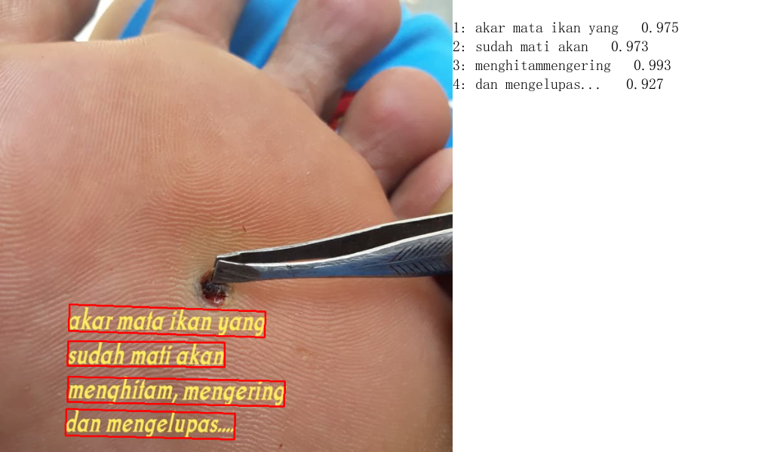
Post Evaluation: Irrelevant Images
It can be seen in the testing dataset that the testing data sometimes contains images that are not relevant to the text (in this case OCR), so it will be an impossible task to do. From there our team found that the testing dataset has data that has the same label sequentially every 10 data, so we can do post evaluation by obtaining the mode of each of the 10 data and replacing the data with the mode.
For example, as in the image on the left, where the image has no text relevant to the label. However, we as humans understand that this image is still connected to the label around it, namely "Callusol" which is the medicine for the above disease.

Slide 13
Modeling & Results After Post Evaluation
Metrics | Score
Accuracy | 100%
WER | 0.0
CER | 0.0
After conducting a post-evaluation, we successfully rectified all errors in the dataset, resulting in a flawless assessment of our approach.

Slide 14
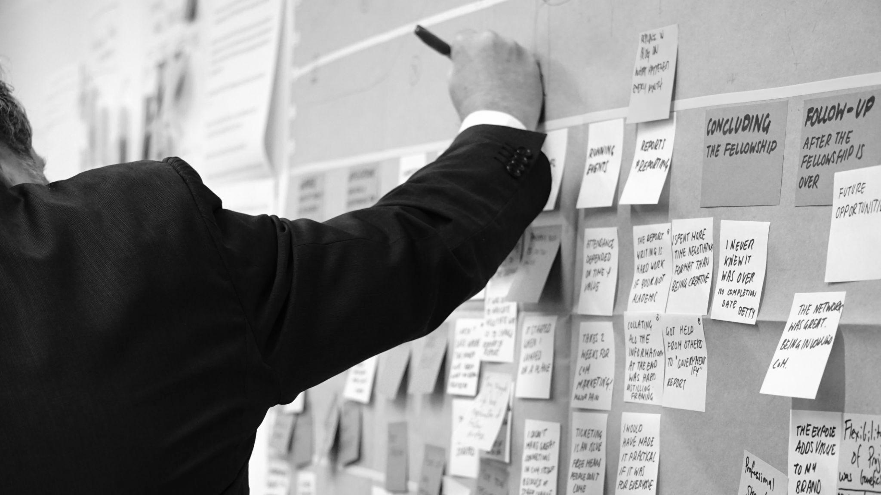
Thank
You

