Slide 1
Cutting-Edge Technology
14.10.2016
Mario Tema Platform
Djelloul Senior Software Quality Engineer E2PR Team

Slide 2
About Mario
???

Slide 3
About Djelloul
Senior Software Quality Engineer E2PR Team
Join the E2OPEN Family since 01.09.2016
My nickname DJ

Slide 4
Agenda
Motivation
Project decsription
Architectur
Technologies overview
Spring Boot
Spring Data
Spring AOP
SSE
Java 1.8
Camel Route
JunitTest , IT , Spock Framework , Code coverage
Lambok
Node JS , React JS, Flux-Pattern (Facebook)
Typescript 2.0 , NPM, Grunt, Webpack,
Git
Sonarqube
Performance test Gatling , Serenity-BDD

Slide 5
Motivation
Motivation
Project decsription
Architectur
Technologies overview
Spring Boot
Spring Data
Spring AOP
SSE
Java 1.8
Camel Route
JunitTest , IT , Spock Framework , Code coverage
Lambok
Node JS , React JS, Flux-Pattern (Facebook)
Typescript 2.0 , NPM, Grunt, Webpack,
Git
Sonarqube
Performance test Gatling , Serenity-BDD

Slide 6
Project decsription
Project decsription
Architectur
Technologies overview
Spring Boot
Spring Data
Spring AOP
SSE
Java 1.8
Camel Route
JunitTest , IT , Spock Framework , Code coverage
Lambok
Node JS , React JS, Flux-Pattern (Facebook)
Typescript 2.0 , NPM, Grunt, Webpack,
Git
Sonarqube
Performance test Gatling , Serenity-BDD

Slide 7
Architectur
Architectur
Technologies overview
Spring Boot
Spring Data
Spring AOP
SSE
Java 1.8
Camel Route
JunitTest , IT , Spock Framework , Code coverage
Lambok
Node JS , React JS, Flux-Pattern (Facebook)
Typescript 2.0 , NPM, Grunt, Webpack,
Git
Sonarqube
Performance test Gatling , Serenity-BDD

Slide 8
Technologies overview
Spring Boot
Spring Data
Spring AOP
SSE
Java 1.8
Camel Route
JunitTest , IT , Spock Framework , Code coverage
Lambok
Node JS , React JS, Flux-Pattern (Facebook)
Typescript 2.0 , NPM, Grunt, Webpack,
Git
Sonarqube
Performance test Gatling , Serenity-BDD

Slide 9
Technologies overview
Spring Data
Spring AOP
SSE
Java 1.8
Camel Route
JunitTest , IT , Spock Framework , Code coverage
Lambok
Node JS , React JS, Flux-Pattern (Facebook)
Typescript 2.0 , NPM, Grunt, Webpack,
Git
Sonarqube
Performance test Gatling , Serenity-BDD

Slide 10
Technologies overview
Spring AOP
SSE
Java 1.8
Camel Route
JunitTest , IT , Spock Framework , Code coverage
Lambok
Node JS , React JS, Flux-Pattern (Facebook)
Typescript 2.0 , NPM, Grunt, Webpack,
Git
Sonarqube
Performance test Gatling , Serenity-BDD

Slide 11
Technologies overview
SSE
Java 1.8
Camel Route
JunitTest , IT , Spock Framework , Code coverage
Lambok
Node JS , React JS, Flux-Pattern (Facebook)
Typescript 2.0 , NPM, Grunt, Webpack,
Git
Sonarqube
Performance test Gatling , Serenity-BDD

Slide 12
Technologies overview
Java 1.8
Camel Route
JunitTest , IT , Spock Framework , Code coverage
Lambok
Node JS , React JS, Flux-Pattern (Facebook)
Typescript 2.0 , NPM, Grunt, Webpack,
Git
Sonarqube
Performance test Gatling , Serenity-BDD

Slide 13
Technologies overview
Camel Route
JunitTest , IT , Spock Framework , Code coverage
Lambok
Node JS , React JS, Flux-Pattern (Facebook)
Typescript 2.0 , NPM, Grunt, Webpack,
Git
Sonarqube
Performance test Gatling , Serenity-BDD

Slide 14
Technologies overview
Testing
JunitTest , IT , Spock Framework , Code coverage
Lambok
Node JS , React JS, Flux-Pattern (Facebook)
Typescript 2.0 , NPM, Grunt, Webpack,
Git
Sonarqube
Performance test Gatling , Serenity-BDD

Slide 15
Technologies overview
Lambok
Node JS , React JS, Flux-Pattern (Facebook)
Typescript 2.0 , NPM, Grunt, Webpack,
Git
Sonarqube
Performance test Gatling , Serenity-BDD

Slide 16
Technologies overview
Front-End
Node JS , React JS, Flux-Pattern (Facebook)
Typescript 2.0 , NPM, Grunt, Webpack,
Git
Sonarqube
Performance test Gatling , Serenity-BDD

Slide 17
Technologies overview
Front-End
Typescript 2.0 , NPM, Grunt, Webpack
Git
Sonarqube
Performance test Gatling , Serenity-BDD

Slide 18
Technologies overview
Git
Sonarqube
Performance test Gatling , Serenity-BDD

Slide 19
Technologies overview
Sonarqube
Performance test Gatling , Serenity-BDD

Slide 20
Technologies overview
Gatling
Performance test Gatling
Serenity-BDD

Slide 21
Technologies overview
Serenity-BDD
Serenity-BDD

Slide 22

Performance Test (Djelloul)

Slide 23


JMETER
first official release 1998-12-15
Notes:
most famous performance tool

Slide 24
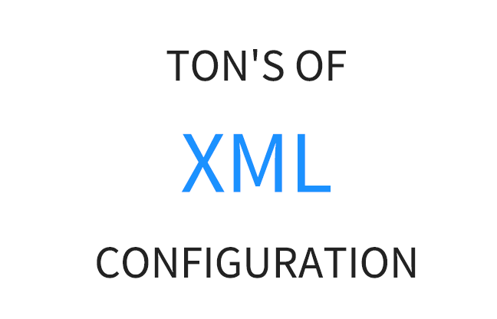


Gatling vs JMETER
Gatling
Scala
Scripting
Notes:
JMeter is GUI oriented. Opening, editing and saving a JMX file must be made with JMeter Graphical interface.
Do not attempt to modify the JMX yourself, even if the XML is human readable, it’s really not sustainable.

Slide 25

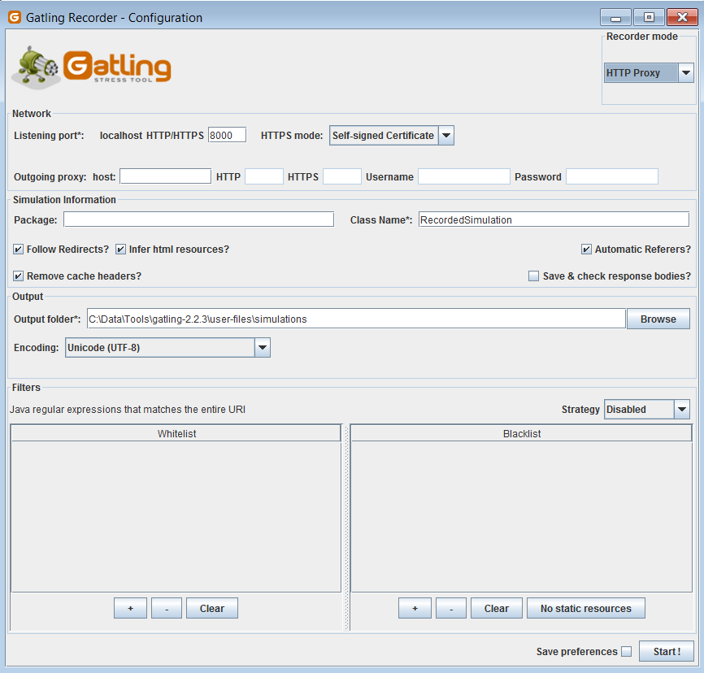
Gatling vs JMETER
JMETER
You Need
pilot license
Gatling
You Need
Developer mindset
Notes:
JMeter is GUI oriented. Opening, editing and saving a JMX file must be made with JMeter Graphical interface.
Do not attempt to modify the JMX yourself, even if the XML is human readable, it’s really not sustainable.

Slide 26
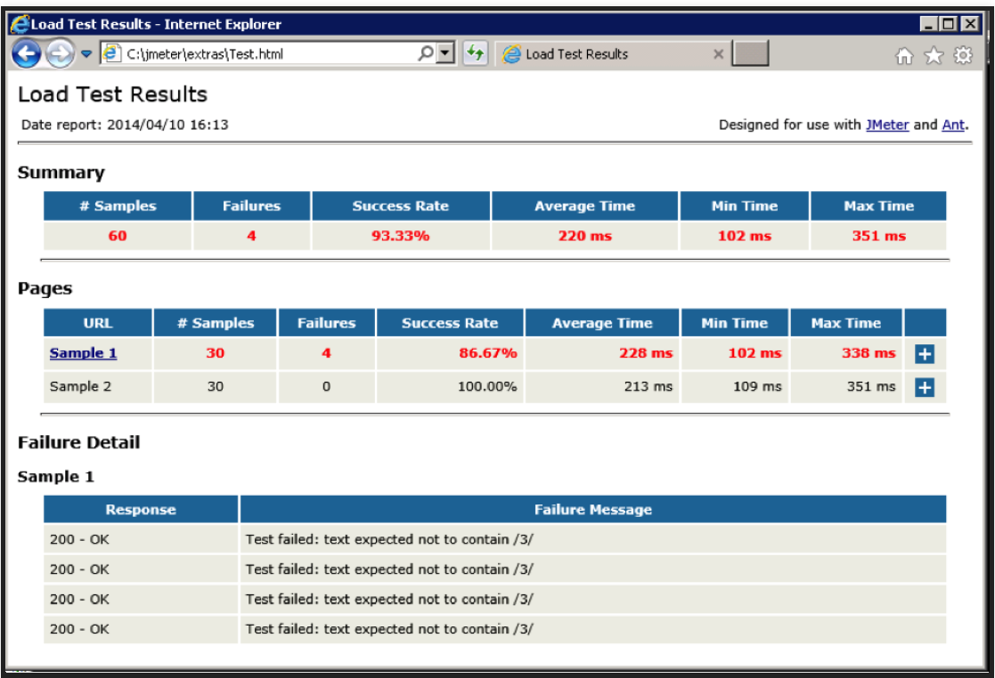
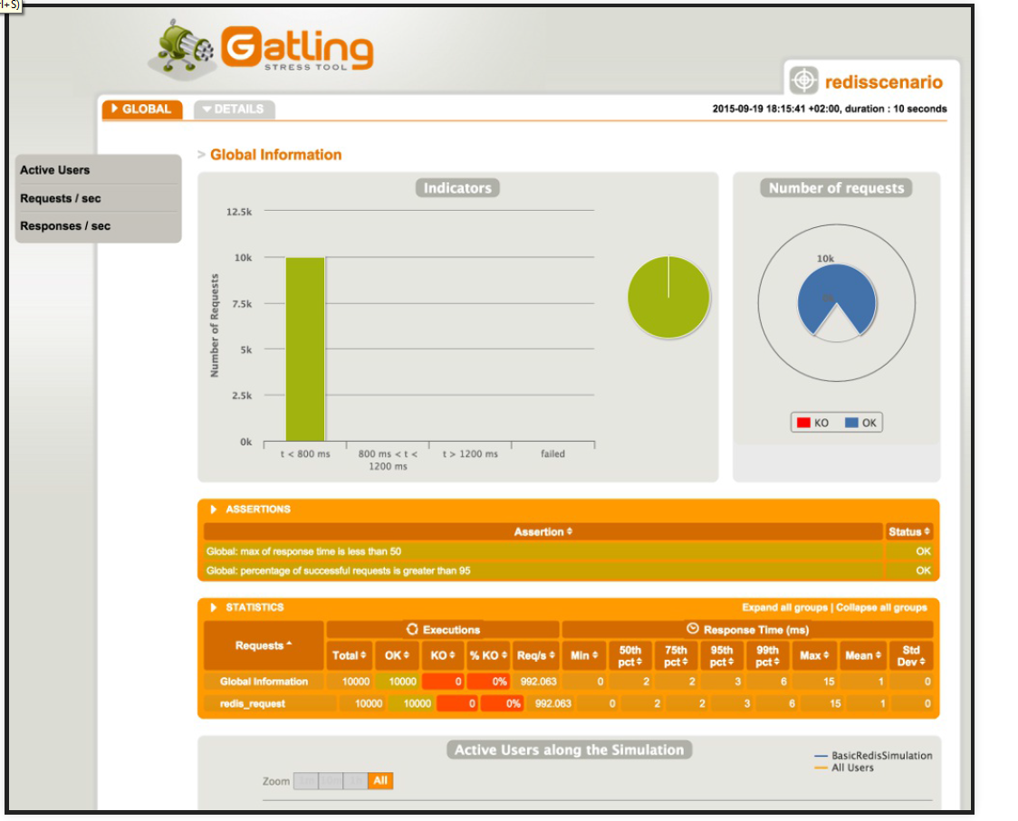
Gatling vs JMETER

Slide 27
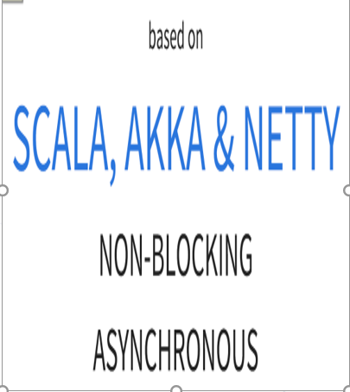
Gatling vs JMETER
Every Virtual user=Thread
IO Bloking
SYNCHRONOUS
Notes:
JMeter uses the One Thread = One User Paradigm. It means that each simulated virtual user inside the load generator equals to a single thread. Wait times are simulated by Thread.sleep. The user waits for the server response when sending a request. This is sometimes called Synchronous processing.
Gatling uses a more advanced engine based on Akka. Akka is a distributed framework based on the actor model. It allows fully asynchronous computing. Actors are small entities communicating with other actors through messaging. It can simulate multiple virtual users with a single Thread. Gatling also makes use of Async HTTP Client.

Slide 28
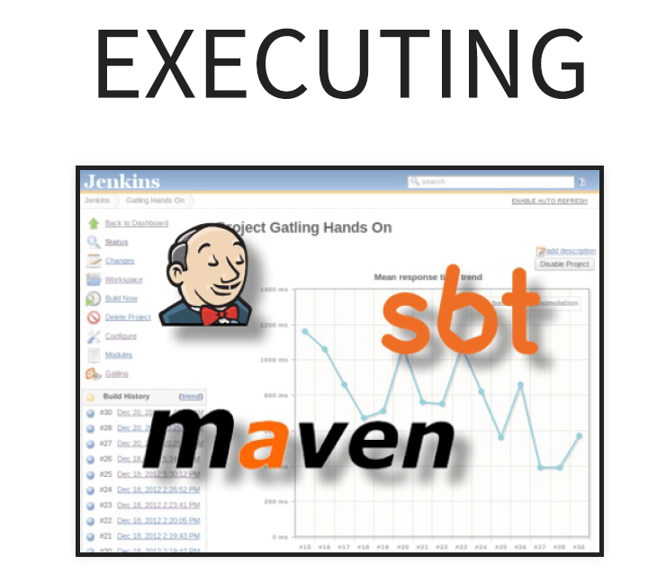
Gatling Continuous Integration

Slide 29


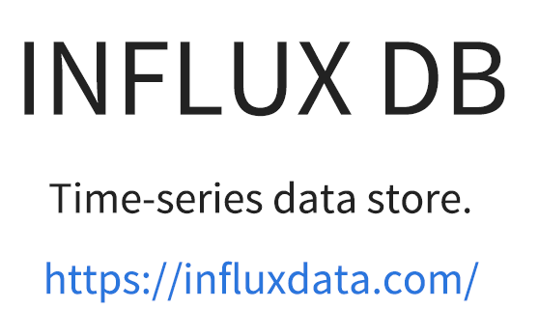
Gatling

Slide 30
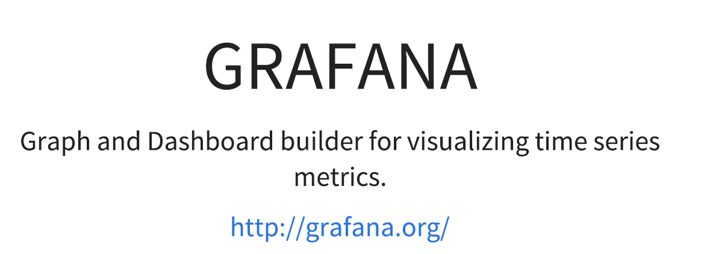
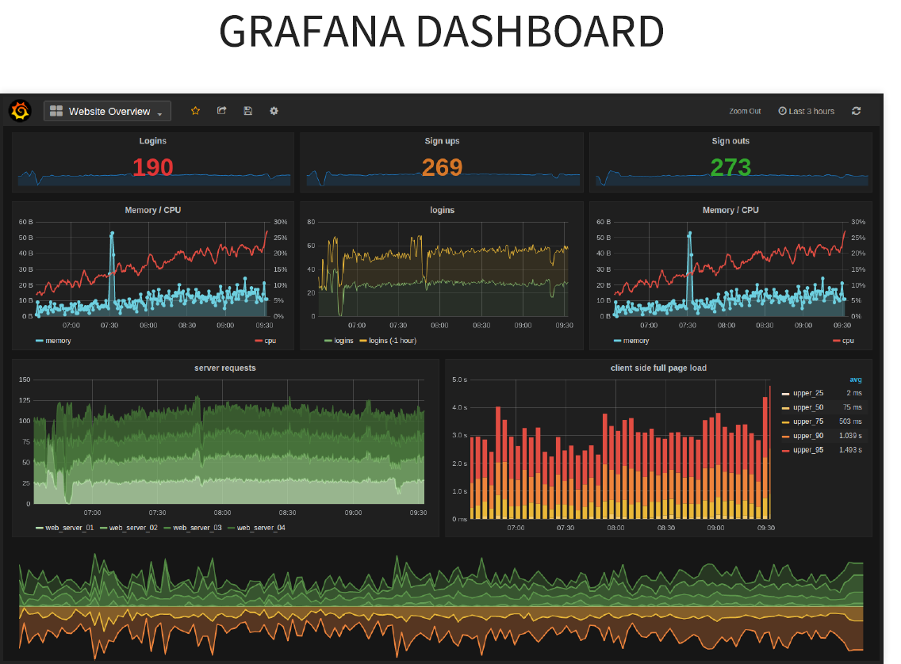
Gatling

Slide 31


Slide 32
Technologies overview
Gatling Demo
Performance test Gatling
Serenity-BDD

Slide 33
Technologies overview
Serenity-BDD
Serenity-BDD

Slide 34
Thank you

