Slide 1
Cutting-Edge Technology
14.10.2016
Mario Tema (Senior Software Engineer, E2DX Team)
Djelloul (Senior Software Quality Engineer, E2PR Team)

Slide 2
About Mario
My name is Mario Tema,
I’m 45 Years old and I come from Karlsruhe.
I have 13 years of Information and Technology experience in various Skills and Frameworks,
especially in Web-Technology based on Java/JEE.
If I do not code, most likely you find me in wakeboarding or kiting somewhere.
I join the E2OPEN Family since 01.09.2016 as Senior Software Engineer in E2DH Team

Slide 3
About Djelloul
Senior Software Quality Engineer E2PR Team
Join the E2OPEN Family since 01.09.2016
My nickname DJ

Slide 4
Agenda
Motivation
Project decsription
Architectur
Technologies overview
Backend
Spring Boot, Spring Data, Spring AOP
SSE
Java 1.8
Camel Route
Lambok
JunitTest, IT, Spock Framework , Code coverage
Frontend
Node JS, NPM, Grunt, Webpack
React JS with Flux-Pattern (Facebook)
Typescript 2.0 NPM, Grunt, Webpack
Git
Sonarqube
Performance-Test Gatling, Serenity-BDD

Slide 5
Motivation
Knowhow Sharing

Slide 6
Project decsription
We'll be building a simple but realistic Message Notification Center with Spring Boot that you can read and edit messages, a basic version of the real time Messages offered by REST-Server.
We'll provide:
A ORM of Messages
A form to import Messages via Apache Camel Route
JPA Hooks to provide SSE Broadcast for frontend
Cache Abstraction
Junit Test, IT and Spock Framework
CCD and TDD
Code Coverage
It'll also have a few neat features:
Live loading: Messages will be imported from FTP/Remote-Folder with Camel Route.
Data converting, validating and persisting: Convert DTO’s to Entities and Value Objects
Live SSE broadcasting to client.
CRUD hooks to broadcast SSE event.

Slide 7
Architectur
Design und Architektur from Distributed Multitiered Applications:
Web tier (web components, web services, REST)
Business tier (distributed objects and components)
Data source tier (object relational mapping)
Service-Oriented Architectures (SOA).

Slide 8
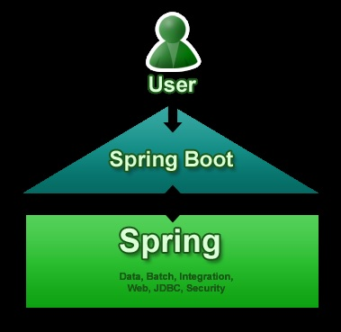
Spring Boot
A tool for getting started very quickly with Spring
Common non-functional requirements for a "real" application
Exposes a lot of useful features by default
Gets out of the way quickly if you want to change defaults
Focuses attention at a single point (as opposed to large collection of spring-* projects)
Pros of Spring Boot:
It is very easy to develop Spring Based applications with Java or Groovy.
It reduces lots of development time and increases productivity.
It avoids writing lots of boilerplate Code, Annotations and XML Configuration.
It is very easy to integrate Spring Boot Application with its Spring Ecosystem like Spring JDBC, Spring ORM, Spring Data, Spring Security etc.
It follows “Opinionated Defaults Configuration” Approach to reduce Developer effort
It provides Embedded HTTP servers like Tomcat, Jetty etc. to develop and test our web applications very easily.
It provides CLI (Command Line Interface) tool to develop and test Spring Boot (Java or Groovy) Applications from command prompt very easily and quickly.
It provides lots of plugins to develop and test Spring Boot Applications very easily using Build Tools like Maven and Gradle
It provides lots of plugins to work with embedded and in-memory Databases very easily.
Notes:
Spring Team has released one of major innovation on the top of existing Spring Framework is Spring Boot. It is a completely new project from Pivotal Team (The Spring Team). Spring Boot is their latest innovation to keep up to date with the changing technology needs. The primary motivation behind developing Spring Boot is to simplify the process for configuring and deploying the spring applications.
Spring Boot Primary Goals
Spring Boot primary goals are:
Provide a radically faster and widely accessible getting started experience for all Spring development.
Be opinionated out of the box, but get out of the way quickly as requirements start to diverge from the defaults.
Provide a range of non-functional features that are common to large classes of projects (e.g. embedded servers, security, metrics, health checks, externalized configuration).
Absolutely no code generation and no requirement for XML configuration, to avoid XML Configuration completely
To avoid defining more Annotation Configuration(It combined some existing Spring Framework Annotations to a simple and single Annotation)
To avoid writing lots of import statements
To provide some defaults to quick start new projects within no time.
4. Why New Project Need Spring Boot?
To ease the Java-based applications Development, Unit Test and Integration Test Process.
To reduce Development, Unit Test and Integration Test time by providing some defaults.
To increase Productivity.
5. What Spring Boot Isn’t?
As above mention Spring Boot is not a framework to write applications, it helps you to develop and build, package and deploy application with minimal configuration or zero configuration.
It is not an application server. But it’s the embedded servlet container that provides application server functionality, not Spring Boot itself.
Future Spring projects would not have any XML configurations as part of it, everything will be handled by the project Spring Boot.

Slide 9
Server-Sent Events
In a standard HTTP request-response scenario a client opens a connection, sends a HTTP request to the server (for example a HTTP GET request), then receives a HTTP response back and the server closes the connection once the response is fully sent/received. The initiative always comes from a client when the client requests all the data.
In contrast, Server-Sent Events (SSE) is a mechanism that allows server to asynchronously push the data from the server to the client once the client-server connection is established by the client.
Technologies supporting server-to-client communication:
Polling
Long-polling
Server-Sent events
WebSocket
Notes:
What are Server-Sent Events
In a standard HTTP request-response scenario a client opens a connection, sends a HTTP request to the server (for example a HTTP GET request), then receives a HTTP response back and the server closes the connection once the response is fully sent/received. The initiative always comes from a client when the client requests all the data. In contrast, Server-Sent Events (SSE) is a mechanism that allows server to asynchronously push the data from the server to the client once the client-server connection is established by the client. Once the connection is established by the client, it is the server who provides the data and decides to send it to the client whenever new "chunk" of data is available. When a new data event occurs on the server, the data event is sent by the server to the client. Thus the name Server-Sent Events. Note that at high level there are more technologies working on this principle, a short overview of the technologies supporting server-to-client communication is in this list:
Polling
With polling a client repeatedly sends new requests to a server. If the server has no new data, then it send appropriate indication and closes the connection. The client then waits a bit and sends another request after some time (after one second, for example).
Long-polling
With long-polling a client sends a request to a server. If the server has no new data, it just holds the connection open and waits until data is available. Once the server has data (message) for the client, it uses the connection and sends it back to the client. Then the connection is closed.
Server-Sent events
SSE is similar to the long-polling mechanism, except it does not send only one message per connection. The client sends a request and server holds a connection until a new message is ready, then it sends the message back to the client while still keeping the connection open so that it can be used for another message once it becomes available. Once a new message is ready, it is sent back to the client on the same initial connection. Client processes the messages sent back from the server individually without closing the connection after processing each message. So, SSE typically reuses one connection for more messages (called events). SSE also defines a dedicated media type that describes a simple format of individual events sent from the server to the client. SSE also offers standard javascript client API implemented most modern browsers. For more information about SSE, see the SSE API specification.
WebSocket
WebSocket technology is different from previous technologies as it provides a real full duplex connection. The initiator is again a client which sends a request to a server with a special HTTP header that informs the server that the HTTP connection may be "upgraded" to a full duplex TCP/IP WebSocket connection. If server supports WebSocket, it may choose to do so. Once a WebSocket connection is established, it can be used for bi-directional communication between the client and the server. Both client and server can then send data to the other party at will whenever it is needed. The communication on the new WebSocket connection is no longer based on HTTP protocol and can be used for example for for online gaming or any other applications that require fast exchange of small chunks of data in flowing in both directions.

Slide 10
Java 1.8
There are dozens of features added to Java 8, the most significant ones are mentioned below −
Lambda expression − Adds functional processing capability to Java.
Method references − Referencing functions by their names instead of invoking them directly. Using functions as parameter.
Default method − Interface to have default method implementation.
New tools − New compiler tools and utilities are added like ‘jdeps’ to figure out dependencies.
Stream API − New stream API to facilitate pipeline processing.
Date Time API − Improved date time API.
Optional − Emphasis on best practices to handle null values properly.
Nashorn, JavaScript Engine − A Java-based engine to execute JavaScript code.
Along with these new featuers, lots of feature enhancements are done under-the-hood, at both compiler and JVM level.

Slide 11
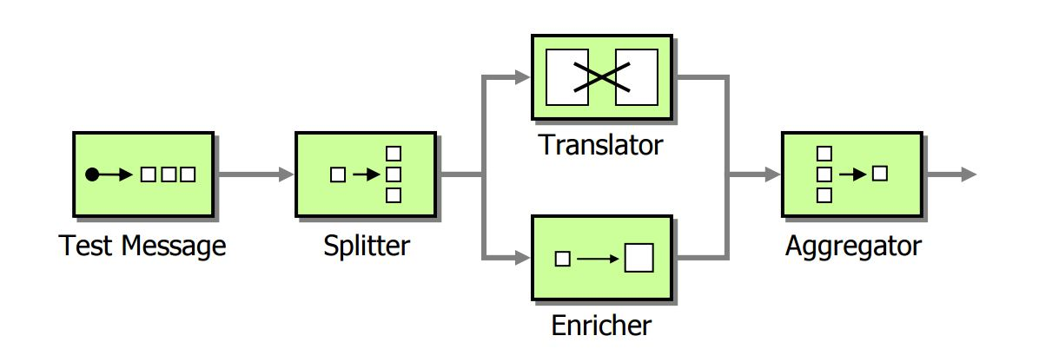
Camel Route
Apache Camel is a powerful Open Source Integration Framework based on known Enterprise Integration Patterns
Camel uses a Java based Routing Domain Specific Language (DSL) or an Xml Configuration to configure routing and mediation rules which are added to a CamelContext to implement the various Enterprise Integration Patterns.
At a high level Camel consists of a Camel Context which contains a collection of Component instances. A Component is essentially a factory of Endpoint instances. You can explicitly configure Component instances in Java code or an IoC container like Spring or Guice, or they can be auto-discovered using URIs.
An Endpoint acts rather like a URI or URL in a web application or a Destination in a JMS system; you can communicate with an endpoint; either sending messages to it or consuming messages from it. You can then create a Producer or Consumer on an Endpoint to exchange messages with it.
Notes:
Concise
Application
Messaging
Exchange
Language

Slide 12
Lombok
Project Lombok makes java a spicier language by adding 'handlers' that know how to build and compile simple, boilerplate-free, not-quite-java code.
Features / Supports
@Getter and @Setter
@ToString
@EqualsAndHashCode
@AllArgsConstructor, @RequiredArgsConstructor and @NoArgsConstructor
@Log, @Log4j, @Log4j2, @Slf4j, @XSlf4j, @CommonsLog, @JBossLog
@Data
@Builder
@Value
@UtilityClass with IntelliJ 2016.2
… much more

Slide 13
Spock Framework
Spock is a testing and specification framework for Java and Groovy applications. What makes it stand out from the crowd is its beautiful and highly expressive specification language.
Fixture Methods
def setup() {} // run before every feature method
def cleanup() {} // run after every feature method
def setupSpec() {} // run before the first feature method
def cleanupSpec() {} // run after the last feature method
def "HashMap accepts null key"() {
setup:
def map = new HashMap()
when:
map.put(null, "elem")
then:
notThrown(NullPointerException)
}
Notes:
Thanks to its JUnit runner, Spock is compatible with most IDEs, build tools,
and continuous integration servers.
Spock is inspired from JUnit, jMock, RSpec, Groovy, Scala, Vulcans, and other fascinating life forms.

Slide 14
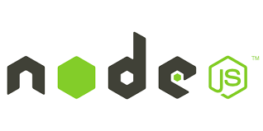
Node JS
Node.js® is a JavaScript runtime built on Chrome's V8 JavaScript engine.
Node.js uses an event-driven, non-blocking I/O model that makes it lightweight and efficient.
Node.js' package ecosystem, npm, is the largest ecosystem of open source libraries in the world.
Notes:
As an asynchronous event driven JavaScript runtime, Node is designed to build scalable network applications.

Slide 15

Grunt
Grunt is a JavaScript Task Runner, a tool used to automatically perform frequently used tasks such as minification, compilation, unit testing, linting, etc. It uses a command-line interface to run custom tasks defined in a file (known as a Gruntfile).
Grunt was created by Ben Alman and is written in Node.js. It is distributed via npm.
Notes:
Presently, there are more than five thousand plugins available in the Grunt ecosystem.

Slide 16
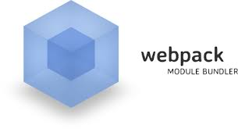
Webpack
Webpack is a module bundler.
Webpack takes modules with dependencies and generates static assets representing those modules.
Goals
Split the dependency tree into chunks loaded on demand
Keep initial loading time low
Every static asset should be able to be a module
Ability to integrate 3rd-party libraries as modules
Ability to customize nearly every part of the module bundler
Suited for big projects
Notes:
Why another module bundler?
Existing module bundlers are not well suited for big projects (big single page applications).
The most pressing reason for developing another module bundler was Code Splitting and that static assets should fit seamlessly together through modularization.
I tried to extend existing module bundlers, but it wasn’t possible to achieve all goals

Slide 17
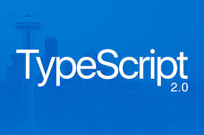
Typescript 2.0
TypeScript delivers close ECMAScript spec alignment, wide support for JavaScript libraries and tools, and a language service that powers a first class editing experience in all major editors; all of which come together to provide an even more productive and scalable JavaScript development experience.
TypeScript 2.0 brings several new features over the 1.8 release, some of which we detailed in the 2.0 Beta and Release Candidate blog posts. Below are highlights of the biggest features that are now available in TypeScript.
Simplified Declaration File (.d.ts) Acquisition
Non-nullable Types
Control Flow Analyzed Types
The readonly Modifier
Notes:
Simplified Declaration File (.d.ts) Acquisition
Typings and tsd have been fantastic tools for the TypeScript ecosystem. Up until now, these package managers helped users get .d.ts files from DefinitelyTyped to their projects as fast as possible.
Non-nullable Types
JavaScript has two values for “emptiness” – null and undefined. If null is the billion dollar mistake, undefined only doubles our losses. These two values are a huge source of errors in the JavaScript world because users often forget to account for null or undefined being returned from APIs.
In TypeScript 2.0, null and undefined have their own types which allows developers to explicitly express when null/undefined values are acceptable. Now, when something can be either a number or null, you can describe it with the union type number | null (which reads as “number or null”).
Control Flow Analyzed Types
The readonly Modifier
Immutable programming in TypeScript just got easier. Starting TypeScript 2.0, you can declare properties as read-only.

Slide 18
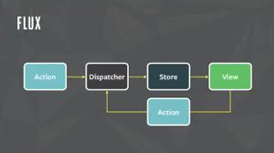
FLUX Pattern (Facebook)
Flux is an architecture that Facebook uses internally when working with React. It is not a framework or a library. It is simply a new kind of architecture that complements React and the concept of Unidirectional Data Flow.
That said, Facebook does provide a repo that includes a Dispatcher library. The dispatcher is a sort of global pub/sub handler that broadcasts payloads to registered callbacks.
A typical Flux architecture will leverage this Dispatcher library, along with NodeJS’s EventEmitter module in order to set up an event system that helps manage an applications state.
Notes:
Flux is probably better explained by explaining its individual components:
Actions – Helper methods that facilitate passing data to the Dispatcher
Dispatcher – Receives actions and broadcasts payloads to registered callbacks
Stores – Containers for application state & logic that have callbacks registered to the dispatcher
Controller Views – React Components that grab the state from Stores and pass it down via props to child components.

Slide 19

ReactJS
React is front end library developed by Facebook. It's used for handling view layer for web and mobile apps. ReactJS allows us to create reusable UI components. It is currently one of the most popular JavaScript libraries and it has strong foundation and large community behind it.
React is an open-source JavaScript library providing a view for data rendered as HTML. React views are typically rendered using components that contain additional components specified as custom HTML tags.
It is maintained by Facebook, Instagram and a community of individual developers and corporations.
Goals:
Declarative
Component-Based
Notes:
Declarative
React makes it painless to create interactive UIs. Design simple views for each state in your application, and React will efficiently update and render just the right components when your data changes.
Declarative views make your code more predictable and easier to debug.
Component-Based
Build encapsulated components that manage their own state, then compose them to make complex UIs.
Since component logic is written in JavaScript instead of templates, you can easily pass rich data through your app and keep state out of the DOM.

Slide 20
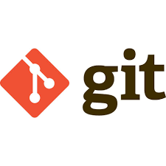
Git
Git is a free and open source distributed version control system designed to handle everything from small to very large projects with speed and efficiency.
Git is easy to learn and has a tiny footprint with lightning fast performance. It outclasses SCM tools like Subversion, CVS, Perforce, and ClearCase with features like cheap local branching, convenient staging areas, and multiple workflows.
Branching and Merging
Git allows and encourages you to have multiple local branches that can be entirely independent of each other. The creation, merging, and deletion of those lines of development takes seconds.
Notes:
Branching and Merging
The Git feature that really makes it stand apart from nearly every other SCM out there is its branching model.
Git allows and encourages you to have multiple local branches that can be entirely independent of each other. The creation, merging, and deletion of those lines of development takes seconds.
This means that you can do things like:
Frictionless Context Switching. Create a branch to try out an idea, commit a few times, switch back to where you branched from, apply a patch, switch back to where you are experimenting, and merge it in.
Role-Based Codelines. Have a branch that always contains only what goes to production, another that you merge work into for testing, and several smaller ones for day to day work.
Feature Based Workflow. Create new branches for each new feature you're working on so you can seamlessly switch back and forth between them, then delete each branch when that feature gets merged into your main line.
Disposable Experimentation. Create a branch to experiment in, realize it's not going to work, and just delete it - abandoning the work—with nobody else ever seeing it (even if you've pushed other branches in the meantime).

Slide 21
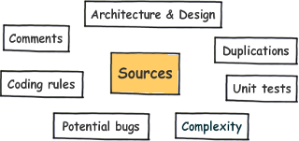
Sonarqube
SonarQube is an open platform to manage code quality. As such, it covers the 7 axes of code quality:
Notes:
Supports languages: Java (including Android), C/C++, Objective-C, C#, PHP, Flex, Groovy, JavaScript, Python, PL/SQL, COBOL, Swift, etc. (note that some of them are commercial)
Offers reports on duplicated code, coding standards, unit tests, code coverage, code complexity, potential bugs, comments and design and architecture.[2][3]
Records metrics history and provides evolution graphs ("time machine") and differential views.
Provides fully automated analysis: integrates with Maven, Ant, Gradle and continuous integration tools (Atlassian Bamboo, Jenkins, Hudson, etc.).[4][5][6]
Integrates with Eclipse, Visual Studio and IntelliJ IDEA development environments through the SonarLint plugins
Integrates with external tools: JIRA, Mantis, LDAP, Fortify, etc.
Is expandable with the use of plugins.[7][8]
Implements the SQALE methodology to evaluate technical debt.

Slide 22
Development
Time to see some code now…
E2OPEN-Client (https://github.com/sevenfate/e2open-client/tree/develop)
Install our dependencies
npm install
typings install
Putting it all together
webpack or
npm start
Package all together
npm run build
E2OPEN-Server (https://github.com/sevenfate/e2open-server/tree/develop)
mvn clean test ( run JUnit test)
mvn clean verify ( run JUnit and IT test)
mvn clean install ( compile, test, build and install to maven repository)
mvn clean install –Pproduction ( compile, test, build and install to maven repository with given profiles)

Slide 23
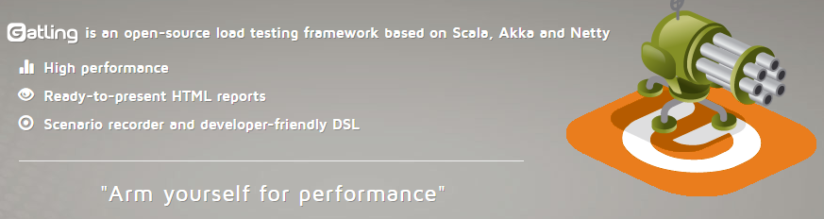
Performance Test (Djelloul)

Slide 24
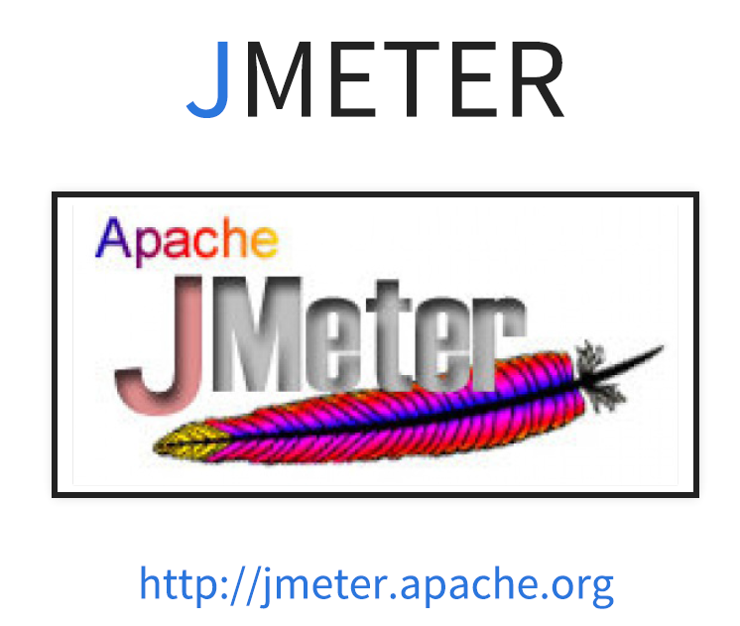

JMETER
first official release 1998-12-15
Notes:
most famous performance tool

Slide 25
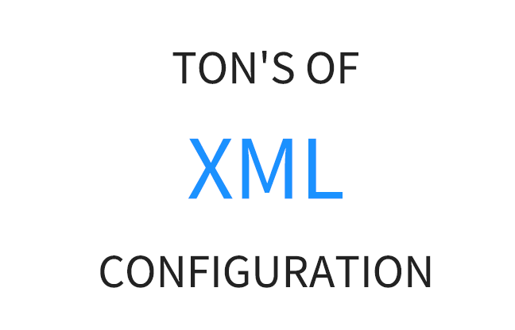


Gatling vs JMETER
Gatling
Scala
Scripting
Notes:
JMeter is GUI oriented. Opening, editing and saving a JMX file must be made with JMeter Graphical interface.
Do not attempt to modify the JMX yourself, even if the XML is human readable, it’s really not sustainable.

Slide 26

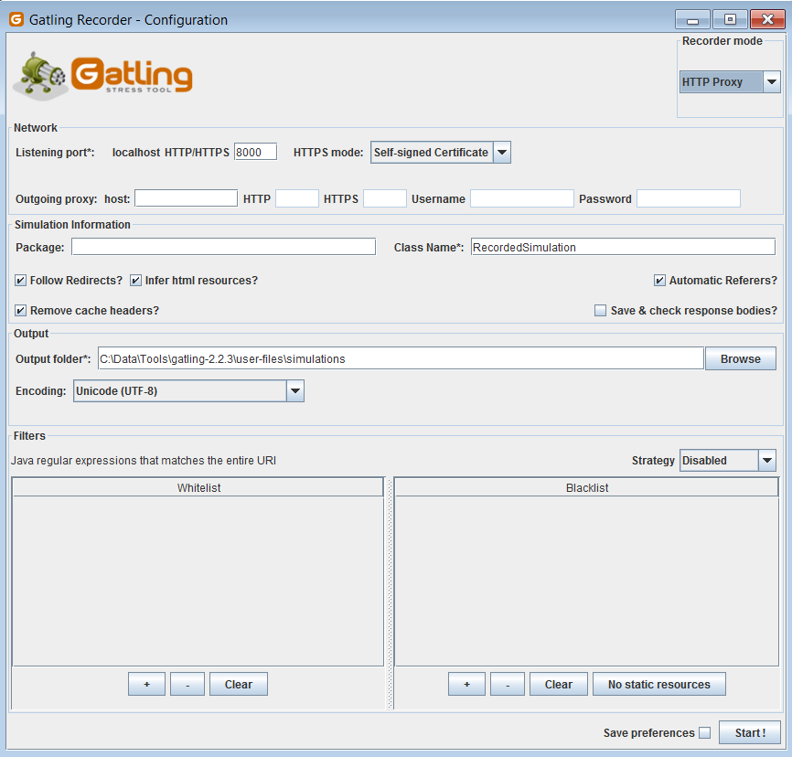
Gatling vs JMETER
JMETER
You Need
pilot license
Gatling
You Need
Developer mindset
Notes:
JMeter is GUI oriented. Opening, editing and saving a JMX file must be made with JMeter Graphical interface.
Do not attempt to modify the JMX yourself, even if the XML is human readable, it’s really not sustainable.

Slide 27
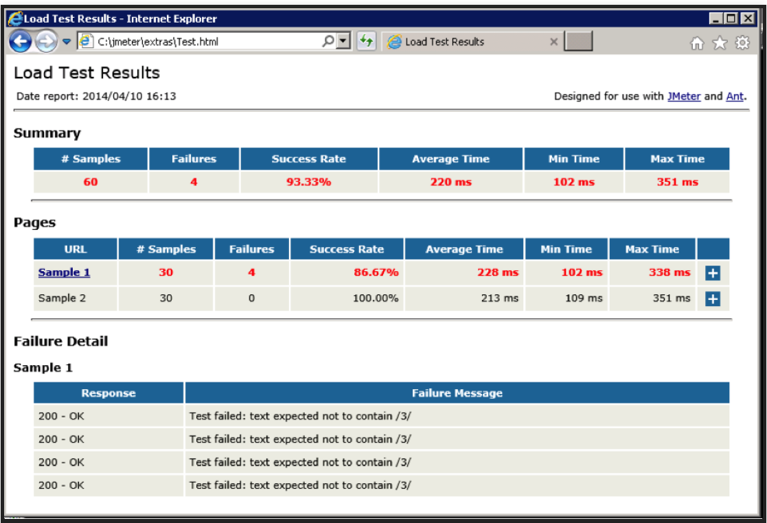
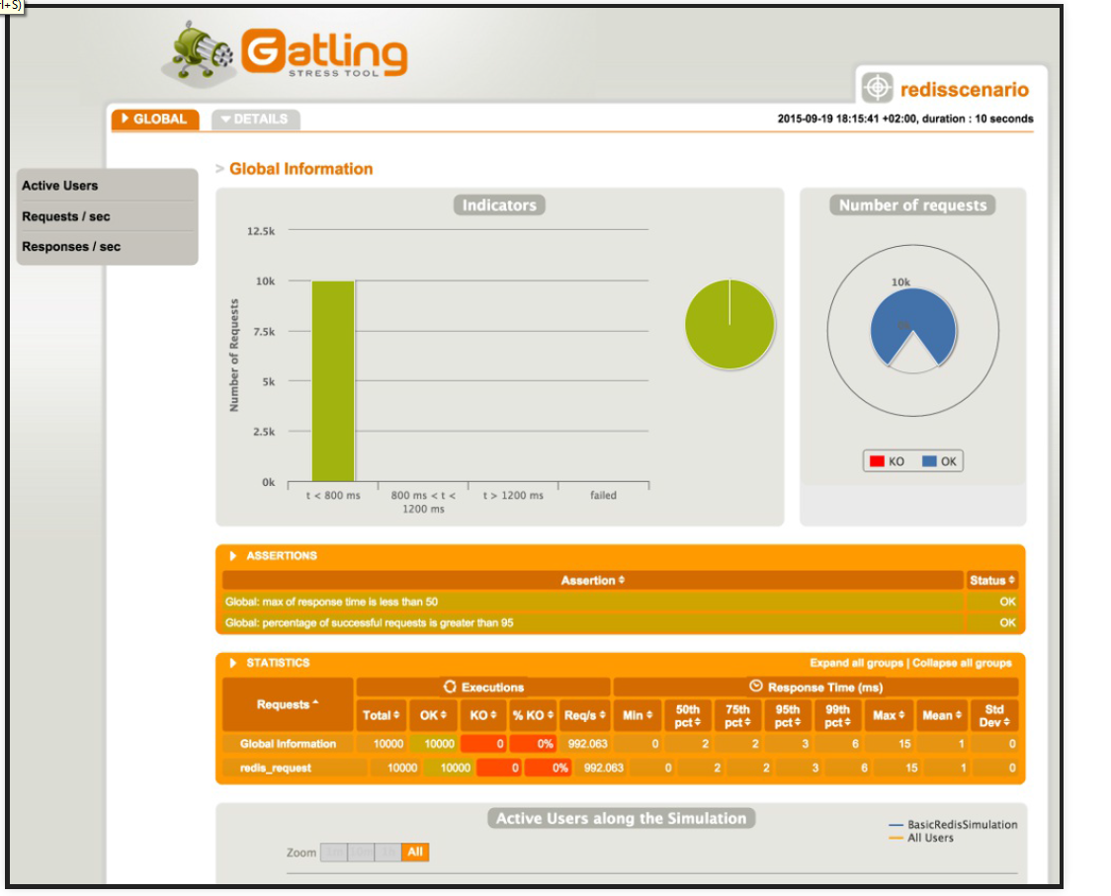
Gatling vs JMETER

Slide 28
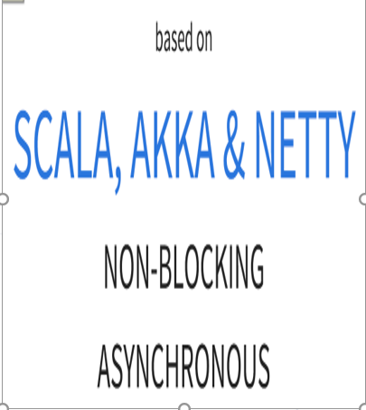
Gatling vs JMETER
Every Virtual user=Thread
IO Bloking
SYNCHRONOUS
Notes:
JMeter uses the One Thread = One User Paradigm. It means that each simulated virtual user inside the load generator equals to a single thread. Wait times are simulated by Thread.sleep. The user waits for the server response when sending a request. This is sometimes called Synchronous processing.
Gatling uses a more advanced engine based on Akka. Akka is a distributed framework based on the actor model. It allows fully asynchronous computing. Actors are small entities communicating with other actors through messaging. It can simulate multiple virtual users with a single Thread. Gatling also makes use of Async HTTP Client.

Slide 29
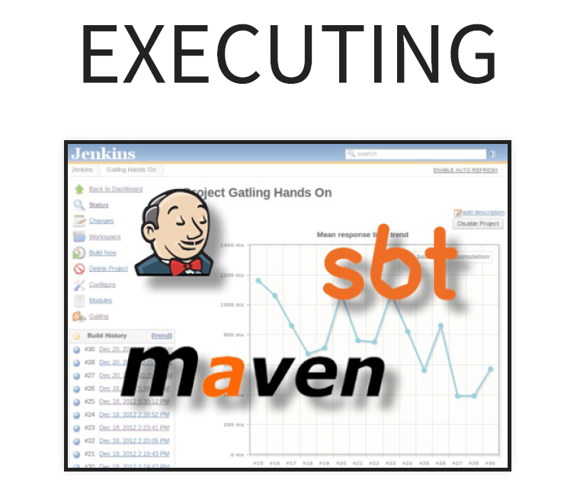
Gatling Continuous Integration

Slide 30


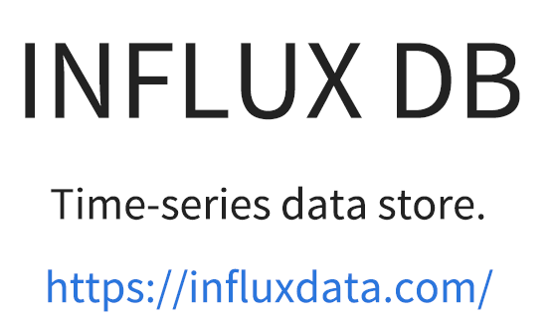
Gatling

Slide 31
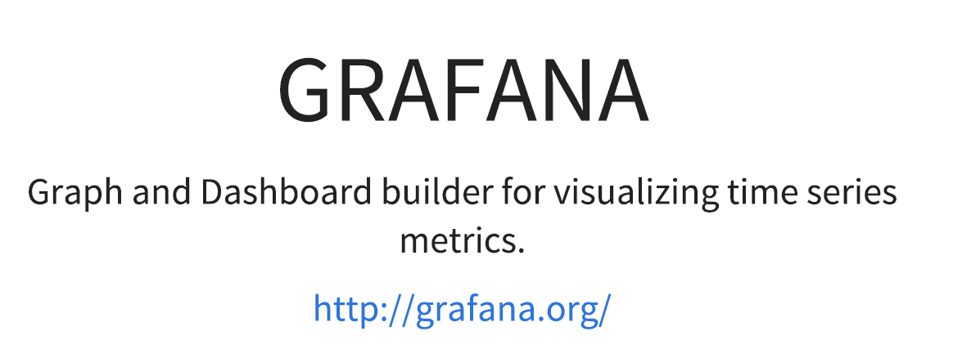
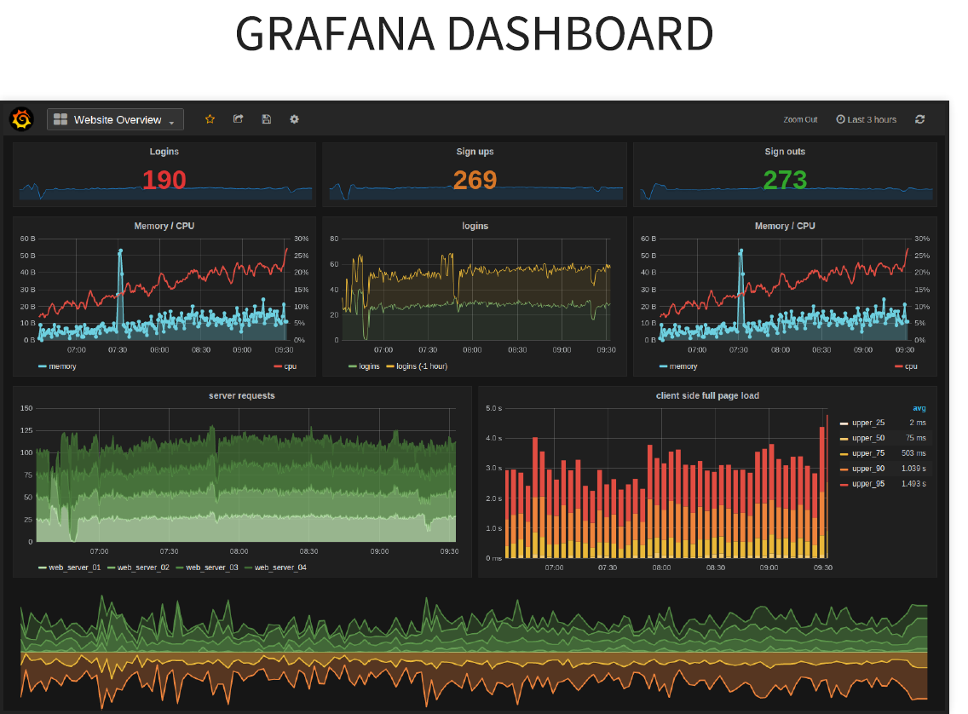
Gatling

Slide 32
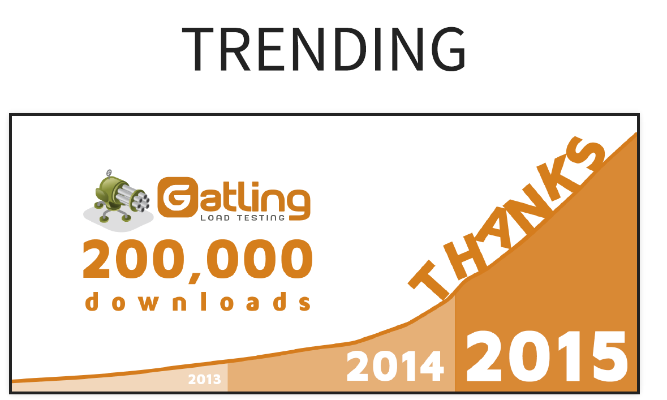

Slide 33
Technologies overview
Gatling Demo
Performance test Gatling
Serenity-BDD

Slide 34
Technologies overview
Serenity-BDD
Serenity-BDD

Slide 35
Thank you Questions?

