Slide 1
DB Restore
2022-10-28

Slide 2
1. Go to backup mail

Slide 3
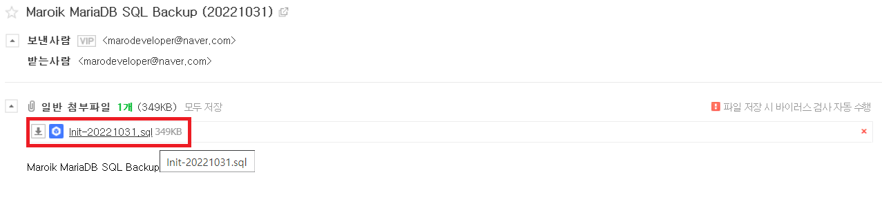
2. Download SQL

Slide 4
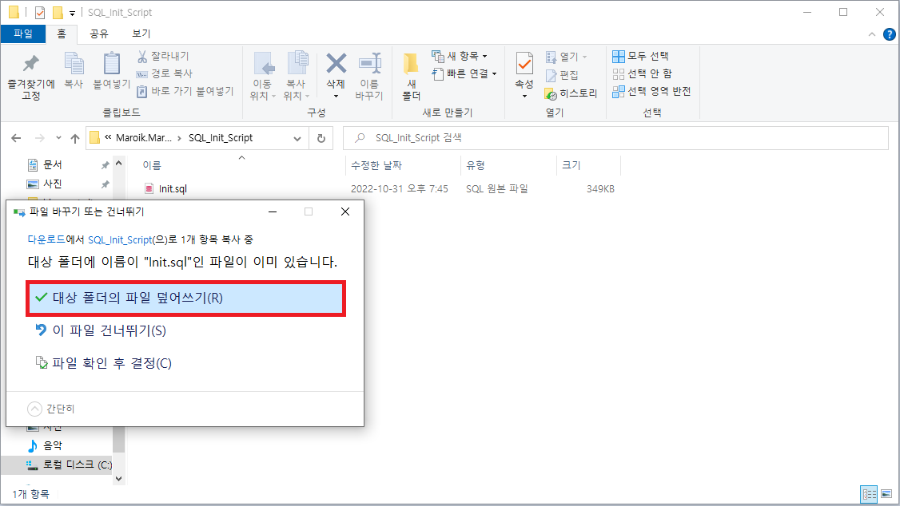
3. Override the downloaded SQL file into ./Maroik/Maroik.DB/PostgreSQL/SQL_Init_Script

