Slide 1
UploadFileRestore
2022-10-28

Slide 2

1. Go to backup mail

Slide 3
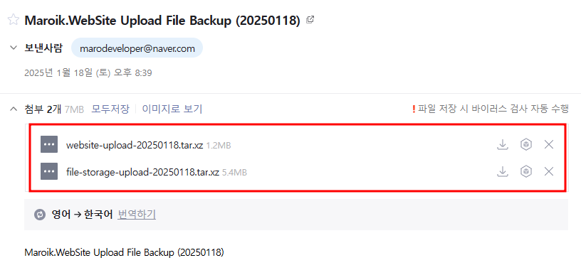
2. Download the file

Slide 4
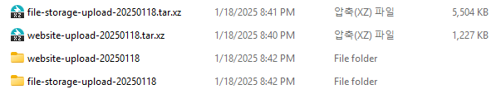
2. Unzip file

Slide 5
3. Override the downloaded files [file-storage-upload-20250118\home\peter-cho\Maroik\file-storage-upload-20250118] into [.\Maroik\Maroik.FileStorage\upload]

Slide 6
4. Override the downloaded files [website-upload-20250118\home\peter-cho\Maroik\website-upload-20250118] into [.\Maroik\Maroik.WebSite\wwwroot\upload]

