Slide 1

NexJob
A smarter job search experience — built for speed, clarity, and organization. Discover, filter, and save opportunities without the friction.
FRONTEND PROJECT
JOB SEARCH PLATFORM

Slide 2


The Job Search Problem
Most job seekers waste time jumping between platforms, reloading pages, and losing track of listings they meant to revisit. The process is fragmented, slow, and disorganized.
Too many clicks
No memory
Slow filters
Complex navigation slows discovery
Saved listings disappear between sessions
Page reloads break the search flow

Slide 3
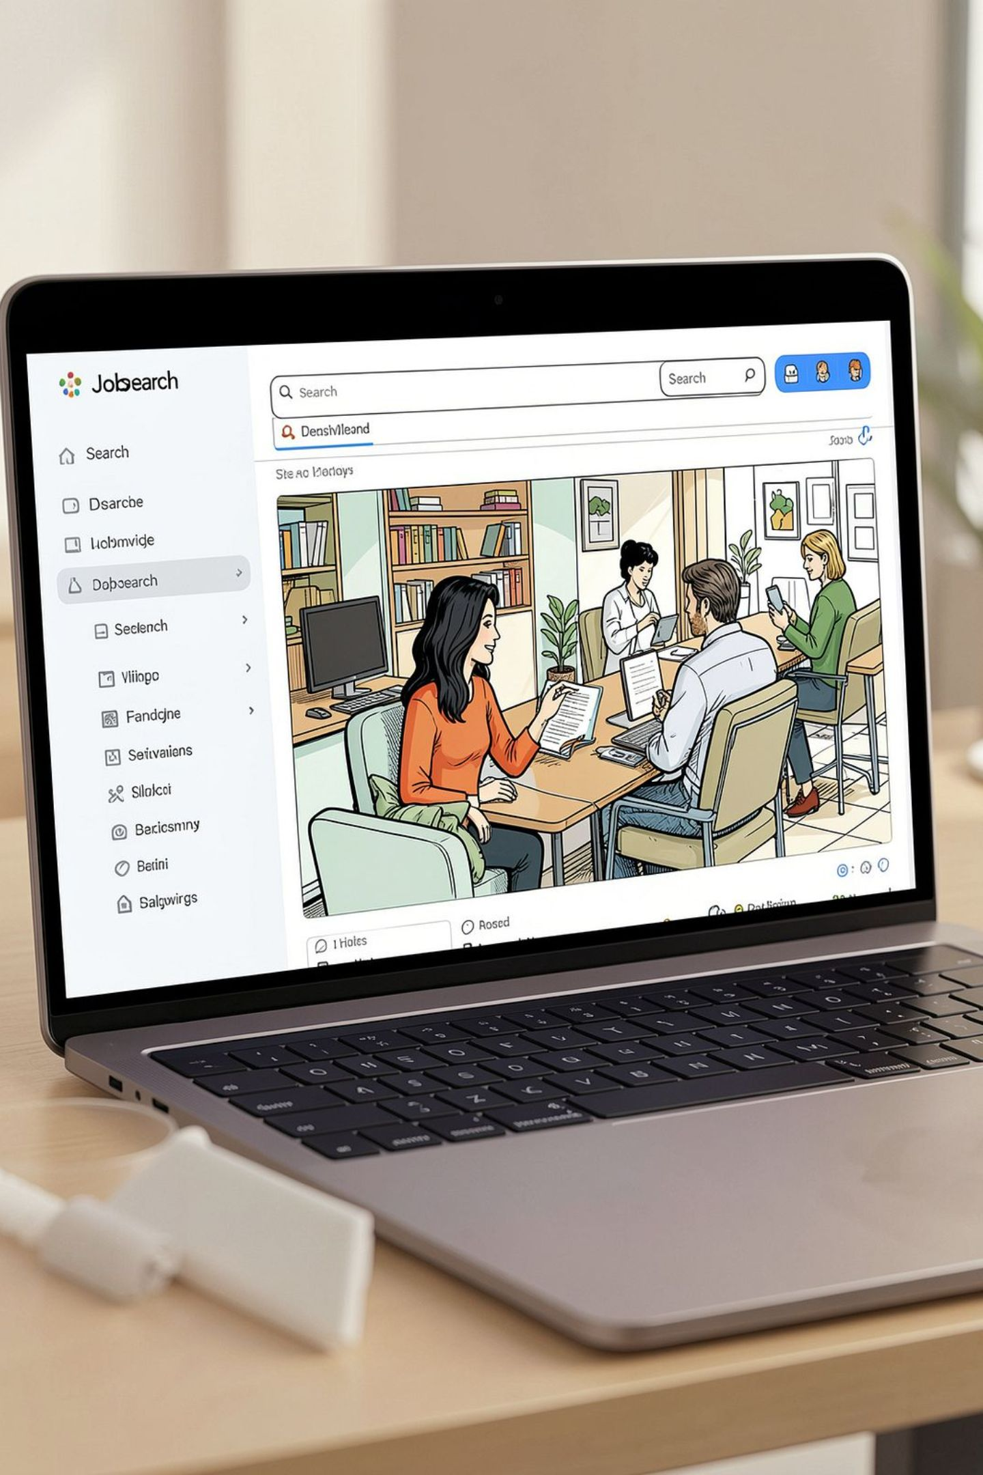
One Platform. Zero Friction.
NexJob consolidates the entire job hunt into a single, streamlined experience. From first browse to final save, every interaction is designed to keep you moving forward — not stuck waiting or searching for what you already found.

Slide 4
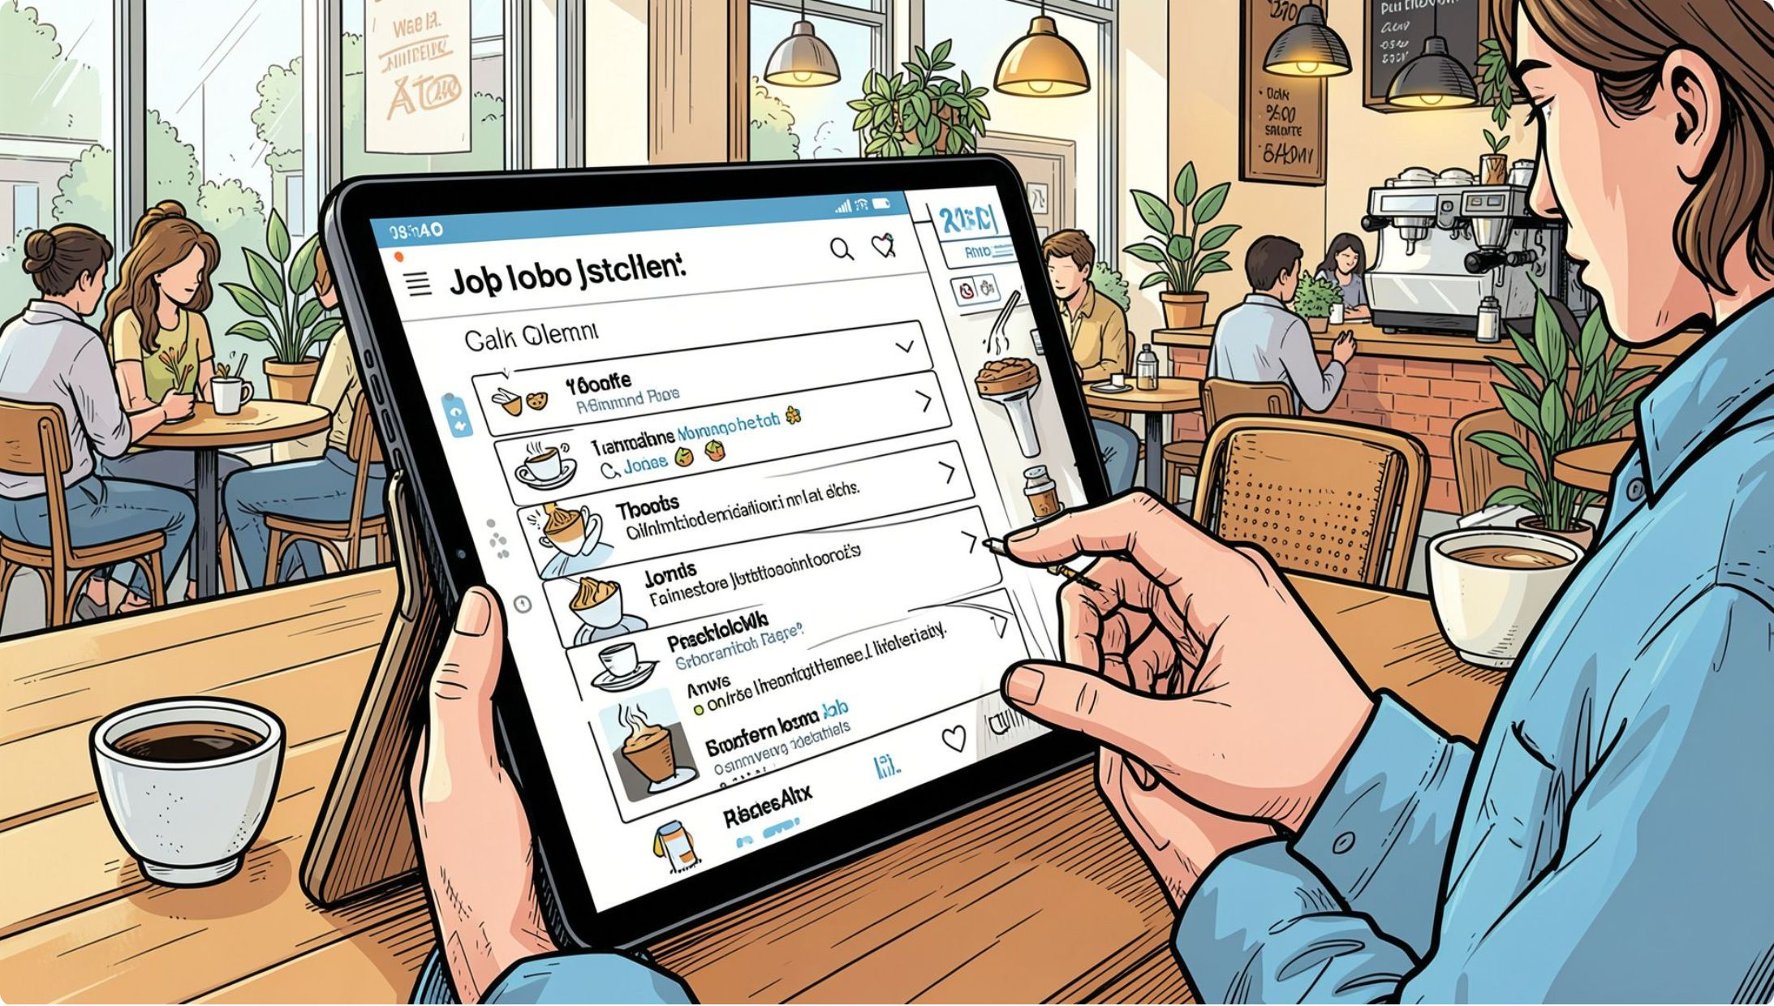
Frictionless Job Discovery
A Centralized Hub
NexJob opens directly into a browsable feed of available opportunities. No complex menus, no multi-step onboarding — just immediate access to real job listings the moment you arrive.
Instant access
Clear layout
No sign-up wall to browse
Readable, scannable listings

Slide 5
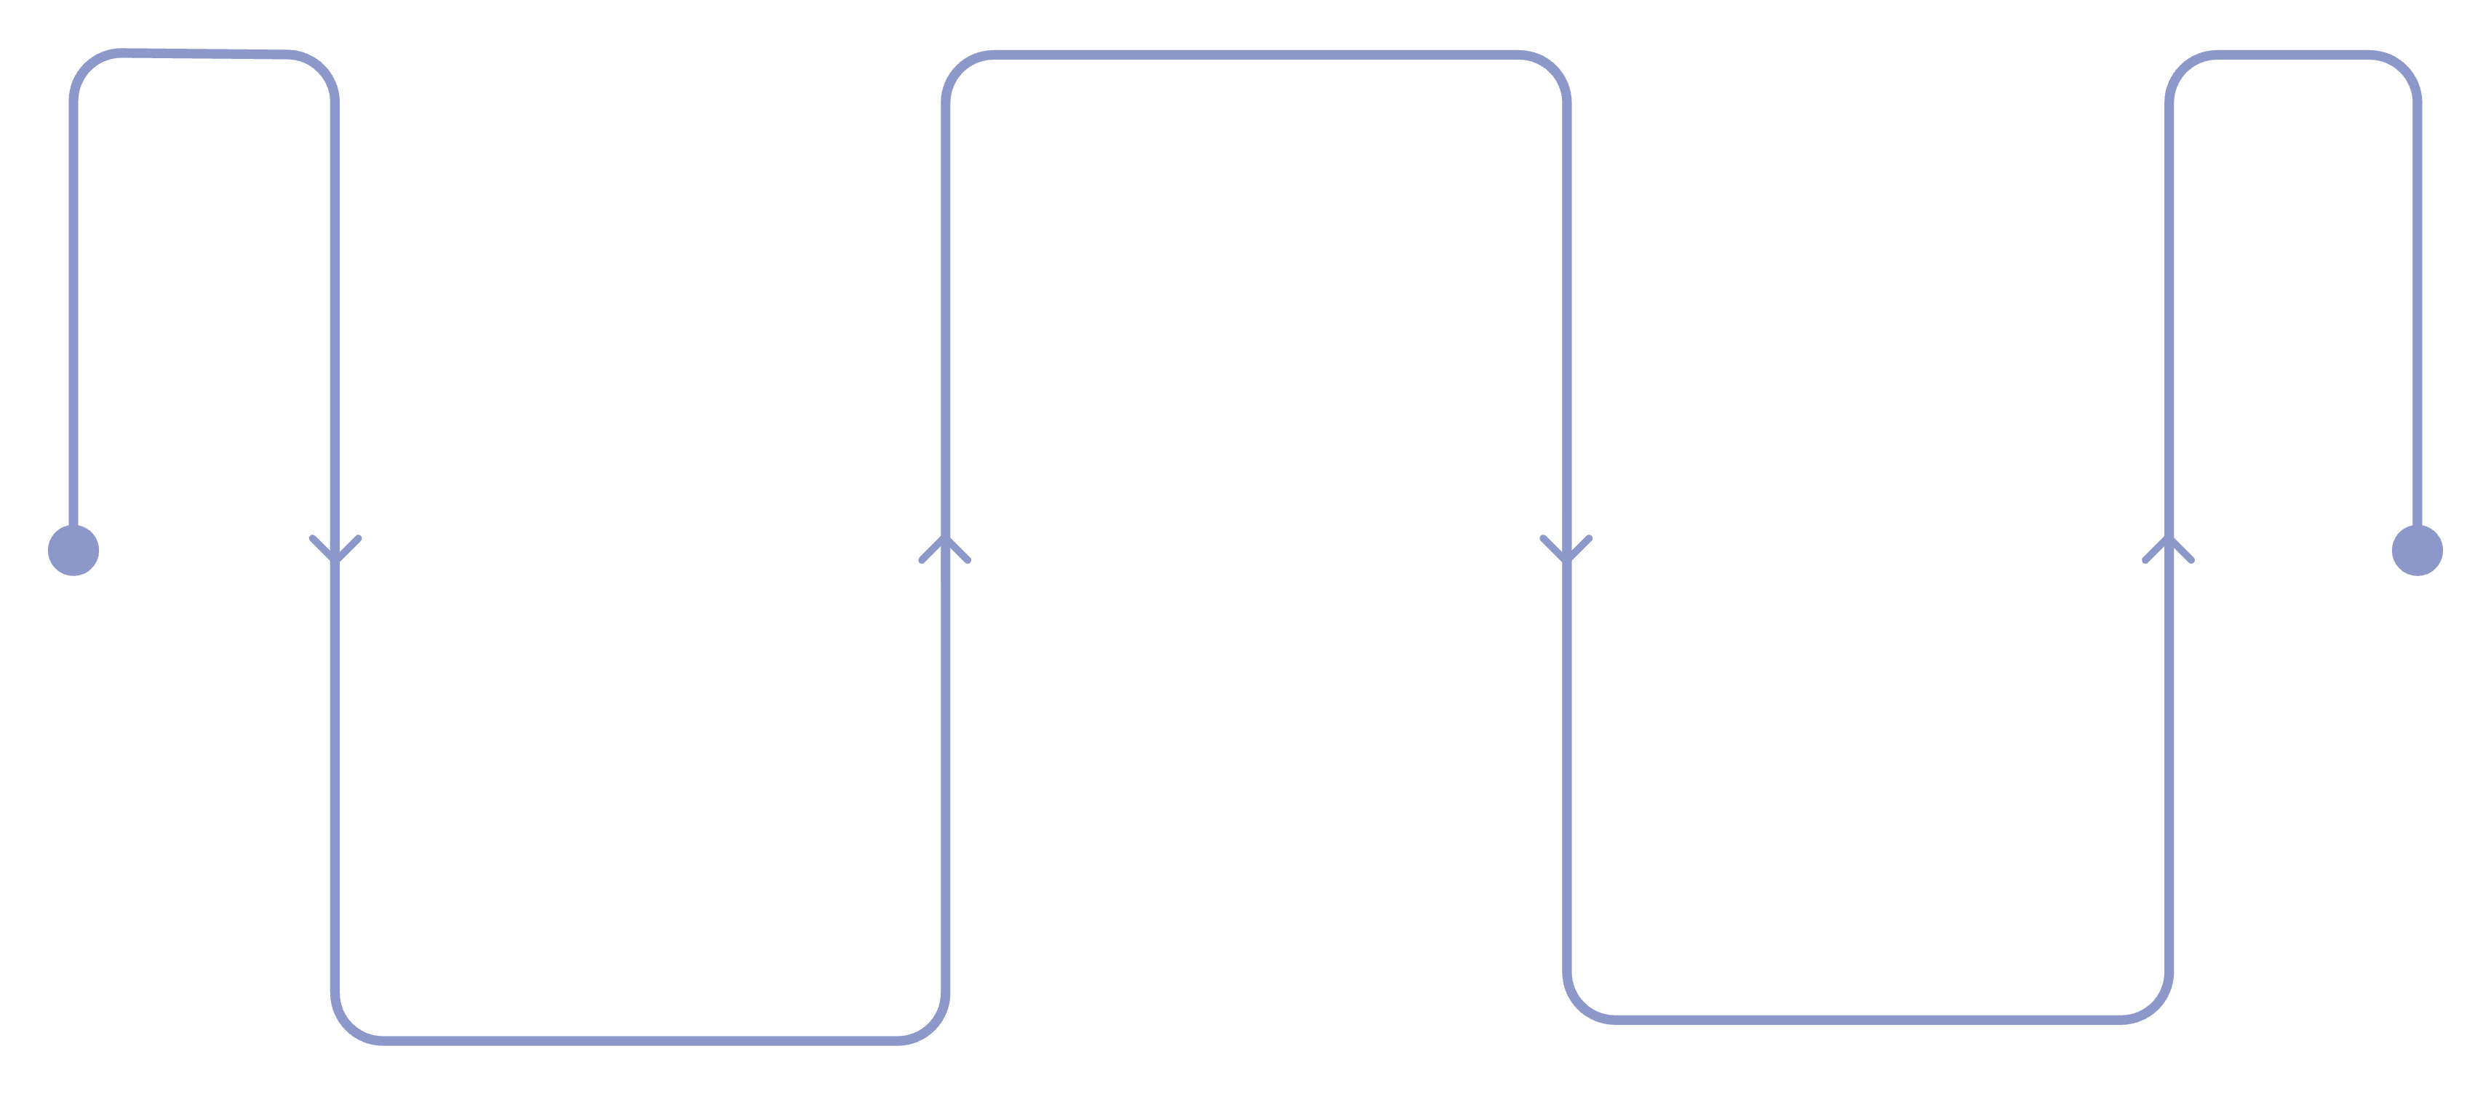
Instant Search & Filtering
Type a keyword — job title, company name, or skill — and results update in real time. No waiting. No page reloads. Just instant, relevant matches.
Apply Filter
Choose Full-time, Part-time, Contract
Type Keyword
See Results
Enter job title, company, or skill
Listings update instantly
This real-time feedback loop keeps users in a state of flow, eliminating the interruption of traditional search-and-wait patterns.

Slide 6




Powerful Filters, Zero Wait Time
Keyword Search
Search by job title, company, or any relevant term. Results refine as you type.
Job Type Filter
Instantly narrow results to Full-time, Part-time, or Contract roles with a single click.
Live Updates
No page reloads. The interface responds in milliseconds, keeping the search momentum alive.

Slide 7


Persistent Job Saving
Your Personal Job Organizer
Finding the right role takes time. NexJob lets users save any listing with a single click — and those saved jobs stay right where they left them, even after closing the browser.
Saved jobs persist across sessions, so your shortlist is always waiting when you return.

Slide 8
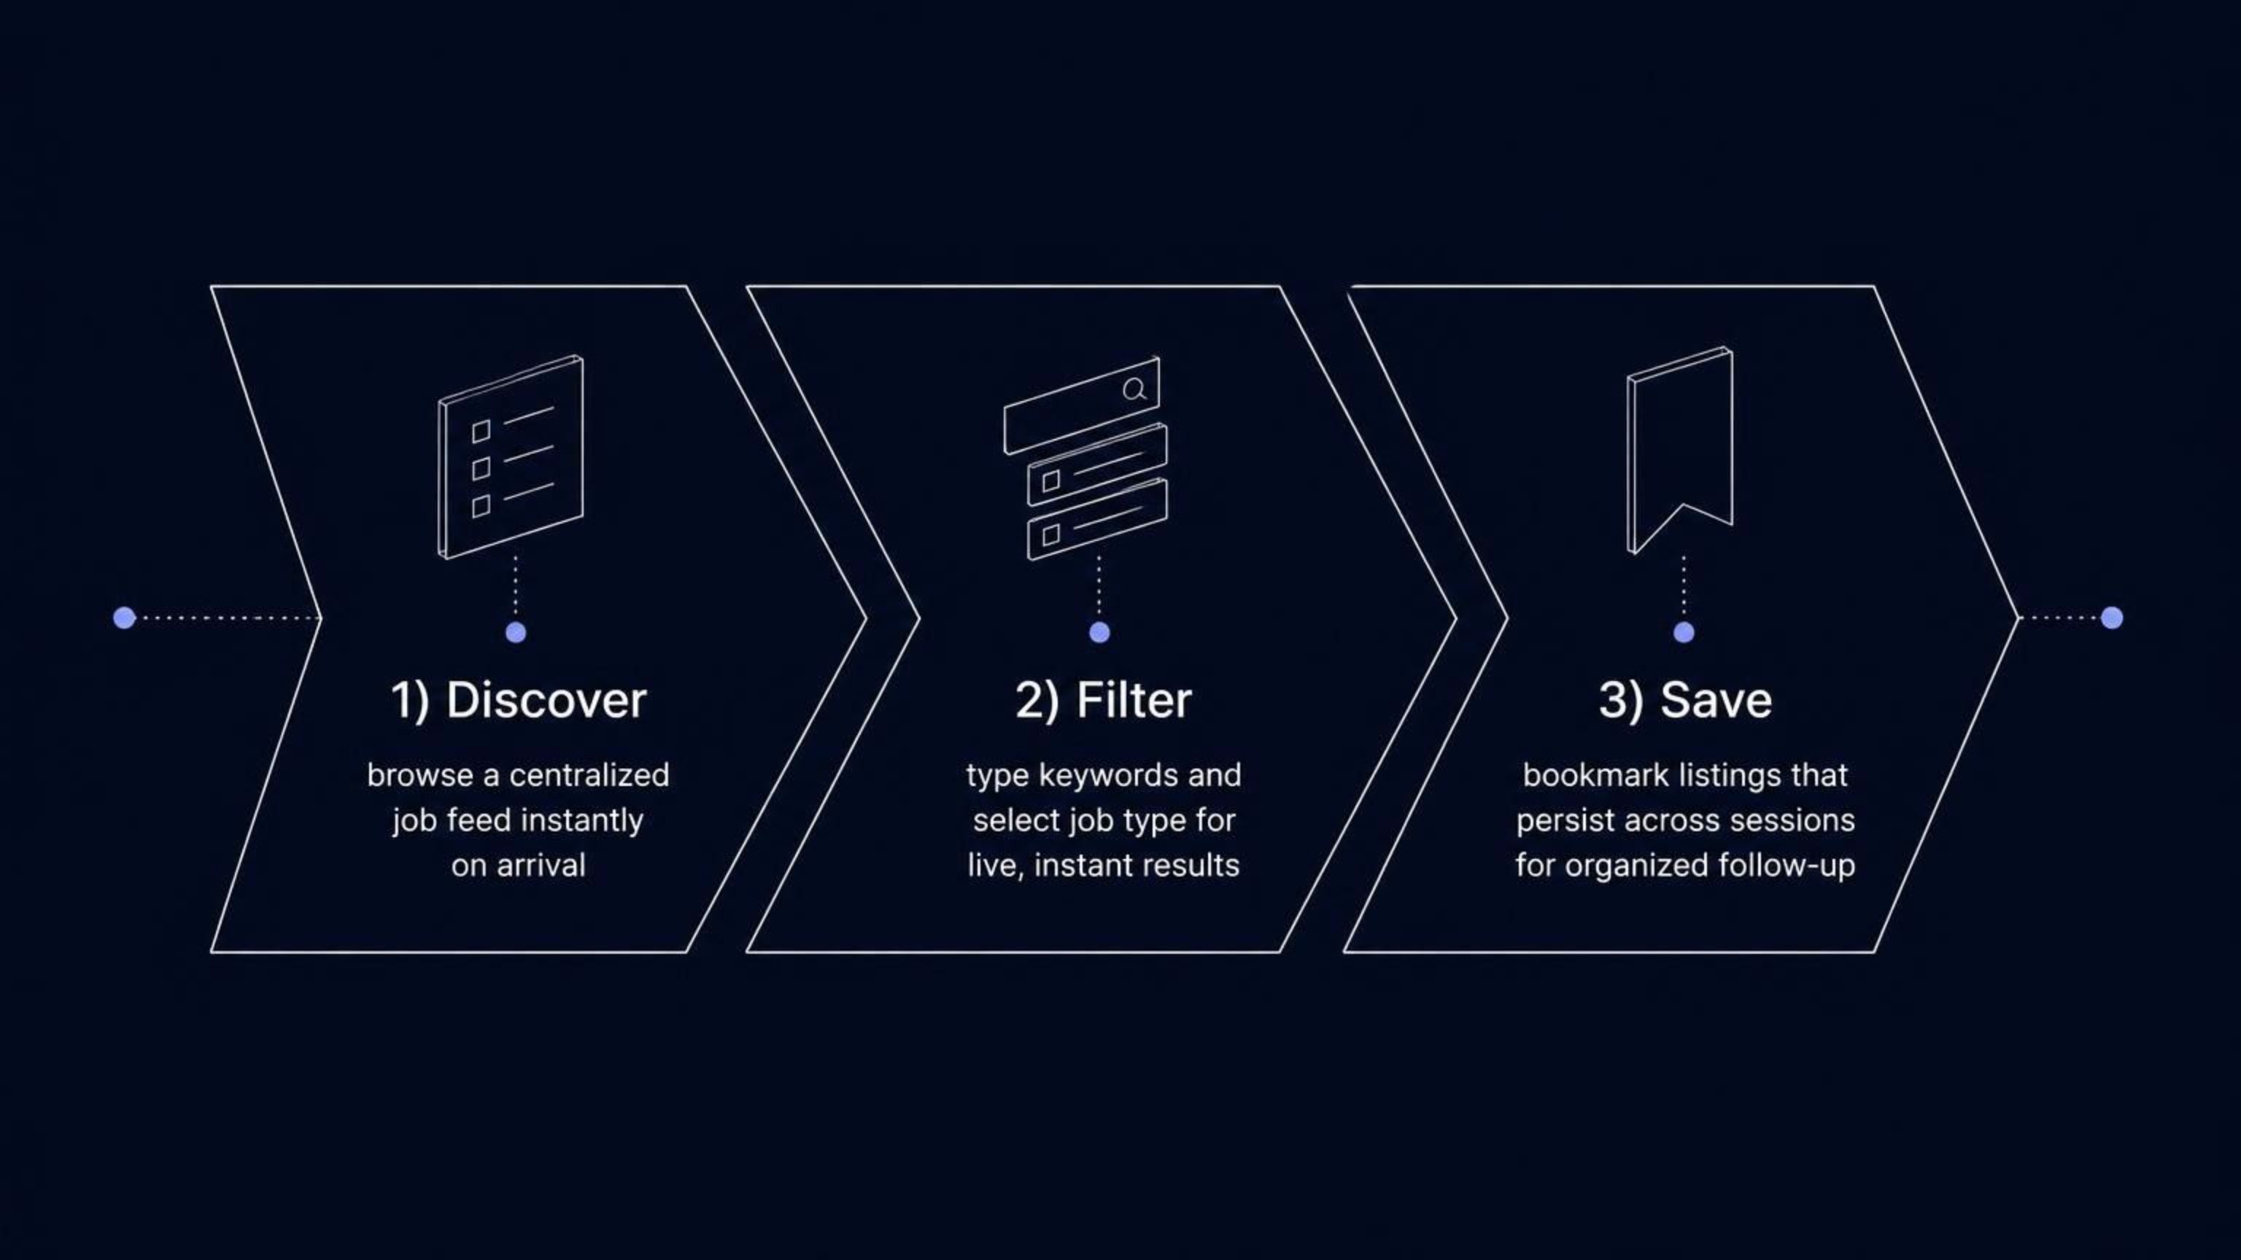
How the Features Work Together
Each feature removes a specific pain point — and together, they create a seamless, end-to-end job search workflow that is faster, smarter, and far more organized than traditional job boards.

Slide 9
Impact at a Glance
3
0
Core Features
Page Reloads
Discovery, instant filtering, and persistent saving — all in one platform
Search and filter updates happen instantly, with zero interruption
1
∞
Centralized Hub
Session Memory
One place to browse, search, and organize your entire job hunt
Saved jobs persist indefinitely — your shortlist is always ready

Slide 10

NexJob — Built for the Modern Job Seeker
NexJob proves that a thoughtful frontend experience can meaningfully improve a real-world process. By combining instant search, smart filtering, and persistent organization, it turns a fragmented, frustrating task into something fast, focused, and genuinely efficient.
Discover
Filter
Browse instantly
Search in real time
Save
Organize your hunt

