Slide 1


Detecting Fake News using NLP
Ikram - 1RVU22BSC054

Slide 2
Objectives & Problem statement
Objective:
Build a system to classify news articles as Fake or Real using Natural Language Processing techniques.
Problem Statement:
The rise of fake news on digital platforms is misleading readers.
Manual verification is inefficient — a machine learning approach is essential to automate the detection process.
Input: News articles (title, author, text) Output: Label - Real (0) / Fake (1)

Slide 3
Dataset & Preprocessing
Dataset Details:
Source: Kaggle Fake News Dataset (~20,800 articles)
Features: title, author, text, label (1=Fake, 0=Real)
Preprocessing Steps:
Combined title and author into a single text field
Removed null values
Performed stemming using PorterStemmer
Removed stopwords, non-alphabetic characters
Transformed text into numerical features using TF-IDF Vectorizer

Slide 4
Methodology
Model Used: Logistic Regression Data Split:
Train-Test Split: 80-20 ratio
Stratified sampling to preserve label distribution
Workflow:
Text cleaning & feature extraction
TF-IDF vectorization
Logistic Regression training
Model evaluation using accuracy, precision, recall, F1-score

Slide 5
Results & Visualizations
Accuracy:
Training Set: ~98.6%
Test Set: ~97.9%
Metrics for Label = 1 (Fake):
Precision: ~0.99
Recall: ~0.96
F1-score: ~0.98
Visuals:
Confusion Matrix Heatmap
Bar Plot of Precision, Recall, F1-Score

Slide 6
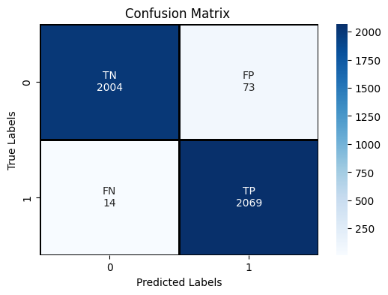
Confusion Matrix: True vs. predicted labels

Slide 7
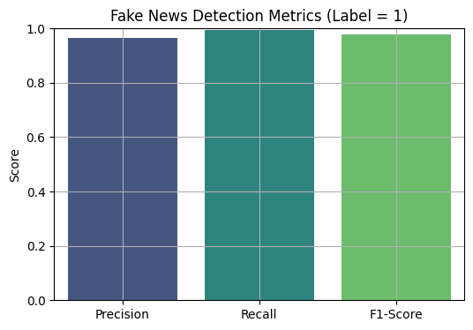

Slide 8
Challenges & Insights
Challenges:
Data imbalance (less real news than fake)
Sparse input space after TF-IDF vectorization
Handling incomplete or noisy text fields
Insights:
Combining title and author helped provide better signal
TF-IDF captured textual patterns effectively
Lessons Learned:
Importance of text cleaning & feature engineering
Logistic Regression is a solid baseline for binary classification in NLP

Slide 9
References
Multi-Source Multi-Class Fake News Detection
https://aclanthology.org/C18-1131.pdf
A Review on Fake News Detection: 3T's - Typology, Time of Detection, and Taxonomies
https://link.springer.com/article/10.1007/s10207-022-00625-3
Research on Fake News Detection Based on Dual Evidence https://www.sciencedirect.com/science/article/pii/S0952197624004299
Explainable Detection of Fake News on Social Media Using Co-Attention Mechanism
https://par.nsf.gov/servlets/purl/10406319
Fake News Detection and Classification: A Comparative Study of CNNs, LLMs, and NLP Models
https://www.mdpi.com/1999-5903/17/1/28

Slide 10
References
Deepfake Detection Using Deep Learning Methods: A Systematic Review https://wires.onlinelibrary.wiley.com/doi/10.1002/widm.1520
Early Detection of Fake News by Utilizing the Credibility of News, Publishers, and Users
https://arxiv.org/abs/2012.04233
Hierarchical Propagation Networks for Fake News Detection: Investigation and Exploitation
https://arxiv.org/abs/1903.09196
SAFE: Similarity-Aware Multi-Modal Fake News Detection
https://arxiv.org/abs/2003.04981
Fake News Detection Through Graph-Based Neural Networks: A Survey https://arxiv.org/abs/2307.12639

Slide 11
References
Albanian Fake News Detection
https://dl.acm.org/doi/10.1145/3487288
Numbers Do Not Lie: A Bibliometric Examination of Machine Learning Techniques in Fake News Research
https://www.researchgate.net/publication/378017162_Numbers_Do_Not_Lie_A_Bibliometric_Examination_of_Machine_Learning_Techniques_in_Fake_News_Research
Fake News Detection on Social Media: A Data Mining Perspective
https://www.researchgate.net/publication/318981549_Fake_News_Detection_on_Social_Media_A_Data_Mining_Perspective
Detecting Fake News with Deep Learning: A Survey
https://ieeexplore.ieee.org/document/9031530
Fake News Detection Using Machine Learning: A Systematic Literature Review
https://www.sciencedirect.com/science/article/pii/S1877050920301552

