Slide 1
Medical Cost Analysis
CloudyML Data Analytics Project | Ikram Hussain | Tools: Excel, Pivot Tables, Charts

Slide 2
Dataset Overview
Column | Description | Type
age | Age of primary beneficiary | Numeric
sex | Gender of insurance contractor | Categorical
bmi | Body Mass Index (kg/m²) | Numeric
children | Number of dependents covered | Numeric
smoker | Smoking status (yes/no) | Categorical
region | Residential area in the US | Categorical
charges | Individual medical costs billed | Numeric
1,337
7 Columns
4 Regions
Total Records
Features Analyzed
US Geographic Areas

Slide 3
Q1 — Basic Statistics & Data Understanding
Metric | Charges ($) | BMI | Age
Average | $13,279 | 30.66 | 39.22
Median | $9,386 | 30.40 | 39.00
Std Dev | $12,110 | 6.10 | 14.04
Min | $1,122 | 15.96 | 18
Max | $63,770 | 53.13 | 64
💡 Charges are right-skewed — mean ($13,279) > median ($9,386), indicating a small group with very high costs.

Slide 4
Q2 — Gender Analysis
Avg Medical Charges by Gender
Avg BMI by Gender
💡 Males incur higher avg charges ($13,975 vs $12,570) and slightly higher BMI (30.94 vs 30.38).

Slide 5
Q3 — Impact of Smoking on Medical Costs
$8,441
Non-Smokers Avg
$32,050
Smokers Avg
3.8x
Higher Cost for Smokers
💡 Smoking is the single biggest cost driver — smokers pay 3.8x more than non-smokers. This is the most significant finding in the dataset.

Slide 6
Q4 — Dependents & Medical Charges
Children | Avg Charges
0 | $12,385
1 | $12,731
2 | $15,074 ▲
3 | $15,355 ▲
4 | $13,851
5 | $8,786
💡 Beneficiaries with 2–3 children have the highest charges. 5 children is an outlier due to very small sample size.
Number of Children / Dependents

Slide 7
Q5 — Geographical Insights by Region
Region | Avg Charges | Avg BMI
Northeast | $13,406 | 29.17
Southeast | $14,735 ▲ | 33.36
Northwest | $12,451 | 29.20
Southwest | $12,347 ▼ | 30.60
💡 Southeast has highest charges ($14,735) AND highest BMI (33.36). Southwest has lowest charges ($12,347).

Slide 8
Q6 — Cost Distribution Analysis
Cost Brackets
💡 Most beneficiaries (356) fall in $1K–$5K bracket. Distribution is right-skewed — majority have low costs, small group has very high charges.

Slide 9
Q7 — BMI Classification
Category | Count | Share
Obese (30+) | 706 | 53%
Overweight | 386 | 29%
Normal | 225 | 17%
Underweight | 20 | 1%
Formula Used:
=IF(BMI<18.5,"Underweight",IF(BMI<25,"Normal",IF(BMI<30,"Overweight","Obese")))
💡 82% of beneficiaries are overweight or obese — indicating high BMI as a systemic health risk in this dataset.

Slide 10
Q8 — BMI vs Medical Charges (Correlation)
R² = 0.039
Weak Positive Correlation
Key Findings:
• Positive but weak correlation (R²=0.039)
• Higher BMI slightly increases charges
• BMI alone is not a strong predictor
• Smoking + High BMI = biggest cost driver

Slide 11
Q9 — Smoking & Region Interaction
Region | Smokers Avg ($)
Southeast ▲ | $34,845
Southwest | $32,269
Northwest | $30,192
Northeast ▼ | $29,674
💡 Southeast is the most expensive region for smokers ($34,845). Combined with Southeast's high BMI (33.36), it represents the highest-risk profile in the dataset.

Slide 12
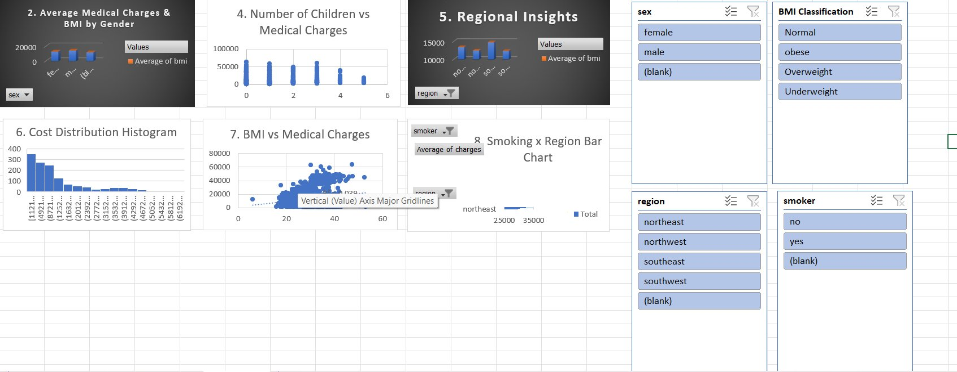
Q10 — Interactive Dashboard
Dashboard includes: Gender Filter • Smoker Filter • Region Filter • BMI Classification Filter • 6 Interactive Charts

Slide 13
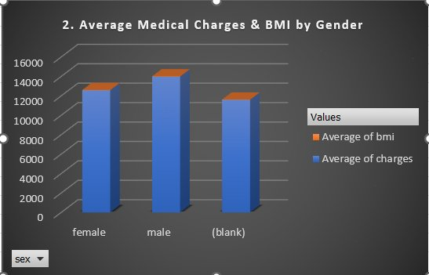
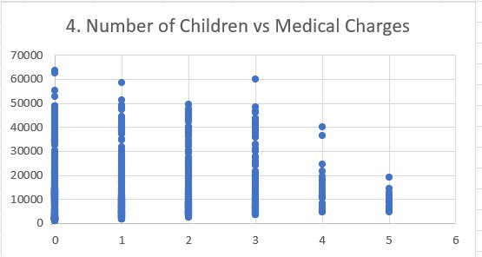
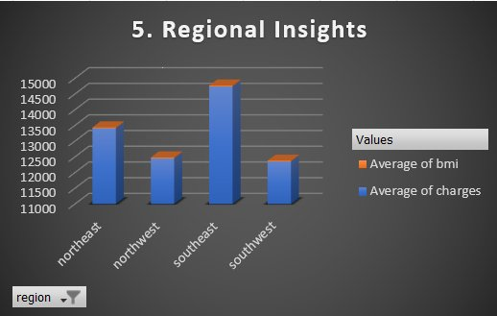
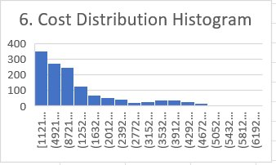
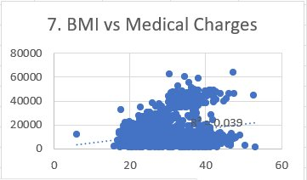
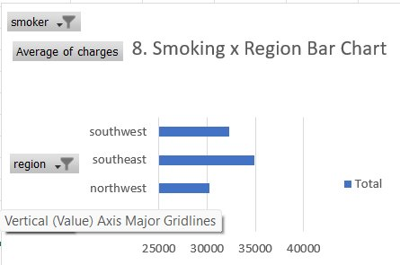
Q10 — Dashboard Charts

Slide 14
Key Insights & Conclusion
🚬 Smoking = #1 Cost Driver
🗺️ Southeast = Highest Risk Region
Smokers pay 3.8x more ($32,050 vs $8,441). Single biggest predictor of high medical costs.
Highest charges ($14,735) + Highest BMI (33.36). Smokers in Southeast pay $34,845.
⚖️ 82% Overweight or Obese
👶 2–3 Children = Peak Costs
Only 17% have Normal BMI. High BMI population contributes to elevated costs.
Families with 2–3 dependents incur the highest medical charges (~$15,000+).

Slide 15
Project Submission
🎥 YouTube Video Link
[Paste your YouTube link here]
Name | Ikram Hussain
Course | Data Analytics — CloudyML
Tools Used | Excel, Pivot Tables, Charts, Slicers
Dataset | Insurance Medical Cost — 1,337 records

