Slide 1

CIOL at CLPsych 2025: Leveraging Hybrid LLM-Classifiers for Clinical Mental Health Summarization
Md. Iqramul Hoque, Mahfuz Ahmed Anik, Azmine Toushik Wasi

Slide 2
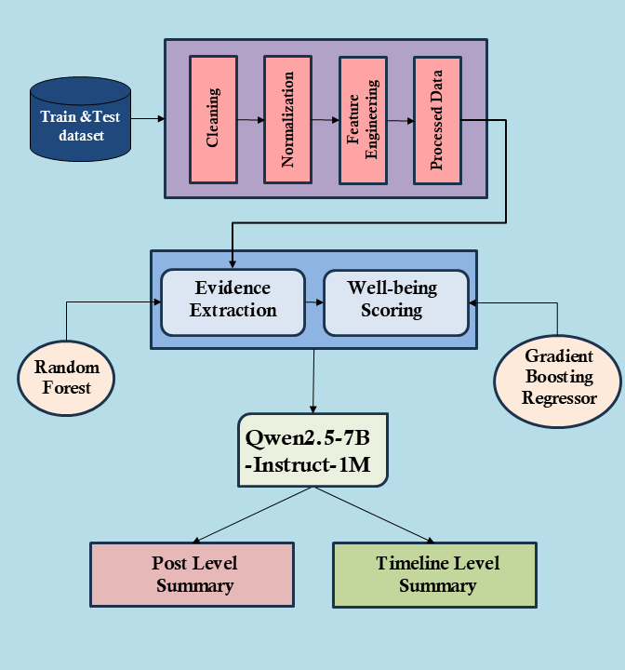
Motivation
The Challenge of Social Media-Based Monitoring
Problem: Static clinical evaluations fail to capture real-time psychological state fluctuations in social media users.
CLPsych 2025 Focus: Longitudinal analysis of Reddit timelines to identify transitions between adaptive (e.g., coping strategies) and maladaptive (e.g., self-harm ideation) states.
Framework Objectives
Evidence Extraction: Detect self-state indicators (Affect, Behavior, Cognition, Desire) from posts.
Well-being Scoring: Predict scores (1–10) using regression models.
Summary Generation: Produce clinician-friendly summaries aligned with evidence.

Slide 3
Methodology: Hybrid LLM + Feature Engineering
Three-Stage Pipeline
Data Preprocessing:
  Merged user timelines, TF-IDF vectorization, and feature extraction (lexical diversity, sentiment polarity).
Evidence Extraction:
  RandomForest classifiers + Qwen2.5-7B LLM for span identification (Recall: 0.56).
Well-being Scoring:
  GradientBoostingRegressor with MSE 3.89, combining temporal and linguistic features.
Summary Generation:
  Fine-tuned T5-based models for clinical narratives (BERTScore consistency: 0.801).
Key Innovation
Hybrid architecture balances LLM context-awareness with feature-based interpretability.

Slide 4
Results and Competitive Analysis
Strengths and Limitations
Strengths:
  High timeline-level consistency (0.801) for longitudinal analysis.
  Minimal hallucination in summaries (<2% unsupported claims).
Limitations:
  Binary self-state classification oversimplifies nuanced mental states.
  Bias toward users with high post frequency.

Slide 5
Clinical Implications and Future Work
Enancing Digital Mental Health Tools
Early Intervention: Detect subtle linguistic shifts (e.g., reduced positive affect) preceding crises.
Resource Allocation: Prioritize high-risk cases via automated timeline scoring.
Technical Advancements Needed
Multimodal Integration: Incorporate visual/audio data from platforms like Instagram.
Bias Mitigation: Address demographic disparities in well-being scoring.
Real-time Deployment: Lightweight models for mobile mental health apps.

Slide 6
Conclusions
Key Achievement
  4th overall rank in CLPsych 2025 with a balanced hybrid framework.
  Demonstrated feasibility of LLMs for interpretable clinical summaries.
Next Steps:
  Clinical validation with psychiatrists for real-world adoption.
  Expand to diverse platforms (TikTok, Facebook) and languages.

Slide 7
Thank You!
If you have any questions, please ask!

