Slide 1

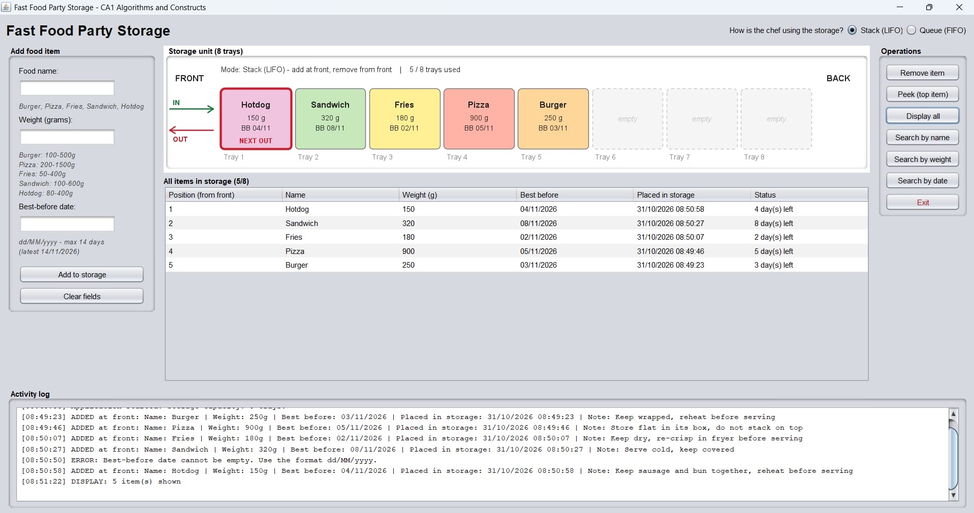
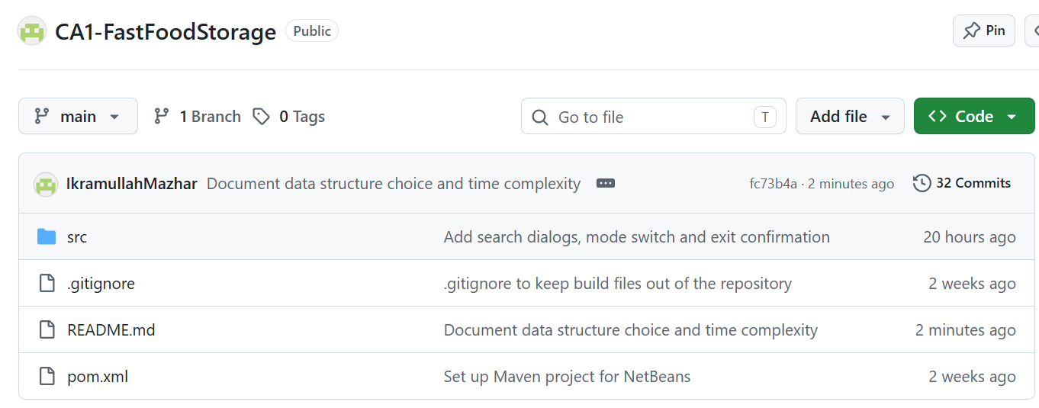
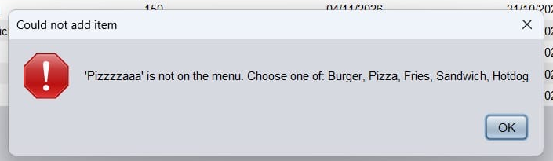
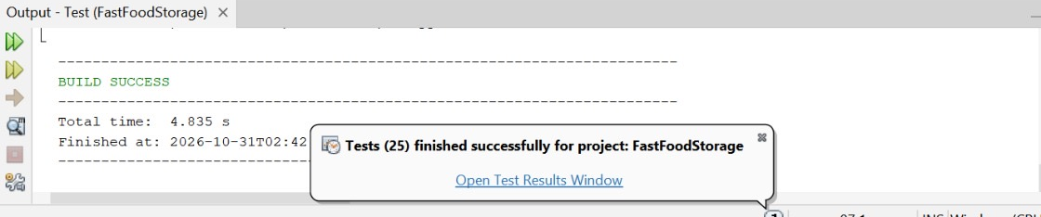
Fast Food Party Storage: Stack and Queue in one circular deque
CA1 Algorithms and Constructs | Lecturer: Taufique Ahmed | Group: Ikramullah Mazhar (2024476) · Shahzaib Hassan (2024669) · Majid Nawaz (2024473)
GitHub repository: https://github.com/IkramullahMazhar/CA1-FastFoodStorage Video presentation: <paste Google Drive link>
The problem
Ikramullah
How the circular array works
Ikramullah
The application
Majid
Advantages and limitations
Team
Party food (Burger, Pizza, Fries, Sandwich, Hotdog) is kept in a unit with 8 trays and two sides. The chef always adds at the front, then removes from the front or the back. Each item stores its name, weight, best-before date (max 14 days) and time stored.
Item i is stored at (front + i) % 8 and the back item at (front + size − 1) % 8. Adding moves front back one slot, wrapping from 0 to 7, so nothing is ever shifted.
Advantages
O(1) add, remove and peek in both modes.
One structure for both ways of working.
Fixed memory, like the 8 trays.
Stack mode: add and remove at the FRONT (LIFO)
back = (6+4−1) % 8 = 1
front = 6
FRONT
BACK
Fries
Pizza
Hotdog
Sandwich
Limitations
in
Hotdog
Sandwich
Fries
Pizza
Burger
Fixed capacity: it cannot grow.
Search is linear, O(n).
A middle item (e.g. expired) cannot be removed directly.
out
0
1
2
3
4
5
6
7
Queue mode: add at FRONT, remove at BACK (FIFO)
Array indexes: size = 4, wrapping past index 7
FRONT
BACK
private void addFront(T item) throws StorageFullException {
if (isFull()) throw new StorageFullException(capacity());
front = (front - 1 + trays.length) % trays.length;
trays[front] = item;
size++;
}
Our Swing GUI in NetBeans: the next item out is outlined in red.
GitHub commits and team roles
in
Hotdog
Sandwich
Fries
Pizza
Burger
Team
out
Validation and error handling
Shahzaib
Red outline = next item out
Object-oriented design
Name: one of the five foods, any case.
Weight: whole grams in the food’s range (Burger 100–500 g).
Best-before: real dd/MM/yyyy date, today to +14 days.
Ninth item: “Storage is full”.
Empty storage: remove, peek, display and search all report it.
Why a circular deque?
Ikramullah
Shahzaib
A stack or a queue alone covers only one of the chef's two methods. A double-ended queue (deque) gives O(1) access at both ends, so one structure handles both. A fixed array of 8 matches the real unit: no resizing, and full means size == 8. We wrote our own because java.util.ArrayDeque grows without limit.
MainFrame + TrayPanel (Swing UI)
StorageManager
FoodValidator
«interface» FoodStorage<T>
«abstract» FoodItem
Ikramullah: circular deque, interface, exceptions, deque tests, complexity.
Shahzaib: food classes, factory, validation, validator and manager tests.
Majid: StorageManager, Swing GUI, tray view, run guide and test plan.
Time complexity
Ikramullah
implements
extends
Operation | Time
add() at front | O(1)
remove(): stack or queue | O(1)
peek(): top item | O(1)
toList(): display all | O(n)
search(): name, weight, date | O(n)
isFull() / isEmpty() | O(1)
CircularDequeStorage<T>
Burger, Pizza, Fries, Sandwich, Hotdog
Encapsulation: private array and indexes.
Abstraction: the GUI only sees FoodStorage.
Inheritance: five food subclasses; Full and Empty exceptions.
Polymorphism: each food gives its own handling note.
Testing
Team
25 JUnit 5 tests cover both removal orders, array wrap-around, boundary values and every empty and full case.
References
Team
Goodrich, M.T., Tamassia, R. and Goldwasser, M.H. (2014) Data Structures and Algorithms in Java. 6th edn. Hoboken, NJ: Wiley.
Sedgewick, R. and Wayne, K. (2011) Algorithms. 4th edn. Upper Saddle River, NJ: Addison-Wesley.
Oracle (n.d.) Deque (Java SE 17 & JDK 17). Available at: https://docs.oracle.com/en/java/javase/17/docs/api/java.base/java/util/Deque.html (Accessed: 31 October 2026).
JUnit Team (n.d.) JUnit 5 User Guide. Available at: https://junit.org/junit5/docs/current/user-guide/ (Accessed: 31 October 2026).
Anthropic (2026) Claude [AI model]. Available at: https://claude.ai (Accessed: 31 October 2026). See AI declaration.
n ≤ 8, so linear search is effectively instant.

