Slide 1





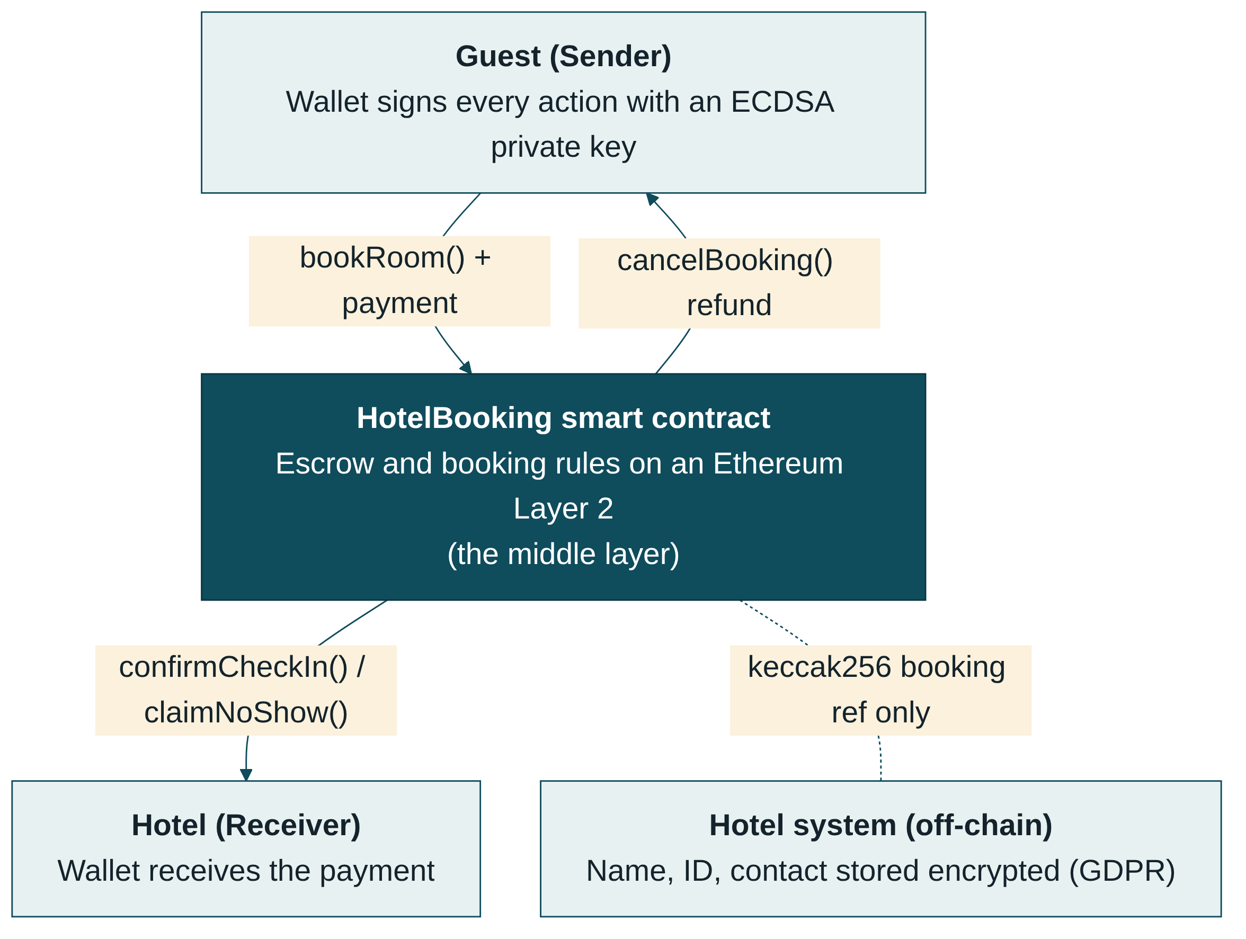



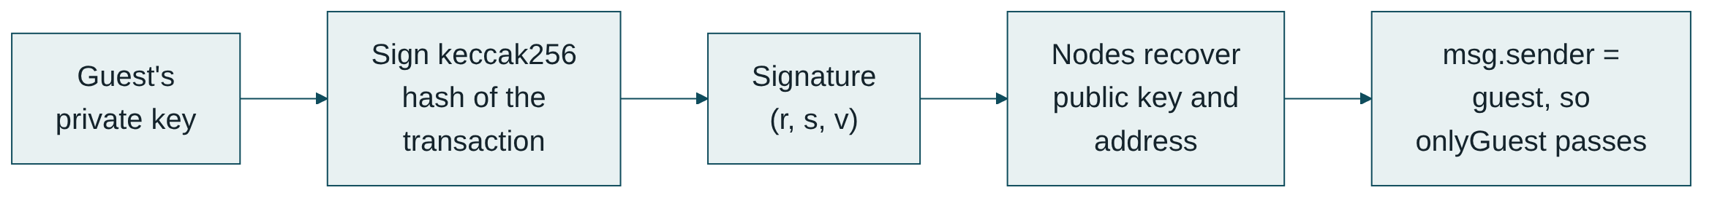



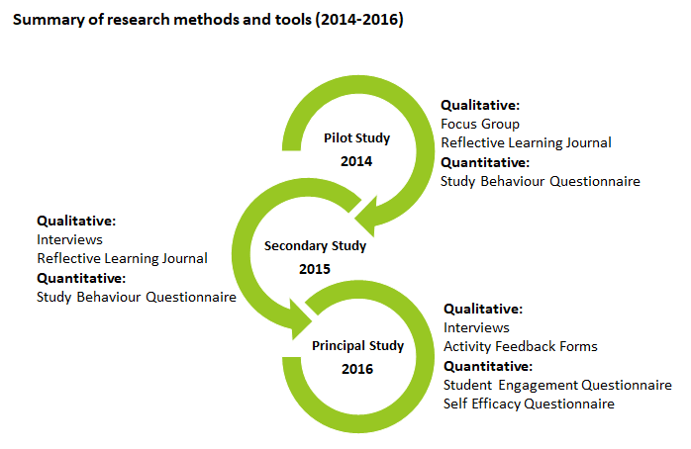
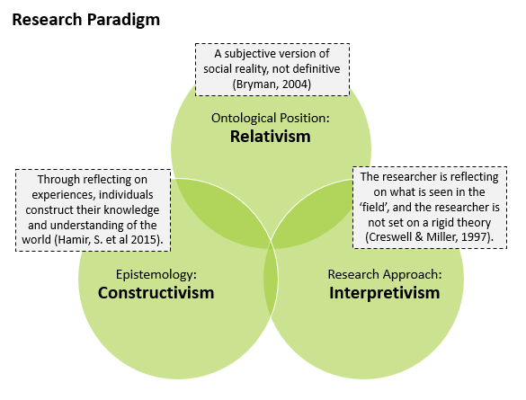

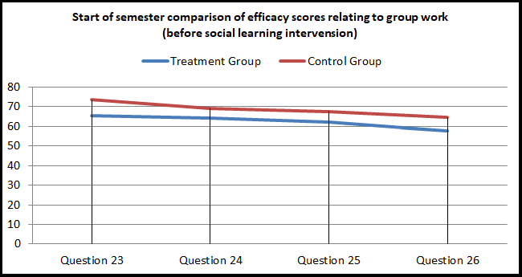
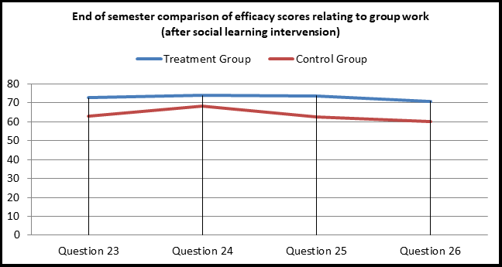

Trustless Hotel Booking on Ethereum
Guest pays the contract → contract holds the money → hotel gets paid by the rules
Ikramullah Mazhar • 2024476 • CCT College Dublin • Distributed Digital Transactions CA1 • github.com/IkramullahMazhar/ddt-hotel-booking-dapp
The Problem Today
Recent Advancements
Smart Contract Design
Most hotels sell rooms through online travel agencies (OTAs) like Booking.com and Expedia. These platforms reportedly take around 15% commission per booking, and up to 25–30% from some independent hotels (Preno, n.d.). Both sides have to trust the middleman with the money. Refunds can be slow, rooms still get double-booked across channels, and no-shows and card chargebacks cost hotels money.
Layer 2 + EIP-4844 (Dencun, March 2024): rollups like Base and Arbitrum became far cheaper – Base fees fell from about $0.70 to under a cent (ForkLog, 2024). Running my contract on a Layer 2 makes a booking cost almost nothing.
Smart accounts – EIP-7702 (Pectra, May 2025): a normal wallet can act like a smart contract, so the hotel can sponsor the gas and the guest doesn’t need to hold ETH (Zmudzinski, 2025).
Stablecoins (e.g. USDC): prices stay pegged to euro/dollar value, so a €120 room is still €120 at check-in.
My Solution
I built a smart contract that sits between the guest (sender) and the hotel (receiver). When a guest books, they pay the contract, not the hotel, and the money is held in escrow. It is only released when a rule is met: check-in pays the hotel, cancelling 24 hours or more before check-in gives a full refund (later is split 50/50), and if the guest never arrives the hotel can claim the payment after the stay. The rules are code, so they are the same for everyone.
Benefits & Challenges
How it fits together
Benefits | Challenges
No middleman commission | Adoption – Winding Tree was abandoned (Treiblmaier, 2025)
Automatic, transparent refunds | Guests must manage wallets and private keys
No double-booking | Who proves the guest checked in? (oracle problem)
Tamper-proof record of every booking | GDPR right to erasure vs an immutable chain
Fast payment, worldwide | Code bugs are permanent; crypto regulation
Testing & Results
Being honest about the limits
My contract trusts the guest to confirm check-in. If a hotel refused entry and the guest didn’t confirm, the hotel could still claim a no-show after the stay. A real system would need a dispute step or a smart-lock oracle to prove arrival.
Personal details stay off-chain in the hotel’s system; only a keccak256 booking reference goes on the blockchain.
Cryptographic Security
Why It Is Disruptive
Every action – booking, cancelling, checking in – is a transaction signed with the user’s private key using ECDSA on the secp256k1 curve. Ethereum recovers the signer from the signature, and that is msg.sender. So my onlyGuest and onlyHotel checks are only as strong as ECDSA.
No commission: the hotel keeps more and can offer lower prices.
Automatic refunds: the cancellation policy runs itself, no support tickets.
Fast settlement: payment arrives in minutes, from anywhere.
New business model: a platform could charge a small flat fee per booking instead of a percentage.
Why ECDSA?
Conclusion
At a Glance
Authentication: only the key owner can cancel or check in.
Integrity & non-repudiation: a signed booking can’t be altered or denied – useful in refund disputes.
Efficient: 256-bit ECC gives security comparable to 3072-bit RSA (NIST, 2020), so transactions stay small.
Confidentiality: the chain is public, so guest details stay off-chain, encrypted; only a Keccak-256 hash is stored.
~15%
<$0.01
24 h
References
typical OTA commission (Preno, n.d.)
Layer 2 fee after Dencun (ForkLog, 2024)
free-cancellation window in my contract

