Slide 1
Executive Summary Outline for Stratethon 4
HOSPITAL.LY MODEL
TEAM404 – IKSHIT , SACHETAN

Slide 2
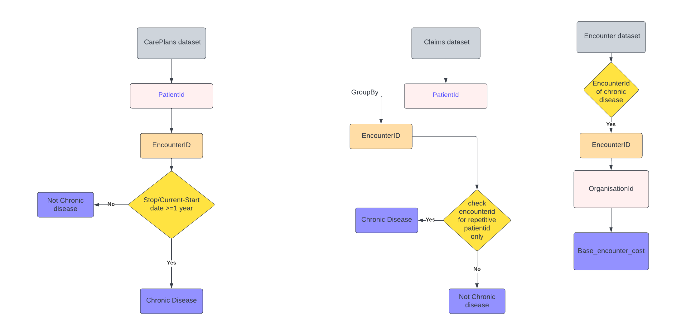
Health Care Model
A value based care model for improving consumer experience by providing-
Pricing transparency
Affordability

Slide 3
Problem ,Solution and its prospects
Usually people find it difficult to know the prices for treatment of the chronic diseases they going through.
They need to visit the hospital various times to get their chronic disease treated. This costs money and they are unaware whether they are getting the most affordable treatment or not.
Our model helps in identification of chronic diseases through the dataset and helps to bring pricing transparency and affordability through Machine Learning.

Slide 4
THANK YOU

