Slide 1
ARTIFICIAL INTELLIGENCE ASSIGNMENT-2
We applied the following algorithms to two distinct environments:
1. FrozenLake Environment
Branch and Bound (BnB)
Iterative Deepening A * (IDA*)
2. Travelling Salesman Problem (TSP)
Simulated Annealing (SA)
Hill Climbing (HC)
The above algorithms were implemented and evaluated to assess their efficiency and performance in solving these problems.
Submitted by :
IKSHITHA CS22B027
SAHITI CS22B056

Slide 2
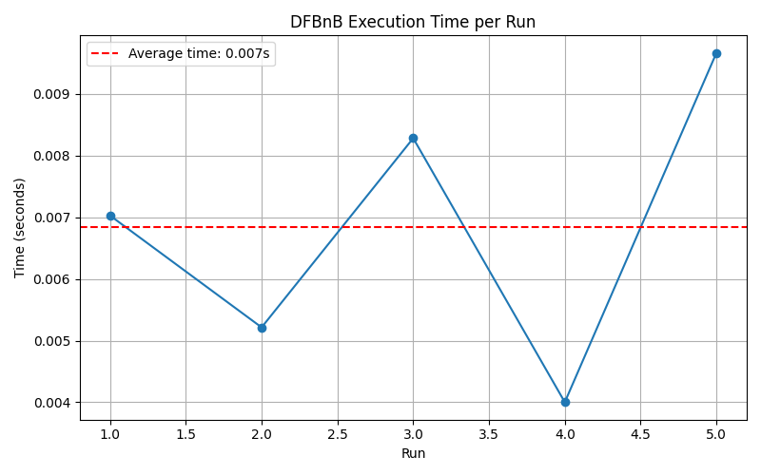
Results of BnB
Avg Execution Time:0.007s

Slide 3
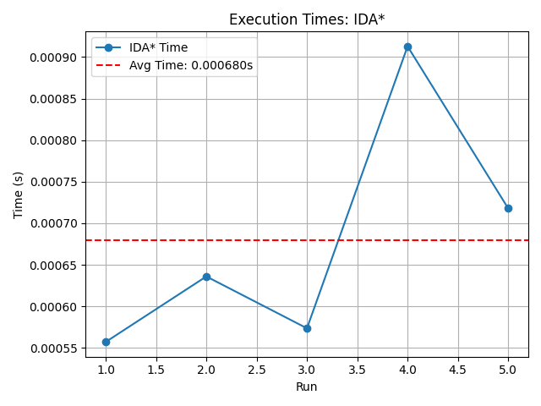
Results of IDA*
Average execution time:0.0006s

Slide 4
Observations:
Manhattan heuristic is chosen because it is:
Admissible: It’s an underestimate of the optimal path cost, making it suitable for search algorithms like A* and IDA*.
Consistent: The estimated cost from a node to the goal is never greater than the cost to a neighbor plus the neighbor's estimate, ensuring optimality and completeness.
Why is IDA better than Branch and Bound?*
Heuristic-driven: IDA* uses a heuristic (e.g., Manhattan distance) to guide the search efficiently, whereas Branch and Bound relies on actual cost alone.
Memory Efficient: IDA* performs depth-first searches using linear memory, while Branch and Bound requires more memory to store all active paths.
Optimality: IDA* guarantees optimal solutions with an admissible heuristic, whereas Branch and Bound explores more nodes without heuristic pruning.
Faster in Large Spaces: IDA* performs better in larger search spaces due to heuristic pruning and memory efficiency, while Branch and Bound may struggle with memory usage.

Slide 5
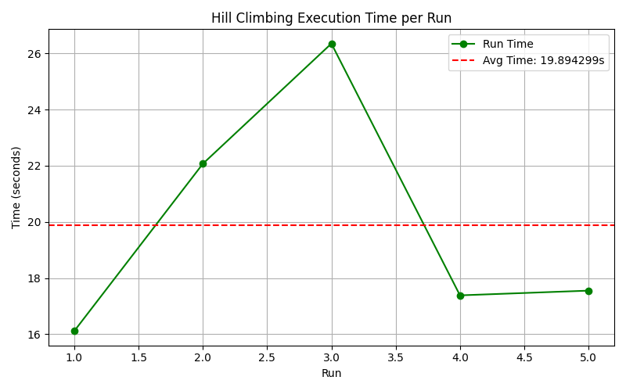
HC
Avg Exceution Time:19.89s

Slide 6
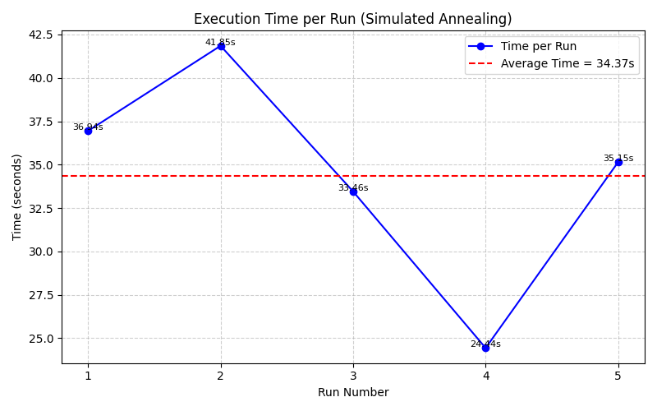
SA
Avg Execution Time:34.37s

Slide 7
Observations:
SA outperforms HC because:
Avoids Local Optima: SA can escape local minima, increasing the likelihood of finding the global optimum.
Global Search: SA explores a larger solution space, making it better for problems with many local optima.
Smooth Exploration: SA’s probabilistic nature allows for more thorough exploration by accepting worse solutions initially.
SA takes more time than HC because:
Longer Search Process: SA involves more iterations due to gradual temperature decay and complex acceptance criteria.
Additional Computational Overhead: Tuning temperature and decay parameters adds to the time required for convergence.
Objective function for TSP:f(tour)=_{i=1}∑^{n}​distance(city_{i}​,city_{i+1​})+distance(city_{n​},city₁​) is chosen because:
Directly represents the goal: Measures the total distance of the tour, directly corresponding to the objective of minimizing the tour length.
Smooth cost surface: Ensures small changes in the tour result in smooth variations in the cost, facilitating better exploration in SA.

