Slide 1
ARTIFICIAL INTELLIGENCE ASSIGNMENT-2
We applied the following algorithms to two distinct environments:
1. FrozenLake Environment
Branch and Bound (BnB)
Iterative Deepening A * (IDA*)
2. Travelling Salesman Problem (TSP)
Simulated Annealing (SA)
Hill Climbing (HC)
The above algorithms were implemented and evaluated to assess their efficiency and performance in solving these problems.
Submitted by :
Github
IKSHITHA CS22B027
SAHITI CS22B056

Slide 2
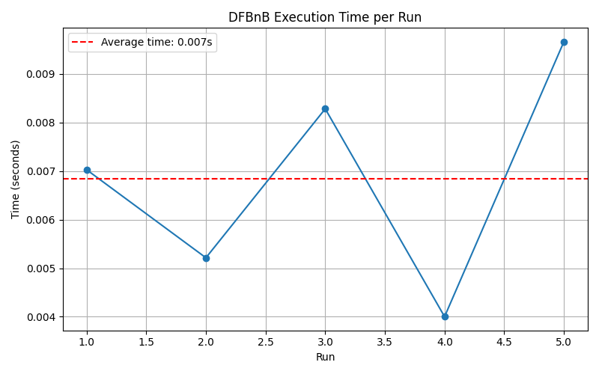
Branch and Bound(BnB)
BnB performs pruning of paths but initially it has to reach a goal node(before pruning) for which it might have to go deep in the tree.
Hence its performance is highly dependent on the structure of the environment.
Avg Execution Time:0.007s

Slide 3
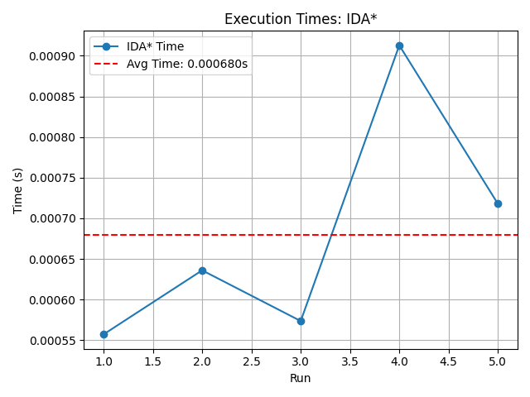
Iterative Deepening A*(IDA*)
It explores all possible paths iteratively until it reaches the goal
Manhattan distance as the heuristic function makes it better in terms of performance as it helps prune most of the irrelevant paths.
Performance depends on heuristic,map size and its structure.
Average execution time: 0.0006s

Slide 4
Observations:
Manhattan heuristic is chosen because it is:
Admissible: It’s an underestimate of the optimal path cost, making it suitable for search algorithms like A* and IDA*.
Consistent: The estimated cost from a node to the goal is never greater than the cost to a neighbor plus the neighbor's estimate, ensuring optimality and completeness.
Why is IDA better than Branch and Bound?*
Heuristic-driven: IDA* uses a heuristic (Manhattan distance) to guide the search efficiently, whereas Branch and Bound relies on actual cost alone.
Memory Efficient: IDA* performs depth-first searches using linear memory, while Branch and Bound requires more memory to store all active paths.
Optimality: IDA* guarantees optimal solutions with an admissible heuristic, whereas Branch and Bound explores more nodes without heuristic pruning.
Faster in Large Spaces: IDA* performs better in larger search spaces due to heuristic pruning and memory efficiency, while Branch and Bound may struggle with memory usage.

Slide 5
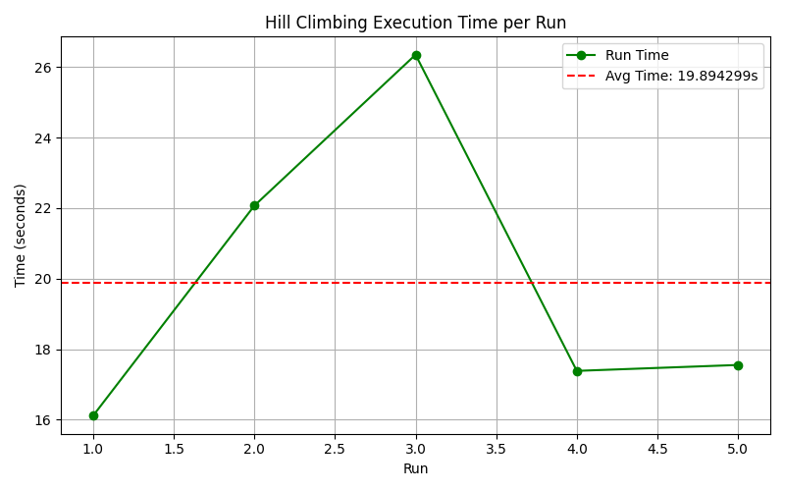
Hill Climbing(HC)
It converged faster(less no.of iterations) because it got trapped in a local optimal path cost.
It is highly sensitive to the random path that was generated initially.
Avg Execution Time:19.89s

Slide 6
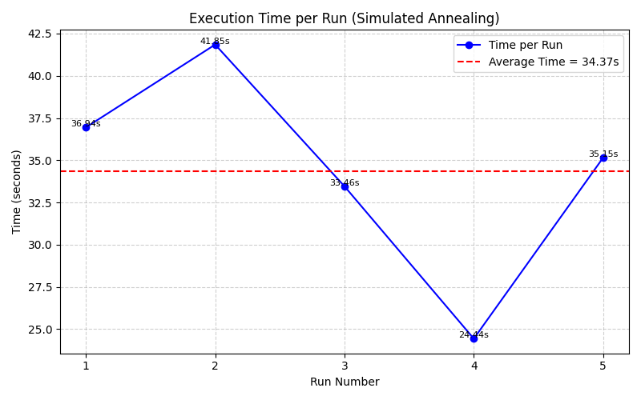
Simulated Annealing(SA)
It converged slower(more no.of iterations) because it was also accepting worse solutions with some probability.
The no.of iterations taken to converge depends on the cooling schedule and the final temperature.Slower cooling schedule(linear T=T-alpha) lead to longer runtimes and convergence time whereas exponential cooling (T = T × α) converged faster while still escaping local minima.
Avg Execution Time:34.37s

Slide 7
Observations:
SA outperforms HC because:
Avoids Local Optima: SA can escape local minima, increasing the likelihood of finding the global optimum.
Global Search: SA explores a larger solution space, making it better for problems with many local optima.
Smooth Exploration: SA’s probabilistic nature allows for more thorough exploration by accepting worse solutions initially.
SA takes more time than HC because:
Longer Search Process: SA involves more iterations due to gradual temperature decay and complex acceptance criteria.
Additional Computational Overhead: Tuning temperature and decay parameters adds to the time required for convergence.
Objective function for TSP:f(tour)=_{i=1}∑^{n}​distance(city_{i}​,city_{i+1​})+distance(city_{n​},city₁​) is chosen because:
Directly represents the goal: Measures the total distance of the tour, directly corresponding to the objective of minimizing the tour length.
Smooth cost surface: Ensures small changes in the tour result in smooth variations in the cost, facilitating better exploration in SA.

