Slide 1
ARTIFICIAL INTELLIGENCE ASSIGNMENT-3
We applied the following algorithms on the Gym Chess Environment
Minimax(k-ply)
Alpha beta pruning
Submitted by :
Github
IKSHITHA CS22B027
SAHITI CS22B056

Slide 2
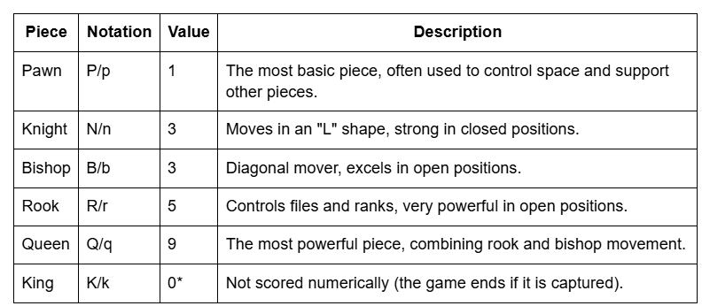
Evaluation Function
Material Score is a basic heuristic used to evaluate a chess position by comparing the total value of pieces each player has on the board.
Material Score = Σ [Value(piece) × Count(White pieces)] − Σ [Value(piece) × Count(Black pieces)]

Slide 3
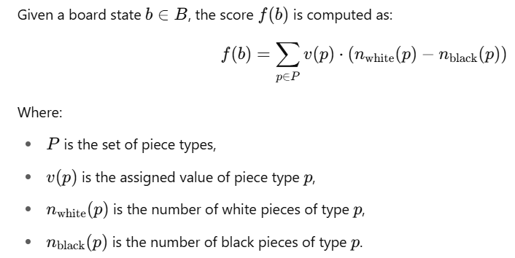
Mathematical Rationale:
Why is it used for the given chess environment:
Evaluates Terminal Nodes:
Minimax requires a way to numerically compare board states at the search tree’s leaves.
Material score provides a quantitative utility value f(b)∈Rf(b) \in \mathbb{R}f(b)∈R.
Captures Strategic Advantage:
A material lead often implies greater control, attack potential, and endgame advantage.
Computational Efficiency:
Linear-time complexity in terms of number of piece types — crucial for deep search trees.
Objective and Interpretable:
No ambiguity — a higher material score clearly favors one player.

Slide 4

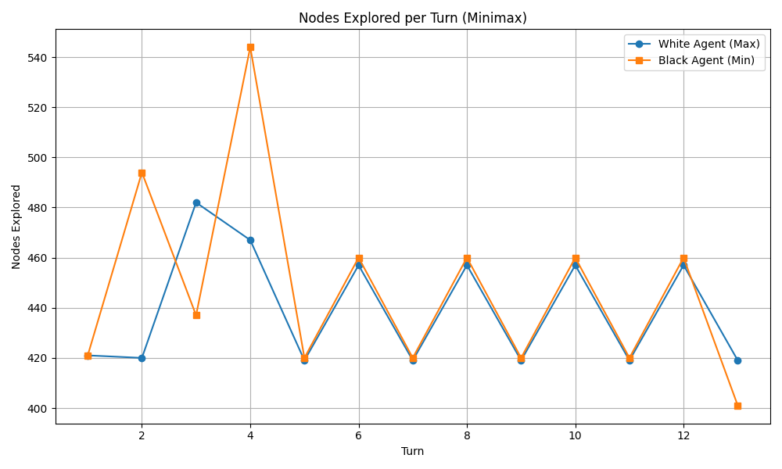
MiniMax
This is the k-ply minimax run with max_depth = 4

Slide 5
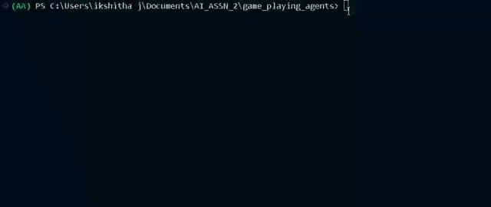
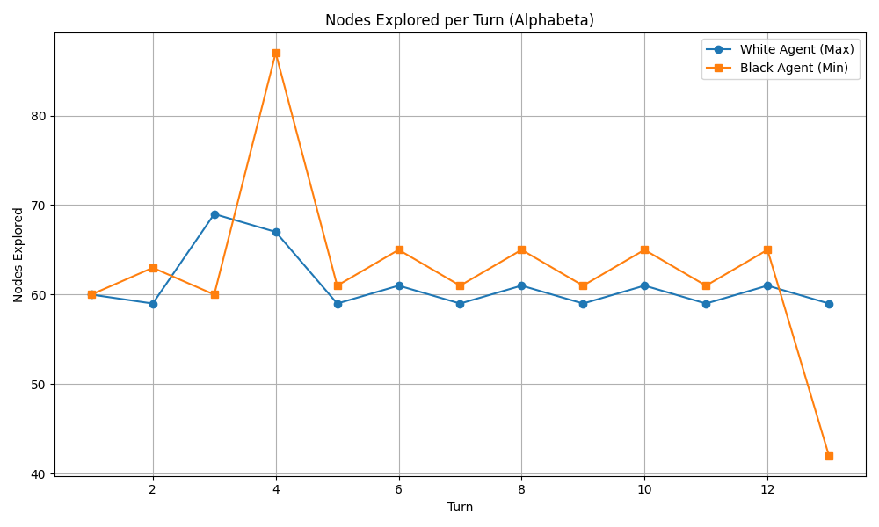
Alpha Beta Pruning
This is the k-ply alpha-beta-pruning run with max_depth = 4

Slide 6
Observations
As we increase the depth in the algorithm we see that we there are more moves for the players.
Depth 5 : 190 moves
Depth 2: 26 moves
This is possibly because:
Deeper search prefers safer lines: At depth 5, the algorithm may avoid risky fast mates in favor of materially advantageous but longer paths.
Evaluation function favors material: If the function scores based on material, it may choose to capture rather than checkmate quickly.
Lack of checkmate detection: If the engine doesn't explicitly recognize mate positions, it may miss faster mates even at higher depths.
Search instability: Deeper search may uncover threats that cause the engine to change plans, delaying the win.
Horizon effect: The algorithm may delay threats or mate just beyond the depth limit, extending the game.

Slide 7
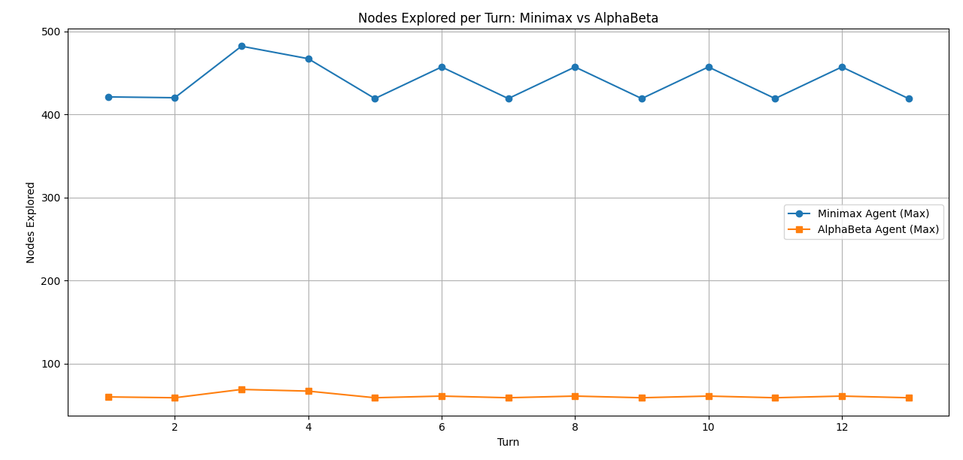
Comparing results:
Minimax Agent Explores Significantly More Nodes
The Minimax agent consistently explores over 400 nodes per turn which shows its exhaustive nature, as it examines every possible move without pruning.
Alpha-Beta Agent is Much More Efficient
The AlphaBeta agent explores far fewer nodes—mostly between 55 and 65 nodes per turn.
This efficiency comes from pruning irrelevant branches, especially in deeper trees.
AlphaBeta Reduces Search by ~85-90%
On average, AlphaBeta explores only ~15% of the nodes that Minimax does, without sacrificing optimality (assuming same depth and evaluation).

