Slide 1


Web-Based Job Market Intelligence and Career Path Analytics Using Knowledge Graphs
GRAPH AND WEB ANALYTICS
Ikshitha - 2320030140
Ananya - 2320030254
Surag - 2320030117

Slide 2
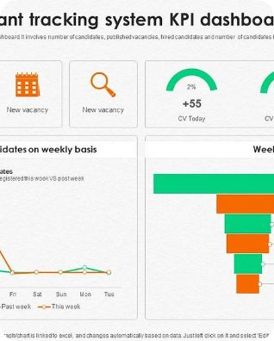
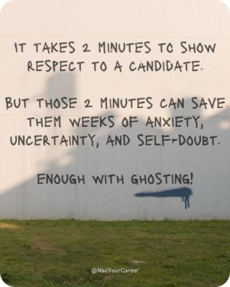


The Legacy Burden: Why Hiring Feels Broken
Keyword traps
Ghost talent pools
The moving target
ATS scores prioritize matching words, not demonstrated ownership — producing false negatives and missed hires.
Automated rejections and opaque filters create inactive pools of capable candidates who never get discovered.
Rapid role evolution leaves candidates chasing titles instead of transferable capabilities.
There was an error generating this image

Slide 3

The Shift to Capability Intelligence
Capability Intelligence reframes assessment: from static titles to evidence of decision ownership, problem complexity handled, and how skills transfer across contexts.
Ownership over tasks
Complexity scale
Who made the decision, not just who executed it.
Level of ambiguity and cross-functional coordination required.
Transferability
How skills map to adjacent roles and industries.

Slide 4
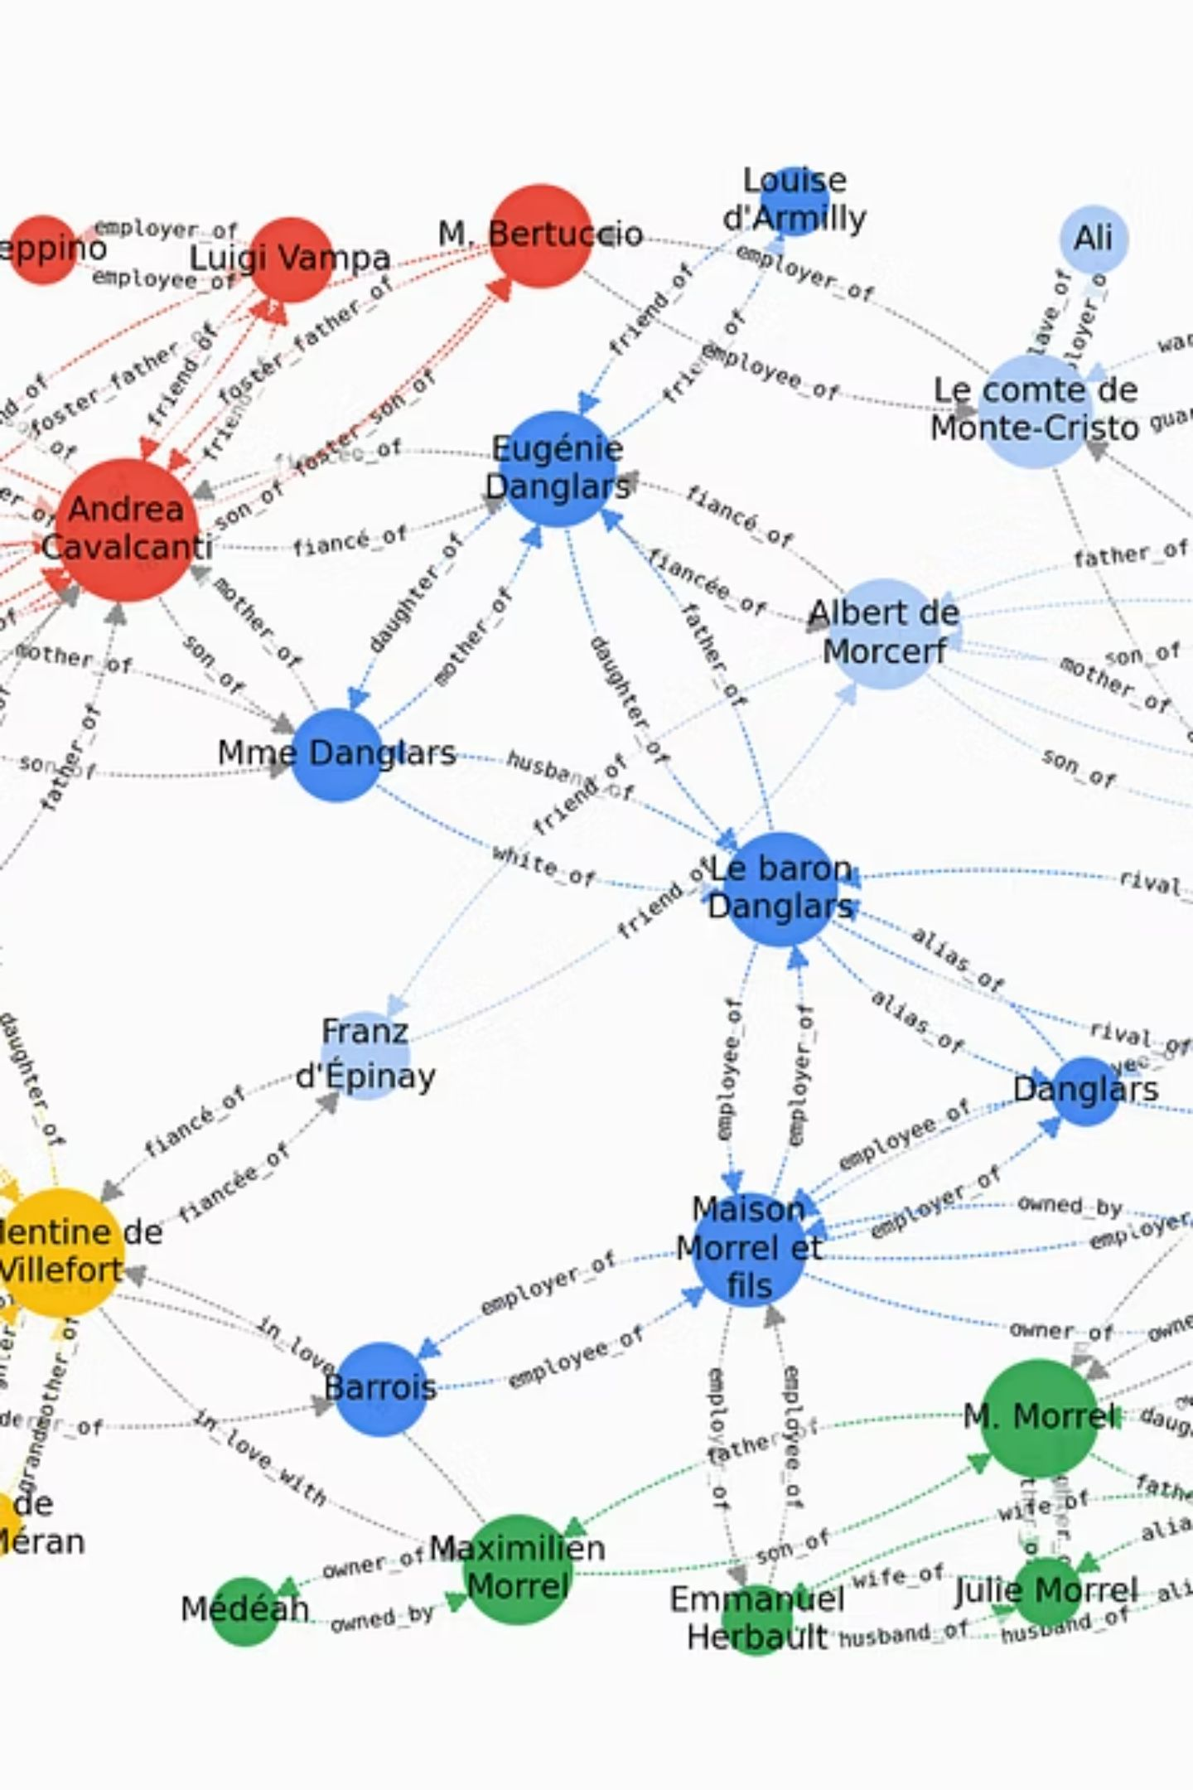
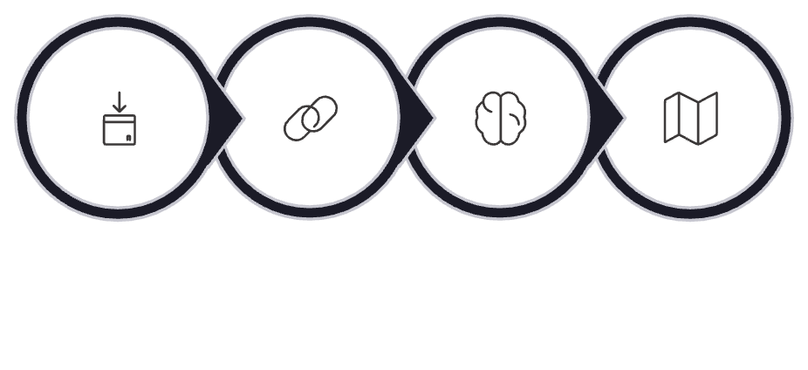
How Knowledge Graphs Power the Market
Knowledge graphs model relationships between people, skills, roles, and outcomes. When combined with semantic embeddings, they infer potential matches beyond exact keywords — scaling human judgment into repeatable pathing and trajectory modeling.
Ingest Data
Entity Linking
Infer Capabilities
Recommend Paths
Entity linking: people ↔ skills ↔ projects
Embedding inference: latent capability signals
Pathing: probabilistic career route generation

Slide 5
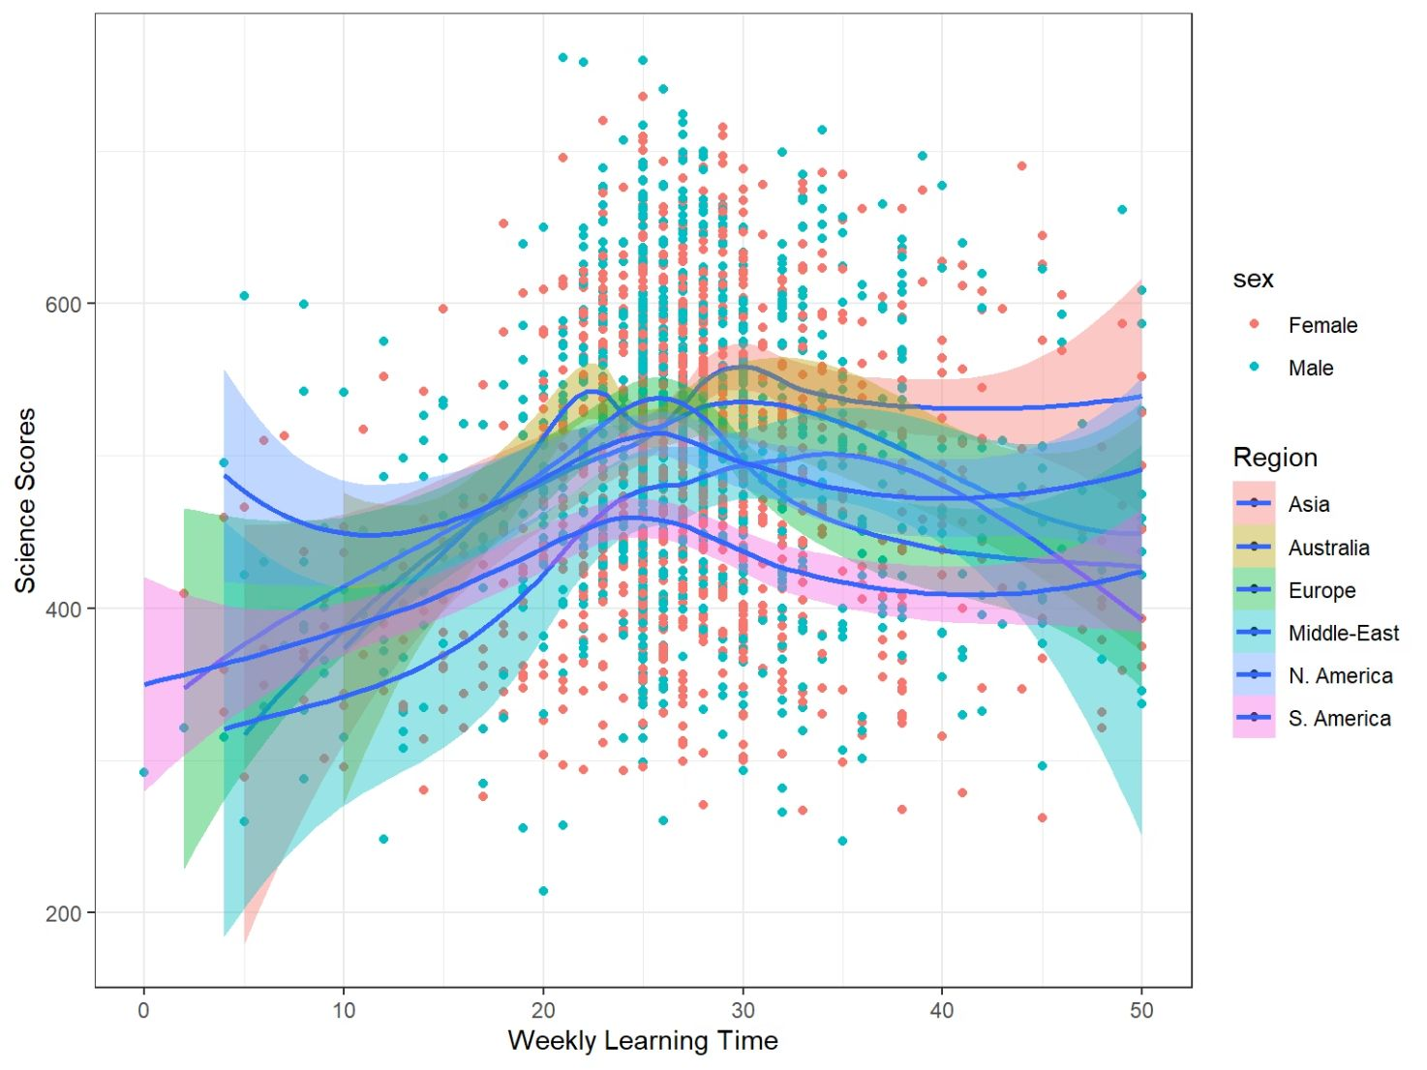
Data in Action: The 3.4 Million Record Insight
We aggregated 3.4M records across job posts, profiles, and occupational taxonomies to produce structured skill-gap maps and individualized roadmaps.
Multi-source fusion
Skill distillation
Actionable roadmaps
LinkedIn, O*NET, real-time job feeds, and proprietary HR APIs
From noisy text to normalized capability vectors
Personalized steps: learning, projects, role-to-role transitions

Slide 6
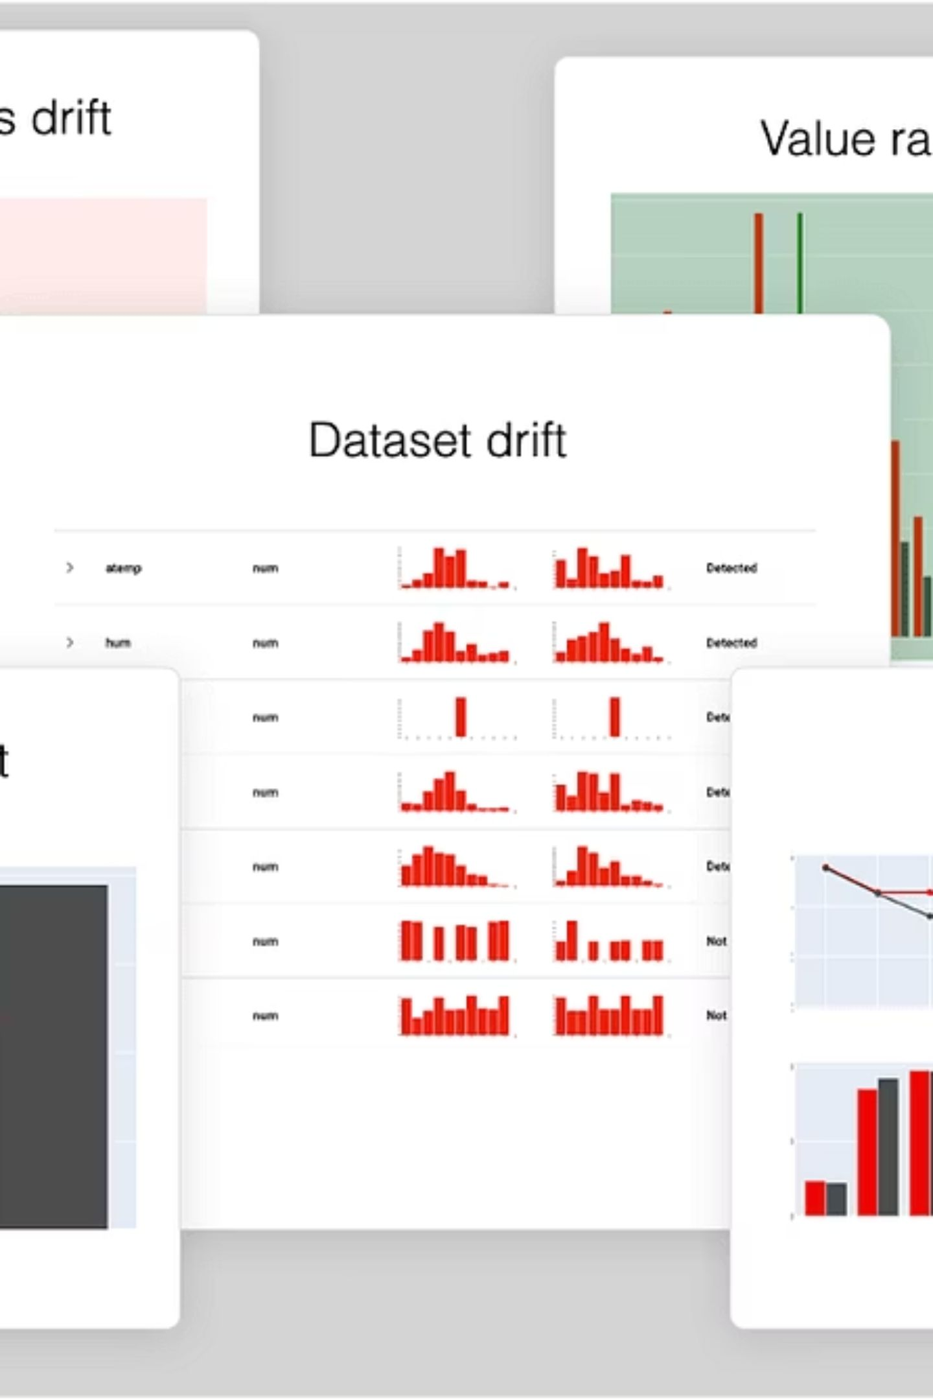
The 2026 Reality: AI Fluency as a Baseline
AI literacy is now assumed across many roles — but definitions vary. Hiring must separate shallow awareness from true production capability.
Aware Users
Understand AI concepts and use tools; limited model design or evaluation skills.
Production Builders
Design, validate, and deploy models; manage data pipelines and monitoring.
Agentic ambiguity
Job ads invoking "agentic AI" risk misaligned expectations without clear capability descriptors.

Slide 7
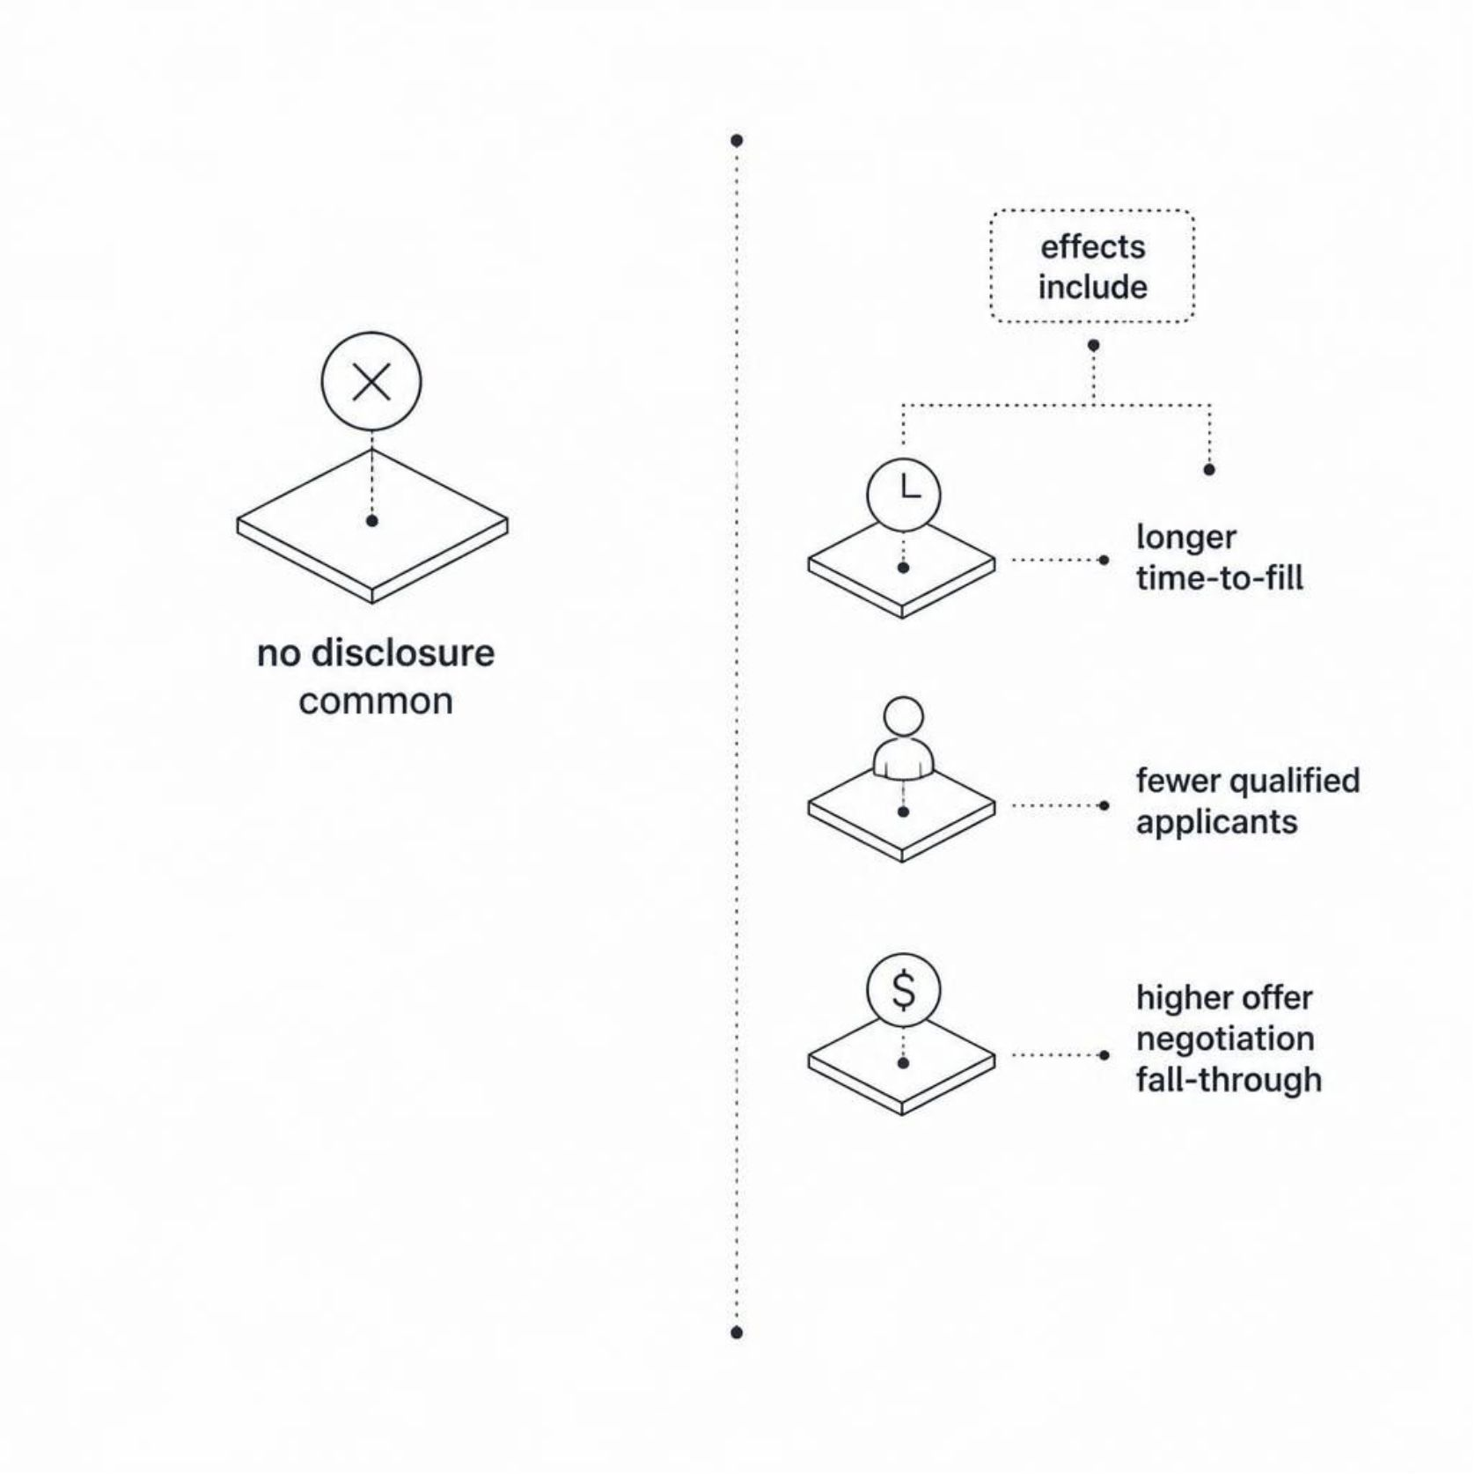
The Transparency Crisis
Despite regulatory pushes like the EU Pay Transparency Directive, our multi-country audit found zero clear salary disclosures across sampled ads — worsening hard-to-fill roles and decreasing hiring efficiency.
Withheld ranges cause self-selection bias
Employers misjudge candidate interest and compensation fit

Slide 8
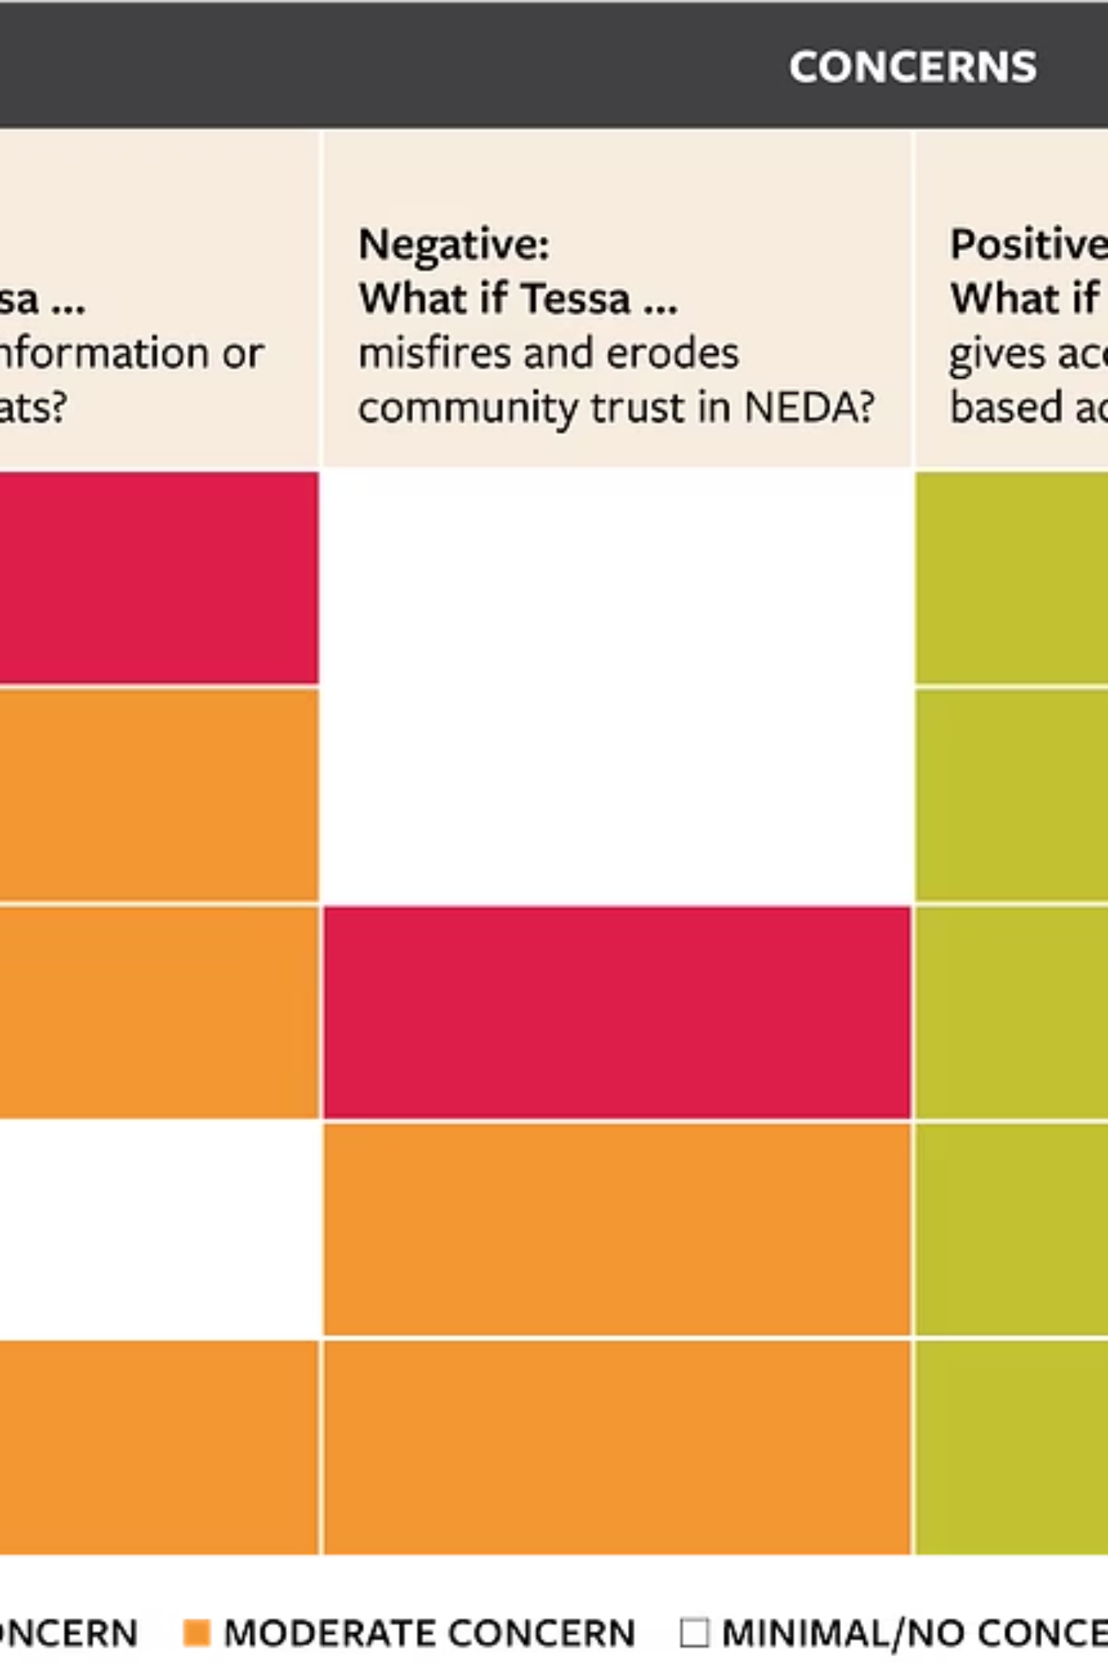
Designing for the Future: Ethical & Agentic AI
Move from opaque systems to auditable, compliant, and fair career platforms that can responsibly source, interview, and upskill candidates.
01
02
Algorithmic audits
Transparent signals
Regular bias and impact assessments aligned with the EU AI Act.
Clear capability descriptors, provenance for inferred skills, and explainable matches.
03
Ethical agents
Design agentic workflows with human-in-the-loop checkpoints for hiring decisions.

Slide 9
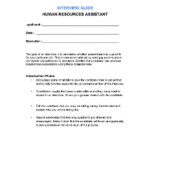
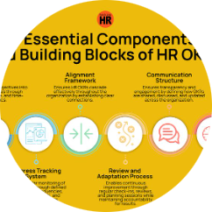
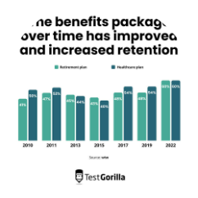
Strategic Takeaways for Professionals
For Candidates
For Employers
ROI of honesty
Audit demonstrated ownership, decision scope, and reporting lines — document impact, not just tasks.
Publish realistic success metrics, clarify team roles, and disclose compensation ranges to improve retention and shorten searches.
Transparent, capability-focused hiring reduces mismatches and accelerates hiring cycles.

Slide 10


The Future of Career Pathing
Careers will become lifelong, data-driven journeys mapped on knowledge graphs. AI scales opportunity by revealing structural clarity — your career is no longer a linear ladder but a navigable graph of possibilities.
Start mapping: document ownership, capture evidence, and connect learning to explicit capability signals.

Slide 11
THANK YOU

