Slide 1
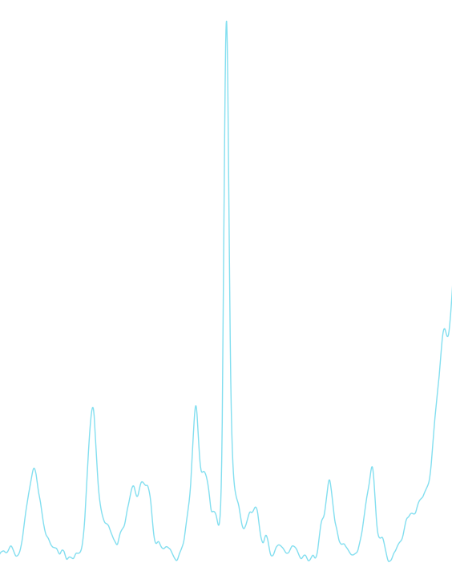
Maciej Pawelski Raman spectroscopy in understanding the pathomechanism of osteoarthritis
Supervisor: Marlena Gąsior-Głogowska PhD, Eng
Faculty of Fundamental Problems of Technology
Department of Biomedical Engineering
Wrocław University of Science and Technology

Slide 2




About me
Bachelor thesis: Tattoo Ink Ingredients
Supervisor: Prof. Paweł Kafarski, DSc, PhD, Eng Faculty of Chemistry Department of Bioorganic Chemistry
Job: Linux system administrator & DevOps engineer @ Atos
Hobbies & Interests: Programming, gaming, music, guitar, graphics, motorization

Slide 3
Agenda
FT-Raman spectroscopy
Osteoarthritis
Goal, idea & aim
Tools
Methodology
Results
Conclusion

Slide 4
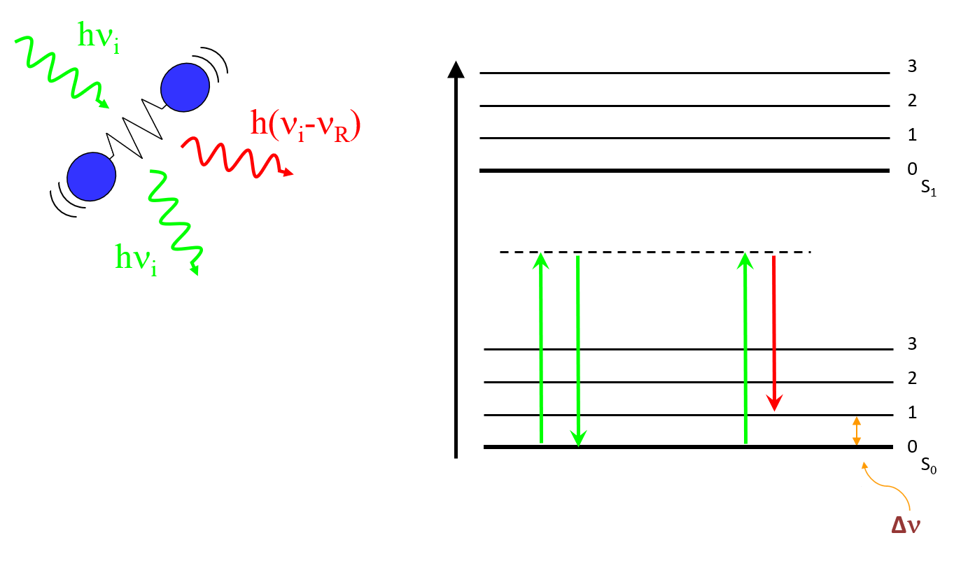
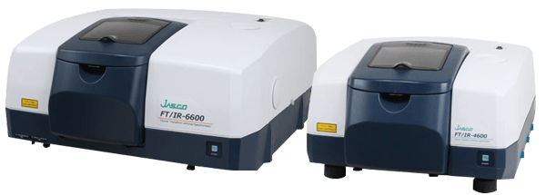
FT-Raman spectroscopy
Principle
Bsed on nonelastic scattering of monochromatic light.
Frequency of the reemitted photons is shifted in comparison with original monochromatic frequency, which is called the Raman effect.
Interferogram acquired by an FT-Raman spectrometer is translated into spectrum by Fast Fourier Transform algorithm
Energy
Virtual level
https://i1.wp.com/jascoinc.com/wp-content/uploads/2017/03/ft-ir-spectrometers-1.png
Rayleigh band
Raman band

Slide 5
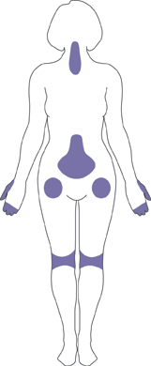
Osteoarthritis
Osteoarthritis (OA) is defined as a heterogenous group of conditions that lead to joint symptoms and signs which are associated with defective integrity of articular cartilage, in addition to related changes in the underlying bone and at the joint margins.
Common symptoms:
Joint pain and stiffness
Joint swelling,
Decreased range of motion
When the back is affected, weakness or numbness of the arms and legs.
https://upload.wikimedia.org/wikipedia/commons/7/74/Areas_affected_by_osteoarthritis.gif
Areas affected by OA

Slide 6
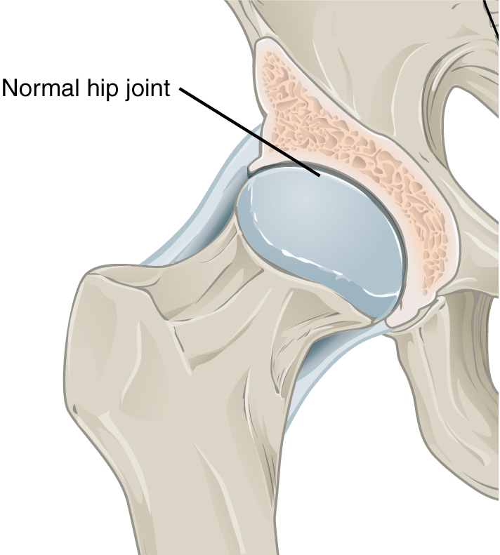
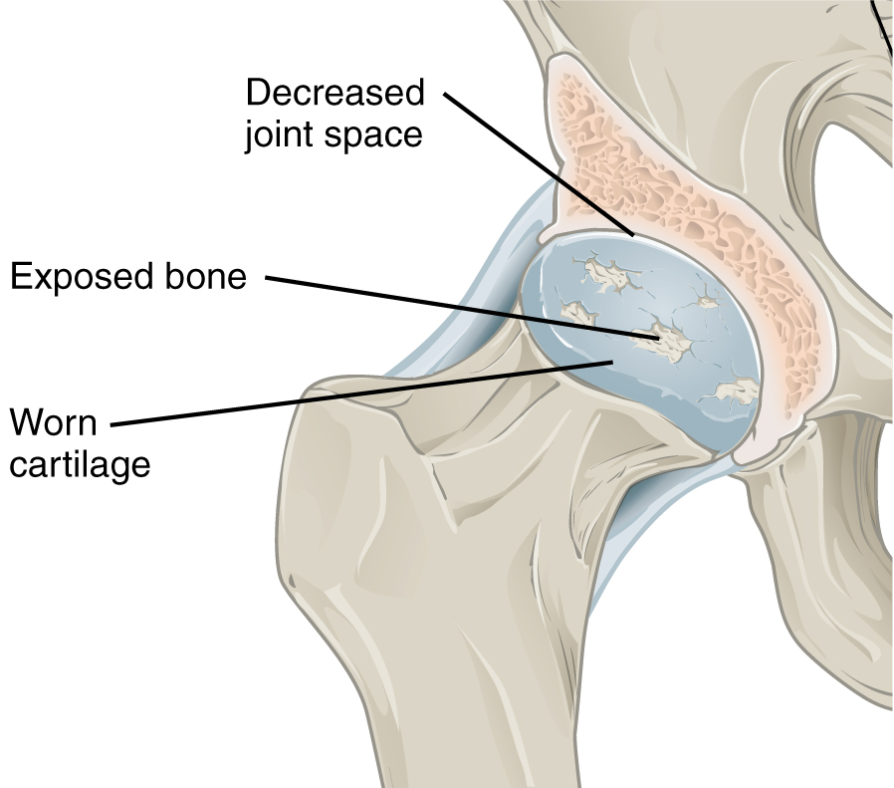
https://en.wikipedia.org/wiki/Osteoarthritis#/media/File:0910_Oateoarthritis_Hip_A.png
https://en.wikipedia.org/wiki/Osteoarthritis#/media/File:0910_Oateoarthritis_Hip_B.png

Slide 7
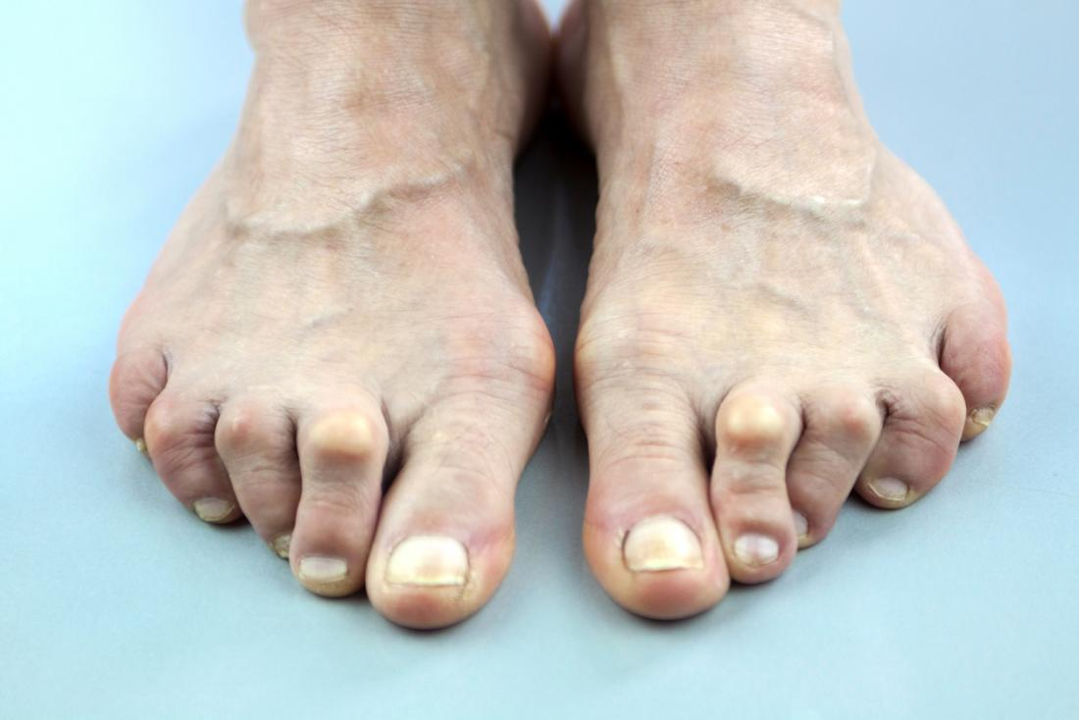
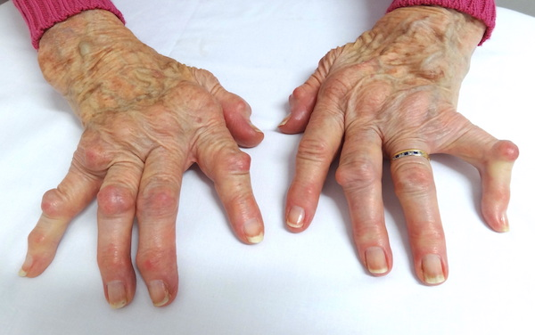
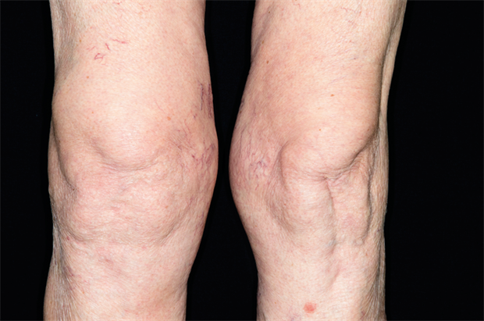
Primary osteoarthritis
Risk factors:
Damage from mechanical stress with insufficient self repair by joints
Misalignments of bones caused by congenital or pathogenic causes
Mechanical injury
Excess body weight
Loss of strength in the muscles supporting a joint
Impairment of peripheral nerves, leading to sudden or uncoordinated movements
Change in hormone levels
[2] https://assets.website-files.com/57677c15bd63608e7eb52969/58479be845511ce87c8f5477_Pathology%20DSC02139%20severe%20hand%20arthritis%20copy.JPG
[3] https://cached.imagescaler.hbpl.co.uk/resize/scaleWidth/620/cached.offlinehbpl.hbpl.co.uk/news/PGH/C0168216-Swollen_knee_cdp-20141009081411533.png
[1] https://cdn1.medicalnewstoday.com/content/images/articles/319/319769/arthritis-in-feet-and-toes.jpg
[1]
[2]
[3]

Slide 8
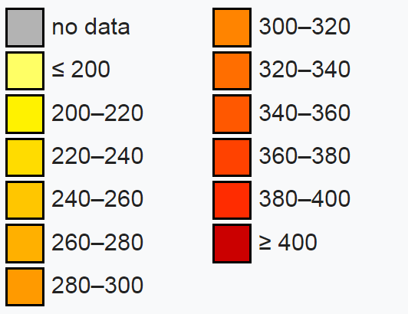
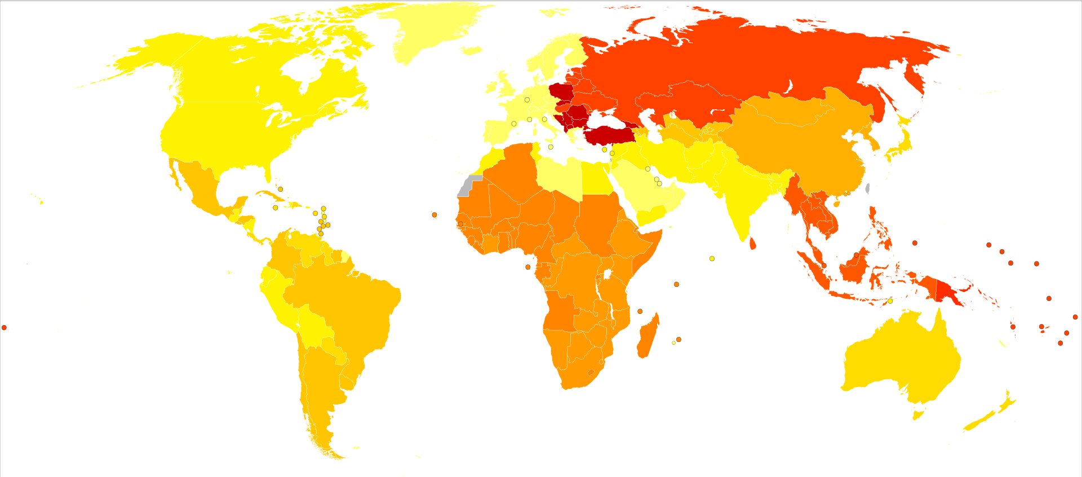
Secondary osteoarthritis
Disability-adjusted life year for osteoarthritis per 100,000 inhabitants in 2004
OA may also be caused by other disorders such as:
Alkaptonuria
Congenital disorders of joints
Ehlers-Danlos Syndrome
Hemochromatosis
Wilson's disease
Joint infection
https://upload.wikimedia.org/wikipedia/commons/thumb/b/be/Osteoarthritis_world_map_-_DALY_-_WHO2004.svg/1024px-Osteoarthritis_world_map_-_DALY_-_WHO2004.svg.png

Slide 9

The Goal
Assessment of the applicability of FT-Raman spectroscopy for analysis of changes in the chemical and phase composition of joint structures at particular stages of degenerative disease development
How can it get faster?

Slide 10

The Idea
Create a program that would automize the analysis

Slide 11

The Final Aim
Create an online application for automatic analysis

Slide 12




The Tools

Slide 13
Substitution of carbonate ions in locations of phosphate ions
A₁₀₇₀/A₉₆₀
Degree of mineralization
A₉₆₀/A_{amide I}
The Search
indicates a more mineralized collagen matrix
relates to the functional properties of bone
Degree of crystallization (size)
1/FWMH
decreasing bandwidth indicates greater crystallinity - a well-ordered crystal lattice

Slide 14
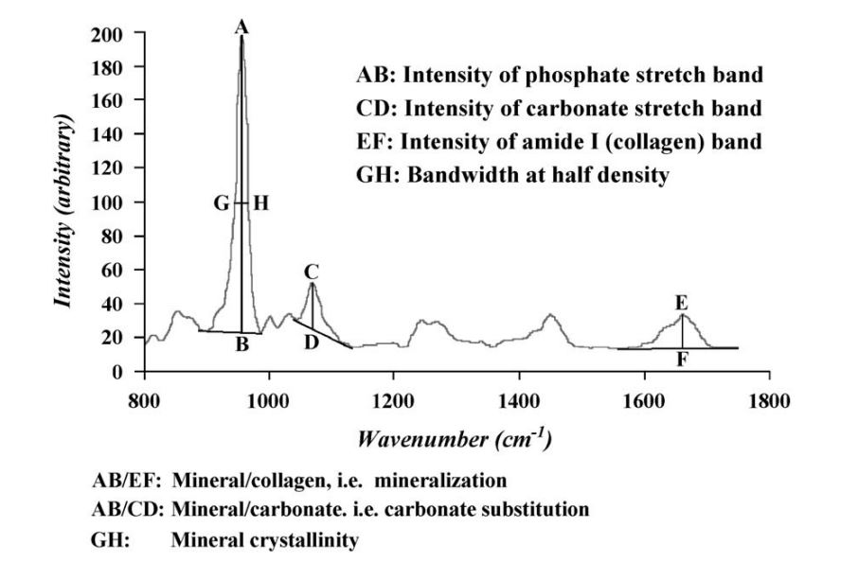
The Search
Age-related changes in physicochemical properties of mineral crystals are related to impaired mechanical function of cortical bone. Ozan Akkus, Fran Adar and Mitchell B. Schaffler. Bone 34 (2004) 443 – 453

Slide 15
Overview of the analyis
Get the data.
Remove wave number values below 250 which are overshadowed due to Raman scattering.
Cut the baseline.
Find peak closest to 960 band of phosphate vibration, characteristic in mineral phase Raman spectra.
Normalize the plot to 960 band.
Read intensity, FWMH and area of 960 and 1070 bands.
Analytic comparison – carbonate substitution, sample mineralization & crystal size.

Slide 16
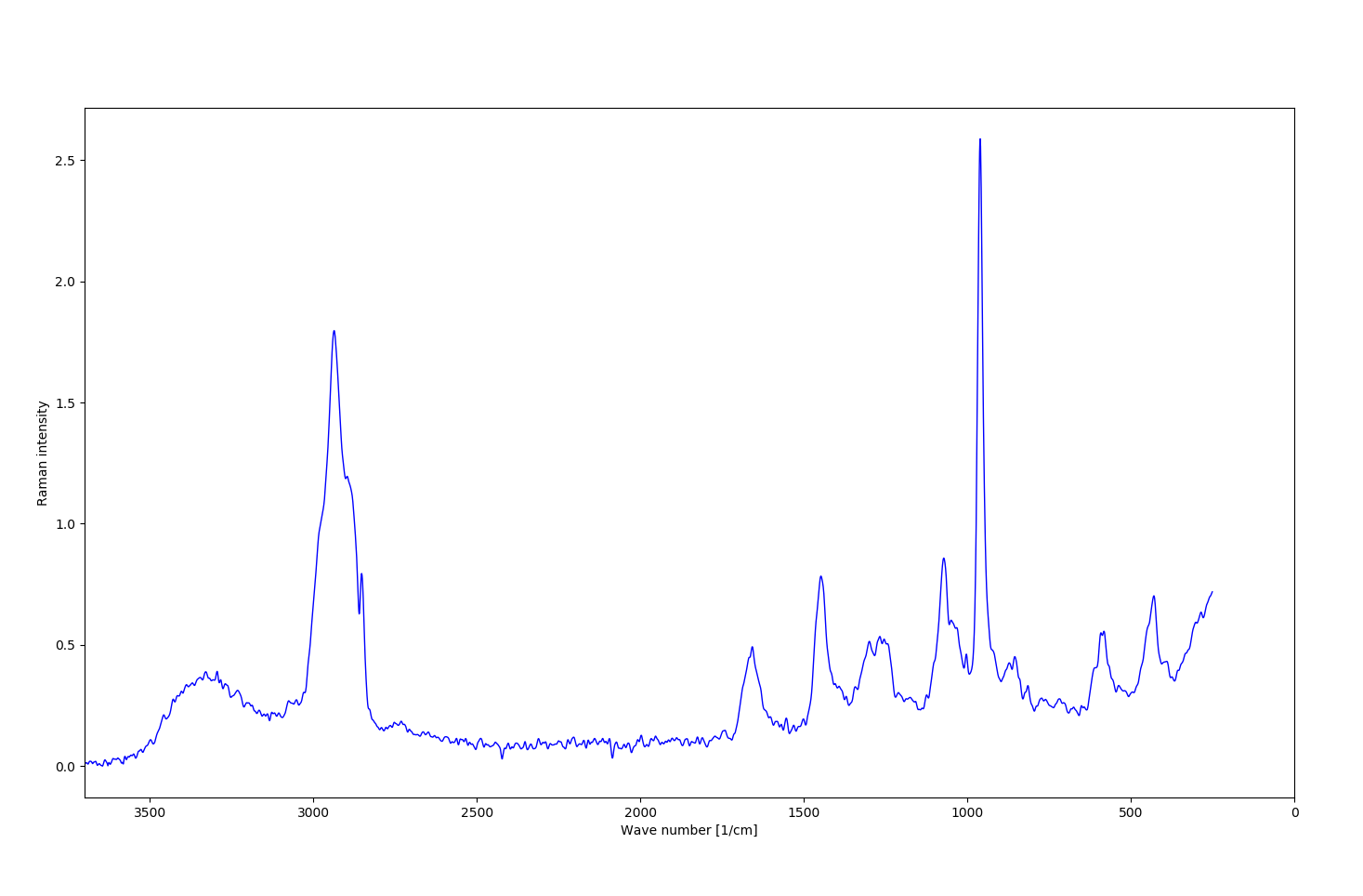
The initial spectra

Slide 17
https://upload.wikimedia.org/wikipedia/commons/8/89/Lissage_sg3_anim.gif
Smoothing the data using Savitzky-Golay filter

Slide 18
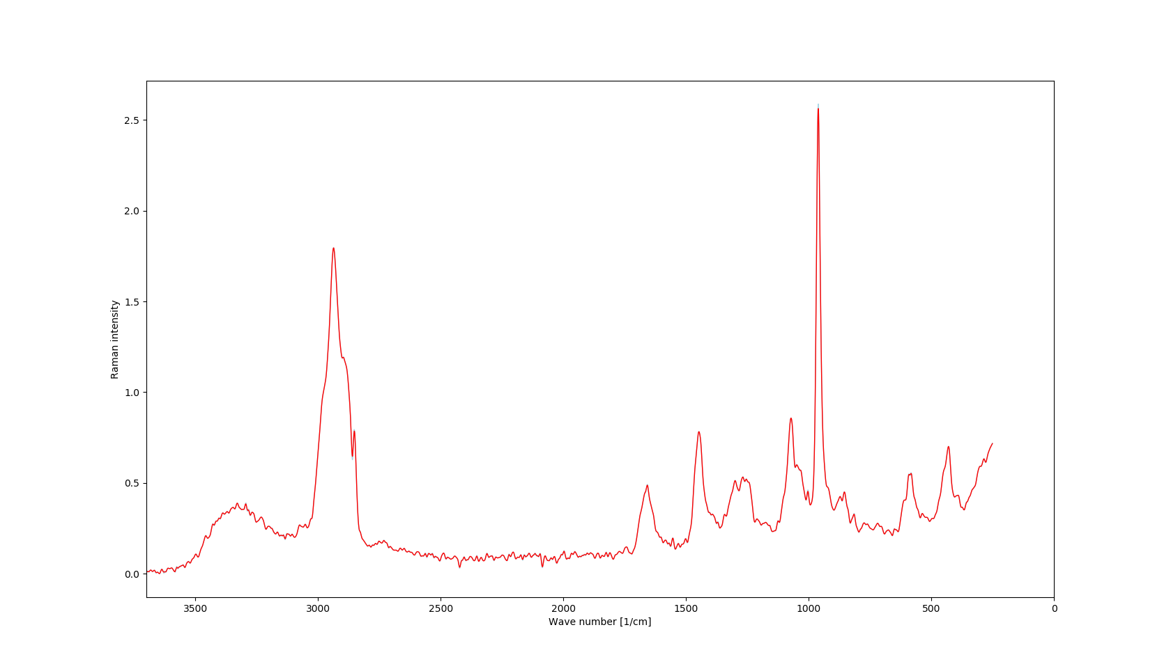

Slide 19
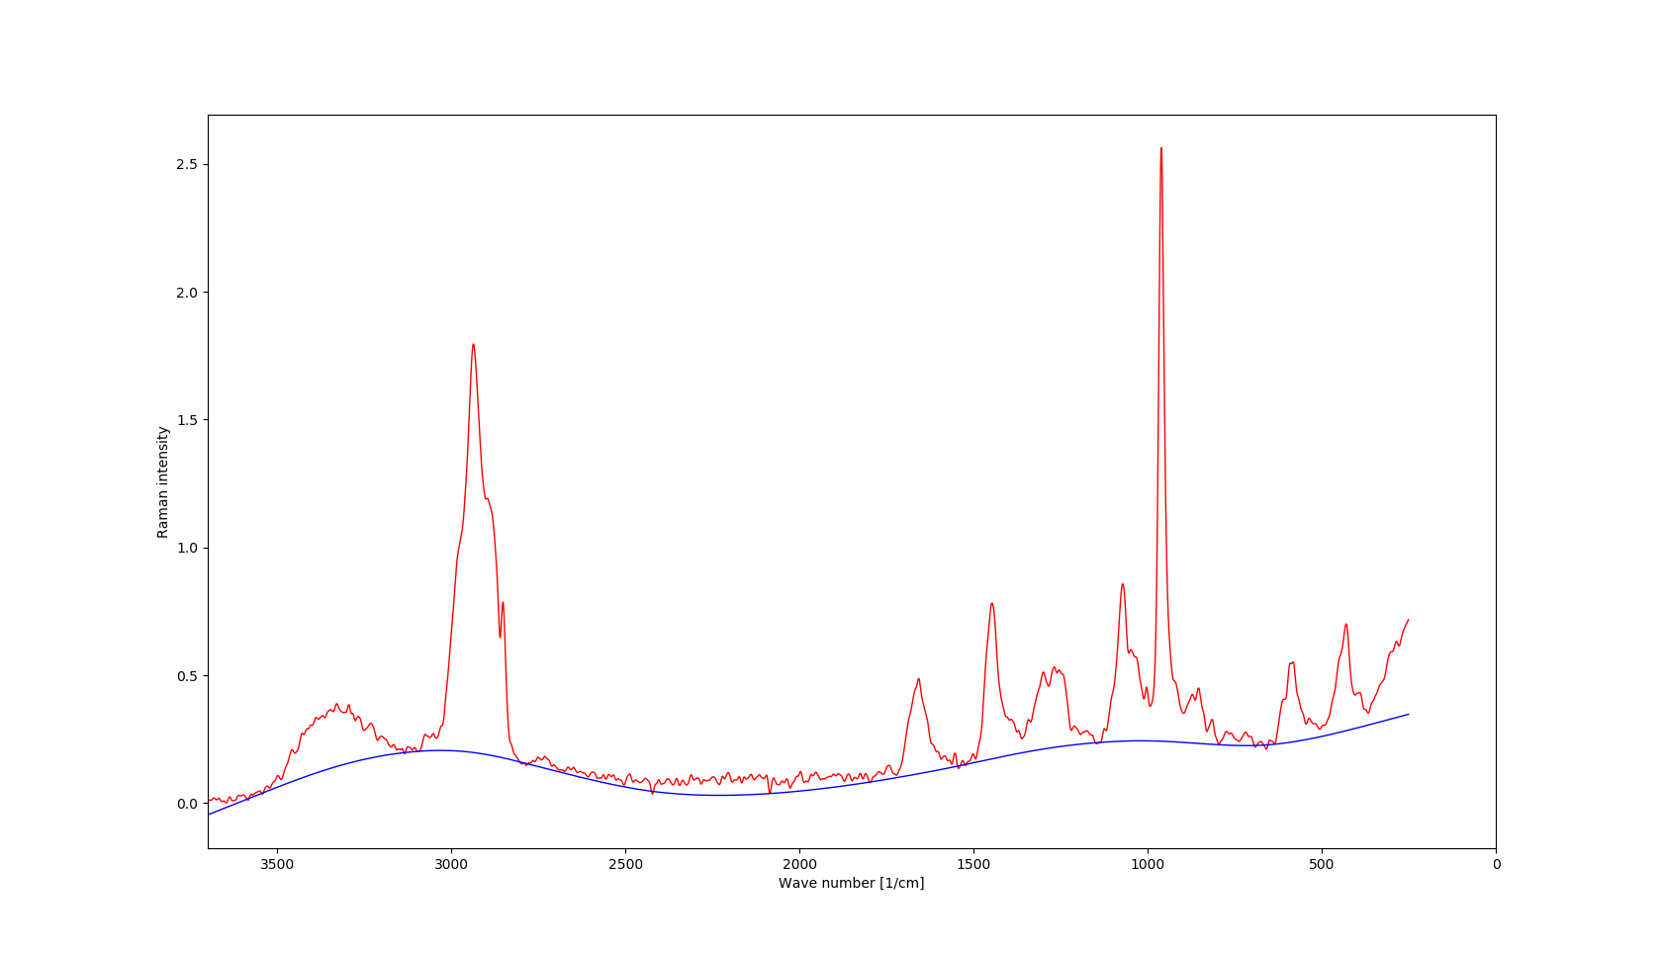
Baseline correction with assymetric least squares
p = penalty parameter (0.001 ≤ p ≤ 0.1) for weight calculation (w_{i} = p if y_{i} > z_{i} and w_{i} = 1 − p otherwise)
λ = smoothness parameter (10² – 10⁷ for heavy smoothing)
n = number of iterations

Slide 20
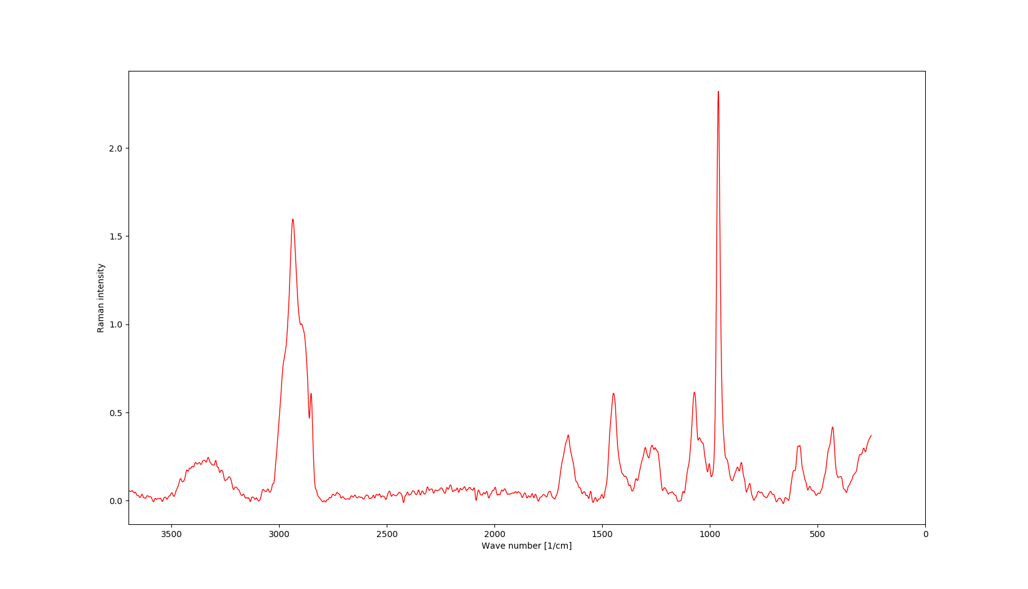

Slide 21
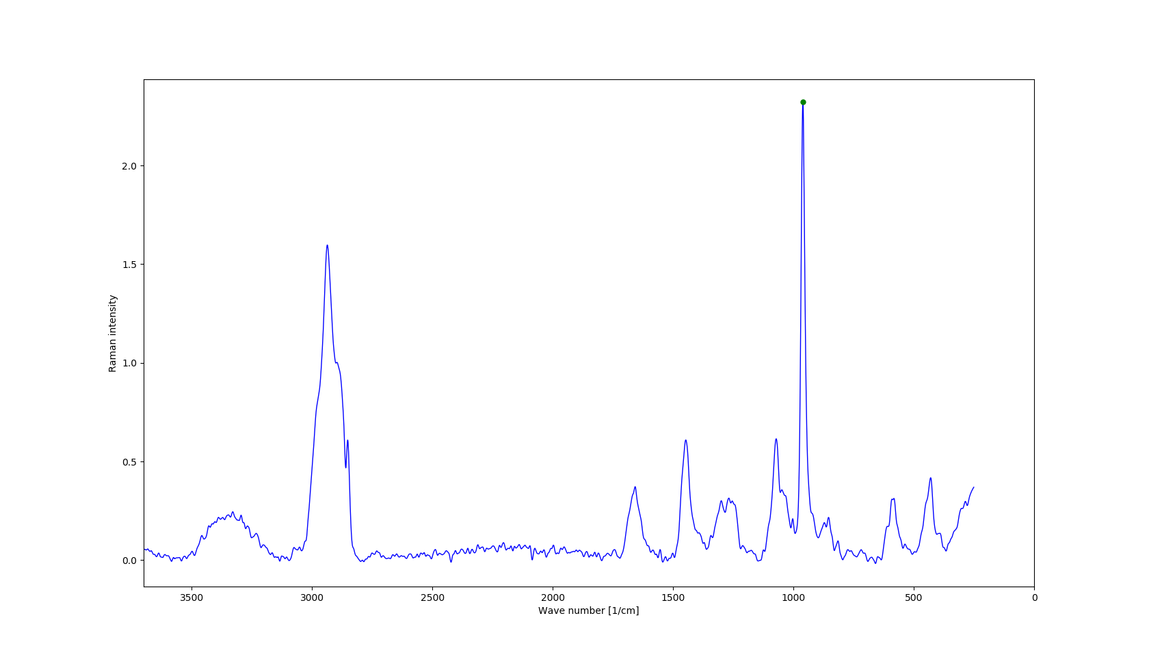
Find peak nearest to 960

Slide 22
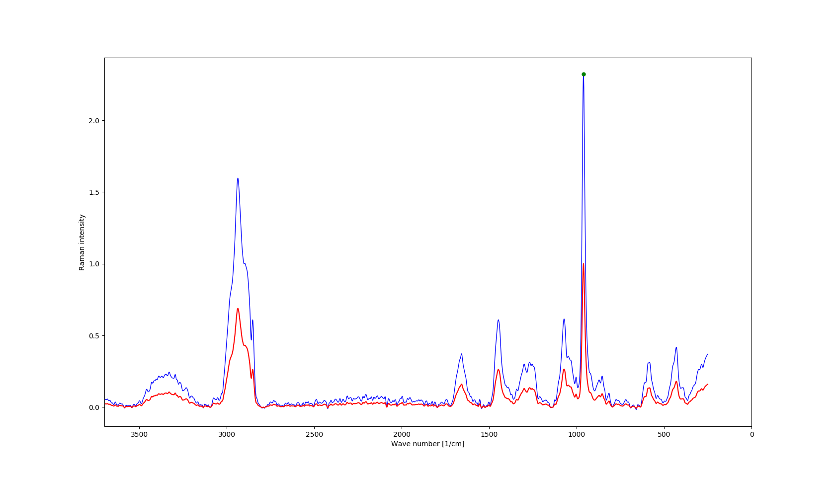
Normalization

Slide 23
Steps to be done
Read intensity, FWMH and area of 960 and 1070 bands.
Analytic comparison – carbonate substitution, sample mineralization & crystal size.
Conclusions
Automatization of spectroscopic analysis is possible and proves to be a useful tool to quickly perform data transformation
FT-Raman spectroscopy can be well used in research of pathomechanism of osteoarthritis

Slide 24
Bibliography
Baseline Correction with Asymmetric Least Squares Smoothing. Paul H. C. Eilers Hans F.M. Boelens October 21, 2005.
Efficient computation for Whittaker-Henderson smoothing. Howard L. Weinert, October 2007. Computational Statistics & Data Analysis 52(2):959-974 DOI: 10.1016/j.csda.2006.11.038
Synthesis and characterization of hydroxyapatite crystals: A review study on the analytical methods. S. Koutsopoulos. Department of Chemistry, University of Patras, GR-26500 Patras, Greece. Received 14 December 2001; accepted 20 February 2002
Age-related changes in physicochemical properties of mineral crystals are related to impaired mechanical function of cortical bone. Ozan Akkus, Fran Adar and Mitchell B. Schaffler. Bone 34 (2004) 443 – 453. Received 6 March 2003; revised 17 September ; accepted 3 November 2003.
https://onlinelibrary.wiley.com/doi/pdf/10.1002/art.1780290816 - accessed 20.05.2019
Zhang, Yuqing, and Joanne M Jordan. “Epidemiology of osteoarthritis.” Clinics in geriatric medicine vol. 26,3 (2010): 355-69. doi:10.1016/j.cger.2010.03.001
https://onlinelibrary.wiley.com/doi/pdf/10.1002/art.1780381103 - accessed 14.05.2019

