Slide 1
TechCorp Enterprises – IAM Platform Implementation Roadmap
Tata Consultancy Services | Cybersecurity Practice
Prepared by: Ikwuka Okoye
Date: 2nd December, 2025

Slide 2
Digital Identity Pattern
TechCorp Enterprises
Identity & Access Management (IAM) Platform
Detailed Implementation Roadmap & Integration Strategy
Prepared for: TechCorp CISO & IT Leadership
Prepared by: Ikwuka Okoye, IAM Consultant – TCS Virtual Experience Program

Slide 3
Executive Summary
A 20-week, low-risk, phased rollout delivering:
100% automated user lifecycle management
Enterprise-wide Zero Trust access controls
Full compliance readiness (SOC 2, ISO 27001, GDPR, NIST CSF)
Expected ROI: 380% over 3 years through productivity gains and risk reduction
Core Principle: Secure by Design, Automated by Default

Slide 4
Chosen IAM Technology Stack (2025 Leaders)
Table:
Layer | Selected Solution | Gartner 2025 Solution
Identity Governance | SailPoint IdentityNow | Leader
Access Management | Okta Workforce Identity Cloud | Leader
Privileged Access | Saviynt Enterprise Identity Cloud | Leader
Zero Trust Enforcement | Google BeyondCorp Enterprise + Prisma Access | Leader
HRIS Source of Truth | Workday (existing) | –

Slide 5
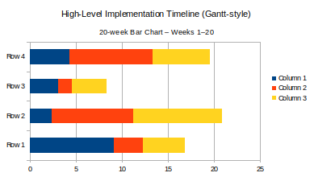
High-Level Implementation Timeline (Gantt-style)
Phase 1: Discovery & Design Weeks 1–4
Phase 2: Pilot (Engineering + Finance) Weeks 5–10
Phase 3: Enterprise Rollout Weeks 11–16
Phase 4: Optimization & Handover Weeks 17–20
Go-Live Target: End of Week 16

Slide 6
Phase 1: Discovery & Design (Weeks 1–4)
Key Activities & Milestones
Current-state workshops with 12 application owners
Identity data cleanup (duplicate/stale accounts)
Define 180+ birthright & functional roles
Finalize integration architecture diagram
Deliverables: Detailed design document, integration matrix, risk register

Slide 7
Phase 2: Pilot – Engineering & Finance (Weeks 5–10)
Scope: 2,500 users, 18 critical applications
Success Criteria
95% automated joiner-mover-leaver
Zero manual tickets for pilot apps
Phishing-resistant MFA for all privileged accounts
User satisfaction NPS > 8.0

Slide 8
Phase 3: Enterprise Rollout (Weeks 11–16)
Wave-based approach
Wave 1: All internal employees (Weeks 11–12)
Wave 2: Contractors & partners (Weeks 13–14)
Wave 3: Customer-facing & legacy apps (Weeks 15–16)
Daily stand-ups + weekly steering committee

Slide 9
Critical Integration Challenges & Mitigation
Table:
Challenge | Risk Level | Mitigation Strategy
Legacy HR system (on-prem) | High | Custom SCIM connector + nightly sync with reconciliation
15+ homegrown apps (no APIs) | High | Reverse-proxy authentication via Okta + header injection (PAM fallback)
Mainframe applications | Medium | Host-based agent + RACF connector for SailPoint
Cloud SaaS sprawl (1,200+ apps) | Medium | Okta + Seamless federated SSO; auto-discovery via Cloud Access Security Broker
Data sovereignty (APAC entities) | High | Multi-region deployment (SailPoint APAC pods) + geo-fencing policies

Slide 10
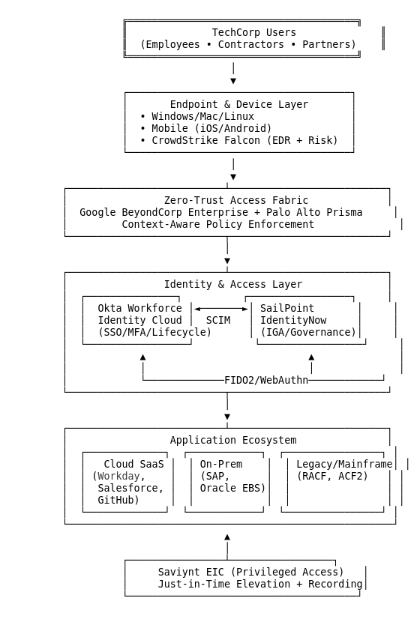
TechCorp Target-State IAM Architecture – Secure, Automated, Zero-Trust
Architecture Diagram

Slide 11
TechCorp Target State IAM Architecture
Shown:
Workday → SailPoint → Okta → Applications (cloud + on-prem)
Google BeyondCorp context-aware access overlay
Real-time risk feed from CrowdStrike → Saviynt
Continuous compliance reporting dashboard
Attached below is a Google Drive link to the TechCorp Architecture diagram, created with Draw.io.

Slide 12
Resource Requirements
Role | Qty | Duration | Source
TCS IAM Architect | 1 | Full 20 weeks | TCS
TechCorp Identity SME | 2 | Full-time | Internal
Application Owners | 25 | 4–8 hrs/week | Internal
Security & Compliance Team | 3 | Part-time | Internal
Okta/SailPoint Vendor SEs | 2 | As needed | Vendor

Slide 13
Alignment with TechCorp Strategic Goals
Table:
Business Goals | How IAM Delivers
Zero major breaches | Phishing-resistant MFA + continuous session risk monitoring
30% faster time-to-productivity | New hires fully provisioned in <4 hours (vs current 5 days)
Seamless hybrid work | Location-agnostic Zero Trust access – no VPN required
M&A readiness | Rapid identity ingestion framework already built
Cost reduction | 72% fewer access-related helpdesk tickets (industry benchmark)

Slide 14
Success Metrics Dashboard
Key Performance Indicator (KPI) Cards
Automated Provisioning Rate: 98%
MFA Adoption (Phishing-Resistant): 100% privileged, 92% workforce
Mean Time to Grant Access: 3.2 minutes
Access Review Completion: 100% quarterly
Incidents Caused by Access Issues: 0 (post go-live)

Slide 15
Next Steps and Recommendation
Immediate Actions
Approve Phase 1 kickoff (Week 1)
Assign TechCorp IAM co-lead
Schedule vendor workshops (SailPoint & Okta)
Recommendation: Green-light the 20-week implementation plan – proven, low-risk, and directly accelerates TechCorp’s position as a secure, agile technology leader.

Slide 16
Thank You
Questions?
Ikwuka Okoye
Cybersecurity IAM Consultant
Tata Consultancy Services – Virtual Experience Program
X (formerly Twitter): https://x.com/maaziikwuka | Email: ikwuka.cysec@gmail.com
GitHub: https:github.com/IkwukaCySec

